Slide 1


K.RAMAKRISHNAN COLLEGE OF TECHNOLOGY
(AUTONOMOUS), TRICHY.
DEPARTMENT OF
COMPUTER SCIENCE AND ENGINEERING
20CS5501 DESIGN PROJECT-1
Batch No. : 11
Date : 05.12.2024

Slide 2
ECO-ATTENDANCE THROUGH FACIAL RECOGNITION
Guided by Team
Ms.S.Uma Mageshwari.(M.E) Arulnithi K(811722104015)
Assistant Professor, CSE Balaji K (811722104020)
Hariprasath S (811722104046)

Slide 3
OBJECTIVE OF THE PROJECT
The objective of our project is to develop an automated system for school attendance tracking and rule enforcement using facial recognition and identity card scans. The specific goals include:
1.Automated Attendance Tracking: To automatically record student attendance in an Excel sheet, eliminating the need for manual roll calls and reducing errors.
2. Enforcement of School Rules: To automatically log fines for absences and dress code violations, creating transparent records and promoting accountability.
3. Improvement of Administrative Efficiency: To save time for both students and staff, reinforce school policies, and foster a disciplined environment through the use of innovative AI solutions.

Slide 4
ABSTRACT
A system that uses facial recognition to determine whether a student is present or absent and, if present, automatically records their attendance including date and time in an Excel sheet.
The system operates by capturing real-time video frames through a camera, detecting and recognizing student’s faces, and matching them against a pre-stored database of student images.
When a match is found, the student's attendance is marked as "present" and logged with a timestamp in an Excel sheet, otherwise, the student is considered "absent."

Slide 5
LITERATURE SURVEY
TITLE OF THE PAPER | AUTHOR (S) | PUBLISHER | PAPER GIST | TECHNOLOGY USED
Facial Fusion(2023) | Rana H. Al-Abboodi,Ayad A. Al-Ani | version of record (VoR) journal articles | Facial Fusion as synthesis by combining features from multiple images. | CNNs (Convolutional Neural Networks) GANs (Generative Adversarial Networks
ArcFace: Additive Angular Margin Loss (2019) | Deng, J., Guo, J., Xue, N., & Zafeiriou, S | Pattern Analysis and Machine Intelligence (PAMI) | Additive Angular Margin Loss, for improving deep face recognition systems. | "ArcFace: Additive Angular Margin Loss(AAML) for Deep Face Recognition"
Texture-Guided Transfer Learning (2004) | Smith, A.; Johnson, B.; & Lee, C | Texture-Guided (TG) | Improve the transfer of knowledge between tasks, specifically in the context of image recognition | “Texture-Guided Transfer Learning" for Low-Quality Face Recognition.

Slide 6
LITERATURE SURVEY
TITLE OF THE PAPER | AUTHOR (S) | PUBLISHER | PAPER GIST | TECHNOLOGY USED
Facial hair recognition (2009) | Fang, H., & Costen, N. | International Conference on Image Processing (ICIP), | Focuses on the problem of recognizing and distinguishing facial hair in images | Facial hair recognition using frequency domain features
FaceNet: A Unified Embedding for Face Recognition and Clustering(2015) | Schroff, F., Kalenichenko, D., & Philbin, J. | IEEE Conference on Computer Vision and Pattern Recognition (CVPR) | unified embedding model that transforms face images into a 128-dimensional Euclidean space | -Triplet Loss Function -Face Embeddings -Pre-trained Model and Transfer Learning

Slide 7
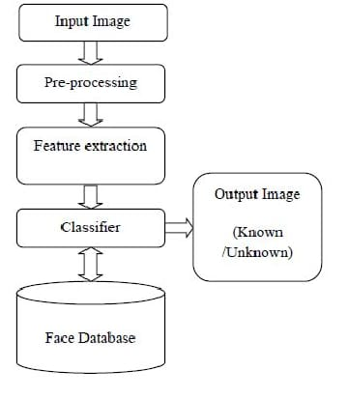
PROPOSED SYSTEM ARCHITECTURE

Slide 8
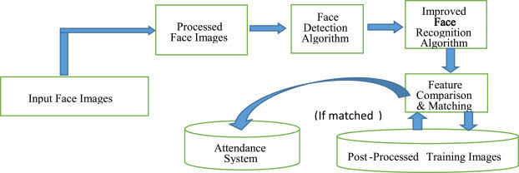
EXISTING SYSTEM ARCHITECTURE

Slide 9
SOFTWARE AND HARDWARE REQUIREMENTS
HARDWARE
SOFTWARE
1.OPERATION SYSTEM : Window OS
2.Excel Software
3.Python IDLE 3.11.0
4.Python Libraries
5.Open CV
1.Processor : Intel i5 or Equalvalent AMD
2.RAM : 4 GB Recommended
3.ROM : 120 GB
4. Web Camera

Slide 10
MODULES
1.Face Detection
2.Face Recognition
3.Image matching
4.Updating Excel sheet

Slide 11
SUMMARY OF MODULE-1
Face Detection
Detect a face: To detect a face of a student we need take a snap of student and detection of student face will be done by model file called the haarcascade _frontalface _default.xml
Pre-trained model file: The haarcascade_frontalface_default.xml is a pre-trained model file used in computer vision, specifically for detecting faces in images and videos.
Framework : OpenCV (Open Source Computer Vision Library) framework.
Approach : The model uses a sliding window approach to scan the input image, applying Haar features to determine whether a face is present

Slide 12
SUMMARY OF MODULE-2
Face Recognition
Algorithm: Face Recognition is done a Algorithm LPBH(Local Binary Patterns Histograms) is a popular face recognition algorithm.
Proposed algorithm : The proposed algorithm begins by converting the input face into a grayscale image, which is then divided into smaller regions called "blocks".
Blocks: For each block, the Local Binary Patterns (LBP) operator is applied to extract a histogram of features that describe the texture and patterns of the face.
Returns: The algorithm returns the closest match, which is the recognized face.

Slide 13
SUMMARY OF MODULE-3
IMAGE MATCHING
Matching and Identification:
Once a face is detected, it is compared to the student database.
If a match is found, the student is recognized and marked as present.
Technologies:
OpenCV, FaceNet, Dlib, Python (TensorFlow, Keras)

Slide 14
SUMMARY OF MODULE-4
Updating in sheet
After recognizing face and beard of a student and that corresponding information or result will be updated automatically in sheet
Additionaly to add a system date and time.

Slide 15

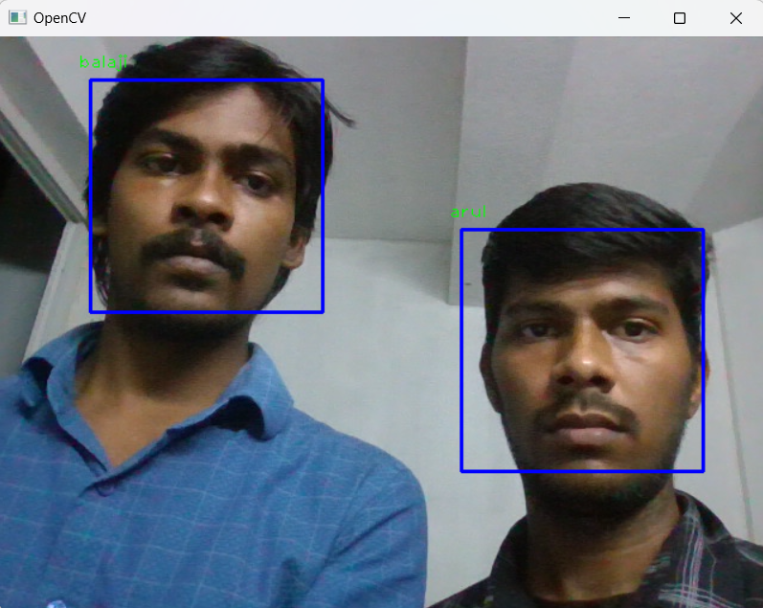
RESULTS AND DISCUSSION
OUTPUT:

Slide 16
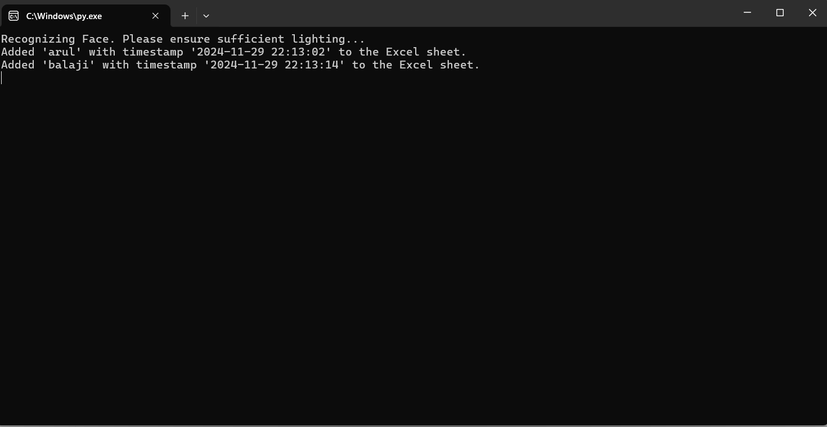
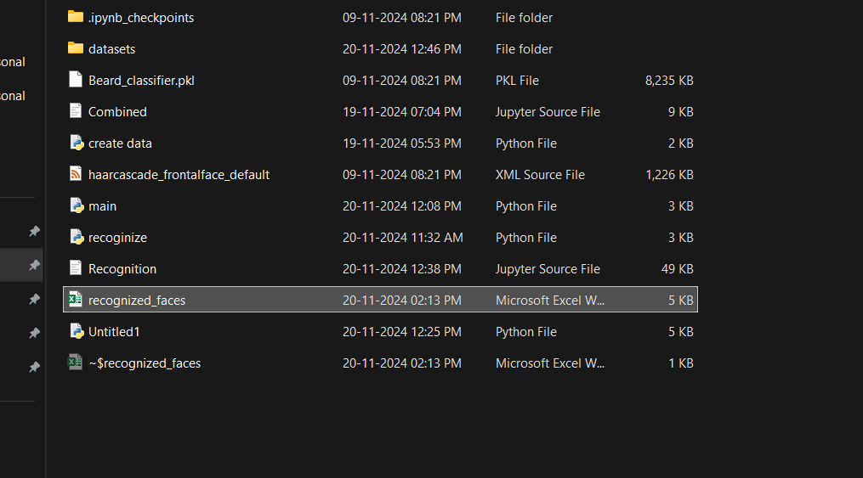

Slide 17
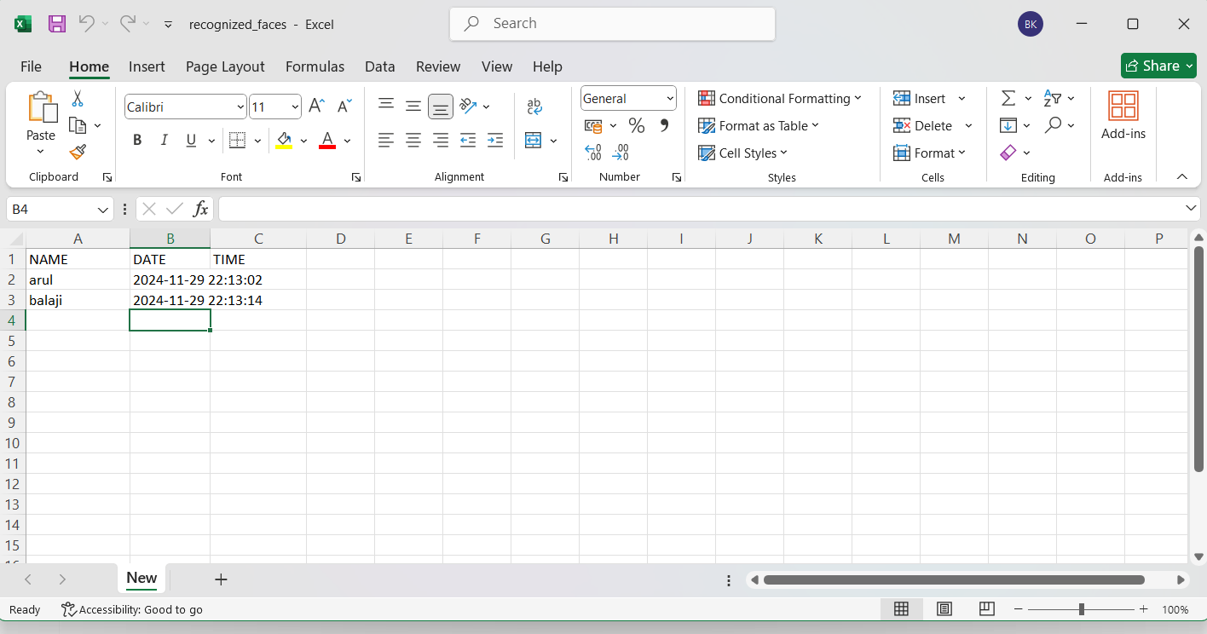

Slide 18
CONCLUSION
The development of an automated system for school attendance tracking and rule enforcement using facial recognition and identity card scans has successfully achieved its objectives.
The implementation of this innovative AI solution has brought numerous benefits , including:
Reduced errors and increased accuracy in attendance tracking
Enhanced transparency and accountability in the enforcement of rules
Increased efficiency and productivity for administrators and staff
Improved student discipline and accountability

Slide 19
THANK YOU

