Slide 1
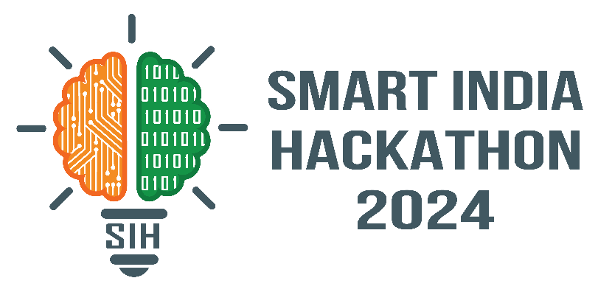
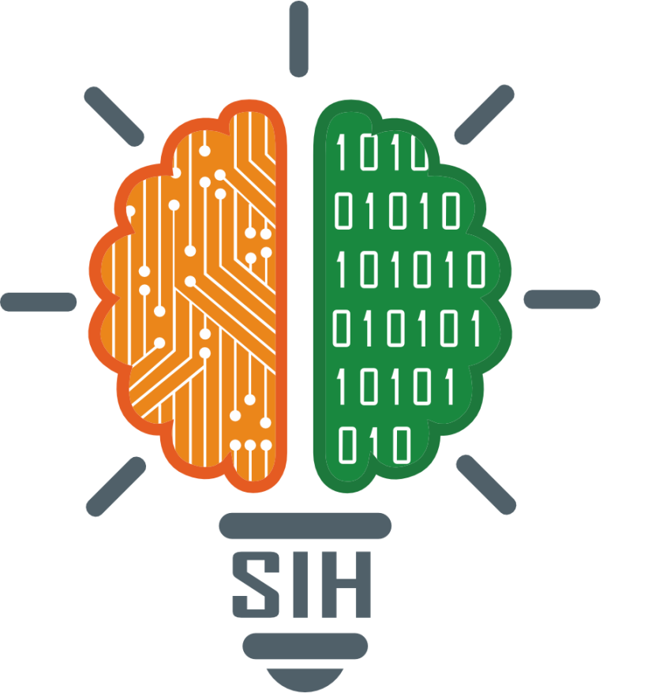
SMART INDIA HACKATHON 2024
Problem Statement ID – SIH1524
Problem Statement Title- Innovating for Sustainability: Driving Smart Resource Conservation (Energy & Water) in Home Appliances (Refrigerators, Air Conditioners, Washing Machines and Desert Air Coolers)
Theme- SMART RESOURCES CONSERVATION
PS Category- Hardware
Team ID-
Team Name (Registered on portal) : Energy conservators

Slide 2
IDEA TITLE
Energy Conservators
The Eco-smart Energy and Water Management System focuses on improving the sustainability of household appliances by utilizing IoT and AI technologies. It optimizes the energy consumption of devices like air conditioners, refrigerators, washing machines based on real-time environmental conditions and user presence, ensuring minimal energy waste while maintaining comfort.
A key feature of the system is the water reuse capability in washing machines. The system captures greywater from the washing machine’s rinse cycle, filters it, and reuses it within the washing machine itself for subsequent wash cycles. This approach significantly reduces water consumption, making the washing process more sustainable and efficient.
The system incorporates AI-driven automation, enabling dynamic adjustment of appliance settings based on real-time environmental conditions, such as temperature and humidity, as well as user preferences. Integrated IoT sensors facilitate continuous data collection and monitoring, ensuring the system consistently operates at peak efficiency. This intelligent, automated approach not only enhances energy and water management but also delivers a seamless user experience, supporting sustainable practices while minimizing the household’s environmental impact.

Slide 3
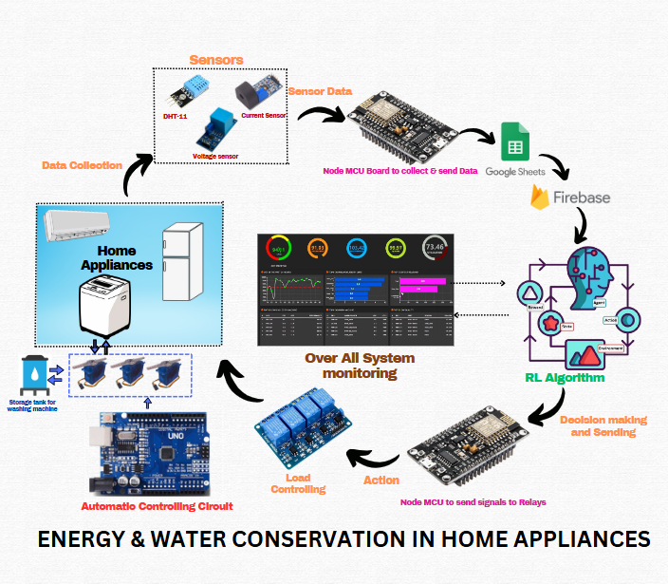
TECHNICAL APPROACH
Energy conservators
Arduino IDE
ESP8266 Microcontroller - Sensor connectivity
Home appliances – Air Conditioner, Refrigerator, Washing Machines
IoT Sensors -Real-time energy monitoring
Communication Protocol - MQTT, REST APIs, HTTP
Firebase DB - Secure real-time data storage.
Datasets creation - Google Spreadsheets and Data Analytics
AI Algorithms- Reinforcement Learning for optimal policy of Energy Management System
Front end: HTML, CSS
Backend: Python Django
Touch Display -User Interface

Slide 4
FEASIBILITY AND VIABILITY
Energy Conservators
Challenges :
Complex installation and potential need for retrofitting existing appliances.
Difficulty for users to adapt to automated and data-driven systems.
Concerns over data privacy and security with continuous monitoring.
Compatibility challenges with different appliance models and smart home platforms.
Risks:
Risk of system failure disrupting appliance functionality.
Risk of technological obsolescence as IoT and AI evolve.
Possible water quality issues from reusing greywater in washing machines.

Slide 5
IMPACT AND BENEFITS
Energy Conservators
IMPACTS
Reduces energy consumption by optimizing appliance performance.
Conserves water through greywater reuse in washing machines.
Real-time monitoring helps users become more conscious of their energy and water usage.
Adjusts appliance operation to account for changing weather conditions, improving resilience to climate fluctuations.
BENEFITS
Enables real-time monitoring for continuous efficiency.
Reduces utility costs by cutting energy and water usage.
Supports sustainable living and environmental responsibility.
Eco-friendly and smart home technologies can boost property value due to growing demand for sustainable living solutions.

Slide 6
RESEARCH AND REFERENCES
Energy Conservators
Previous problem statement:
Developing an AI-powered energy management system for industrial commercial facilities to optimize energy consumption.
We referred from previous SIH statement and other resources & developed our project.
Internet of Things (IoT): A vision, architectural elements, and future directions – ScienceDirect

