Slide 1
BeagleBone Black RevC
-V.Balaji

Slide 2
SYSFS
SYSFS is a fly file system that exists on the RAM
It is a windows that is used to peek into the various subsystem of the Linux Kernel like Networking subsystem, Memory subsystem, Bus, Device Drivers
There are lots of examples in this repo balaji303/BeagleboneBlackC
For SYSFS

Slide 3
BeagleBone Black RevC CMDs
-V.Balaji

Slide 4
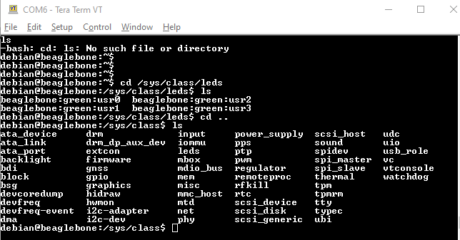
example

Slide 5
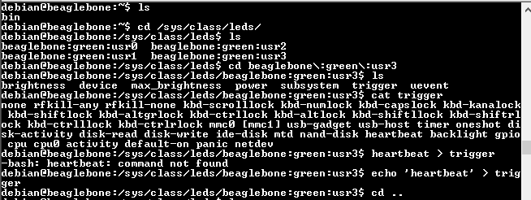
HeartBeat
debian@beaglebone:/sys/class/leds/beaglebone:green:usr3$ echo 'heartbeat' > trigger

Slide 6








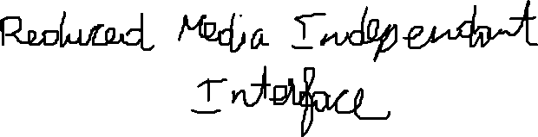


Slide 8
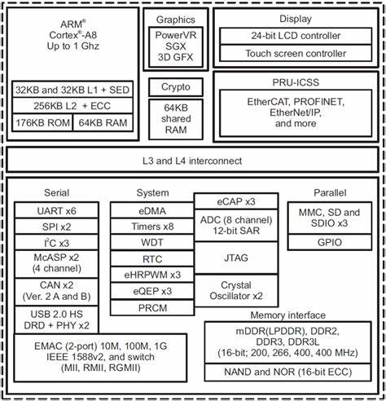







Slide 9




Slide 10







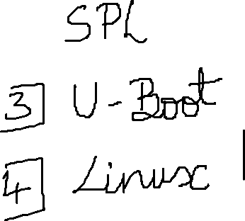

Slide 11








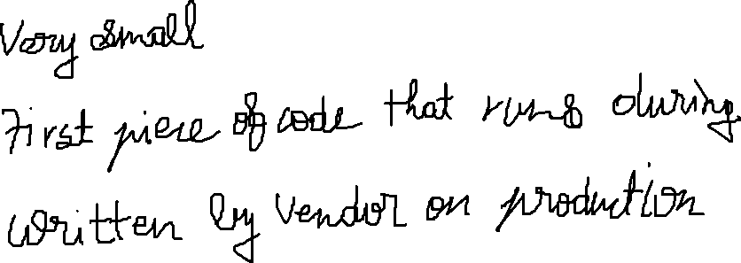





Slide 12



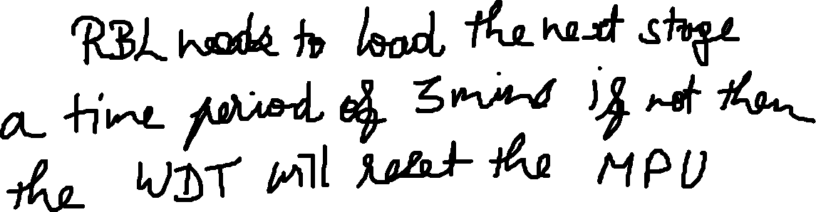


Slide 13
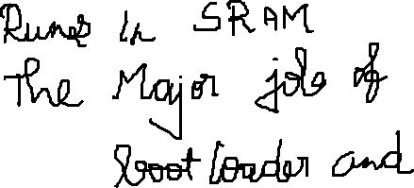








Slide 14












Slide 15




Slide 17




Slide 18
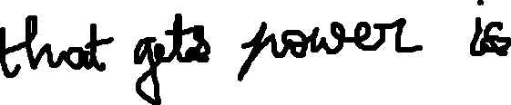










Slide 19












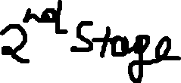

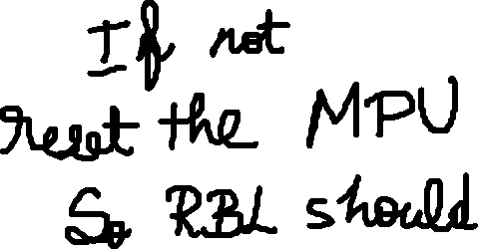


Slide 20






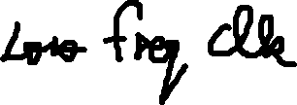




PLL Engine of SoC

Slide 21
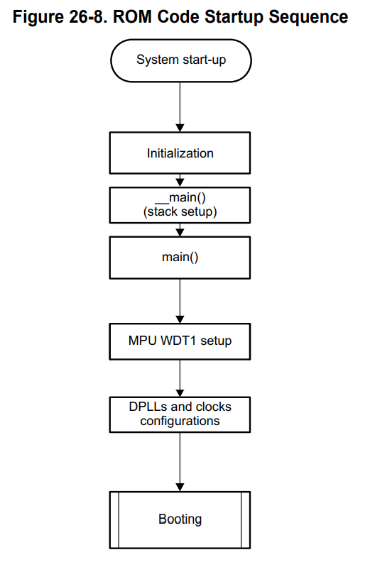

Slide 22

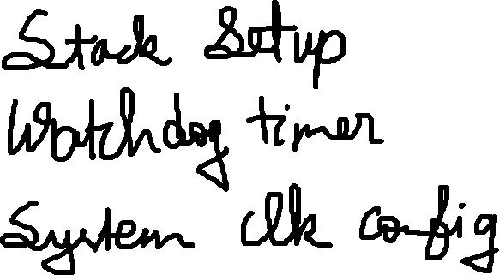
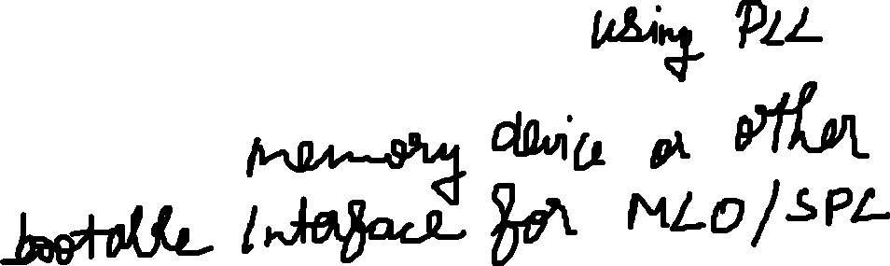



Slide 24



