Slide 1
FreeRTOS
-Balaji
Thanks http://fastbitlab.com/category/blog

Slide 2
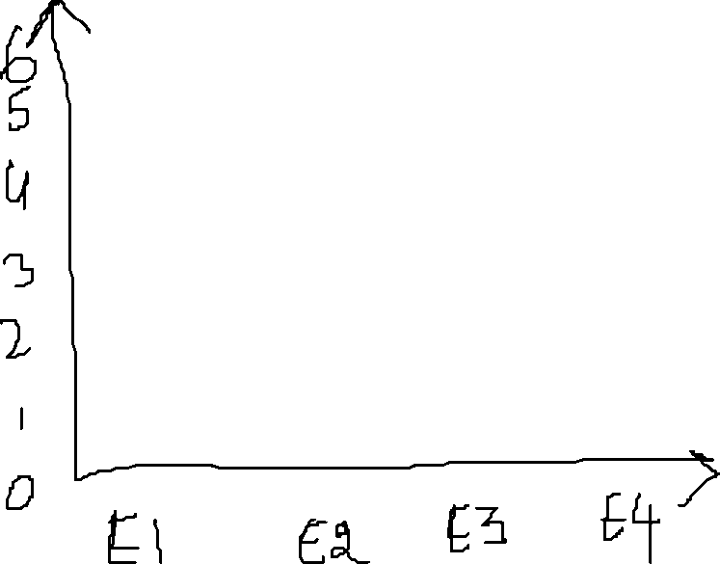



Non-Realtime application
Response Time
Realtime application
Realtime application has same response time irrespective of the load and iteration
Iteration

Slide 3
Real Time Application
Hard Real Time Application
Soft Real Time Application

Slide 4
ThroughPut-
Total Number of Task that are executed by a unit time
GPOS-
In order to achieve high throughput the GPOS will serve 5 to 6 low priority task than the task with high priority
MEET HIGH THOUGHPUT
RTOS-
Task are executed based on priority only
MEET HIGH TIME PREDICTABLITY

Slide 5




RTOS vs GPOS: Task Switching Latency
Task switching time
Number of Thread

Slide 6




time
Interrupt occurs
Tasks resumes
TASK 1
ISR
TASK 2
(Higher priority ready task)
Interrupt Latency
Scheduling Latency

Slide 7
Advantage of RTOS over GPOS:
Priorty based preemptive scheduling mechanism
No or very shortCritical section which disables the preemptive
Priority inversion avoidance
Bounded interrupt latency
Bounded scheduling latency

Slide 8
How schedular divies task based on time
TASK1
TASK2
TASK3
How it actually looks

Slide 10
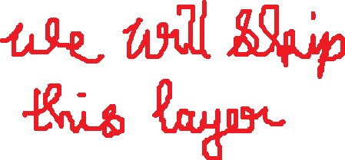

APPLICATION CODE
main
thread
interrupt
CMSIS-RTOS API
Object definition via macro
Function call transaction
object
REAL TIME KERNAL

Slide 11




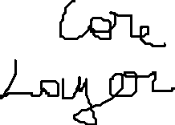





APPLICATION CODE
osTaskCrerate
CMSIS-CORER Layer
xTaskCreate
FreeRTOS

Slide 12
Application Layer
Core/src
CMSIS RTOS API Layer
(Generic Layer)
Real Time Kernel
(FreeRTOS, EmbOS)
CMSIS Core Layer
Driver/CMSIS
Cortex M Processor

Slide 13

GCC |
---ARM_CM4F | ---port.c | --portmacro.h
THESE are low level architecture files required by the FreeRTOS architecture

Slide 14
FreeRTOSConfig.h file modification:
__ICCARM_ - IAR Compiler
__GNUC_ - GNU Compiler
__CC_ARM_ - ARM Native compiler CC
PendSV Handler – This is used to implement the RTOS scheduler
SysTick Handler – This is used to launch the schedular at given interval(Systick interrupt is used to launch
the interrupt at given interval;)

Slide 15
Time Base Selection
FreeRTOS uses ARM Cortex Mx Processor’s internal systick timer as its time base (RTOS Ticking)
STMCube’s HAL also uses systick timer by default,
So we can’t use both HAL and FreeRTOS together
To resolve this issue we use Systick timer for FreeRTOS and for HAL we use any other timer peripheral as time base

Slide 16
TASK
If a task ever leaves the infinite for loop in a task function then the Task must be deleted before leaving the task function
xTaskCreate:
This API creates a new FreeRTOS task using dynamic memory allocation and adds the newly created task to the ready queue to the kernel
If there is 2 Task having a common TaskHandler and if the task handler has a local variable xyz, then there will be 2 separate copies of the local variable in each Task stack

Slide 17
STACK
In FreeRTOS the stack is a Full descending Stack
If we push a element in to a stack the address gets decremented
StackPointer points to top of the stack
Width of the data is 32bit in ARM cortex M

Slide 18
TASK PRIORITY
HIGHER the TASK priority value, Higher the urgency for the task

Slide 19
SCHEDULUAR
configUSE_PREEMPTION == 1
(We use this)
configUSE_PREEMPTION == 0
Pre-emptive Scheduling
Co-operative schedulling
Round Robin(cyclic) Preemptive scheduling
Preiority based Preemptive scheduling

Slide 20














S
TASK-1
S
TASK-4
S
TASK-2
S
TASK-3

Slide 21




TASK-1 - Priority 2
TASK-2 - Priority 4
TASK-3 - Priority 3
TASK-4 - Priority 1
Task Gets Blocked
(waiting for event)
Task2 unblocks
S
TASK-2
S
TASK-2
S
TASK-2
S
TASK-3
S
TASK-1
S
TASK-2
S
TASK-2
Not a context switch
Context switch
(Preemptive)
Context switch
(Not a Preemptive)

Slide 22
Co-operative scheduling
A Task cooperates with other tasks by explicitly giving up the proceor
(processor yielding)
There is no ‘pre-emptive’ of fthe tasks by the scheduler.
That is, the running task will never be interrupt by the scheduler
The RTOS tick interrupt doesn’t cause any pre-emption,
but the tick interrupts are still needed to keep track of the
kernel’s real time tick value
Tasks give up the CPU when they are done or periodically or
blocked/suspended waiting for a resource

Slide 23
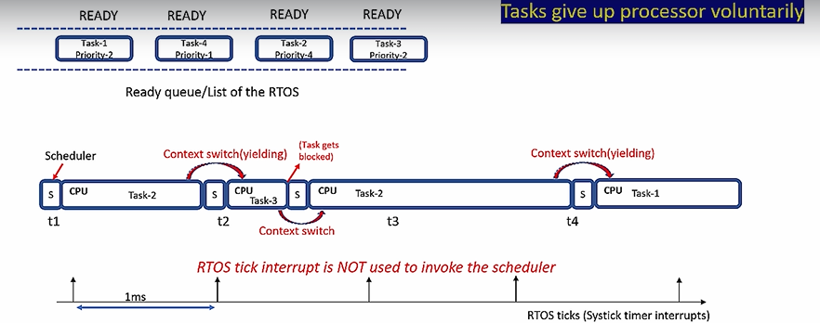
Cooperative scheduling

Slide 24
Printf over SWO pin
Instrumentation Trace Macrocell(Supports printf)
ARM Cortex M4
ITM
ST-LINK V2
STM32F446RE MCU
STM32F4 Nucleo Board

Slide 25
task1
1
1
1
1
1
task2
2
2
2
2
Time
t1
1ms
t2
t3
t4
t5
t6
t7
t8
t9
At t1 the schedular doesn’t care if the task 1 is completed or not it starts the task2 and puts the task 1 in ready state
Same in t2 the schedular stops task2 and resumes task1 from t1
#define configTICK_RATE_HZ( ( TickType_t ) 1000 )
This defines the time gap between t2 and t1

Slide 26
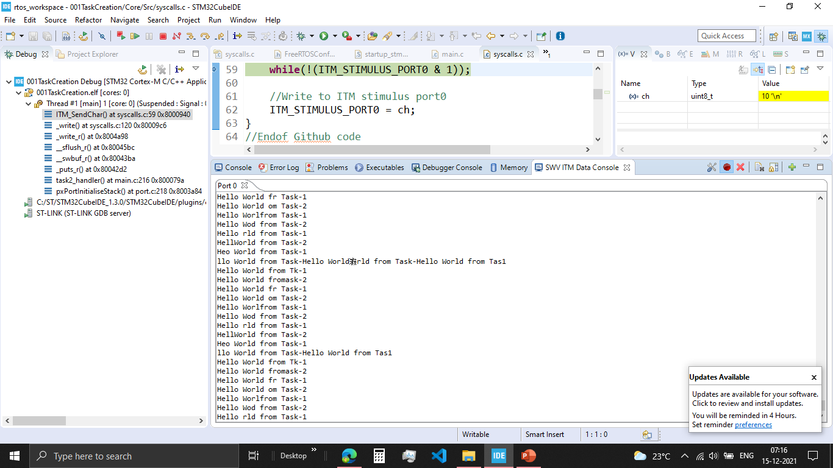
001TaskCreation:
1. In ITM Data console, if we run both the task they overlap each other.

Slide 27
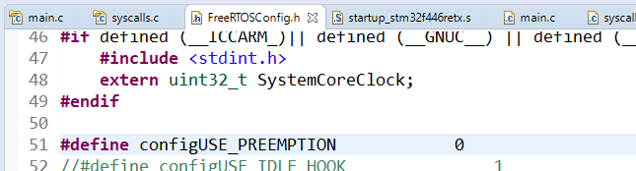
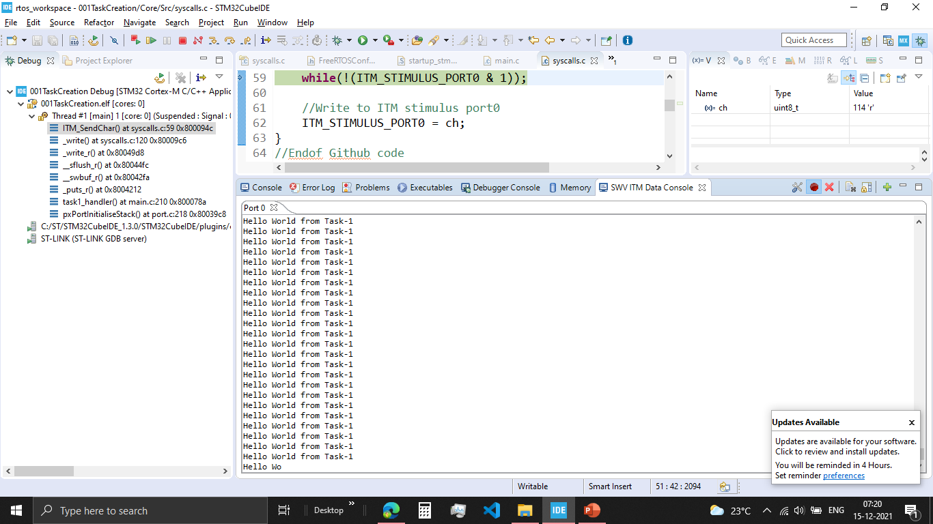
001TaskCreation2:
In ITM Data console, if we run there is only one task print.
This is because we print only one Task
The preemptive is turnedOFF there will be no task switch

Slide 28
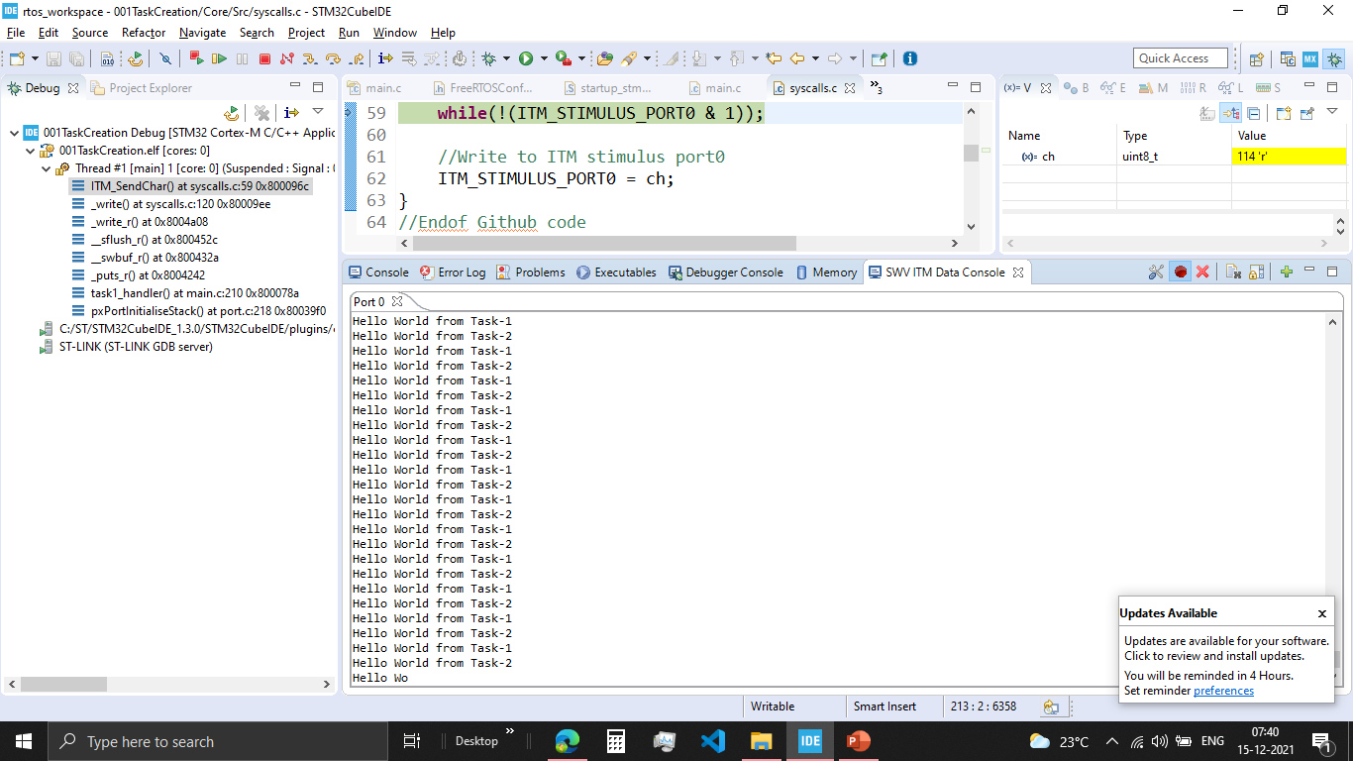
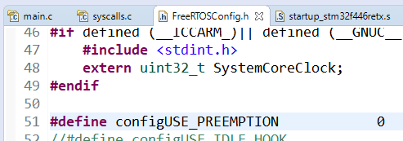
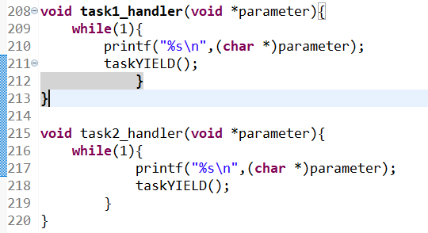
001TaskCreation3:
In ITM Data console, both Task are printed in a right way
Disabled the preemptive macro, so now it is a cooperative scheduluar
Added yield to each task, where the task automatically give up the processor once the task is completed

Slide 29
Used for Global variable, Static Variable, Kernel stack
Total RAM(SRAM) = 128KB
Heap #define configTOTAL_HEAP_SIZE( ( size_t ) ( 75 * 1024 ) )
TCB
STACK
TCB2
STACK2
Semaphore CB
QUEUE CB
QUEUE items
0
128KB

Slide 30


xTaskCreate()
TCB
pxTopOfStack
Stack
TaskReady list maintained by the Kernel
Dedicated Stack Memory will be created for the task and initialised and this stack memory will be used by the PSP of ARM cortex Mx Processor
Task will be put in “Ready list” and will be pickedup by the schedular
TCB will be created in the RAM(Heap section) and intialized

Slide 31
if you want to create a task statically both TCB and stack of the Task will live in the global space of the RAM , that is out side stack and heap area !
where exactly memory for that static variable is allocated. ?
void task_function(void *p)
{
/*this is the task function */
static int i=10;
}
IN THEGLOBAL AREA OF THE RAM, ALSO CALLED AS .DATA SECTION
Suppose there is a non static local variable declared in the task function, where exactly the memory for the non static variable is allocated during the execution of task function ?
void task_function(void *p)
{
/*this is task function */
int i ; /* non static variable */
}
IN THE TASK’S STACK SPACE

Slide 32
System View

Slide 33

Things to download:
System View User Manual
SystemView Source Code for Target
SystemView Windows application v320

Slide 34
TARGET SYSTEM
PC
APPLICATION
SYSTEM VIEWER
User Event, printf
RTOS
Middleware
SYSYTEM VIEW API
J-Link RTT DLL API
RTT API
TARGET RAM
RTT BUFFER (SOFTWARE FIFO)
J-Link DLL
JLINK

Slide 35
IDLE TASK
Idle Task are the task that are automatically created by the FREERTOS schedular to ensure that always there is atleast one task to run in the cpu
It is created with the lowest priority level possible so it doesn’t disturb any other ready task
Timer Service Task
This is also created by the Idle Task
It is created with the lowest priority level possible so it doesn’t disturb any other ready task
If we use software timers then #define configUSE_TIMERS 1
If we don’t use software timers then #define configUSE_TIMERS 0

Slide 36
Three important kernel interrupt responsible for scheduling of Task
vPortSVCHandler()
xPortPentSVHandler()
xPortSysTickHandler()
Used to launch the very first task triggered by SVC instruction
Used to achieve the context switching between tasks Triggered by pending the PendSV System exception of ARM
This implements the RTOS tick management.
Triggered periodically by Systick timer of ARM cortex Mx Processor

Slide 37
For every 1sec there will be 1000 SysTick interrupts
#define configTICK_RATE_HZ( ( TickType_t ) 1000 )
For every 1sec there will be 500 SysTick interrupts
#define configTICK_RATE_HZ( ( TickType_t ) 500 )

Slide 38
vTaskSchedular()
xPortStartSchedular
Configure the SysTick Timers to schedule the interrupts at desired rate
Configure the priority for PendSV and SysTick interrupts
Configure the first task by executing the SVC instruction

Slide 39
RTOS
TICK
Increment the global variable xTickCount
Maintain the delay if required
Switch the task at regular interrupts

Slide 40
Configuration of SysTick
vTaskSchedular()
xPortStartSchedular
task.c
port.c
1
Initialise the SysTick interrupt to lowest priority possible
2
Load the reset value to SysTick timer
3
Enables the Systick timer interrupt and starts the timer

Slide 41

RTOS Tick Configuration
portNVIC_SYSTICK_LOAD_REG = ( configSYSTICK_CLOCK_HZ / configTICK_RATE_HZ ) - 1UL;
#define configSYSTICK_CLOCK_HZ configCPU_CLOCK_HZ
#define configCPU_CLOCK_HZ( SystemCoreClock )
uint32_t SystemCoreClock = 25000000;
#define configTICK_RATE_HZ( ( TickType_t ) 1000 )
So portNVIC_SYSTICK_LOAD_REG = (25000000 / 1000 ) - 1UL = 24999;
The Sysytick Timer when started starts down counting from 24999 to 0; when zero is reached
It gives an interrupt and starts down counting once again

Slide 42
SYSTICK interrupt summary
TickISR runs
xPortSysTickHandler()
SysTick
Interrupt
xTickCount++
1
portDISABLE_Interrupt
2
Checks to see if the new tick value will cause any task to be unblocked
xTaskIncrementTick() == TRUE
Calls application hook function if enables
Pend the PendSV
3
Returns TRUE if context switch is required
portENABLE_INTERRUPTS
4

Slide 43
What is Context Switching
Switching out of Task A and switching in of Task B is known as Context switching
In FreeRTOS context switching is taken care of PendSV Handler in port.c
In other RTOS context switching is taken care of scheduler

Slide 44
If the schedular is based on preemptive scheduler, then every RTOS tick the scheduler will compare the priority of the running task with the priority of the ready task list.
If there is any ready task with high priority then the running task,context switching happens
You can also trigger context switching manually by triggering the taskYIELD()
Context switching also happens immediately if a task unblocks itself
What is Context Switching

Slide 45
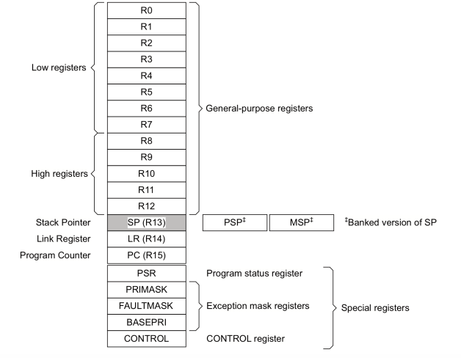
ARM cortex Mx Core register
PSP-Peripheral Stack Pointer
USED FOR USER TASK UTLISATION
MSP – Main Stack Pointer
USED FOR KEREL TASK UTILISATION
PSR – Points to Overflow Flag,

Slide 46
Kernel Stack is used on SysTick Interrupt occurs, Context Switching occurs,
Kernel Stack is tracked by the MSP (Main Stack Pointer)
Kernel Stack

Slide 47
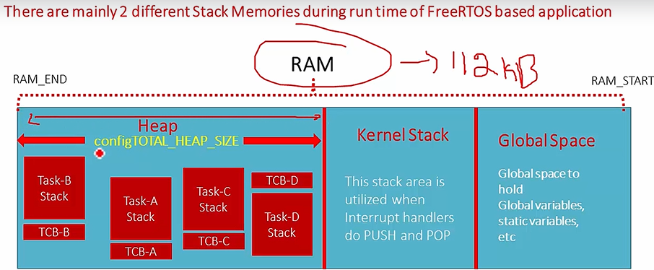

Slide 48
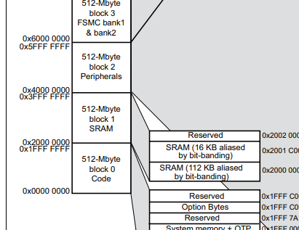
SRAM

Slide 49
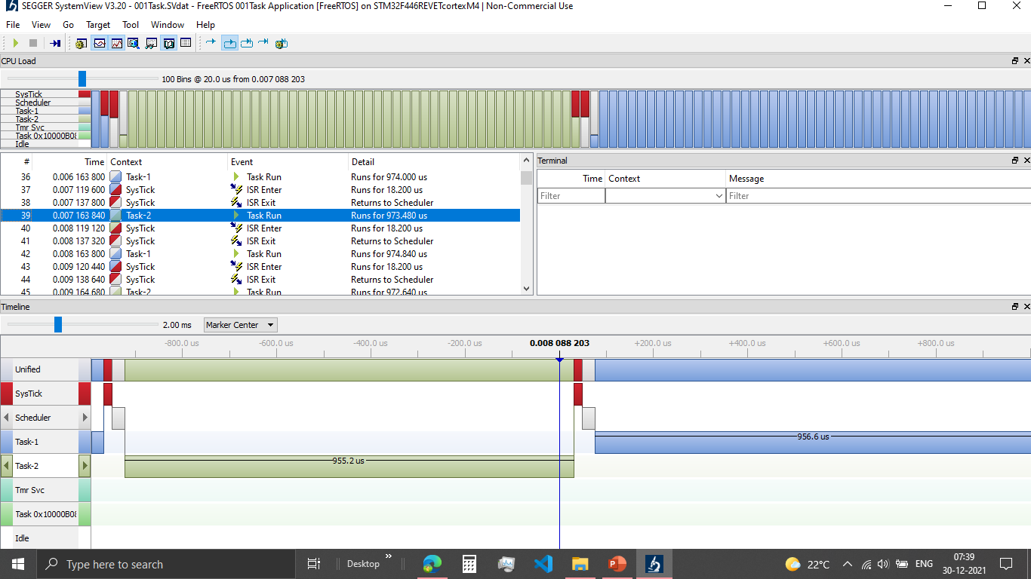

Slide 50
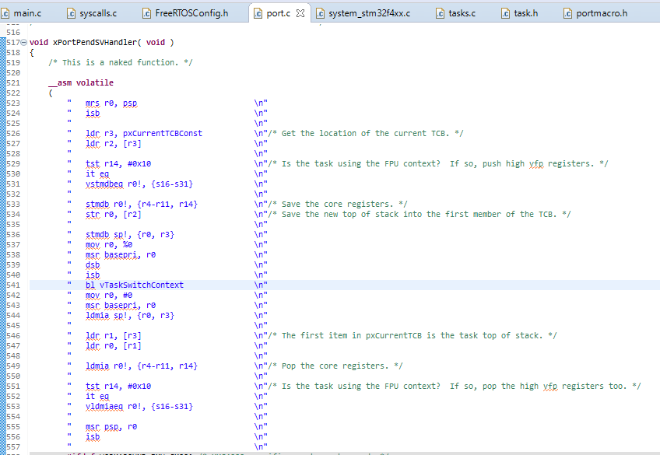
Context Saving
Context Restoring

Slide 51

Task SWITCHING OUT Procedure
Processor core register R0,R1,R2,R3,R12,LR,PC,xPSR(stack frame) are saved on the task’s private stack automatically saved by the processor’s SysTick interrupt entry sequence
If the context switch is required then the Systick timer will pend the PendSV Exception and PendSV handler runs
Processor core register (R4 to R11, R14) have to be saved manually on the task’s private stack memory (Saving the context)
Save the new top of stack value (PSP) into the first member of TCB
Select the next potential task to execute on the CPU, taken care by vTaskSwitchContext() implemented in tasks.c

Slide 52
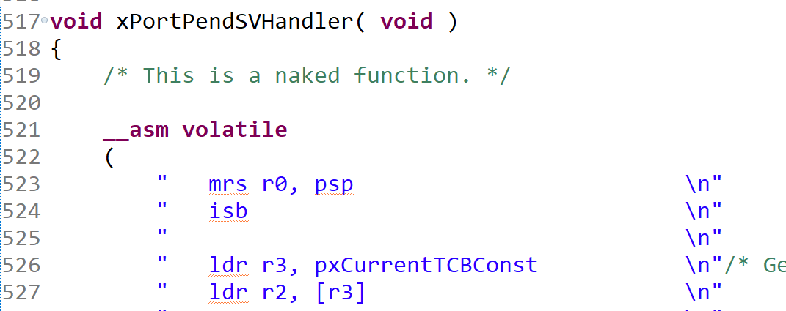
R0-> stores the contents of PSP(Peripharal Stack Pointer) used by the Task1 stack

Slide 53

ldr r3, pxCurrentTCBConst
now R3 = 0x20000000
Ldr r2, [r3]
De-reference 0x20000000 and store the value into R2) So, R2 = 0x20001108 (Address of the Current TCB)
R3-> Loads the value of current TCB pointer
R2-> Points the address of R3

Slide 54
stmdb r0!, {r4-r11, r14}
The contents of register R4 to R11 and R14 are pushed to the address referred by the R0 register
The address of R0 will be degremented on the Go
Ex: If R0 points to 0x2004008, then r4 will be pushed to 0x2004008 and the value of R0 will be reduced to
0x2004007, then r5 will be pushed to 0x2004007 and the value of R0 will be reduced
str r0, [r2]
Later the updated value of R0 is saved to R2, where R0 points to the top of the Stack(least address in the task ) and
now R2 will also point to The top of the stack. WE HAVE TO SAVE THE LATEST PSP TO TCB AND WE HAVE TO
SWITCH OUT. BECAUSE WE NEED THIS PSP LATER IF FEW NEED TO SWITCH IN BACK
bl vTaskSwitchContext
Then do the context switch

Slide 55
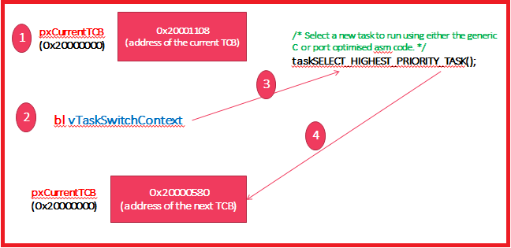

Slide 56
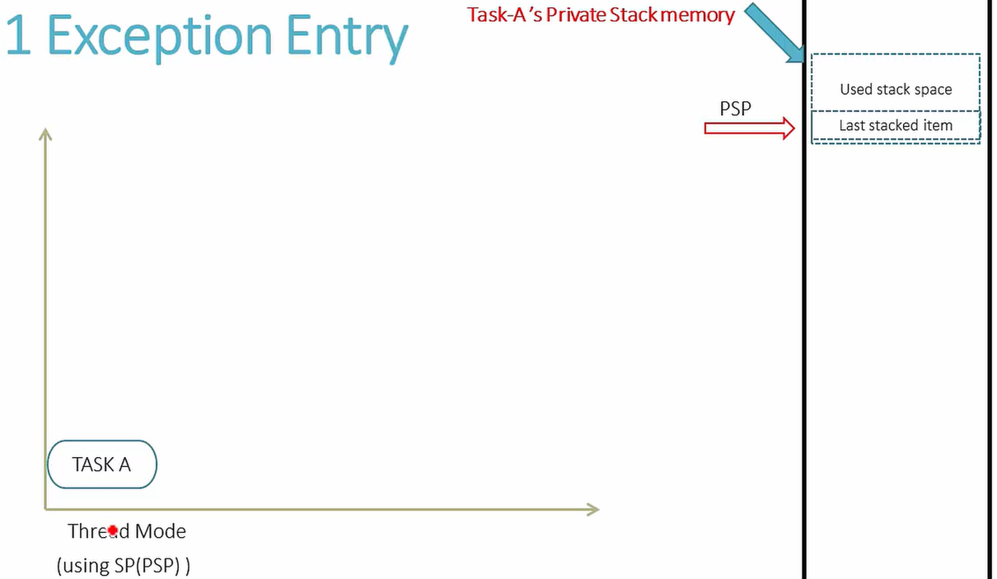

Slide 57
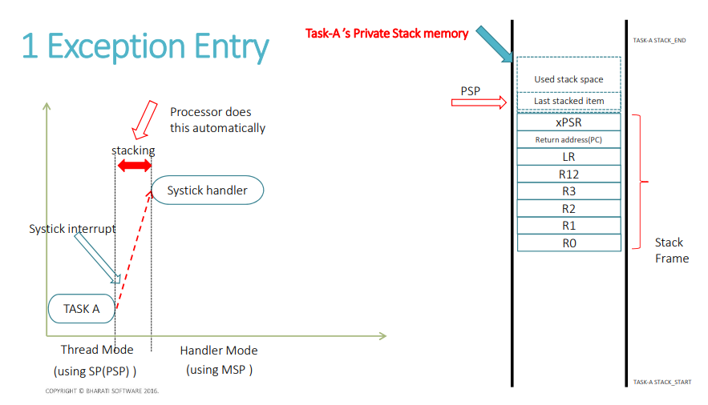

Slide 58
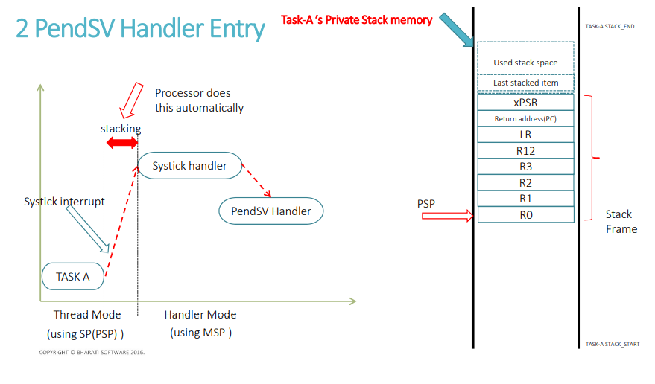

Slide 59
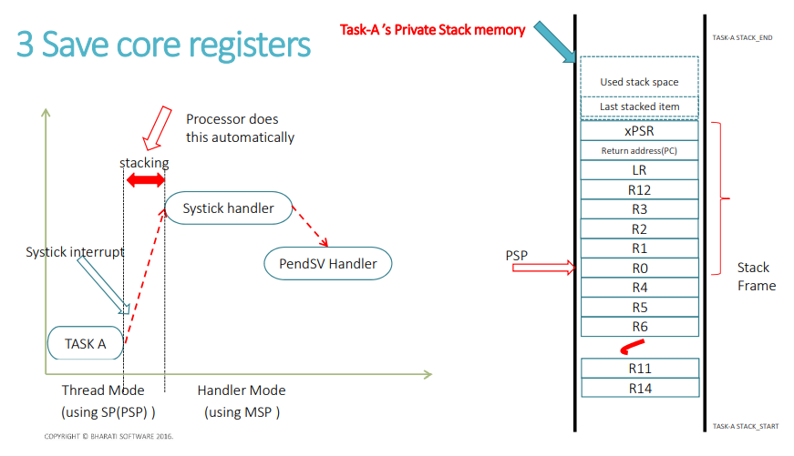

Slide 60
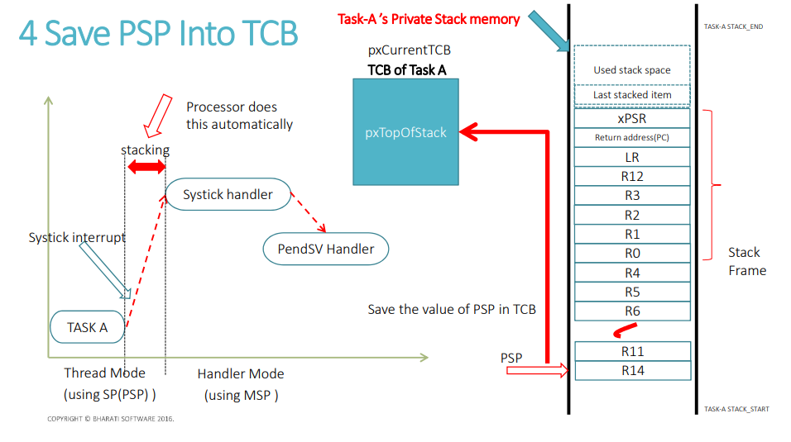

Slide 62
Task SWITCHING IN Procedure
At this point the new Stack’s TCB can be accessed by the pxCurrentTCB pointer
Then get address of the Top of Stack(Copy the value of pxTopOfStack into the PSP register)[In the code instead of loading into PSP they load into r0]
Pop all the register from R4 to R11 and R14 (These are the context registers)
Now PSP is pointing out to the Start of the Stack frame which will be popped out automatically due to the exception exit.

Slide 63
mov r0, #0\n"
"msr basepri, r0\n"
"ldmia sp!, {r0, r3}\n"
"\n"
"ldr r1, [r3]\n"/* The first item in pxCurrentTCB is the task top of stack. */
"ldr r0, [r1]\n"
"\n"
"ldmia r0!, {r4-r11, r14}\n"/* Pop the core registers. */
"\n"
"tst r14, #0x10\n"/* Is the task using the FPU context? If so, pop the high vfp registers too. */
"it eq\n"
"vldmiaeq r0!, {s16-s31}\n"
"\n"
"msr psp, r0\n"
"isb\n"
"\n" "\n"
"bx r14\n"

Slide 64
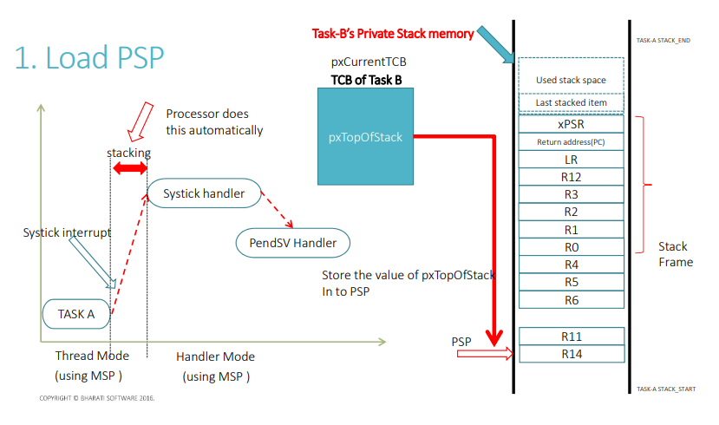

Slide 65
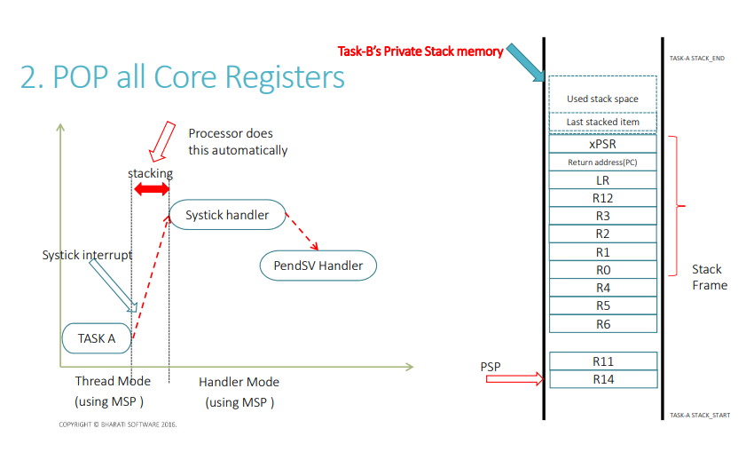

Slide 66
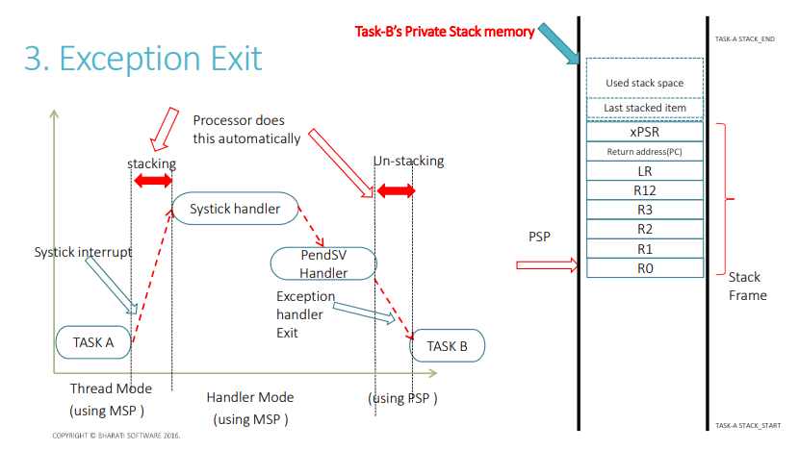

Slide 67
