Slide 1
FreeRTOS
-Balaji

Slide 2
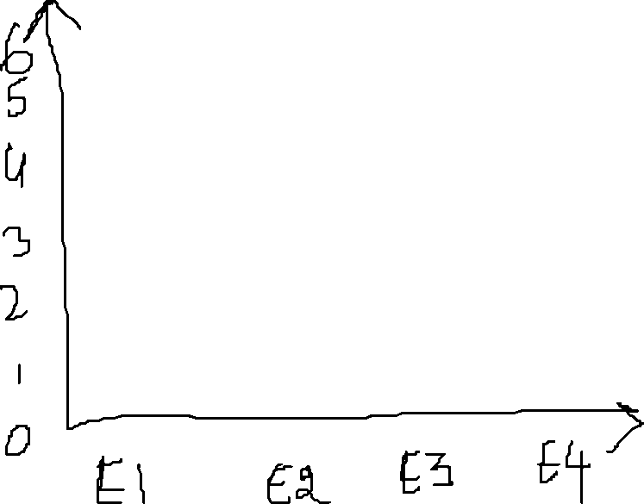



Non-Realtime application
Response Time
Realtime application
Realtime application has same response time irrespective of the load and iteration
Iteration

Slide 3
Real Time Application
Hard Real Time Application
Soft Real Time Application

Slide 4
ThroughPut-
Total Number of Task that are executed by a unit time
GPOS-
In order to achieve high throughput the GPOS will serve 5 to 6 low priority task than the task with high priority
MEET HIGH THOUGHPUT
RTOS-
Task are executed based on priority only
MEET HIGH TIME PREDICTABLITY

Slide 5




RTOS vs GPOS: Task Switching Latency
Task switching time
Number of Thread

Slide 6




time
Interrupt occurs
Tasks resumes
TASK 1
ISR
TASK 2
(Higher priority ready task)
Interrupt Latency
Scheduling Latency

Slide 7
Advantage of RTOS over GPOS:
Priorty based preemptive scheduling mechanism
No or very shortCritical section which disables the preemptive
Priority inversion avoidance
Bounded interrupt latency
Bounded scheduling latency

Slide 8
How schedular divies task based on time
TASK1
TASK2
TASK3
How it actually looks

Slide 10


APPLICATION CODE
main
thread
interrupt
CMSIS-RTOS API
Object definition via macro
Function call transaction
object
REAL TIME KERNAL

Slide 11










APPLICATION CODE
osTaskCrerate
CMSIS-CORER Layer
xTaskCreate
FreeRTOS

Slide 12
Application Layer
Core/src
CMSIS RTOS API Layer
(Generic Layer)
Real Time Kernel
(FreeRTOS, EmbOS)
CMSIS Core Layer
Driver/CMSIS
Cortex M Processor

Slide 13
GCC |
---ARM_CM4F | ---port.c | --portmacro.h
THESE are low level architecture files required by the FreeRTOS architecture

Slide 14
FreeRTOSConfig.h file modification:
__ICCARM_ - IAR Compiler
__GNUC_ - GNU Compiler
__CC_ARM_ - ARM Native compiler CC
PendSV Handler – This is used to implement the RTOS scheduler
SysTick Handler – This is used to launch the schedular at given interval(Systick interrupt is used to launch
the interrupt at given interval;)

Slide 15
Time Base Selection
FreeRTOS uses ARM Cortex Mx Processor’s internal systick timer as its time base (RTOS Ticking)
STMCube’s HAL also uses systick timer by default,
So we can’t use both HAL and FreeRTOS together
To resolve this issue we use Systick timer for FreeRTOS and for HAL we use any other timer peripheral as time base

Slide 16
TASK
If a task ever leaves the infinite for loop in a task function then the Task must be deleted before leaving the task function
xTaskCreate:
This API creates a new FreeRTOS task using dynamic memory allocation and adds the newly created task to the ready queue to the kernel
If there is 2 Task having a common TaskHandler and if the task handler has a local variable xyz, then there will be 2 separate copies of the local variable in each Task stack

Slide 17
STACK
In FreeRTOS the stack is a Full descending Stack
If we push a element in to a stack the address gets decremented
StackPointer points to top of the stack
Width of the data is 32bit in ARM cortex M

Slide 18
TASK PRIORITY
HIGHER the TASK priority value, Higher the urgency for the task

Slide 19
SCHEDULUAR
configUSE_PREEMPTION == 1
(We use this)
configUSE_PREEMPTION == 0
Pre-emptive Scheduling
Co-operative schedulling
Round Robin(cyclic) Preemptive scheduling
Preiority based Preemptive scheduling

Slide 20














S
TASK-1
S
TASK-4
S
TASK-2
S
TASK-3

Slide 21




TASK-1 - Priority 2
TASK-2 - Priority 4
TASK-3 - Priority 3
TASK-4 - Priority 1
Task Gets Blocked
(waiting for event)
Task2 unblocks
S
TASK-2
S
TASK-2
S
TASK-2
S
TASK-3
S
TASK-1
S
TASK-2
S
TASK-2
Not a context switch
Context switch
(Preemptive)
Context switch
(Not a Preemptive)

Slide 22
Co-operative scheduling
A Task cooperates with other tasks by explicitly giving up the proceor
(processor yielding)
There is no ‘pre-emptive’ of fthe tasks by the scheduler.
That is, the running task will never be interrupt by the scheduler
The RTOS tick interrupt doesn’t cause any pre-emption,
but the tick interrupts are still needed to keep track of the
kernel’s real time tick value
Tasks give up the CPU when they are done or periodically or
blocked/suspended waiting for a resource

Slide 23
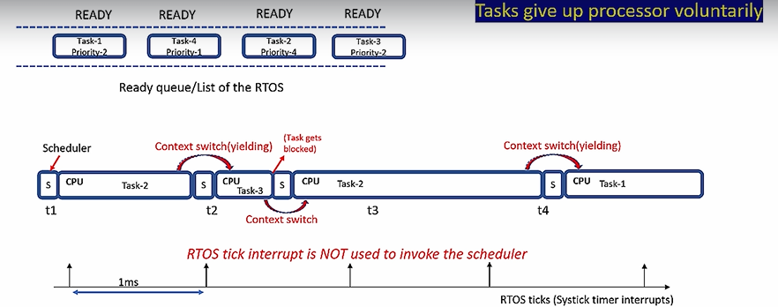
Cooperative scheduling

Slide 24
Printf over SWO pin
Instrumentation Trace Macrocell(Supports printf)
ARM Cortex M4
ITM
ST-LINK V2
STM32F446RE MCU
STM32F4 Nucleo Board

Slide 25
task1
1
1
1
1
1
task2
2
2
2
2
Time
t1
1ms
t2
t3
t4
t5
t6
t7
t8
t9
At t1 the schedular doesn’t care if the task 1 is completed or not it starts the task2 and puts the task 1 in ready state
Same in t2 the schedular stops task2 and resumes task1 from t1
#define configTICK_RATE_HZ( ( TickType_t ) 1000 )
This defines the time gap between t2 and t1

Slide 26
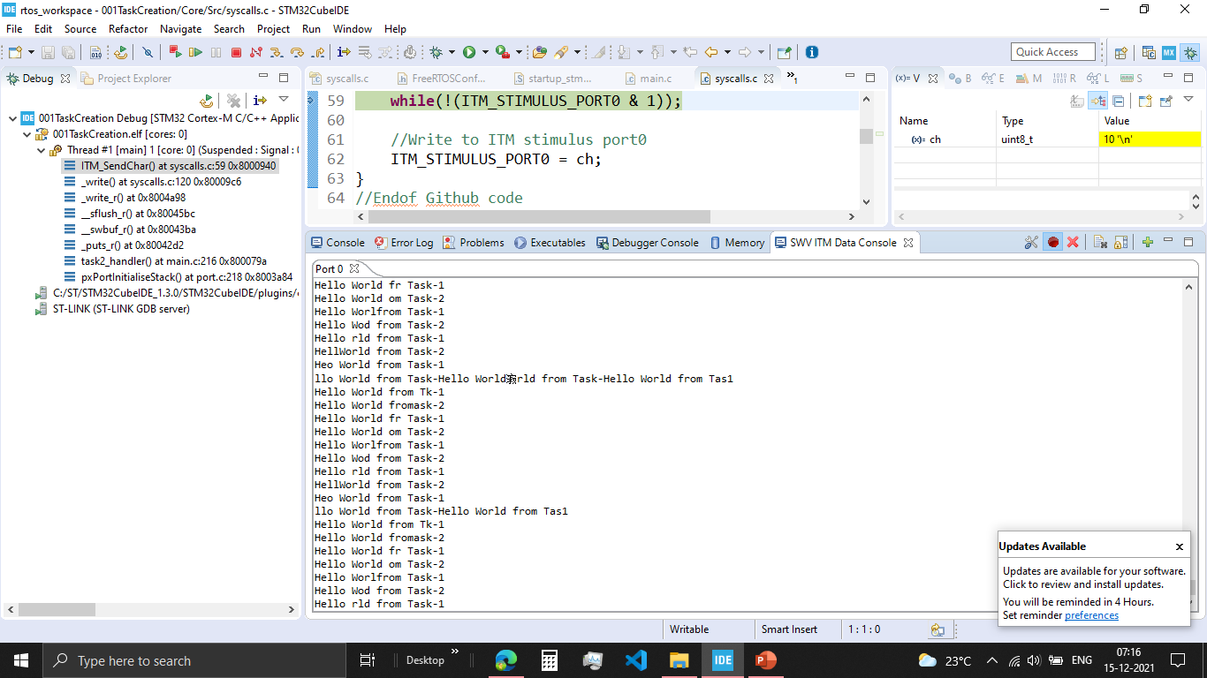
001TaskCreation:
1. In ITM Data console, if we run both the task they overlap each other.

Slide 27
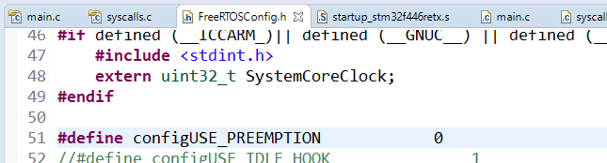
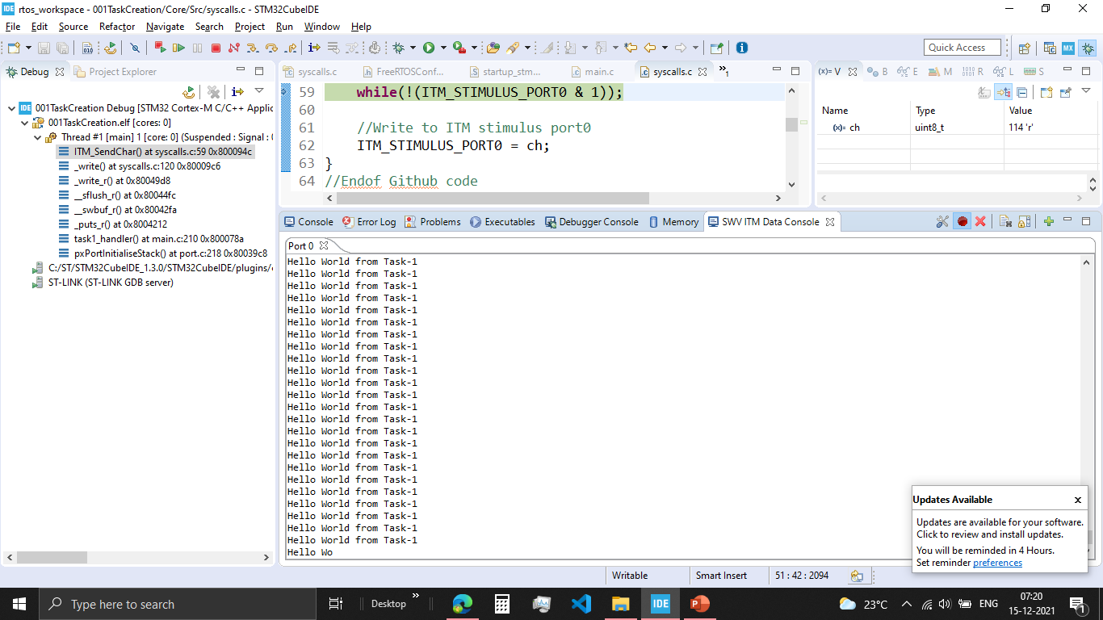
001TaskCreation2:
In ITM Data console, if we run there is only one task print.
This is because we print only one Task
The preemptive is turnedOFF there will be no task switch

Slide 28
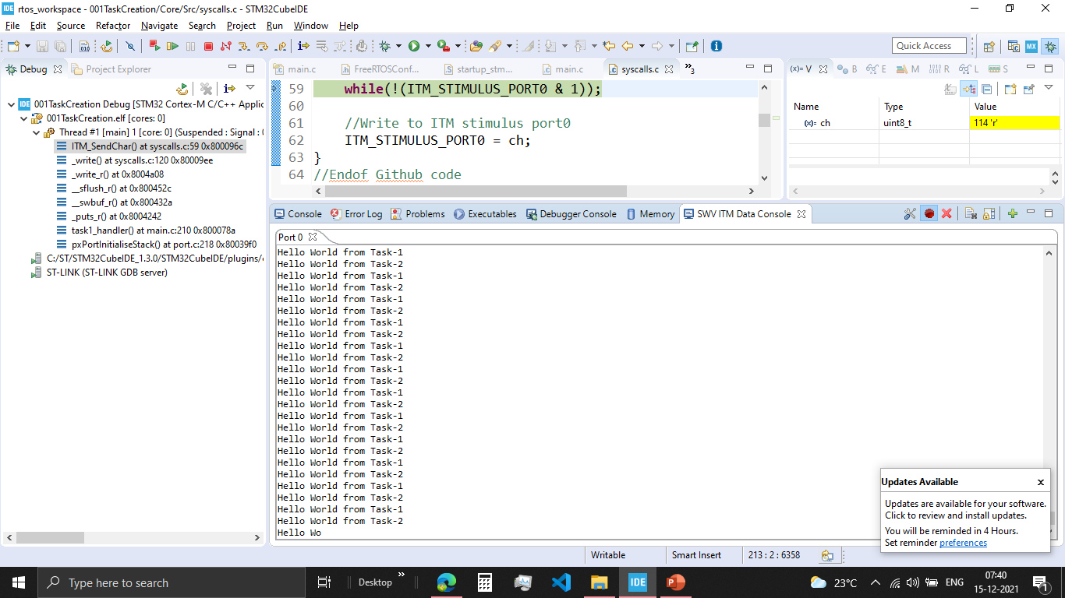
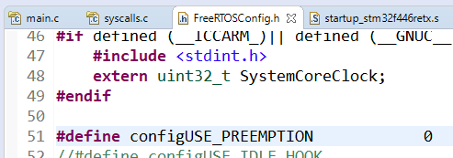
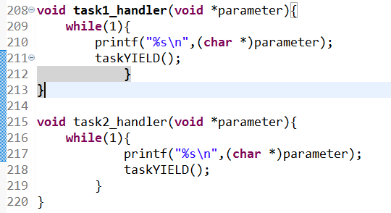
001TaskCreation3:
In ITM Data console, both Task are printed in a right way
Disabled the preemptive macro, so now it is a cooperative scheduluar
Added yield to each task, where the task automatically give up the processor once the task is completed

Slide 29
Used for Global variable, Static Variable, Kernel stack
Total RAM(SRAM) = 128KB
Heap #define configTOTAL_HEAP_SIZE( ( size_t ) ( 75 * 1024 ) )
TCB
STACK
TCB2
STACK2
Semaphore CB
QUEUE CB
QUEUE items
0
128KB

Slide 30


xTaskCreate()
TCB
pxTopOfStack
Stack
TaskReady list maintained by the Kernel
Dedicated Stack Memory will be created for the task and initialised and this stack memory will be used by the PSP of ARM cortex Mx Processor
Task will be put in “Ready list” and will be pickedup by the schedular
TCB will be created in the RAM(Heap section) and intialized

Slide 31
if you want to create a task statically both TCB and stack of the Task will live in the global space of the RAM , that is out side stack and heap area !
where exactly memory for that static variable is allocated. ?
void task_function(void *p)
{
/*this is the task function */
static int i=10;
}
IN THEGLOBAL AREA OF THE RAM, ALSO CALLED AS .DATA SECTION
Suppose there is a non static local variable declared in the task function, where exactly the memory for the non static variable is allocated during the execution of task function ?
void task_function(void *p)
{
/*this is task function */
int i ; /* non static variable */
}
IN THE TASK’S STACK SPACE

Slide 32

Things to download:
System View User Manual
SystemView Source Code for Target
SystemView Windows application v320

Slide 33
TARGET SYSTEM
PC
APPLICATION
SYSTEM VIEWER
User Event, printf
RTOS
Middleware
SYSYTEM VIEW API
J-Link RTT DLL API
RTT API
TARGET RAM
RTT BUFFER (SOFTWARE FIFO)
J-Link DLL
JLINK

