Slide 1
FreeRTOS
-Balaji
Thanks http://fastbitlab.com/category/blog

Slide 2
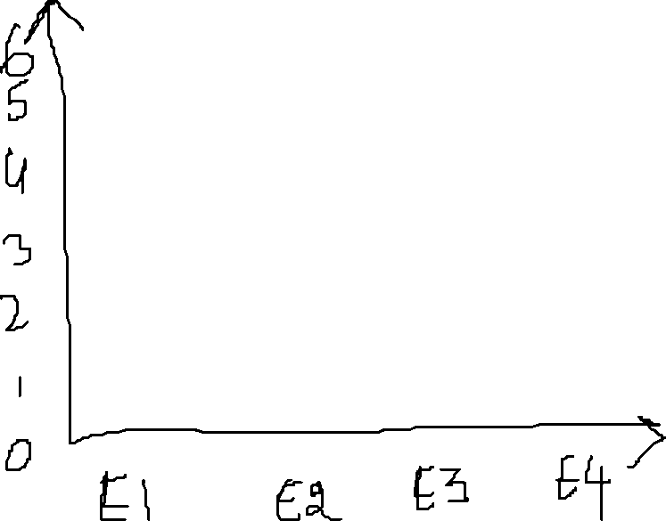



Non-Realtime application
Response Time
Realtime application
Realtime application has same response time irrespective of the load and iteration
Iteration

Slide 3
Real Time Application
Hard Real Time Application
Soft Real Time Application

Slide 4
ThroughPut-
Total Number of Task that are executed by a unit time
GPOS-
In order to achieve high throughput the GPOS will serve 5 to 6 low priority task than the task with high priority
MEET HIGH THOUGHPUT
RTOS-
Task are executed based on priority only
MEET HIGH TIME PREDICTABLITY

Slide 5




RTOS vs GPOS: Task Switching Latency
Task switching time
Number of Thread

Slide 6




time
Interrupt occurs
Tasks resumes
TASK 1
ISR
TASK 2
(Higher priority ready task)
Interrupt Latency
Scheduling Latency

Slide 7
Advantage of RTOS over GPOS:
Priorty based preemptive scheduling mechanism
No or very shortCritical section which disables the preemptive
Priority inversion avoidance
Bounded interrupt latency
Bounded scheduling latency

Slide 8
How schedular divies task based on time
TASK1
TASK2
TASK3
How it actually looks

Slide 10
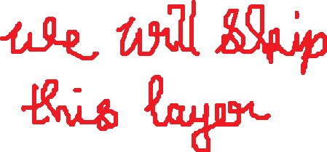

APPLICATION CODE
main
thread
interrupt
CMSIS-RTOS API
Object definition via macro
Function call transaction
object
REAL TIME KERNAL

Slide 11










APPLICATION CODE
osTaskCrerate
CMSIS-CORER Layer
xTaskCreate
FreeRTOS

Slide 12
Application Layer
Core/src
CMSIS RTOS API Layer
(Generic Layer)
Real Time Kernel
(FreeRTOS, EmbOS)
CMSIS Core Layer
Driver/CMSIS
Cortex M Processor

Slide 13

GCC |
---ARM_CM4F | ---port.c | --portmacro.h
THESE are low level architecture files required by the FreeRTOS architecture

Slide 14
FreeRTOSConfig.h file modification:
__ICCARM_ - IAR Compiler
__GNUC_ - GNU Compiler
__CC_ARM_ - ARM Native compiler CC
PendSV Handler – This is used to implement the RTOS scheduler
SysTick Handler – This is used to launch the schedular at given interval(Systick interrupt is used to launch
the interrupt at given interval;)

Slide 15
Time Base Selection
FreeRTOS uses ARM Cortex Mx Processor’s internal systick timer as its time base (RTOS Ticking)
STMCube’s HAL also uses systick timer by default,
So we can’t use both HAL and FreeRTOS together
To resolve this issue we use Systick timer for FreeRTOS and for HAL we use any other timer peripheral as time base

Slide 16
TASK
If a task ever leaves the infinite for loop in a task function then the Task must be deleted before leaving the task function
xTaskCreate:
This API creates a new FreeRTOS task using dynamic memory allocation and adds the newly created task to the ready queue to the kernel
If there is 2 Task having a common TaskHandler and if the task handler has a local variable xyz, then there will be 2 separate copies of the local variable in each Task stack

Slide 17
STACK
In FreeRTOS the stack is a Full descending Stack
If we push a element in to a stack the address gets decremented
StackPointer points to top of the stack
Width of the data is 32bit in ARM cortex M

Slide 18
TASK PRIORITY
HIGHER the TASK priority value, Higher the urgency for the task

Slide 19
SCHEDULUAR
configUSE_PREEMPTION == 1
(We use this)
configUSE_PREEMPTION == 0
Pre-emptive Scheduling
Co-operative schedulling
Round Robin(cyclic) Preemptive scheduling
Preiority based Preemptive scheduling

Slide 20














S
TASK-1
S
TASK-4
S
TASK-2
S
TASK-3

Slide 21




TASK-1 - Priority 2
TASK-2 - Priority 4
TASK-3 - Priority 3
TASK-4 - Priority 1
Task Gets Blocked
(waiting for event)
Task2 unblocks
S
TASK-2
S
TASK-2
S
TASK-2
S
TASK-3
S
TASK-1
S
TASK-2
S
TASK-2
Not a context switch
Context switch
(Preemptive)
Context switch
(Not a Preemptive)

Slide 22
Co-operative scheduling
A Task cooperates with other tasks by explicitly giving up the proceor
(processor yielding)
There is no ‘pre-emptive’ of fthe tasks by the scheduler.
That is, the running task will never be interrupt by the scheduler
The RTOS tick interrupt doesn’t cause any pre-emption,
but the tick interrupts are still needed to keep track of the
kernel’s real time tick value
Tasks give up the CPU when they are done or periodically or
blocked/suspended waiting for a resource

Slide 23
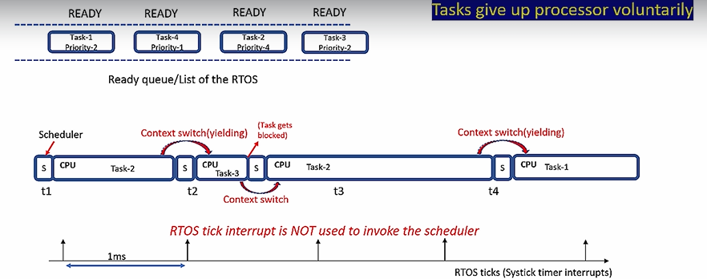
Cooperative scheduling

Slide 24
Printf over SWO pin
Instrumentation Trace Macrocell(Supports printf)
ARM Cortex M4
ITM
ST-LINK V2
STM32F446RE MCU
STM32F4 Nucleo Board

Slide 25
task1
1
1
1
1
1
task2
2
2
2
2
Time
t1
1ms
t2
t3
t4
t5
t6
t7
t8
t9
At t1 the schedular doesn’t care if the task 1 is completed or not it starts the task2 and puts the task 1 in ready state
Same in t2 the schedular stops task2 and resumes task1 from t1
#define configTICK_RATE_HZ( ( TickType_t ) 1000 )
This defines the time gap between t2 and t1

Slide 26
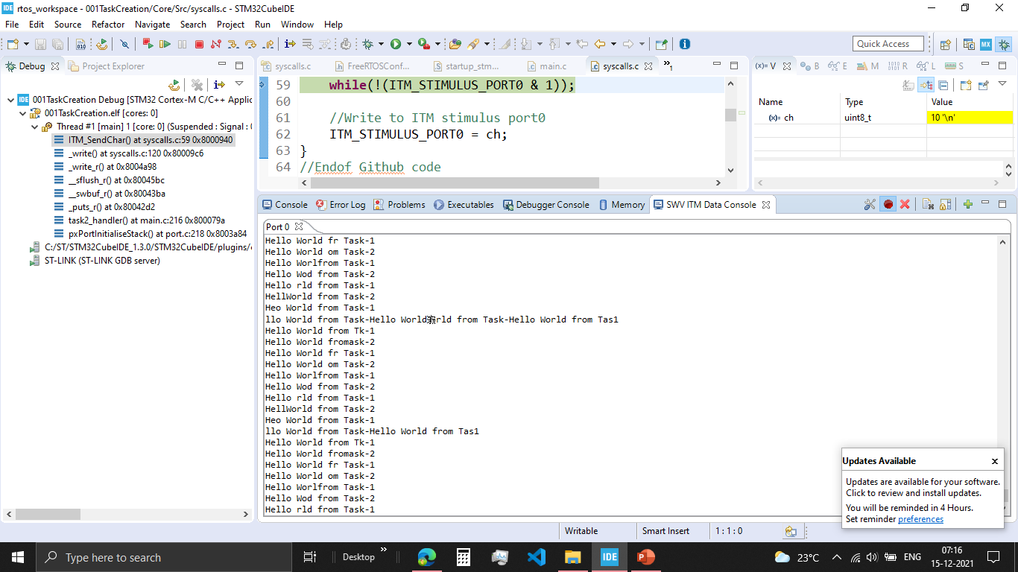
001TaskCreation:
1. In ITM Data console, if we run both the task they overlap each other.

Slide 27
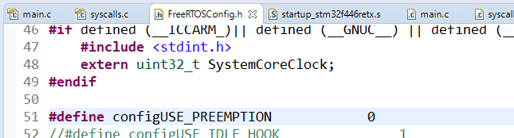
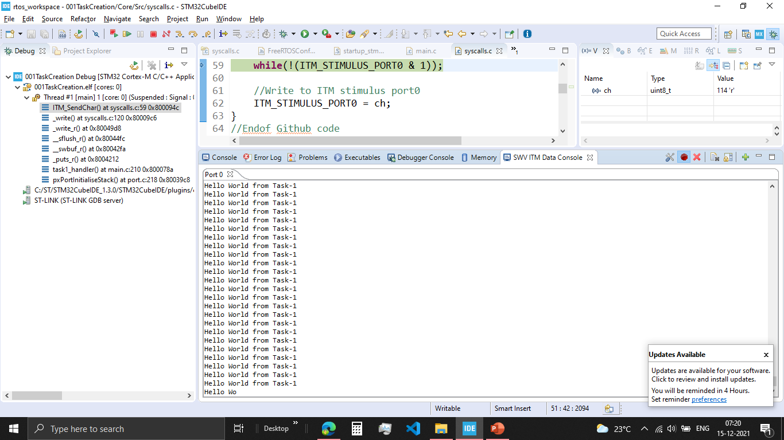
001TaskCreation2:
In ITM Data console, if we run there is only one task print.
This is because we print only one Task
The preemptive is turnedOFF there will be no task switch

Slide 28
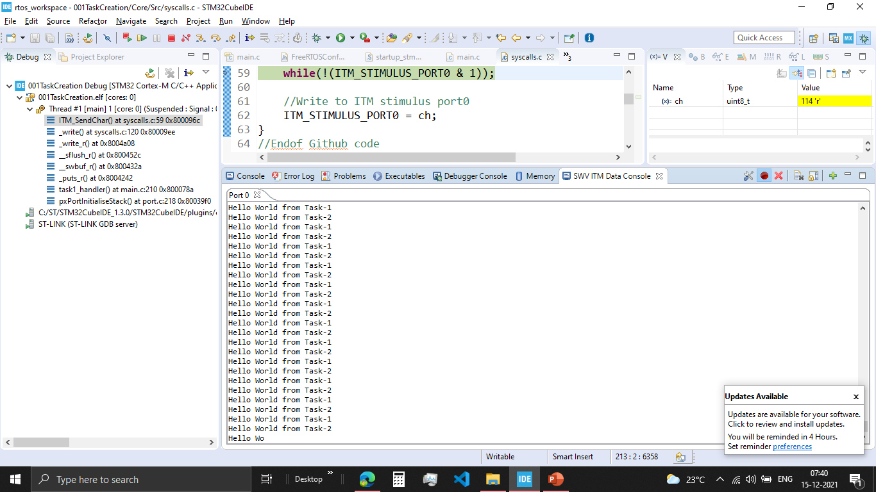
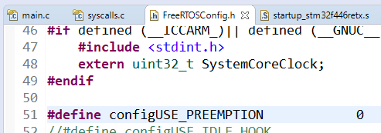
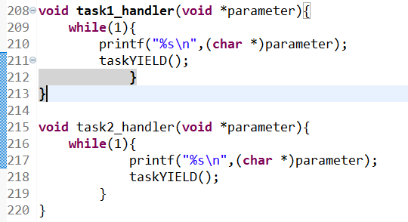
001TaskCreation3:
In ITM Data console, both Task are printed in a right way
Disabled the preemptive macro, so now it is a cooperative scheduluar
Added yield to each task, where the task automatically give up the processor once the task is completed

Slide 29
Used for Global variable, Static Variable, Kernel stack
Total RAM(SRAM) = 128KB
Heap #define configTOTAL_HEAP_SIZE( ( size_t ) ( 75 * 1024 ) )
TCB
STACK
TCB2
STACK2
Semaphore CB
QUEUE CB
QUEUE items
0
128KB

Slide 30


xTaskCreate()
TCB
pxTopOfStack
Stack
TaskReady list maintained by the Kernel
Dedicated Stack Memory will be created for the task and initialised and this stack memory will be used by the PSP of ARM cortex Mx Processor
Task will be put in “Ready list” and will be pickedup by the schedular
TCB will be created in the RAM(Heap section) and intialized

Slide 31
if you want to create a task statically both TCB and stack of the Task will live in the global space of the RAM , that is out side stack and heap area !
where exactly memory for that static variable is allocated. ?
void task_function(void *p)
{
/*this is the task function */
static int i=10;
}
IN THEGLOBAL AREA OF THE RAM, ALSO CALLED AS .DATA SECTION
Suppose there is a non static local variable declared in the task function, where exactly the memory for the non static variable is allocated during the execution of task function ?
void task_function(void *p)
{
/*this is task function */
int i ; /* non static variable */
}
IN THE TASK’S STACK SPACE

Slide 32
System View

Slide 33

Things to download:
System View User Manual
SystemView Source Code for Target
SystemView Windows application v320

Slide 34
TARGET SYSTEM
PC
APPLICATION
SYSTEM VIEWER
User Event, printf
RTOS
Middleware
SYSYTEM VIEW API
J-Link RTT DLL API
RTT API
TARGET RAM
RTT BUFFER (SOFTWARE FIFO)
J-Link DLL
JLINK

Slide 35
IDLE TASK
Idle Task are the task that are automatically created by the FREERTOS schedular to ensure that always there is atleast one task to run in the cpu
It is created with the lowest priority level possible so it doesn’t disturb any other ready task
Timer Service Task
This is also created by the Idle Task
It is created with the lowest priority level possible so it doesn’t disturb any other ready task
If we use software timers then #define configUSE_TIMERS 1
If we don’t use software timers then #define configUSE_TIMERS 0

Slide 36
Three important kernel interrupt responsible for scheduling of Task
vPortSVCHandler()
xPortPentSVHandler()
xPortSysTickHandler()
Used to launch the very first task triggered by SVC instruction
Used to achieve the context switching between tasks Triggered by pending the PendSV System exception of ARM
This implements the RTOS tick management.
Triggered periodically by Systick timer of ARM cortex Mx Processor

Slide 37
For every 1sec there will be 1000 SysTick interrupts
#define configTICK_RATE_HZ( ( TickType_t ) 1000 )
For every 1sec there will be 500 SysTick interrupts
#define configTICK_RATE_HZ( ( TickType_t ) 500 )

Slide 38
vTaskSchedular()
xPortStartSchedular
Configure the SysTick Timers to schedule the interrupts at desired rate
Configure the priority for PendSV and SysTick interrupts
Configure the first task by executing the SVC instruction

Slide 39
RTOS
TICK
Increment the global variable xTickCount
Maintain the delay if required
Switch the task at regular interrupts

Slide 40
Configuration of SysTick
vTaskSchedular()
xPortStartSchedular
task.c
port.c
1
Initialise the SysTick interrupt to lowest priority possible
2
Load the reset value to SysTick timer
3
Enables the Systick timer interrupt and starts the timer

Slide 41

RTOS Tick Configuration
portNVIC_SYSTICK_LOAD_REG = ( configSYSTICK_CLOCK_HZ / configTICK_RATE_HZ ) - 1UL;
#define configSYSTICK_CLOCK_HZ configCPU_CLOCK_HZ
#define configCPU_CLOCK_HZ( SystemCoreClock )
uint32_t SystemCoreClock = 25000000;
#define configTICK_RATE_HZ( ( TickType_t ) 1000 )
So portNVIC_SYSTICK_LOAD_REG = (25000000 / 1000 ) - 1UL = 24999;
The Sysytick Timer when started starts down counting from 24999 to 0; when zero is reached
It gives an interrupt and starts down counting once again

Slide 42
SYSTICK interrupt summary
TickISR runs
xPortSysTickHandler()
SysTick
Interrupt
xTickCount++
1
portDISABLE_Interrupt
2
Checks to see if the new tick value will cause any task to be unblocked
xTaskIncrementTick() == TRUE
Calls application hook function if enables
Pend the PendSV
3
Returns TRUE if context switch is required
portENABLE_INTERRUPTS
4

Slide 43
What is Context Switching
Switching out of Task A and switching in of Task B is known as Context switching
In FreeRTOS context switching is taken care of PendSV Handler in port.c
In other RTOS context switching is taken care of scheduler

Slide 44
If the schedular is based on preemptive scheduler, then every RTOS tick the scheduler will compare the priority of the running task with the priority of the ready task list.
If there is any ready task with high priority then the running task,context switching happens
You can also trigger context switching manually by triggering the taskYIELD()
Context switching also happens immediately if a task unblocks itself
What is Context Switching

Slide 45
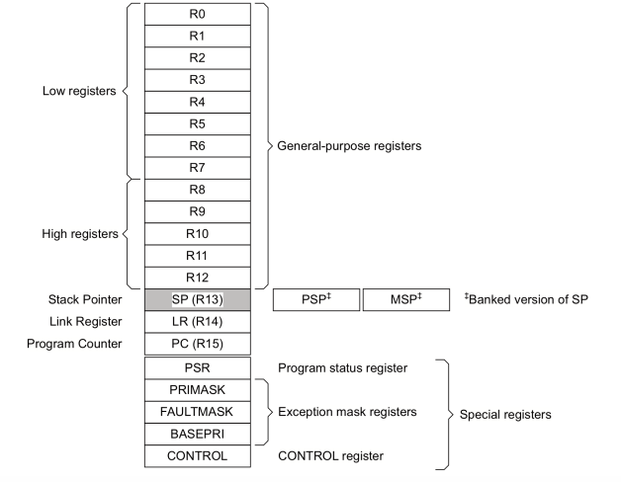
ARM cortex Mx Core register
PSP-Peripheral Stack Pointer
USED FOR USER TASK UTLISATION
MSP – Main Stack Pointer
USED FOR KEREL TASK UTILISATION
PSR – Points to Overflow Flag,

Slide 46
Kernel Stack is used on SysTick Interrupt occurs, Context Switching occurs,
Kernel Stack is tracked by the MSP (Main Stack Pointer)
Kernel Stack

Slide 47
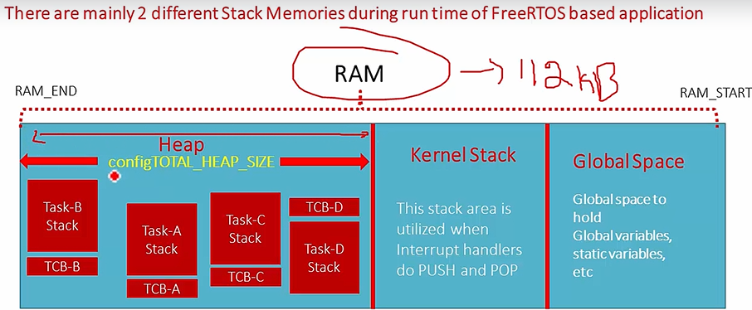

Slide 48
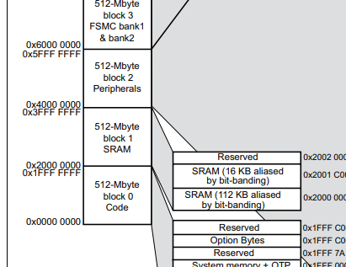
SRAM

Slide 49
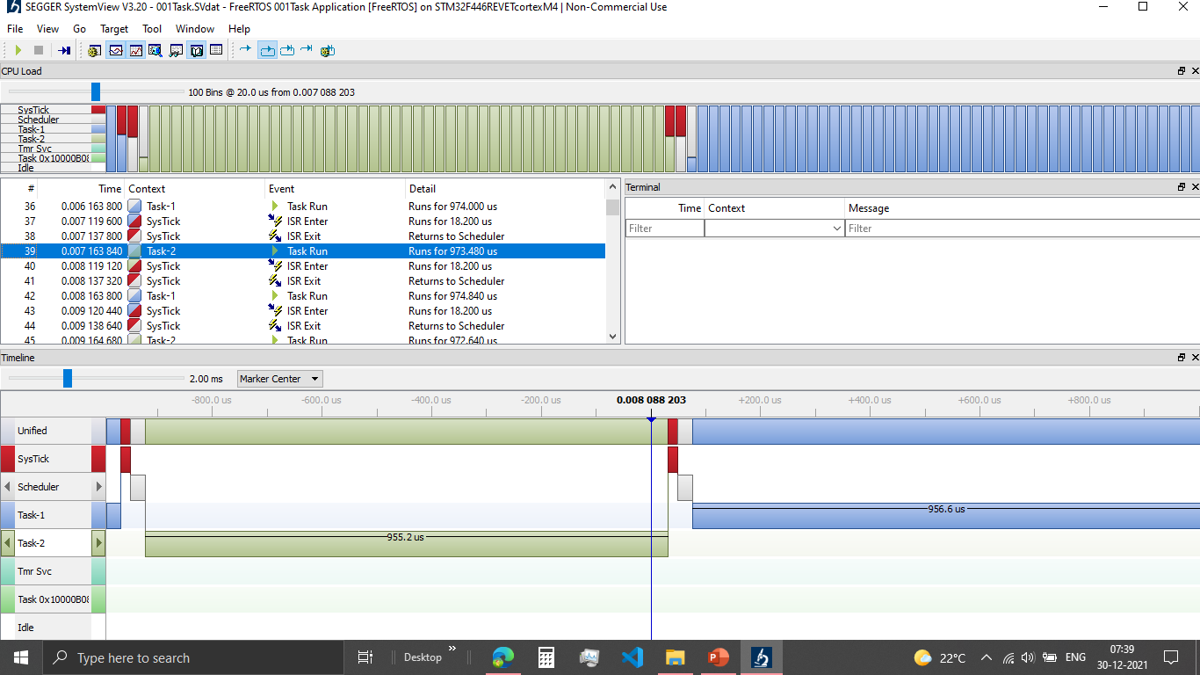

Slide 50
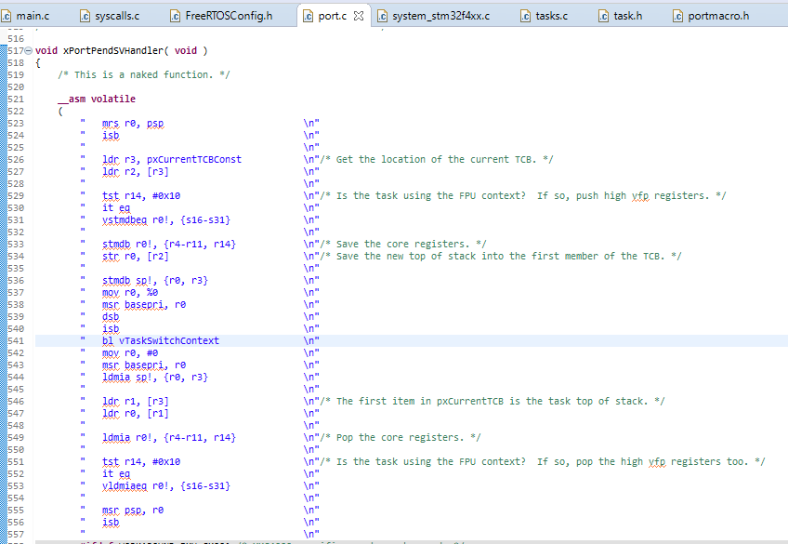
Context Saving
Context Restoring

Slide 51

Task SWITCHING OUT Procedure
Processor core register R0,R1,R2,R3,R12,LR,PC,xPSR(stack frame) are saved on the task’s private stack automatically saved by the processor’s SysTick interrupt entry sequence
If the context switch is required then the Systick timer will pend the PendSV Exception and PendSV handler runs
Processor core register (R4 to R11, R14) have to be saved manually on the task’s private stack memory (Saving the context)
Save the new top of stack value (PSP) into the first member of TCB
Select the next potential task to execute on the CPU, taken care by vTaskSwitchContext() implemented in tasks.c

Slide 52
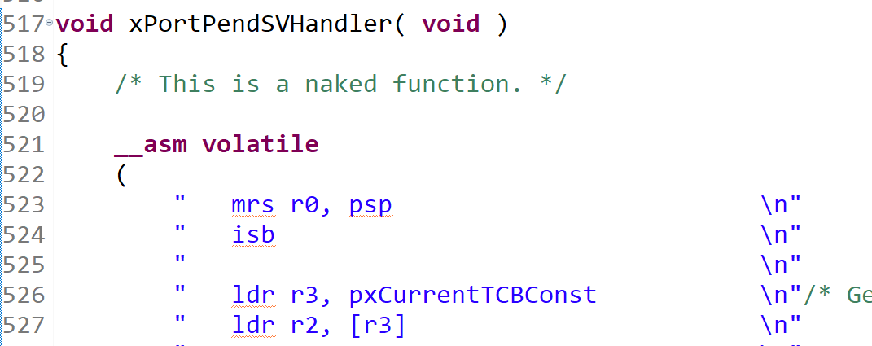
R0-> stores the contents of PSP(Peripharal Stack Pointer) used by the Task1 stack

Slide 53

ldr r3, pxCurrentTCBConst
now R3 = 0x20000000
Ldr r2, [r3]
De-reference 0x20000000 and store the value into R2) So, R2 = 0x20001108 (Address of the Current TCB)
R3-> Loads the value of current TCB pointer
R2-> Points the address of R3

Slide 54
stmdb r0!, {r4-r11, r14}
The contents of register R4 to R11 and R14 are pushed to the address referred by the R0 register
The address of R0 will be degremented on the Go
Ex: If R0 points to 0x2004008, then r4 will be pushed to 0x2004008 and the value of R0 will be reduced to
0x2004007, then r5 will be pushed to 0x2004007 and the value of R0 will be reduced
str r0, [r2]
Later the updated value of R0 is saved to R2, where R0 points to the top of the Stack(least address in the task ) and
now R2 will also point to The top of the stack. WE HAVE TO SAVE THE LATEST PSP TO TCB AND WE HAVE TO
SWITCH OUT. BECAUSE WE NEED THIS PSP LATER IF FEW NEED TO SWITCH IN BACK
bl vTaskSwitchContext
Then do the context switch

Slide 55
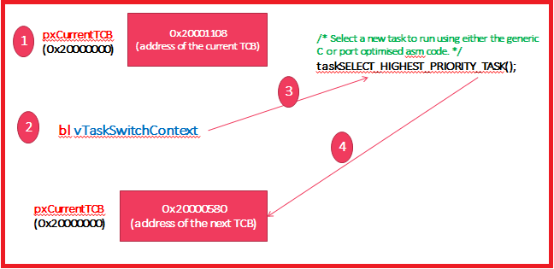

Slide 56
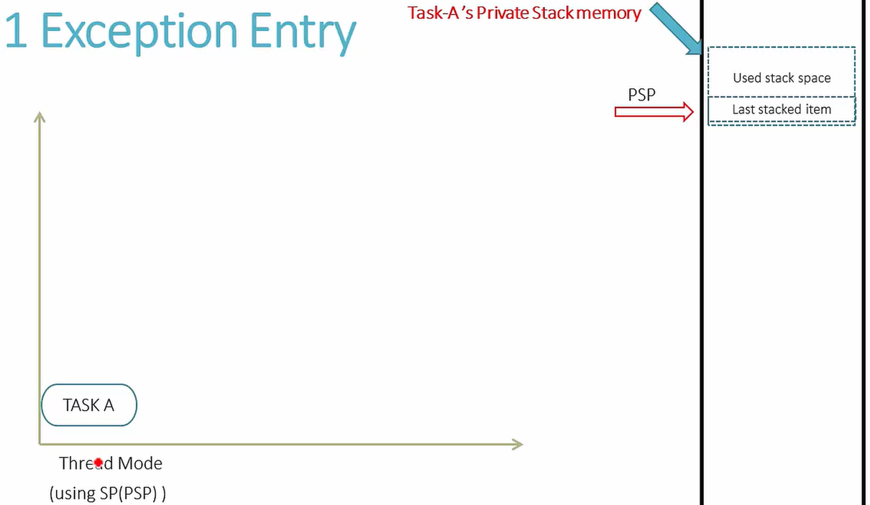

Slide 57
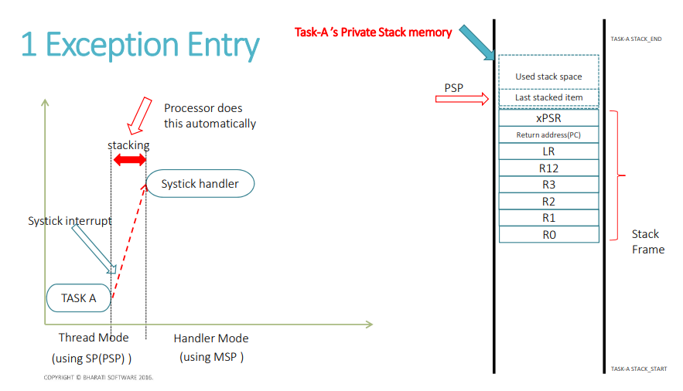

Slide 58
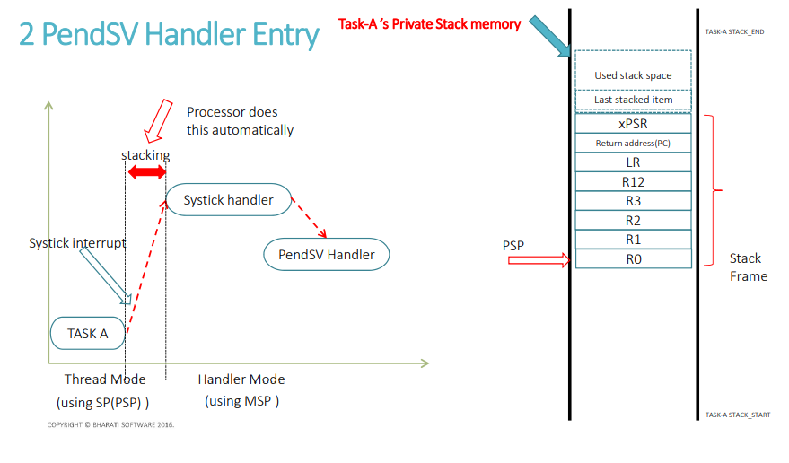

Slide 59
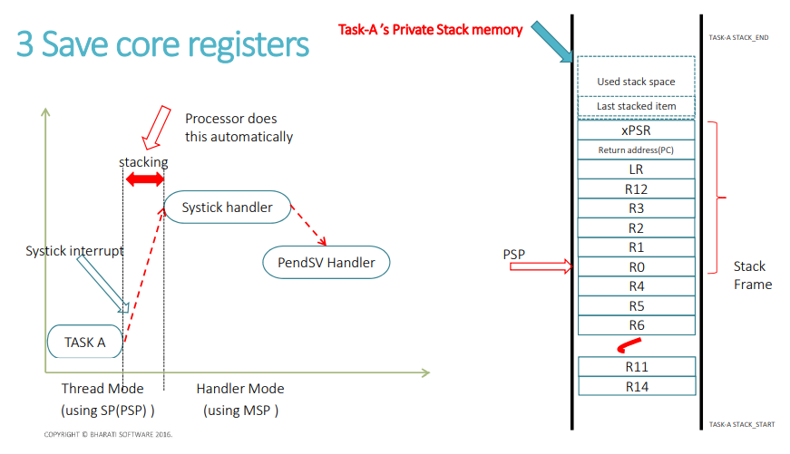

Slide 60
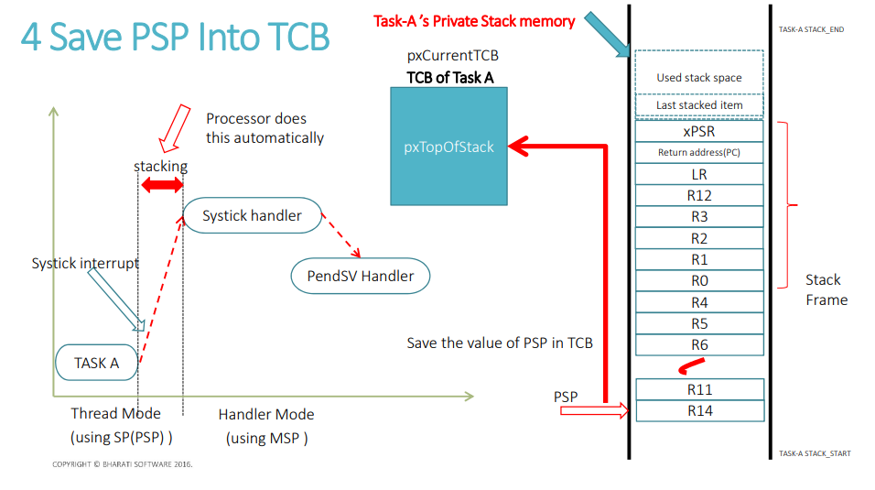

Slide 62
Task SWITCHING IN Procedure
At this point the new Stack’s TCB can be accessed by the pxCurrentTCB pointer
Then get address of the Top of Stack(Copy the value of pxTopOfStack into the PSP register)[In the code instead of loading into PSP they load into r0]
Pop all the register from R4 to R11 and R14 (These are the context registers)
Now PSP is pointing out to the Start of the Stack frame which will be popped out automatically due to the exception exit.

Slide 63
mov r0, #0\n"
"msr basepri, r0\n"
"ldmia sp!, {r0, r3}\n"
"\n"
"ldr r1, [r3]\n"/* The first item in pxCurrentTCB is the task top of stack. */
"ldr r0, [r1]\n"
"\n"
"ldmia r0!, {r4-r11, r14}\n"/* Pop the core registers. */
"\n"
"tst r14, #0x10\n"/* Is the task using the FPU context? If so, pop the high vfp registers too. */
"it eq\n"
"vldmiaeq r0!, {s16-s31}\n"
"\n"
"msr psp, r0\n"
"isb\n"
"\n" "\n"
"bx r14\n"

Slide 64
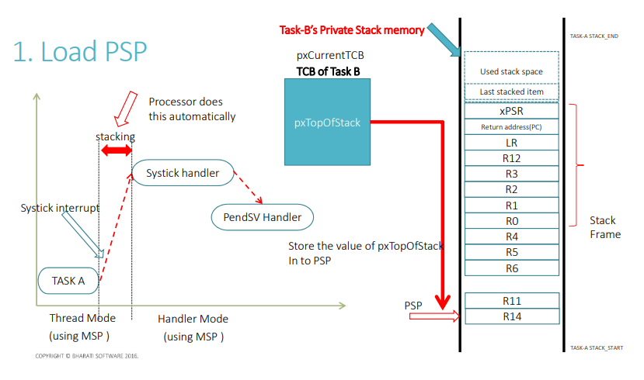

Slide 65
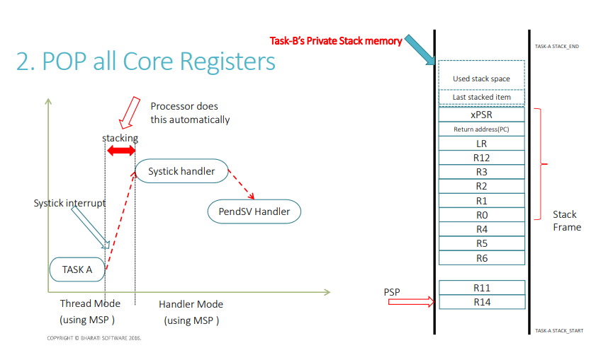

Slide 66
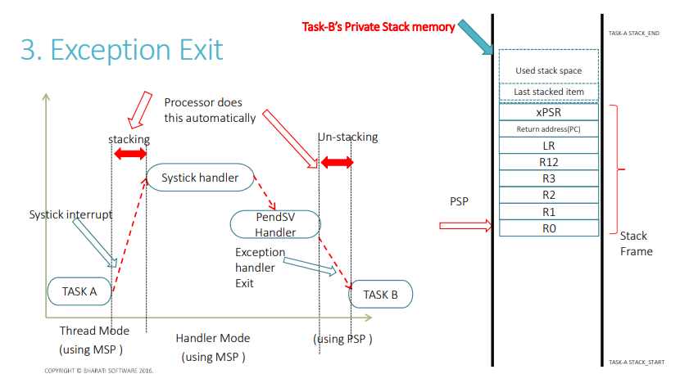

Slide 67
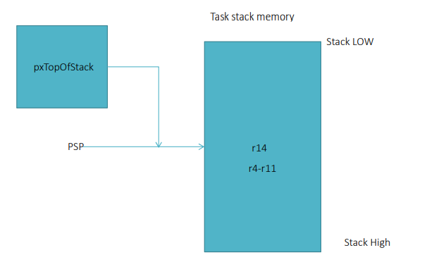

Slide 68
Continues Recording using UART

Slide 69
Steps for Continuous REcord
Include segger_uart.c
In Seggger_Sysview_config.h we have to enable UART_Rec 1 and add few lines of code
In main function
Init UART with BaudRate
Comment out SEGGER_SYSVIEW_Start(); because Already done in UART
As we are using higher clock rate it is recommended to use higher clock rate at the UART peripheral,

Slide 70
WithOut RTOS
One way of using different LED’s without RTOS is using Infinte loop and Using the Delay function after calculations [This is THREAD mode]
Another method is using the Task to different cores, but my board has only one Core.
There is also another method where we can use the interrupt handler to process the user level code, but the user level code needs to be in the unPrilvileged mode where the code under interrupt handler will be in the Prilviledge mode. (Always use the user code in the UnPriviledge mode) [This is Handler MODE]
In Handler mode, the code can change of the registers of ARM Cortex, that’s why we should not write the User level code to the Handler mode

Slide 71
002LEDTASK
Select the STM32 HAL TIME base other than systick in configuration
Select the priority group setting as 4 bits for priority and zero bits for sub- priority
Disable the IRQ handlers for code for Systick, PendSV and SVC handler
Call the function vInitPrioGroupValue(); from HAL_MspInit();

Slide 72

Task States
Suspended Task
Ready Task
Blocked Task
Running Task
Non-Running Task

Slide 73
Task State and APIs used
SUSPEND
vTaskSuspend()
vTaskSuspend()
vTaskResume()
Create NEW Task
READY
schedule
RUNNING
Yield/preEmptive
event
xTaskAbortDelay()
BLOCKED
BlockingAPI calls
Ex: vTaskDelay()
vTaskSuspend()

Slide 74
Different types of Task
Periodic Task (Synchronous Task)
Aperiodic Task (Asynchronous Task)
Continuous Task
Periodic Task (Synchronous Task) we should use vTaskDelayUntil()
Aperiodic Task (Asynchronous Task) we should use vTaskDelay()
Continuous Task

Slide 75
Hz
If, #define configTICK_RATE_HZ( ( TickType_t ) 1000 )
In 1 second there will be 1000 Tick, so 1Tick will take 1/1000 = 1millisec
If, #define configTICK_RATE_HZ( ( TickType_t ) 500 )
In 1 second there will be 500 Tick, so 1Tick will take 1/500 = 2millisec
If, #define configTICK_RATE_HZ( ( TickType_t ) 2000 )
In 1 second there will be 2000 Tick, so 1 Tick will take 1/2000 = 0.5millisec

Slide 76
RTOS Notification
Each RTOS task has a 32bit notification value, initialised with zero while it is created. This happens in xTaskCreate
Notifications are nothing but a value that is been send from Task-A to Task-B, so that the notification value of Task-B can be altered.

Slide 77
Notification APIs
xTaskNotifyWait()
This API is used to receive a notification value from another task
xTaskNotify ()
This API is used to send a notification value to another task
This function can’t be called from ISR because there is another function xTaskNotifyISR()

Slide 78
FreeRTOS API Interface
APPLICATION LAYER
TASK 1
TASK 2
TASK 3
FreeRTOS Kernel
Memory Management
Power
semaphore
timer
task
Queue
Device DRIVER
HARDWARE

Slide 79
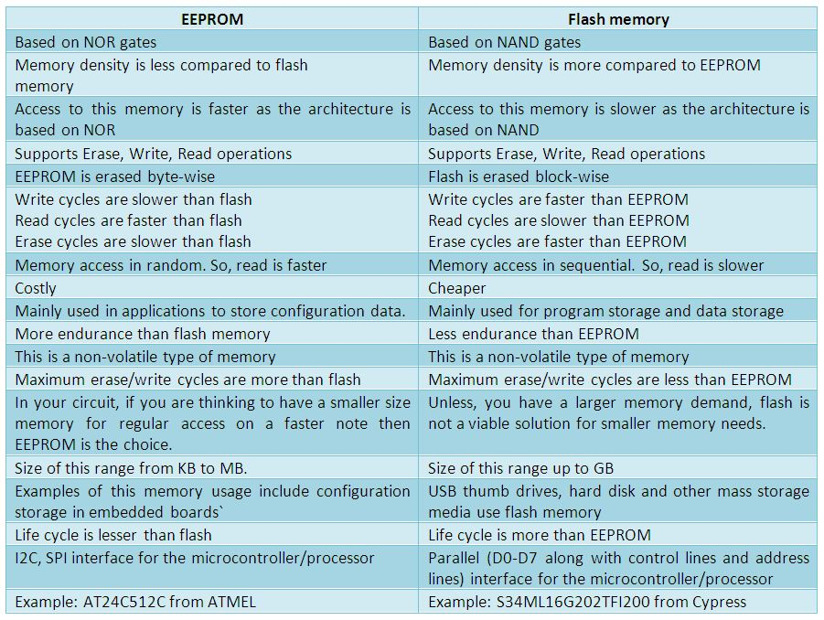

Slide 80
RAM | FLASH
Stores Application data like Global variables, Global Array | Used to hold the application code
You can download code to RAM and run using patch mechanisms | Also holds constants like string, initializations
A part of the RAM is used as STACK to store variables, functional arguments as seen before | Holds the vector table for interrupts and exceptions of the MCU
A part of RAM is used as HEAP for dynamic memory allocations

Slide 81
Stack and Heap in embedded system
PUSH
Heap
Stack
POP
Grows like this
Grows like this
Low Address
Heap is used for dynamic memory allocation. Malloc returns the memory pointer from heap
HIGH Address
This portion of RAM is used to store the global variables
STACK pointer is initialised to the highest memory address of the RAM (beginning of the stack)

Slide 82
How Heap is managed?
In C, malloc is used
In C++, new is used
But for embedded Systems, malloc and free APIs are not recommended because it consumes large amount of code space, lack of deterministic nature and fragmented over time as blocks of memory are allocated
Luckily stack is handed by proper API and management, So Stack is recommended in Embedded Systems
By default the FreeRTOS heap is declaraed by FreeRTOS Kernel
Setting the configAPPLICATION_ALLOCATED_HEAP to 1 allows the heap to instead be decalared by the application

Slide 83
Synchoronization between the task can be achieved by
Events
Semaphores
Queues
Pipes
Mailboxes
Signals
Mutex
FreeRTOS supports the following methods for task sync:
Semaphores
Queues
Mutex

Slide 84


Priority values
Higher the priority higher the urgency
0
1
Task Priority
4
5
LOW
HIGH
0
1
Interrupt Priority
4
5
HIGH
LOW

Slide 85
FreeRTOS Hardware Interrupt Configuration Items
configKERNEL_INTERRUPT_PRIORITY
configMAX_SYSCALL_INTERRUPT_PRIORITY

Slide 86
configKERNEL_INTERRUPT_PRIORITY
There are 3 important Kernel Interrupt as follows
Systick Interrupt
PendSV Interrupt (Used for Context Switching)
SVC Interrupt (Used for launching the first task)

Slide 87
Priority in ARM Cortex-M
In ARM Cortex M processor, lesser the priority number higher the urgency of the task
#define __NVIC_PRIO_BITS 4U /*!< STM32F4XX uses 4 Bits for the Priority Levels */
As the priority bits is 4, we can use upto 16 levels
#define configKERNEL_INTERRUPT_PRIORITY ( configLIBRARY_LOWEST_INTERRUPT_PRIORITY << (8 - configPRIO_BITS) )
The Kernel Interrupt priority has the lowest priority value of 0xF0

Slide 88
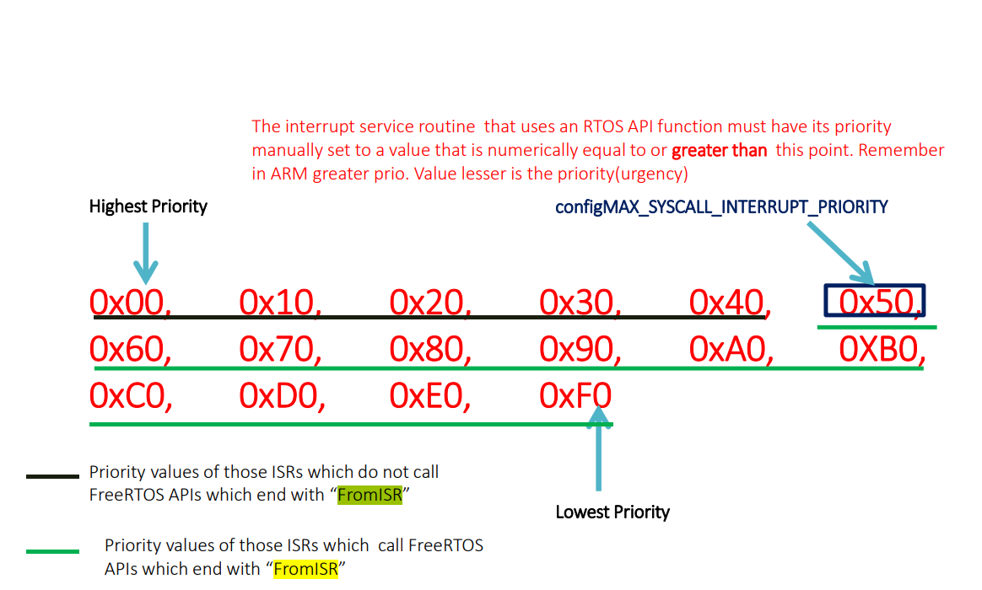
configMAX_SYSCALL_INTERRUPT_PRIORITY

Slide 89
Concluding Points
there are 2 configuration items
configKERNEL_INTERRUPT_PRIORITY
configMAX_SYSCALL_INTERRUPT_PRIORITY
configKERNEL_INTERRUPT_PRIORITY
The Kernel interrupt priority config item actually decides the priority level for the kernel related interrupts like systick, pendSV and SVC and these are set to the lowest priority as possible.
configMAX_SYSCALL_INTERRUPT_PRIORITY
The max sys call interrupt priority level actually decides the maximum interrupt priority level, that allows to use those interrupt which use FreeRTOS API that are ending with FromISR in their interrupt service routines.

Slide 90
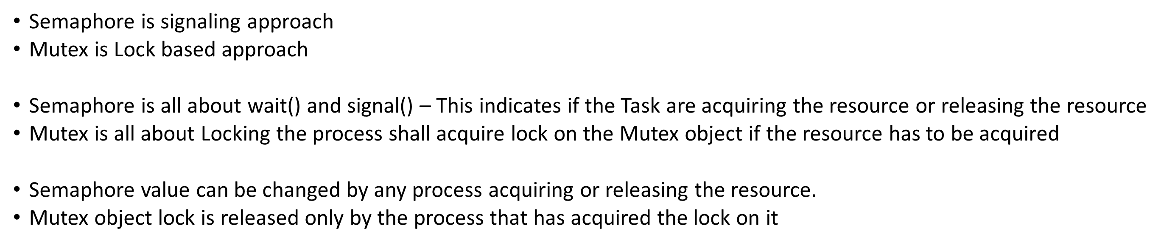
Semaphore vs Mutex

Slide 91
Task
Set of program instructions loaded in memory
Thread
Unit of CPU utilization with its own program counter and Stack
Threads within a process will share resources like stack and also pass the resources with each other
Process
Instance of a computer program
Usually a process will have one or more thread
In FreeRTOS Task = Thread

Slide 92
Port Interruput
portDISABLE_INTERRUPTS()
Disables all the interrupt with priority values 5 to 15

Slide 93
Idle Hook Functions
The Idle Hook Function feature can be enabled using the configUSE_IDLE_HOOK in FreeRTOS_Config.h
The Idle callback will call the function vApplicationIdleHook(void)
Whenever idle function is allowed to run, the hook function will be called and we can configure stuff like seting the MCU to low power mode, etc

Slide 94
Other Hook Functions
RTOS Tick Hook Function
Dynamic Memory allocation failed Hook function(Malloc failed hook function)
Stack Over Flow Hook Function

Slide 95
RTOS Tick Hook Function
The RTOS Hook Function feature can be enabled using the configUSE_TICK_HOOK in FreeRTOS_Config.h
The Idle callback will call the function vApplicationTickHook(void)
Used in SysTick Handler

Slide 96
Malloc Hook Function
The RTOS Hook Function feature can be enabled using the configUSE_MALLOC_FAILED_HOOK in FreeRTOS_Config.h
The Idle callback will call the function vApplicationMallocFailedHook(void)
Used in xTaskCreate

Slide 97
Stack Over Flow Hook Function
The RTOS Hook Function feature can be enabled using the configCHECK_FOR_STACK_OVERFLOW in FreeRTOS_Config.h
The Idle callback will call the function
void vApplicationStackOverflowHook( TaskHandle_t xTask, char * pcTaskName );
Used in xTaskCreate

Slide 98
Queue
It is a data structure which can hold finite number of fixed data items
Max. items a queue can hold is called its length
Data is written at the end of the queue
Data is removed from the end of the queue
Enqueue which is also called write operation
Dequeue which is also called delete operation
Use struct pointers instead of struct to create queue, with lower size (lower dynamic size)
There are 2 APIs in QueueSend
QueueSendFront
QueueSendEnd
There are 2 APIs in QueueReceieve
QueueReceieve (removes item from the end of queue)
QueuePeek (does not removes item from the queue, just reads an item from end)
Tose

Slide 99
Sync VS mutex
Synchronization is aligning the number of task to achieve a desired behaviour
Where as mutual exclusion is avoiding a task to execute the critical section which is already owned by a another task
Semaphore is used to implement synchronization between two task and between tasks and interrupts.
Mutex is used to implement mutual exclusion, protecting access to a shared resource
Semaphore can also be used to implement mutual exclusion but will result in some serious issues.

Slide 100
Semaphore
While semaphore is created, a Block called Semaphore control Block is also created
There are 2 types of semaphore
Binary semaphore (Max. value is 1)
Counting semaphore (Max. value is more than 1)
Semaphore ID or name
SCB
Value
Counting semaphore is used for counting number of events

Slide 101
MUTEX
it's explained the mechanism of MUTEX. It's simple, if the LP task takes the MUTEX and if a higher priority task attempts to take the same mutex then the LP task (who already taked the mutex ) priority level will be TEMPORARILY raised. So in our scenario MP task can not preempt the LP task, because LP task now have higher priority(TEMPORARILY)
https://www.freertos.org/Real-time-embedded-RTOS-mutexes.html

Slide 102
Even though mutex has more features than Binary semaphore, the memory consumed by the Mutex might be high than that of Binary semaphore

Slide 103
xTimer

