Slide 1

RAJALAKSHMI INSTITUTE OF TECHNOLOGY
KUTHAMBAKKAM, CHENNAI – 600 124.
DEPARTMENT OF ELECTRICAL AND ELECTRONICS ENGINEERING
Smart Irrigation System Using IOT
Embedded System
Batch No. | Roll Number | Register Number | Name of the Students | Supervisor
XI | 201505003 | 211715105003 | ABRAR AHAMED A.F | Ms.MONICA M AP/EEE
 | 201505045 | 211715105047 | VIGNESHWARAN.M
 | 201505047 | 211715105049 | VISHAL.G
2/2/2019
1

Slide 2
OBJECTIVE
The availability of the water resources in agriculture is a growing concern throughout the planet
We propose to perform a real-time control and remote monitoring system
For this, a programmable logic controller and a wireless communication technologies are used
2/2/2019
2

Slide 3
LITERATURE REVIEW BASE PAPER
Pavithra D.S, M.S. Srinath “GSM based Automatic Irrigation Control System for Efficient Use of Resources and Crop Planning by Using an Android Mobile”.(2017) IOSR Journal of Mechanical and Civil Engineering (IOSR-JMCE)
Automated irrigation system is essential for conservation of water and indirect viability of the farm since it is an important commodity
The idea is to focus on parameters such as temperature and soil moisture
This is a mobile integrated and a smart irrigation system using IOT based on application controlled monitoring system.
2/2/2019
3

Slide 4
LITERATURE REVIEW REFERENCE PAPER
AGBETUYI Ayoade Felix, OROVWODE Hope.E “DESIGN
AND IMPLEMENTATION OF AUTOMATIC IRRIGATION
SYSTEM BASED ON MONITORING SOIL MOISTURE”
(2017) . Article in journal in Electrical Engineering
The objective of this work is to see how human control could be removed from irrigation and also to optimize the use of water in the process.
This method employed is to continuously monitor the soil moisture level to decide whether irrigation is needed

Slide 5
LITERATURE REVIEW REFERENCE PAPER
Avello-Fernández, L., Izaguirre, E., Vidal, M., Martínez, A.,
Hernández, L. (2018) “Remote supervision and control based on
wireless technology to operation of central pivot irrigation
machine “. International Journal of Environmental Monitoring and
Analysis
The Information that makes possible the decision making in the modern systems of agricultural irrigation.
In the present research is to perform a real-time control and monitoring system, allowing the operation and remote monitoring of irrigation machines

Slide 6
EXISTING SYSTEM
An automatic irrigation control system has been designed to facilitate the automatic supply of adequate of water from a reservoir to field or domestic crops in all agricultural seasons
This System has been used for a single plant irrigation system
A pumping mechanism is used to deliver the needed amount of water to the soil.
2/2/2019
6

Slide 7
EXISTING BLOCK DIAGRAM
LCD INTERFACE
MOBILE
PHONE
ARDUINO
CONTROLLER
SM900A
MODULE
SOIL MOISTURE SENSOR
TEMPERATURE
SENSOR
HUMIDITY
SENSOR

Slide 8
PROPOSED SYSTEM
A moisture sensor is constructed to sense the moisture content of the soil with regulated 12 volts power supply.
In proposed system we use IOT for real time control and remote monitoring. For this a programmable logic control and wireless communication technology are used and as well as to work on various plants at a time by controlling different valves automatically
2/2/2019
8

Slide 9
PROPOSED
BLOCK DIAGRAM
DC PUMP (24V, 28.8W,
1500 rpm)
AC supply (230 V)
Step Down Transformer
(230V/12-0-12 V)
Diode Bridge
rectifier
24V DC
R2
24V DC
PV Panel
(36 cell, 50W 12 V)
R1
Battery (7AH)
24V DC
Water Outlet
Soil Moisture Sensor
ARDUINO MICROCONTROLLER
LCD INTERFACE
IOT
03/08/2018
9
9

Slide 10
REQUIREMENTS
Arduino controller
Soil moisture sensor
LCD
Bridge rectifier (AC to DC)
PV Panel (36 cell, 50W 12 V)
Step Down Transformer(230V/12-0-12 V)
DC PUMP (24V, 28.8W,1500 rpm)
Battery (7 AH)
AC supply (230 V)
IOT
2/2/2019
10

Slide 11
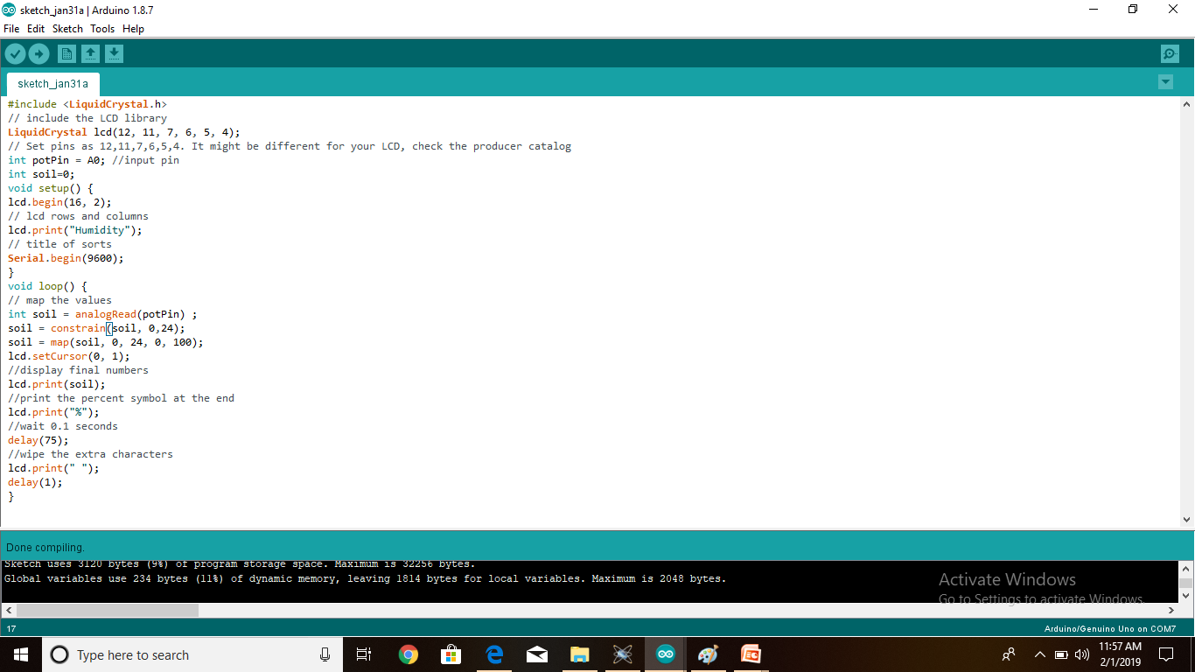
CODING

Slide 12
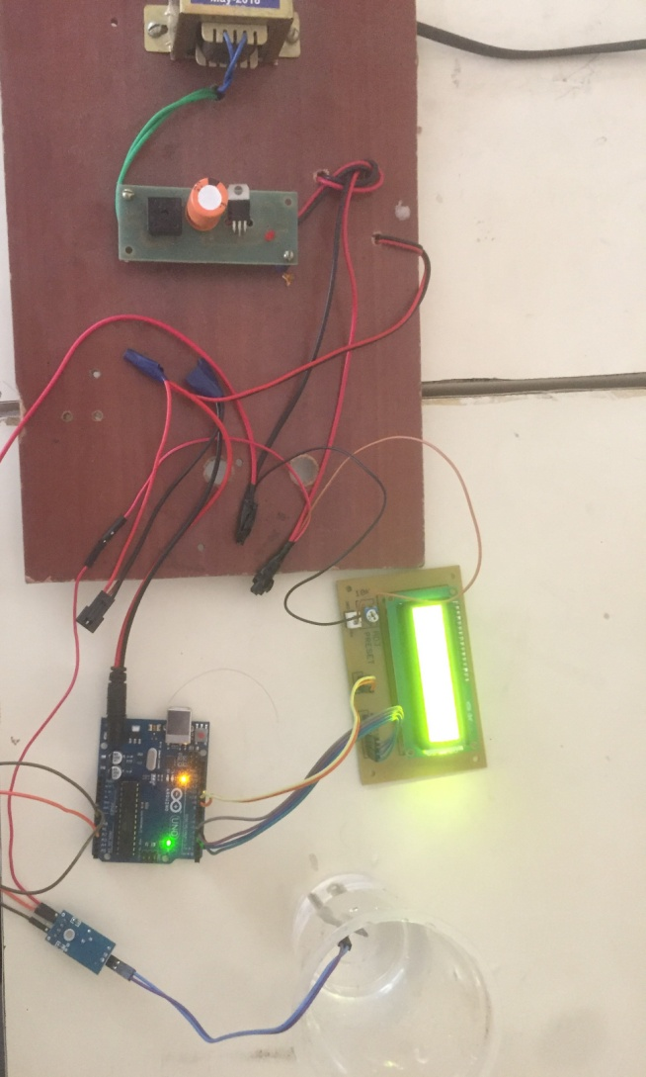
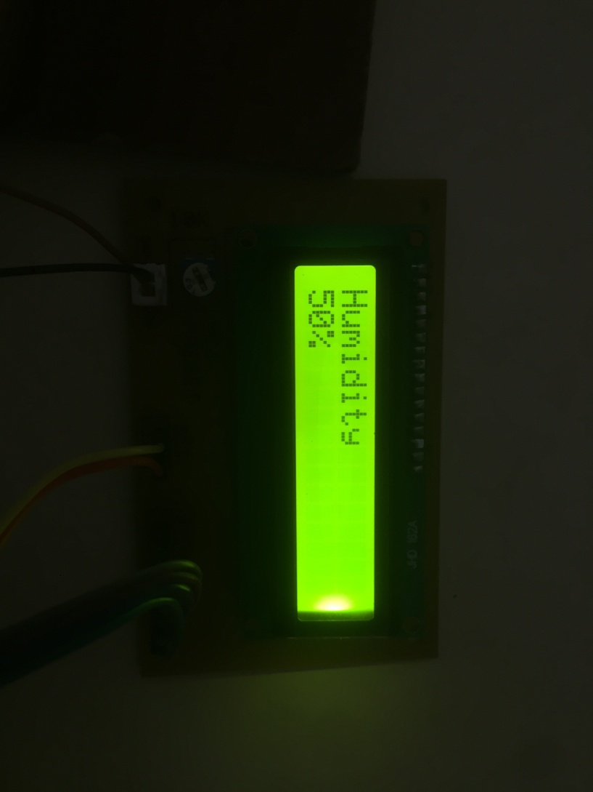
EXECUTED SETUP

Slide 13
REFERENCES
Akash Jain, Suraj Kudre, Mahesh Giri, "A review on smart sensors based monitoring system for agriculture ", IJESR,2014
shylaja, B. srinivas, (2016) “ Design and implementation of agricultural automation through wireless network and GPRS”.
Rafael Munoz Carpena and Michael D. Dukes,“Automatic Irrigation Based on Soil Moisture for Vegetable Crops” IFAS Extension(2018).
Nikesh Gondchwar, R. S. Kawitkar, “IOT based smart agriculture” , International journal Of Advanced research in computer and Communication Engineering (IJARCCE), vol. 5 no. 6, Jun (2018)
2/2/2019
13

Slide 14
THANK YOU

