Slide 1
Learning Basics of Embedded Systems

Slide 2
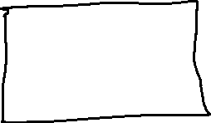










1970- Memory Model of old computers

Slide 3
Memory Model – How 1bit info is stored

Slide 4
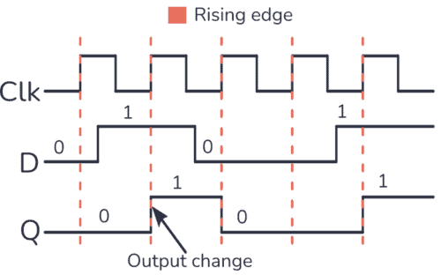








Read and write in D-flipflop

Slide 5






















4 bit Register

Slide 6






DeMux – 8bit FlipFlop - Mux

Slide 7









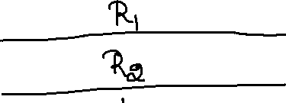












8Bit Register Memory

Slide 8
CPU Model

Slide 9
Von Neuman Architecture

Slide 10


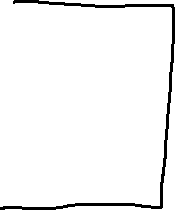




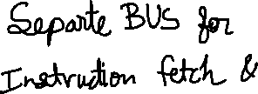





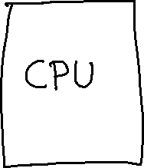
Harvard Architecture

Slide 11
Instruction Fetch Stage

Slide 12






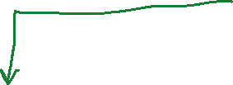










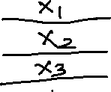

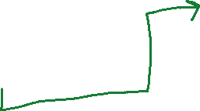

Instruction Processing

Slide 13
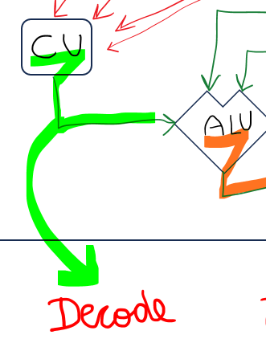







Decode

Slide 14
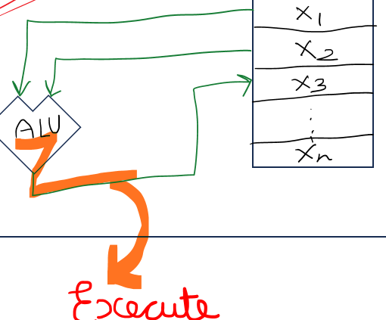






Execute

Slide 15
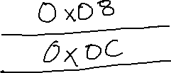
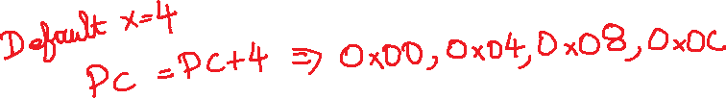




Program Counter

Slide 16
1,2,3

Slide 17





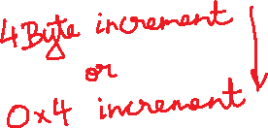






















RV32I

Slide 18






















What are the instruction?

Slide 19




















Slide 20
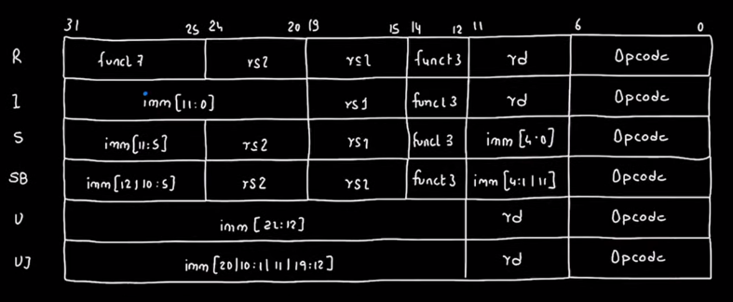
Types of instruction

