Slide 1
Multi-task Computation Offloading and Scheduling in Mobile Edge Cloud Computing Systems
Team Members:
Balaji B 2015115009
Mohammed Hasif M 2015115029
Sarguru K 2015115049
Project Guide:
Dr.M.Vijayalakshmi

Slide 2
INTRODUCTION
The limited CPU processing power and battery lifetime of mobile devices hinder the possible execution of computationally intensive applications.
Computational offloading is a solution to augment system’s capabilities by migrating computation to more resourceful computers (i.e.,servers).
Mobile Edge Cloud Computing (MECC) has becoming an attractive solution.
It exploits the available resources at the network edge thereby eliminating the intensive tasks to be offloaded to a fog node or a remote cloud server.

Slide 3
MOTIVATION
Faster the computation and lower the delay better the user experience.
Efficient utilization by reducing energy consumption and increasing the revenue based on the offloading of the task.
To explore the idle devices and storage resources at the network edge.

Slide 4
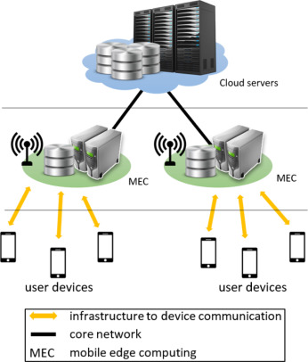
Mobile Edge Cloud Computing

Slide 5
LITERATURE SURVEY

Slide 6
Research papers | Study Purpose | Observation
MULTI-USER MULTI-TASK COMPUTATION OFFLOADING IN GREEN MOBILE EDGE CLOUD COMPUTING. – IEEE TRANSACTIONS ON SERVICES COMPUTING. 2018 | To learn about the multi-user multi-tasking offloading computational framework. Offloading the task from local device to mobile edge. | Distributed Greedy maximal scheduling algorithm is preferred over the Centralized Greedy maximal scheduling algorithm
JOINT OPTIMAL PRICING AND TASK SCHEDULING IN MOBILE CLOUD COMPUTING SYSTEMS. – IEEE TRANSACTIONS ON WIRELESS COMMUNICATION . AUGUST 2017 | The tasks that should be offloaded to cloud and the optimal price of the cloud services. The energy consumption, delay, price of the cloud services in case of mobile users perspective | Queuing delay analysis allowed us to account for both delay-sensitive and delay tolerant applications.
EFFICIENT MULTI-USER COMPUTATION OFFLOADING FOR MOBILE-EDGE CLOUD COMPUTING. -IEEE TRANSACTIONS ON NETWORKING. OCTOBER 2016. | To learn about Green Mobile Edge Cloud Computing. | Efficient computation offloading is achieved in a distributed manner.

Slide 7
Research papers | Study Purpose | Observation
OFFLOADING IN MOBILE EDGE COMPUTING : TASK ALLOCATION AND COMPUTATIONAL FREQUENCY SCALING. - IEEE TRANSACTIONS ON COMMUNICATIONS. AUGUST 2017 | To learn about the optimization framework of offloading from a single devices to multiple edge devices. | Performance can be improved by reducing energy consumption and task’s execution latency.
JOINT OPTIMIZATION OF ENERGY CONSUMPTION AND PACKET SCHEDULING FOR MOBILE EDGE COMPUTING IN CYBER- PHYSICAL NETWORKS. IEEE ACCESS. APRIL 2018 | To learn about the optimal scheduling in mobile edge computing systems. | The queue congestion is minimized by allowing low priority tasks to jump to high priority tasks.
ENERGY- DELAY TRADEOFF FOR DYNAMIC OFFLOADING IN MOBILE- EDGE COMPUTING SYSTEM WITH ENERGY HARVESTING DEVICES. IEEE TRANSACTIONS ON INDUSTRIAL INFORMATICS. OCTOBER 2018 | To study about dynamic tasks assignment in mobile edge cloud computing. | The energy consumption can be minimized by having buffer queue and stable battery energy level.

Slide 8
ARCHITECTURE DIAGRAM

Slide 9
Overall Architecture for multitask computation offloading and scheduling in Mobile Edge Cloud Computing.
Profiler
Application
Application Profiler
Device Profiler
network Profiler
Instance1
Instance1
Instance2
Instance2
Application Partitioning
Offloading
Decision
Scheduler
.
.
offload
.
.
Commun i c a t i on
Hand l e r
Edge Node
Cloud Server
locally
Task Executed locally
Task Output
Mobile Node

Slide 10
DESIGN AND ALGORITHMS

Slide 11
FORMATION OF MOBILE EDGE CLOUD COMPUTING SETUP
Mobile Edge Cloud Computation System setup is formed by integrating Raspberry Pi as mobile edge and the Digital Ocean service as cloud server. (Infrastructure as a service)
The End user’s device is connected to Raspberry Pi through wireless medium and the Raspberry Pi is connected to the cloud server.

Slide 12
APPLICATION PROFILING
The profilers send the various parameters which are required for the offloading decision maker.
The Profiler consists of three profilers namely Device Profiler, Application Profiler and Network profiler which are necessary in making decision for offloading and scheduling. 1.DEVICE PROFILER
Device profiler contains information about battery level, number of CPU Cores, CPU core utilisation and the CPU’s frequency.
It also tells whether the battery is recharging or not, total number of cores available in local device and fog node

Slide 13
APPLICATION PROFILING
2.NETWORK PROFILER
A network profiler collects information about wireless connection status and available bandwidth.
The profiler tracks several parameters for the WiFi and mobile data interfaces including the receiving and transmitting data rate.
3.PROGRAM PROFILER
A program profiler collects characteristics of applications, e.g., the execution time, the memory usage and the size of data.
It gives information on hit ratio, percentage of time taken for each methods.

Slide 14
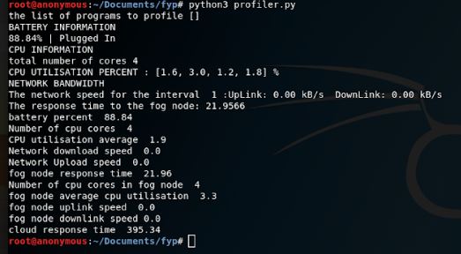
RESULT
Output of Profiler

Slide 15
APPLICATION PARTITIONING
Application partitioning is a technique of splitting the application into separate tasks, while preserving the semantics of the original application.
Method based partitioning will be performed.
Each method in the application is considered as a separate partition.
It takes one or more applications as input and provides a graph based structure.
It provides graph as nodes representing methods and edges representing relations between methods.
Certain methods that cannot be offloaded to the cloud as they can be only done in local device. e.g. method requiring input from sensors in the devices.

Slide 16
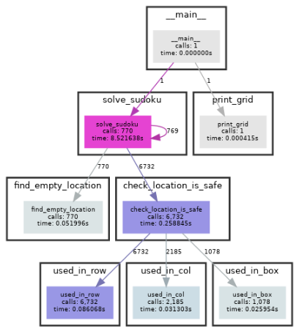
RESULT
A Graphical visualization on the Output of Partitioning of Sudoku Solver Application

Slide 17
OFFLOADING
The tasks which cannot be executed in local node (or) The tasks which are marked as ‘offload’ are copied into a file and transferred for further execution.
OFFLOADING TO MOBILE EDGE
The tasks which can be executed in mobile edge while transferring from local node to the cloud server are offloaded in the edge node itself.
The tasks are offloaded to the Raspberry Pi via network socket.
Execution in mobile edge reduces the transmission delay than executing in cloud server.

Slide 18
OFFLOADING
OFFLOADING TO REMOTE SERVER
The tasks which cannot be executed in either local node or mobile edge are offloaded to the remote server.
The tasks are transferred from mobile edge (Raspberry Pi) to cloud server by scp.
The output of the executed tasks in the cloud server and the mobile edge are transferred back to the local node for integration.

Slide 19
INNOVATION
Providing quality of experience to the user by exploiting the available resources at the network edge.
To make a better offloading and scheduling decision based on the arrival time, amount of workload and delay constraint of the specific job.

Slide 20
THANK YOU

