Slide 1
Multi-task Computation Offloading and Scheduling in Mobile Edge Computing Systems
Team Members:
Balaji B 2015115009
Mohammed Hasif M 2015115029
Sarguru K 2015115049
Project Guide:
Dr.M.Vijayalakshmi

Slide 2
INTRODUCTION
The limited CPU processing power and battery lifetime of mobile devices hinder the possible execution of computationally intensive applications.
Computational offloading is a solution to augment system’s capabilities by migrating computation to more resourceful computers (i.e.,servers).
Mobile Edge Computing (MEC) has becoming an attractive solution.
It exploits the available resources at the network edge thereby eliminating the intensive tasks to be offloaded to a edge node or a remote cloud server.

Slide 3
MOTIVATION
Faster the computation and lower the delay better the user experience.
Efficient utilization by reducing energy consumption and increasing the revenue based on the offloading of the task.
To explore the idle devices and storage resources at the network edge.

Slide 4
LITERATURE SURVEY

Slide 5
Research papers | Study Purpose | Observation
MULTI-USER MULTI-TASK COMPUTATION OFFLOADING IN GREEN MOBILE EDGE CLOUD COMPUTING. – IEEE TRANSACTIONS ON SERVICES COMPUTING. 2018 | To learn about the multi-user multi-tasking offloading computational framework. Offloading the task from local device to mobile edge. | Distributed Greedy maximal scheduling algorithm is preferred over the Centralized Greedy maximal scheduling algorithm
JOINT OPTIMAL PRICING AND TASK SCHEDULING IN MOBILE CLOUD COMPUTING SYSTEMS. – IEEE TRANSACTIONS ON WIRELESS COMMUNICATION . AUGUST 2017 | The tasks that should be offloaded to cloud and the optimal price of the cloud services. The energy consumption, delay, price of the cloud services in case of mobile users perspective | Queuing delay analysis allowed us to account for both delay-sensitive and delay tolerant applications.
EFFICIENT MULTI-USER COMPUTATION OFFLOADING FOR MOBILE-EDGE CLOUD COMPUTING. -IEEE TRANSACTIONS ON NETWORKING. OCTOBER 2016. | To learn about Green Mobile Edge Cloud Computing. | Efficient computation offloading is achieved in a distributed manner.

Slide 6
Research papers | Study Purpose | Observation
OFFLOADING IN MOBILE EDGE COMPUTING : TASK ALLOCATION AND COMPUTATIONAL FREQUENCY SCALING. - IEEE TRANSACTIONS ON COMMUNICATIONS. AUGUST 2017 | To learn about the optimization framework of offloading from a single devices to multiple edge devices. | Performance can be improved by reducing energy consumption and task’s execution latency.
JOINT OPTIMIZATION OF ENERGY CONSUMPTION AND PACKET SCHEDULING FOR MOBILE EDGE COMPUTING IN CYBER- PHYSICAL NETWORKS. IEEE ACCESS. APRIL 2018 | To learn about the optimal scheduling in mobile edge computing systems. | The queue congestion is minimized by allowing low priority tasks to jump to high priority tasks.
ENERGY- DELAY TRADEOFF FOR DYNAMIC OFFLOADING IN MOBILE- EDGE COMPUTING SYSTEM WITH ENERGY HARVESTING DEVICES. IEEE TRANSACTIONS ON INDUSTRIAL INFORMATICS. OCTOBER 2018 | To study about dynamic tasks assignment in mobile edge cloud computing. | The energy consumption can be minimized by having buffer queue and stable battery energy level.

Slide 7
ARCHITECTURE DIAGRAM

Slide 8
Overall Architecture for multitask computation offloading and scheduling in Mobile Edge Computing.
Profiler
Application
Application Profiler
Device Profiler
network Profiler
Instance1
Instance1
Instance2
Instance2
Application Partitioning
Offloading
Decision
offload
Scheduler
Commun i c a t i on
Hand l e r
Cloud Server
locally
Edge Node
Task Executed locally
Task Output
Mobile Node

Slide 9
DESIGN AND ALGORITHMS

Slide 10
FORMATION OF MOBILE EDGE CLOUD COMPUTING SETUP
Mobile Edge Cloud Computation System setup is formed by integrating laptop as edge node and the Digital Ocean service as cloud server. (Infrastructure as a service)
The End user’s device is connected to edge node through wireless medium and the edge node is connected to the cloud server.

Slide 11
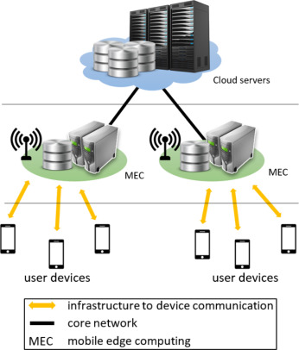
Mobile Edge Cloud Computing

Slide 12
PROFILING
The profilers send the various parameters which are required for the offloading decision maker.
The Profiler consists of three profilers namely Device Profiler, Application Profiler and Network profiler which are necessary in making decision for offloading and scheduling. 1.DEVICE PROFILER
Device profiler contains information about battery level, number of CPU Cores, CPU core utilisation and the CPU’s frequency.
It also tells whether the battery is recharging or not, total number of cores available in local device and edge node.

Slide 13
PROFILING
2.NETWORK PROFILER
A network profiler collects information about wireless connection status and available bandwidth.
The profiler tracks several parameters for the WiFi and mobile data interfaces including the receiving and transmitting data rate.
3.PROGRAM PROFILER
A program profiler collects characteristics of applications, e.g., the execution time, the memory usage and the size of data.
It gives information on hit ratio, percentage of time taken for each methods.

Slide 14
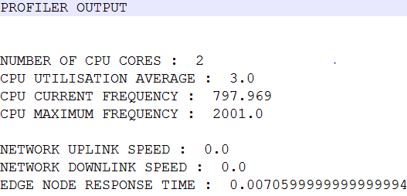
OUTPUT OF PROFILER

Slide 15
APPLICATION PARTITIONING
Application partitioning is a technique of splitting the application into separate tasks, while preserving the semantics of the original application.
Method based partitioning will be performed.
Each method in the application is considered as a separate partition.
It takes one or more applications as input and provides a graph based structure.
It provides graph as nodes representing methods and edges representing relations between methods.
It gives the list of methods in the Sudoku program and also the list of methods that may be offloaded.

Slide 16
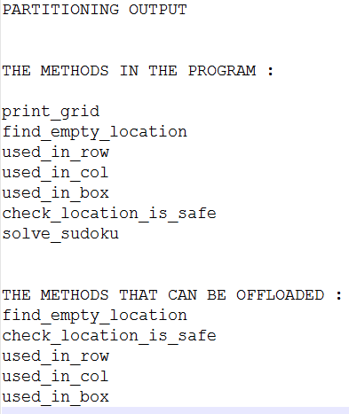
OUTPUT OF PARTITIONING

Slide 17
OFFLOADING DECISION MAKING
The decision maker use Random forest classifier to predict the location of execution of methods.
It takes input as methods execution time, network status, CPU frequency from Profiler and gives the two list of methods.
One list contain the methods to be executed locally.
Another contain the methods to be offloaded.
The tasks are offloaded to the edge node via network socket.

Slide 18
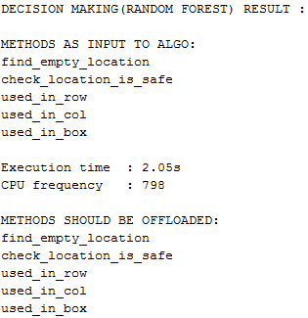
OUTPUT OF DECISION MAKER

Slide 19
OFFLOADING
The tasks which cannot be executed in local node (or) the tasks which are marked as ‘offload’ are copied into a file and transferred for further execution.
OFFLOADING TO MOBILE EDGE
The tasks which can be executed in edge node while transferring from local node to the cloud server are offloaded in the edge node itself.
The tasks are offloaded to the edge node via network socket.
Execution in edge node reduces the transmission delay than executing in cloud server.

Slide 20
OFFLOADING
OFFLOADING TO REMOTE SERVER
The tasks which cannot be executed in either local node or mobile edge are offloaded to the remote server.
The tasks are transferred from edge node to cloud server by socket.
The output of the executed tasks in the cloud server and the mobile edge are transferred back to the local node for integration.

Slide 21
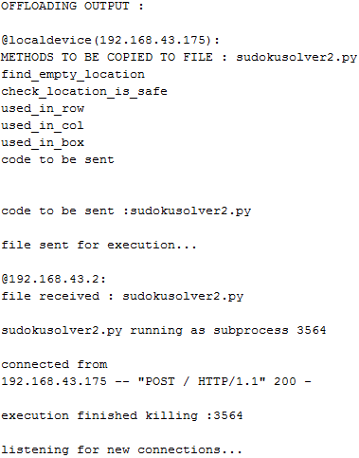
OUTPUT OF OFFLOADING

Slide 22
SCHEDULING
DGMS is used to schedule the tasks which are to be offloaded to edge devices based on edge device’s CPU utilization and network bandwidth between local device and edge device.
Four way Handshaking
The local node broadcasts the offloading request to nearby edge devices.
The edge nodes which received the request reply with its CPU frequency, bandwidth, etc.
The local node selects a edge node based on the highest parameter and send ‘ok’ message.
It also send ‘reject’ message to remaining edge devices.
The edge device which received ‘ok’ message will send ‘Ready’ to receive message to that local node.

Slide 23
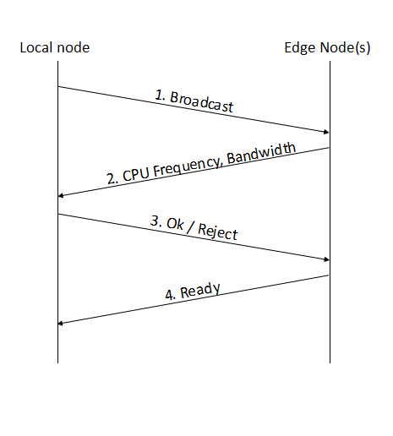
4 way Handshanking

Slide 24
INNOVATION
Providing quality of experience to the user by exploiting the available resources at the network edge.
Reduces the battery usage of local machine.
Increases the CPU Utilization of edge devices.

Slide 25
THANK YOU

