Slide 1

Customer Shopping Behavior Analysis
This project analyzes customer shopping behavior using transactional data from 3,900 purchases across various product categories. The goal is to uncover insights into spending patterns, customer segments, product preferences, and subscription behavior to guide strategic business decisions.

Slide 2
DATASET OVERVIEW
Dataset Summary & Structure
The dataset contains 3,900 rows and 18 columns capturing customer demographics, purchase details, and shopping behavior. Missing data was limited to 37 values in the Review Rating column.
Customer Demographics
Purchase Details
Shopping Behavior
Age, Gender, Location, Subscription Status
Item, Category, Amount, Season, Size, Color
Discount, Promo Code, Previous Purchases, Frequency, Review Rating, Shipping Type

Slide 3

Exploratory Data Analysis in Python
We began with data preparation and cleaning in Python. The dataset was imported using pandas, with df.info() and .describe() used for initial exploration and summary statistics.
Missing values in the Review Rating column were imputed using the median rating of each product category. Columns were renamed to snake case for readability. Feature engineering created age_group and purchase_frequency_days columns. We verified that discount_applied and promo_code_used were redundant, dropping the latter. The cleaned DataFrame was then loaded into PostgreSQL for SQL analysis.

Slide 4
KEY METRICS
Dataset at a Glance
3,900
$59.76
Total Purchases
Avg Purchase Amount
Transactional records analyzed
Across all transactions
44
3.75
Avg Customer Age
Avg Review Rating
Range: 18–70 years
Scale: 2.5–5.0

Slide 5
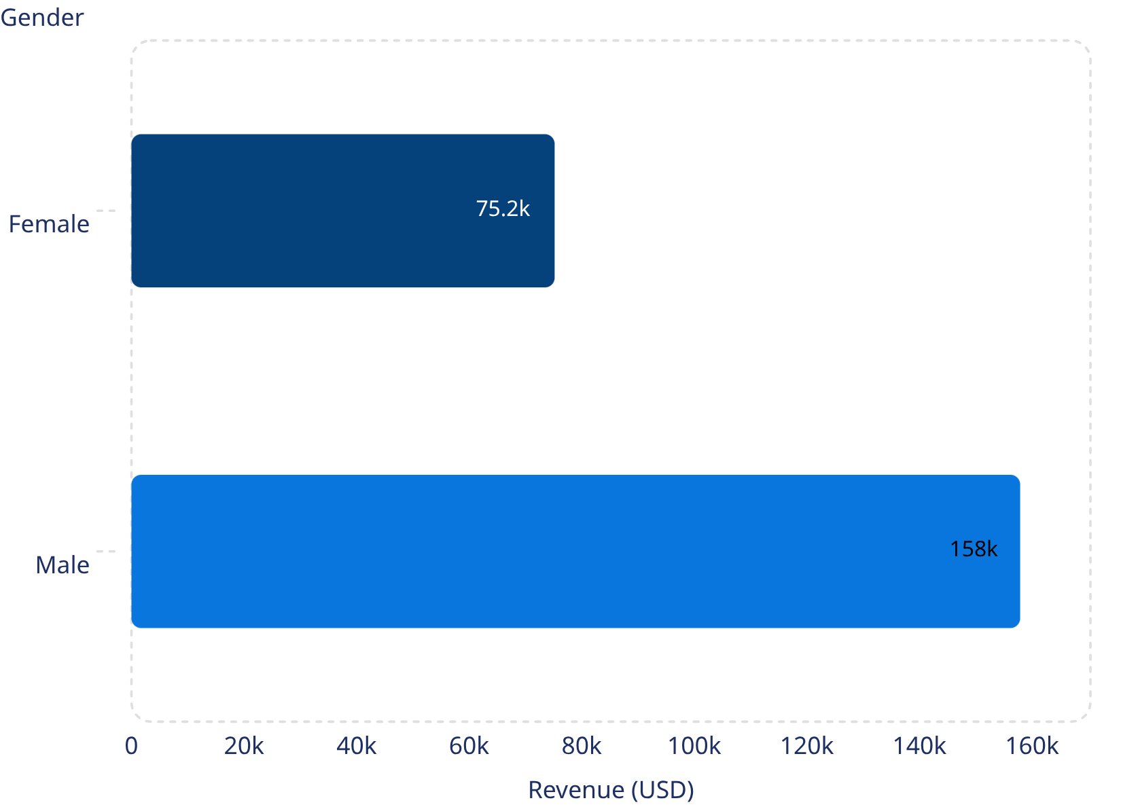
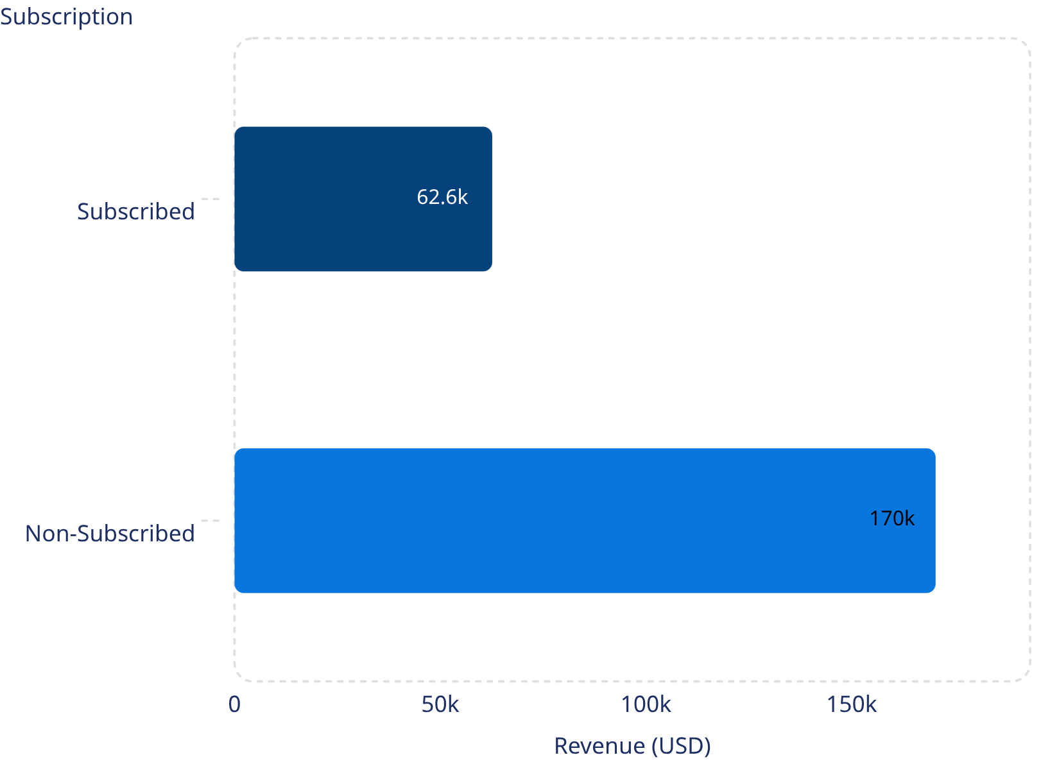
Revenue by Gender & Subscription Status
Male customers generated $157,890 in revenue, more than double the $75,191 from female customers.
Non-subscribers drove $170,436 in revenue across 2,847 customers, while 1,053 subscribers contributed $62,645.

Slide 6
Top-Rated Products & Discount-Dependent Items
Top 5 Products by Rating
Top 5 Discount-Dependent Products
Product
Avg Rating
Product
Discount Rate (%)
Gloves
3.86
Hat
50.00
Sandals
3.84
Sneakers
49.00
Boots
3.82
Coat
49.00
Hat
3.80
Sweater
48.00
Skirt
3.78
Pants
47.00
Gloves lead in customer satisfaction at 3.86, while Hats are the most discount-dependent at 50% — suggesting promotions heavily drive their sales.

Slide 7

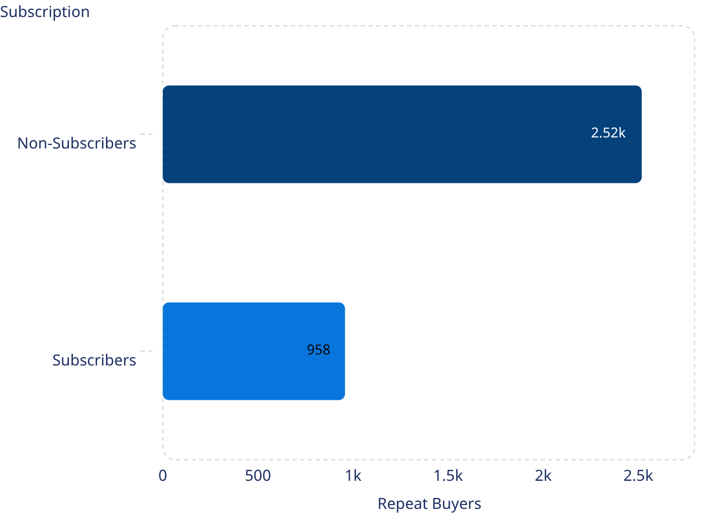


Customer Segmentation & Repeat Buyers
Repeat Buyers & Subscriptions
Among customers with more than 5 purchases, 2,518 are non-subscribers while 958 are subscribers — indicating repeat purchases do not strongly correlate with subscription uptake.
80%
Loyal Customers
3,116 customers
18%
Returning
701 customers
2%
New
83 customers

Slide 8
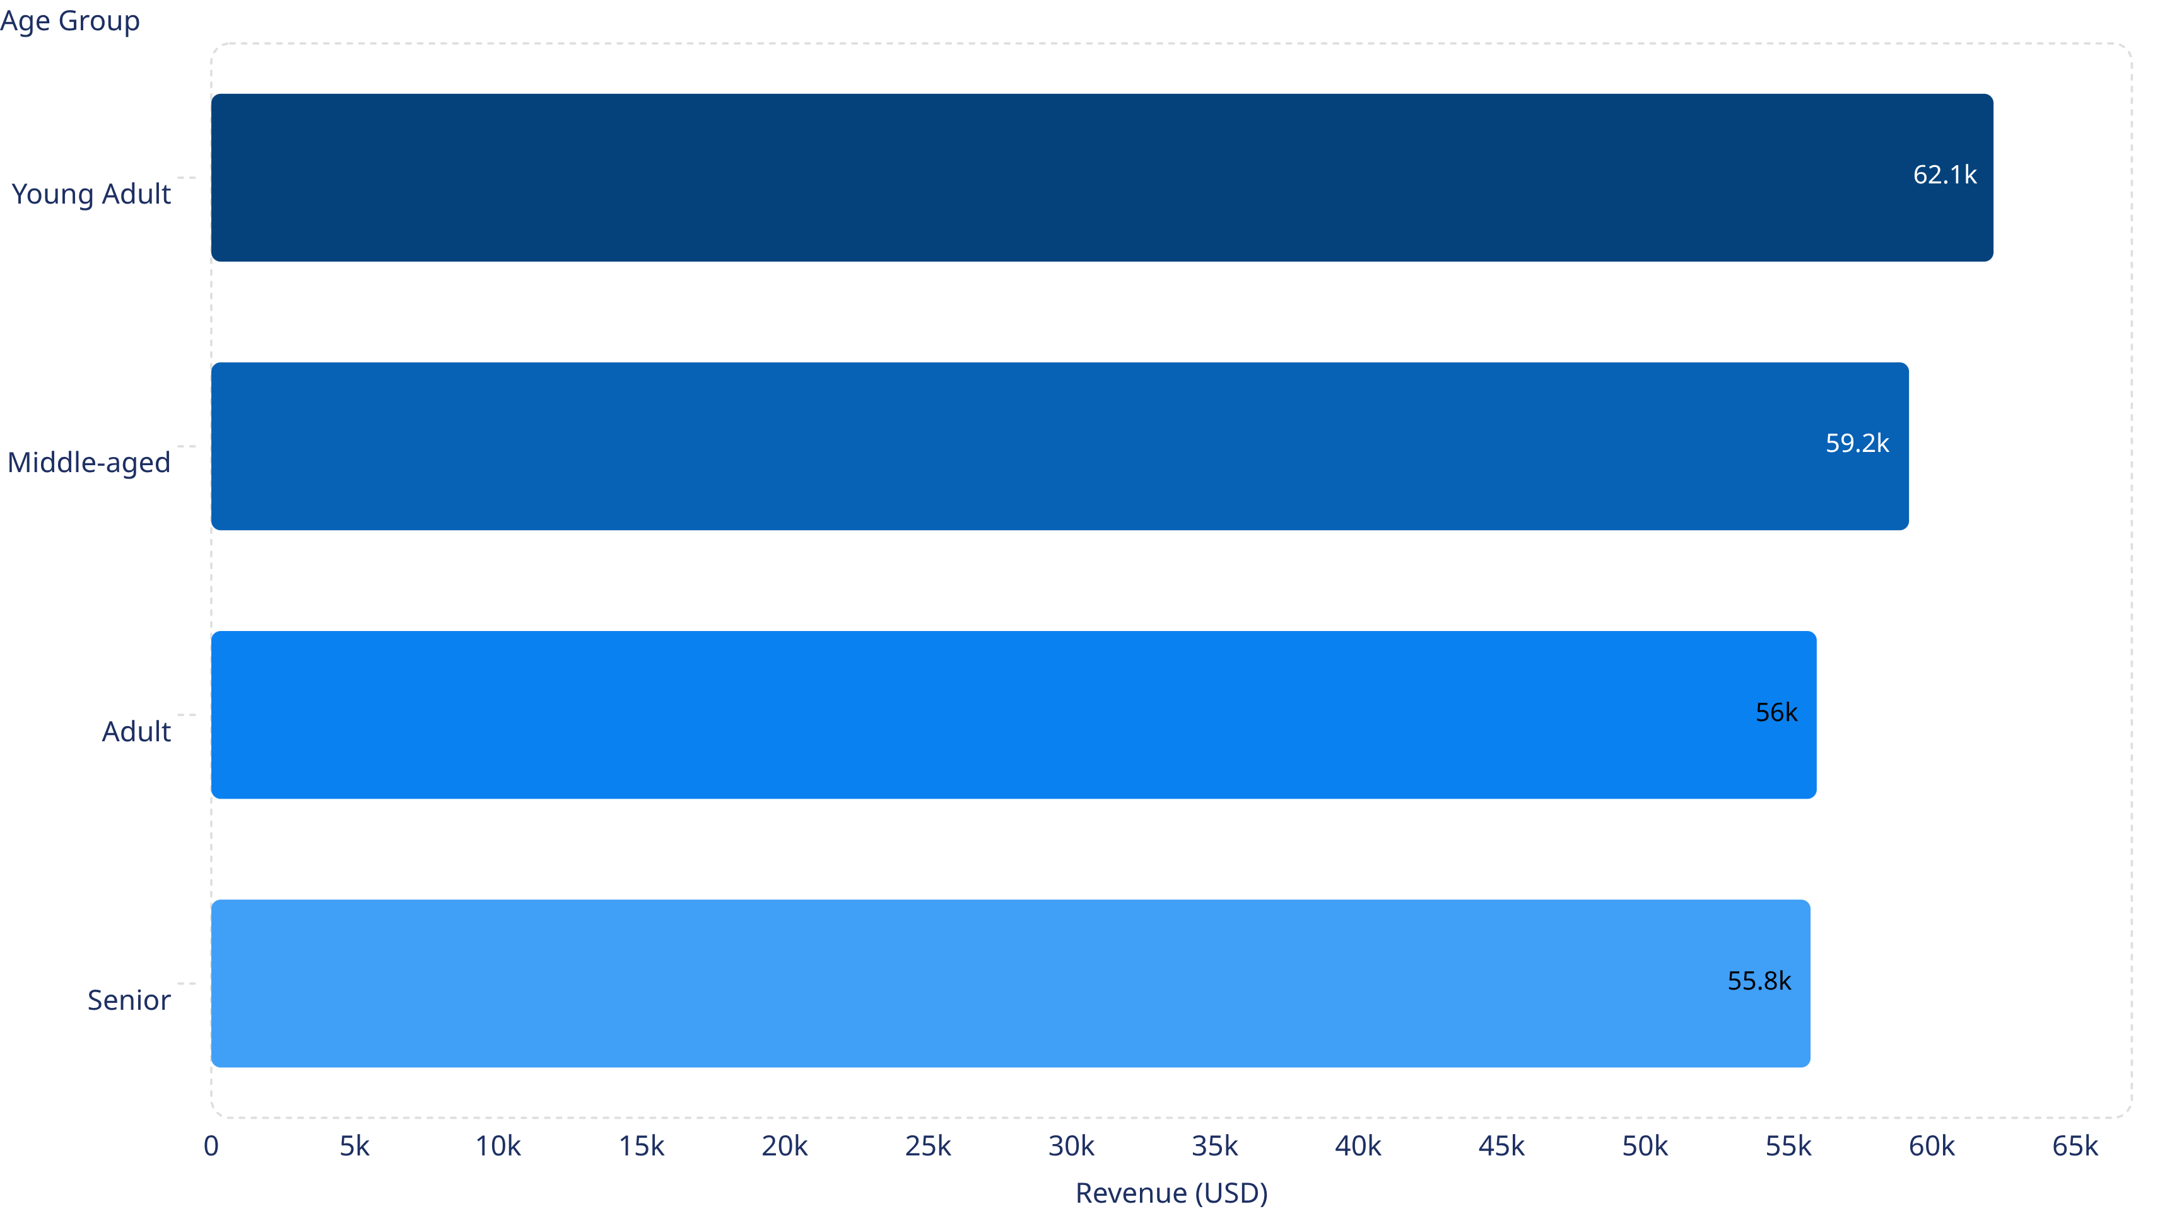
Revenue by Age Group
Young Adults lead in revenue contribution at $62,143, followed closely by Middle-aged customers at $59,197. The spread across age groups is relatively narrow, with Seniors contributing $55,763.

Slide 9

Power BI Dashboard
We built an interactive dashboard in Power BI to present insights visually. The dashboard features a donut chart for subscriber status (1.05K subscribed vs. 2.85K non-subscribed), revenue and sales breakdowns by category, and revenue and sales by age group.
Key headline metrics displayed include 3.9K total customers, $59.76 average purchase amount, and a 3.75 average review rating. Interactive filters allow slicing by gender, category, and shipping type.

Slide 10

STRATEGIC RECOMMENDATIONS
Business Recommendations
Boost Subscriptions
Customer Loyalty Programs
Review Discount Policy
Promote exclusive benefits for subscribers to increase the 27% subscription rate.
Reward repeat buyers to move them into the "Loyal" segment and increase retention.
Balance sales boosts with margin control, especially for high-discount products like Hats.
Product Positioning
Targeted Marketing
Highlight top-rated and best-selling products in marketing campaigns.
Focus efforts on high-revenue age groups like Young Adults and express-shipping users.

