Slide 1
AWS PROJECT
Building Telegram Bot Using Aws Serverless

Slide 2
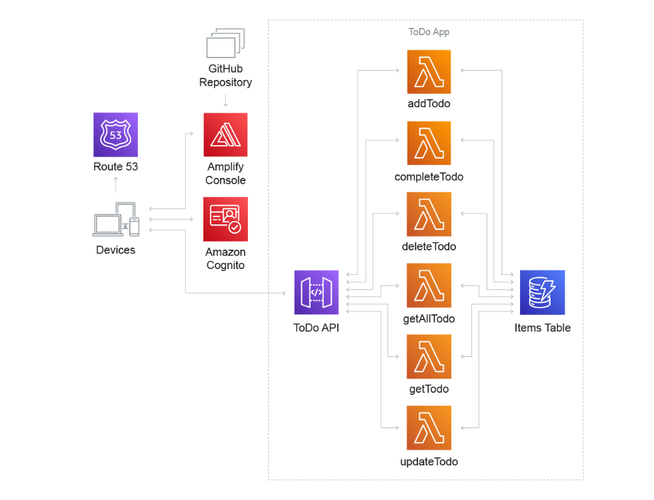
AWS offers technologies for running code, managing data, and integrating applications, all without managing servers. Serverless technologies feature automatic scaling, built-in high availability, and a pay-for-use billing model to increase agility and optimize costs. These technologies also eliminate infrastructure management tasks like capacity provisioning and patching, so you can focus on writing code that serves your customers. Serverless applications start with AWS Lambda, an event-driven compute service natively integrated with over 200 AWS services and software as a service (SaaS) applications.

Slide 3
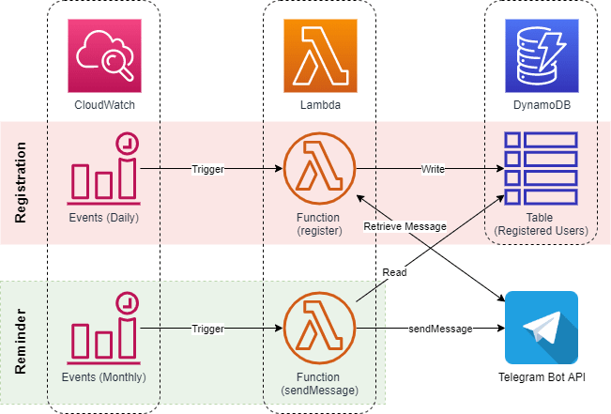
Telegram Bot Integration
Step 1: Create a Telegram Bot with Botfather
Following the Telegram bot guide, you start by looking for @botfather in Telegram and following the instructions to create a new bot. Give your bot a meaningful name, description and profile picture.
Take note of the token that Botfather assigns to you; it will be required for your Lambda functions to call your bot API.
Next click on the link for your new bot generated above (t.me/##yourbotname##) and start a conversation. Text "Hi“
Once you send a message to the bot, the chat will get an ID which will be used for the conversation. To retrieve the ChatID, we will use the Telegram API.
Replace your TOKENid below and call the below URL https://api.telegram.org/bot##yourTOKENid##/getUpdates

Slide 4
Step 2: Attach telegram bot to API gateway
Go to AWS Console -> AWS Lambda -> Click on 'Create Function’
Now, give a valid function name and select the suitable runtime, then go to advance setting and select the checkbox of 'Enable Function URL' and 'None' for the IAM setting (This is great feature and elimiates API Gateway setting altogether), keep rest settings as default and click on 'Create Function'. I chose python in this case
When the sample function is created. Copy the Function URL and open it in a new tab. You should get a response as below. If you are getting unauthorize error, then recheck if you had selected 'None' in function URL which ensures unathenticated access.
It's best practice to define the secure information as Environment Variable (or for advanced uses you can use other secure stores). Go to 'Configuration' tab and click on 'Environment Variables' and add 2 variables 'TOKEN' = Value is ##yourTOKENid## 'CHATID' = Value is ##yourCHATid## (In future, we can retrieve chatid from request to make it dynamic)
Now we will add the functionality to send the message via Lambda. For python, this usually requires importing 'requests' module which is not available out of the box. Hence, for this, we will choose to create a layer in Lambda which will host this library.
Now, update your lambda function with the below code:
import json
import requests
TELE_TOKEN='5915574989:AAH47-Z-zJi7UryCbCVTphkdBzPmvf_hos4’
URL = "https://api.telegram.org/bot{}/".format(TELE_TOKEN)
def send_message(text, chat_id):
final_text = "You said: " + text
url = URL + "sendMessage?text={}&chat_id={}".format(final_text, chat_id)
requests.get(url)
def lambda_handler(event, context):
body=json.loads(event['body'])
chat_id = body['message']['chat']['id']
reply = body['message']['text']
send_message(reply, chat_id)
return { 'statusCode': 200
}

Slide 5
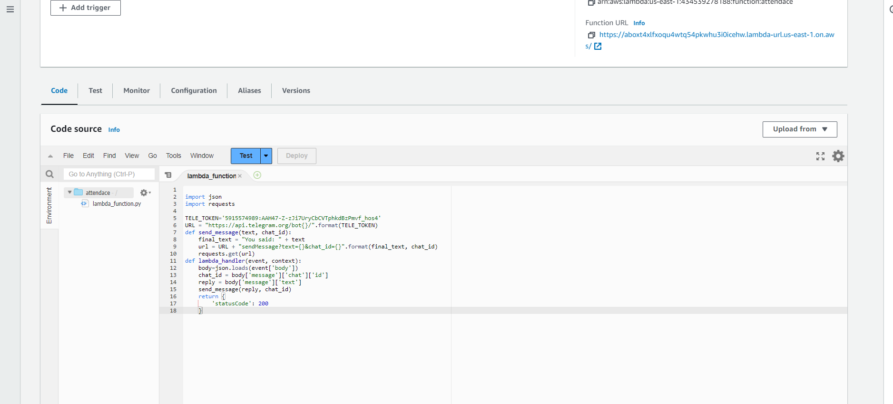

Slide 6
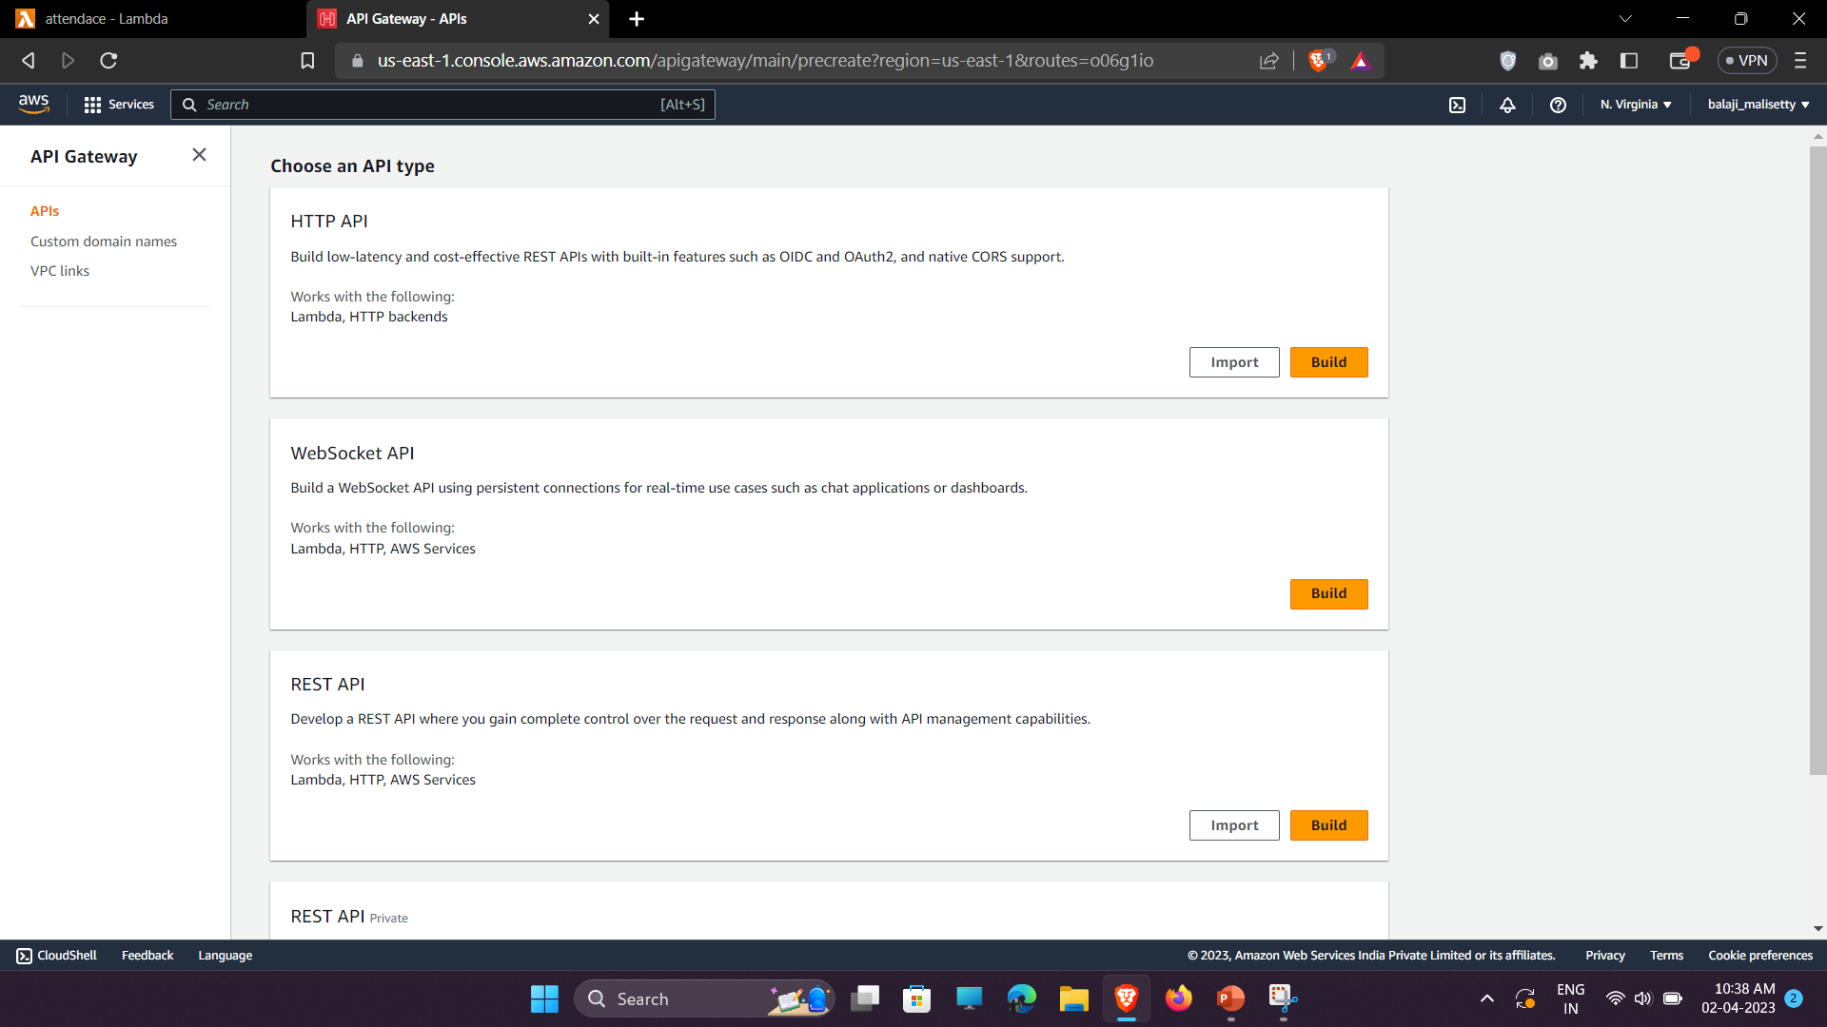
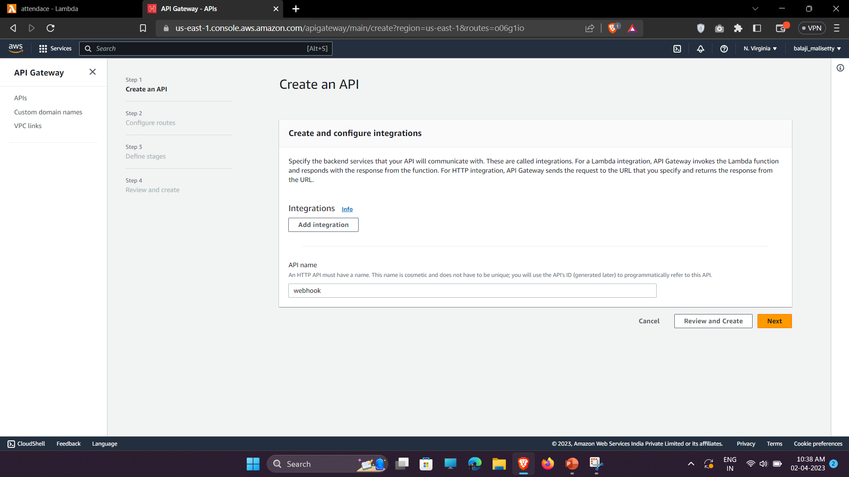
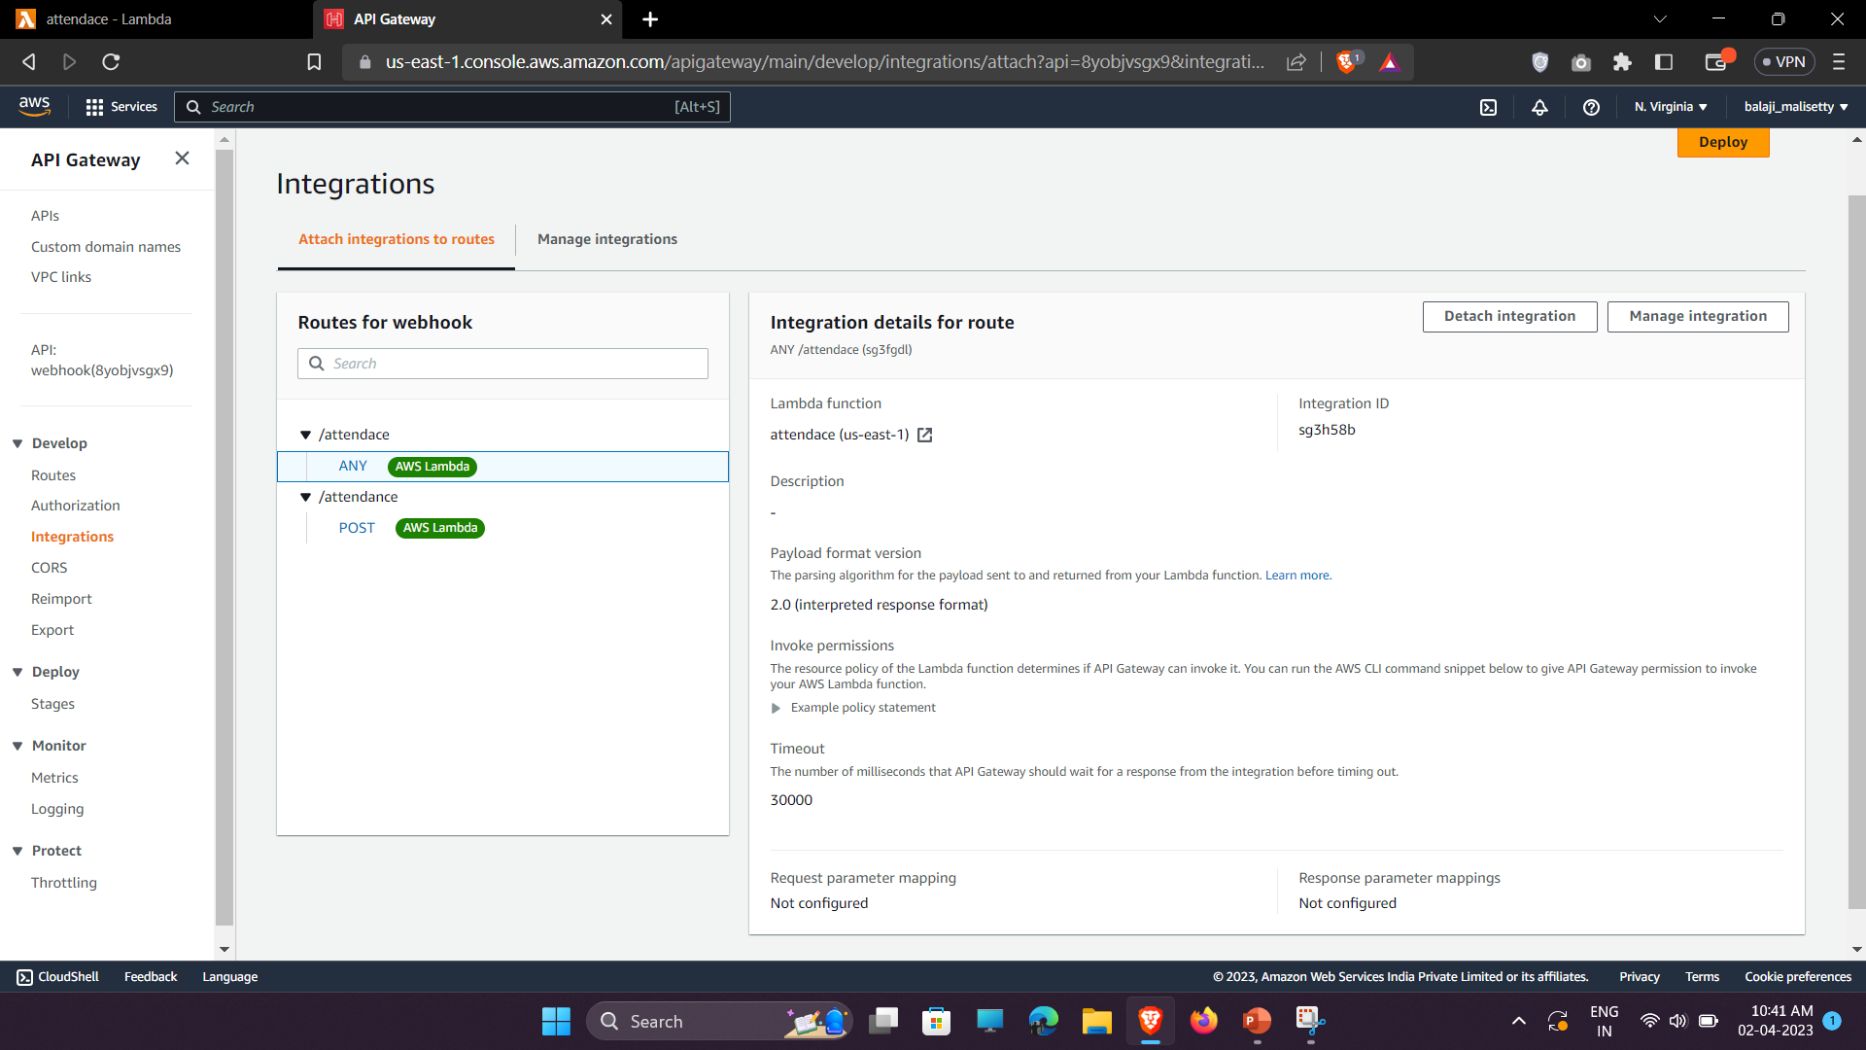
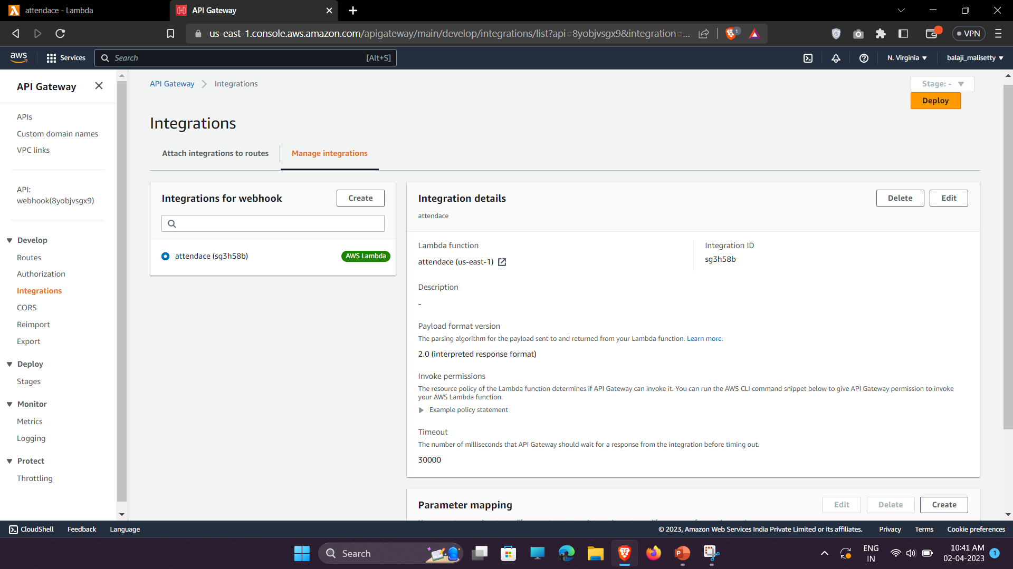
Step 3: Create a webhook

