Slide 1
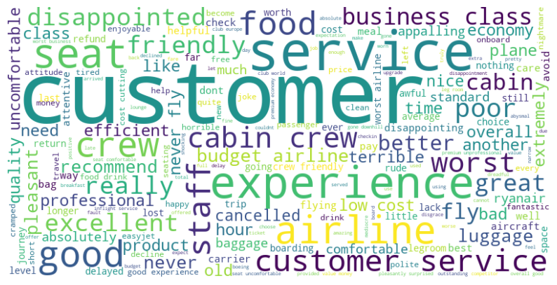
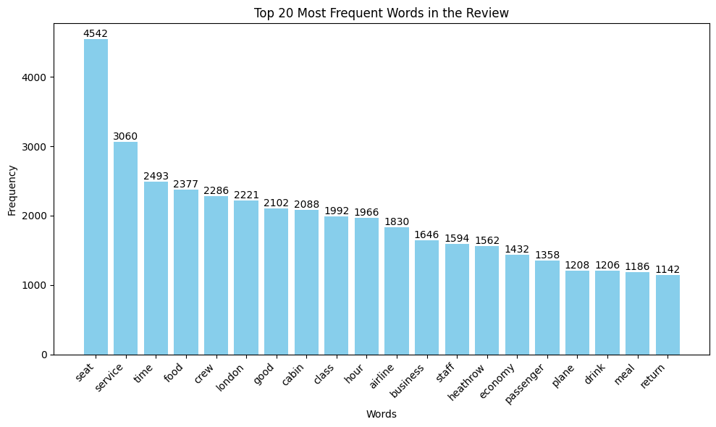
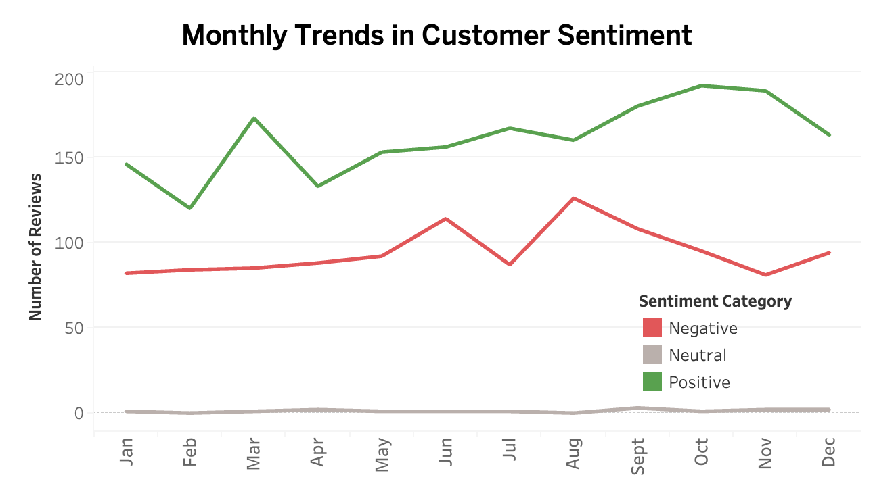
Airlines should focus on enhancing customer service consistency across different classes, with key improvements needed in baggage handling, seat comfort, inflight experience, and timeliness to boost passenger satisfaction
4.69 average rating
Friendly, efficient cabin crew praised frequently
BRITISH AIRWAYS
Majority Positive: Reviews are mostly positive, with fluctuations during peak travel months.
Service Improvements: Negative reviews decrease toward year-end, suggesting better service.
Mid-Year Challenges: June's mixed feedback hints at operational or seasonal challenges.
3804 reviews
over 14 years
from 72 countries

