Slide 1
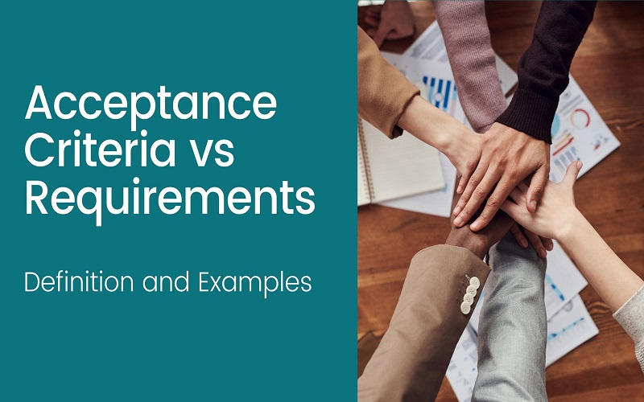
Agile Requirements and acceptance criteria
Ajay k Santhosh
Balaji AM
Tyma TM

Slide 2
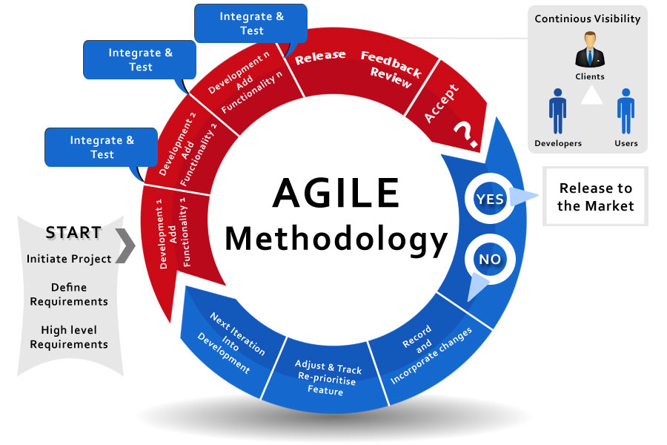
Introduction
Requirements
Acceptance criteria

Slide 3
Requirements
Agile requirements management
Communication and its role in agile requirements
Communication between departments
Communication with client
The requirements backlog
Agile requirements management tools
Asana
Justinmind
JIRA
Notes:
the classic way of gathering and managing requirements, the client works closely with the team on the first few steps of the project. Mostly, this is to ensure that the team understands the client’s business and business requirements for the project. Ultimately, the design team sticks to the client like glue at first but only until that first stage of the project is done. Once the requirements are gathered and understood, many clients simply wait for a more refined presentation of the finished design further down the line.
n the agile way, everything is organized in short sprints – and at the end of each sprint, the client participates in validating the design and seeing the progress made. In that sense, there is still a defined structure to the workflow – but that structure itself allows flexibility and adaptability. From one sprint to the other, a lot of things may change.
Communication between departments
Allows more interactive and efficient project
Allows for realistic requirement and avoid unpleasant surprises
It helps us to achieve solid final product
Communication with client
Customer involvement throughout the project helps to……
Improve communication –avoid misunderstanding and blind spots
Comfortable and fluid – take pressure of the team and allow room for errors
Best and solid result – final project require less revision and satisfy all parties
The requirements backlog
Each record can be written in user stories
User stories should be short and functionality oriented
Each story should be able to add links to more documentation

Slide 4
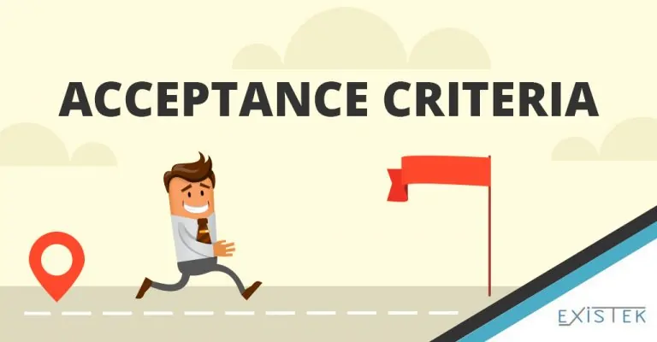
Acceptance criteria
What is Acceptance Criteria?
“Definition of done”.

Slide 5
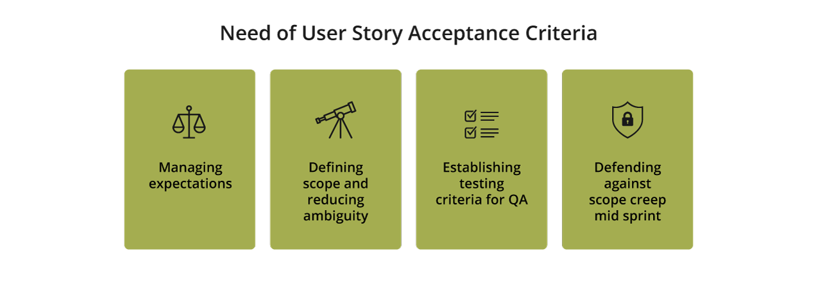
Why do you need User Story Acceptance Criteria?

Slide 6
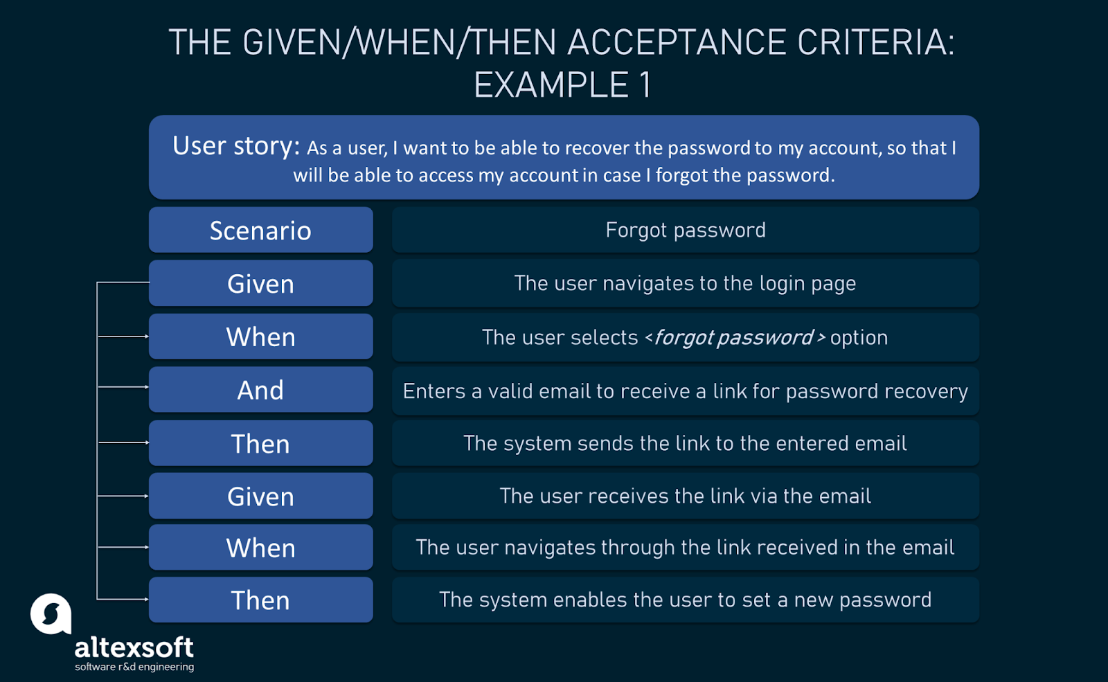
Acceptance criterion types and structures
Scenario oriented.
Rule oriented.
Custom formats.

Slide 7
THANKS

