Slide 1

Agile Requirements and acceptance criteria
Ajay k Santhosh
Balaji AM
Tyma TM

Slide 2
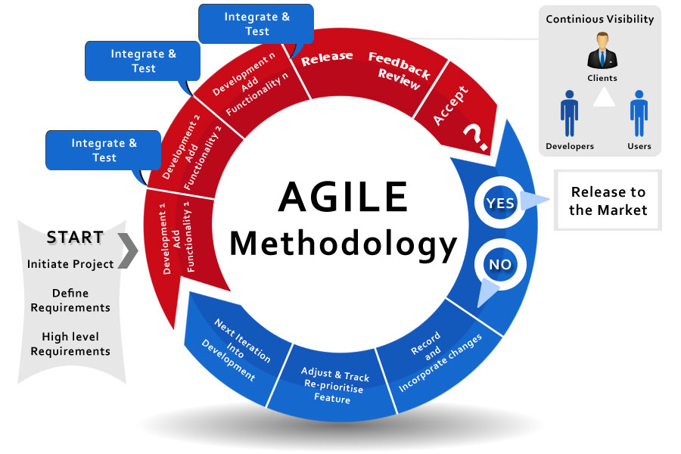
Introduction
Requirements
Acceptance criteria

Slide 3
Requirements
What is agile requirements management?
Agile requirements management tools
Asana
Justinmind
JIRA

Slide 4
Requirement Analysis
Functional Requirements
Non functional requirements

Slide 5

Acceptance criteria
What is Acceptance Criteria?
“Definition of done”.

Slide 6
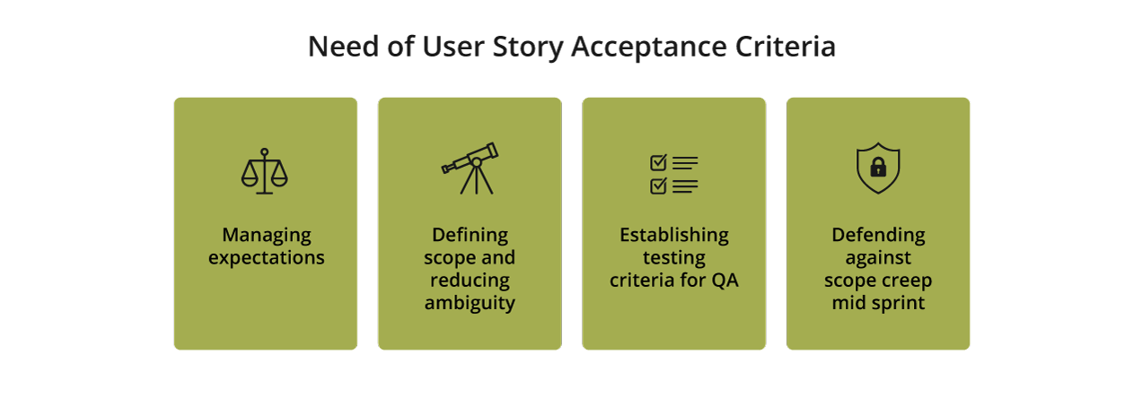
Why do you need User Story Acceptance Criteria?

Slide 7
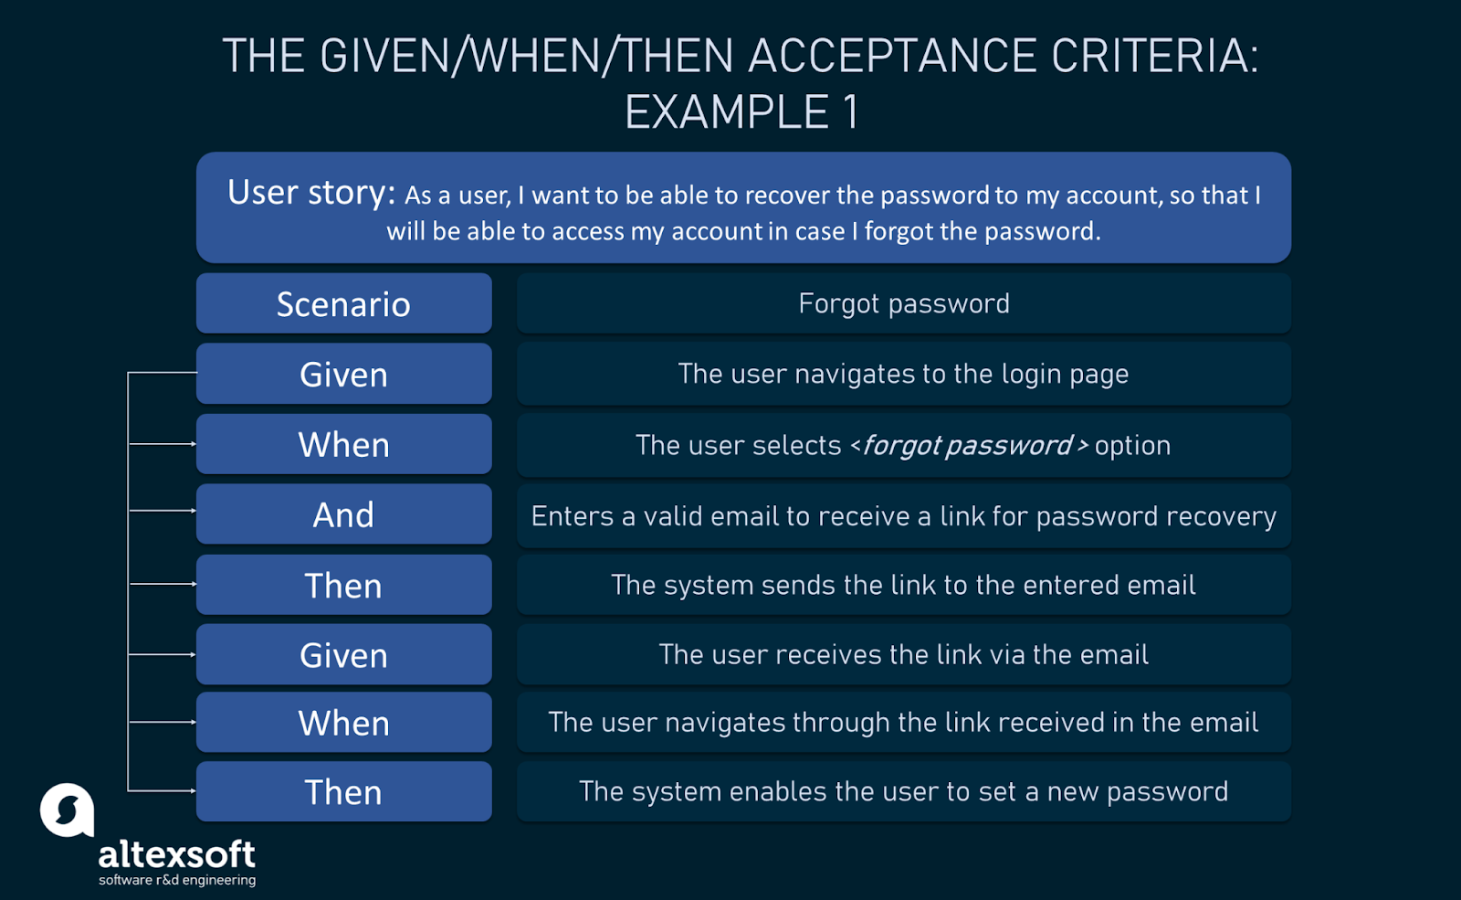
Acceptance criterion types and structures
Scenario oriented.
Rule oriented.
Custom formats.

Slide 8
THANKS

