Slide 1
Overview Bioinformatics Applications (PLPTH813)
Welcome to Bioinformatics Applications 2017 Spring
Sanzhen Liu
1/19/2017

Slide 2
Course materials are online
http://tinyurl.com/bioinfo-app
Course information
Lecture slide files
Labs slide files

Slide 3
Goal
Goal of the course
PLPTH813 will cover the basic principle of regular bioinformatics applications and emphasize the practice of bioinformatics.
The ultimate goal of this course is to help you to be prepared for next-generation biological research that often generates large data and requires researchers to have the capability in data management and data mining.

Slide 4
Lecture topics
Basic Unix
Basic R
Introduction of NGS and NGS bioinformatics tools
DNA sequence alignment
Genome variants
Phylogeny
Construction of a genetic map
QTL and GWAS
RNA-Seq and RNA-Seq assembly
Identification of differential expression via RNA-Seq
Genome assembly

Slide 5
Grading and schedule
Grading
Class participation 10%, Homework 30%, Midterm Exam 20%, Paper presentation 5%, Project 10%, Final Exam 25%
Schedule
Homework: ~6 times
Paper presentation
three topics: GWAS, RNA-Seq, Genome assembly
Midterm exam: 3/16
Final exam: the week of 5/11
Oral project presentation
Office hours
Tuesday 1-2pm @ 4022B Throckmorton Plant Sciences Center

Slide 6
Projects
A project requiring the skills for data analysis
Examples:
1. your own project (e.g., RNA-Seq or genome assembly)
2. A survey of several software packages (e.g., genotype imputation)
3. Implementation of a classical study through re-analysis (need a good justification)
Oral presentation: each project 15-20 min

Slide 7
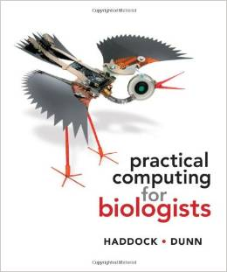
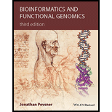
References
Papers
Online resources (e.g., Wikipedia)
Practical computing for biologists, Haddock and Dunn, 2010
Bioinformatics and Functional Genomics, Pevsner, 2015

Slide 8
Lecture: 10:30am-11:20pm, Tuesday, Thursday
Lab: 12:30-3:00pm (typically finished in 2 hours), Thursday
Office hours: 3:00am-4:00pm Wednesday

