Slide 1
Attrition and Monthly Income Prediction Models
Balaji Avvaru

Slide 2
Overview
Data Description
Explanatory Data Analysis
Attrition Classification
Classify employees whether they are likely to quit or not
Observe attrition patterns based on Job Role
Monthly Income Prediction
Predict Monthly Income based on various employee attributes

Slide 3
Data Description
We have been provided 870 employee records with 36 columns
For the purposes of classification of whether or not an employee is likely to quit, we use the column “Attrition”
The dataset is unbalanced based on Attrition:
No: 730 records
Yes: 140 records
For modeling, we have balanced the data by upsampling such that we have an equal number (730) of records for each classification
We have several other variables such as: Age, Business Travel, DailyRate, Department, DistanceFromHome, Education, …

Slide 4
Explanatory Data Analysis
We can eliminate 3 columns due to them having the same value for every row: -
Over18 (‘Y’ in every row)
EmployeeCount (‘1’ in every row)
StandardHours (‘80’ in every row)
We also see that there are numerous variables seen as integers which should actually be seen as factors, or categorical. Converted below numerical variables as factors.
Education EnvironmentSatisfaction
JobInvolvement JobLevel
JobSatisfaction PerformanceRating
RelationshipSatisfaction StockOptionLevel
TrainingTimesLastYear WorkLifeBalance

Slide 5
Explanatory Data Analysis Cont…
Factors with Strongest Impact on Attrition (Chi-Squared test, alpha = 0.05)
Overtime (p = 1.024e-15)
Stock Option Level (p = 3.724e-12)
Job Involvement (p = 5.211e-09)
Job Level (p = 2.085e-08)
Marital Status (p = 3.379e-08)
No Significant Impact (Chi-Squared test, alpha = 0.05)
Gender, Education, Daily/Hourly Rate, Monthly Income, Performance Rating, Relationship Satisfaction, and Time Allotted for Training

Slide 6
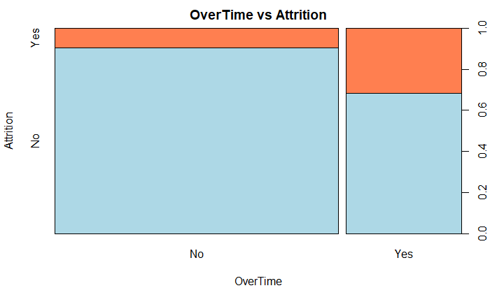
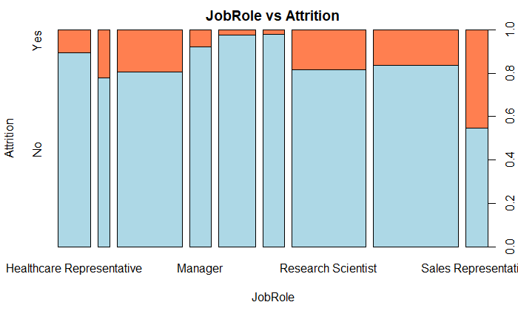
EDA Cont…

Slide 7
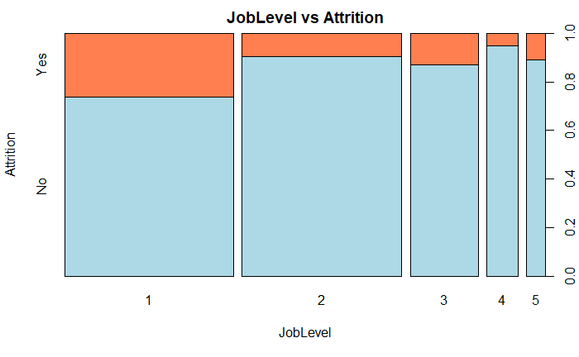
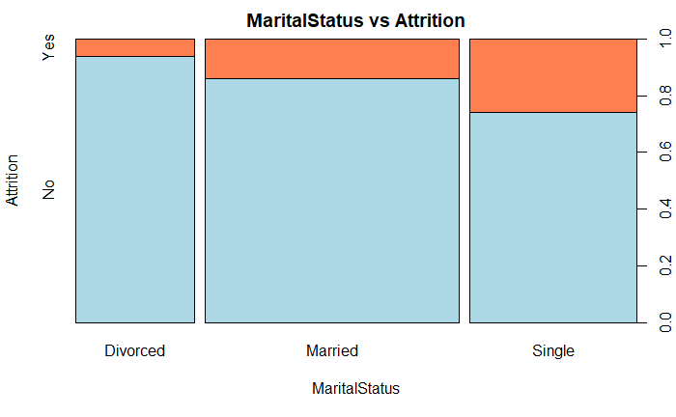
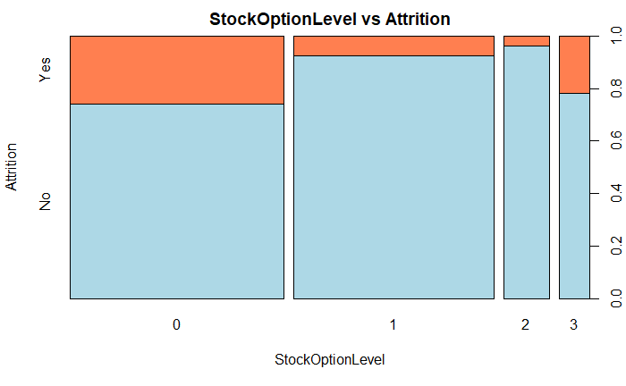
EDA Cont…

Slide 8
Attrition Classification Model
Logistic Regression Model
Model 1
All variables included in this model
Model 2
Removed Variables that had high correlations with other variables
Model 3
Removed all non-significant variables

Slide 9
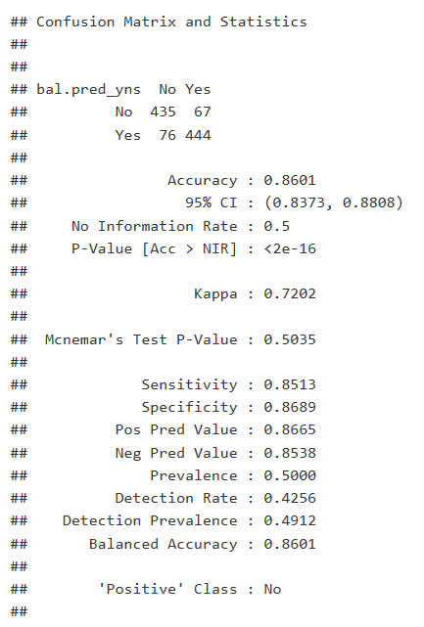
Classification Model Cont…
Accuracy : 86.01
Sensitivity: 85.13
Specificity : 86.89

Slide 10
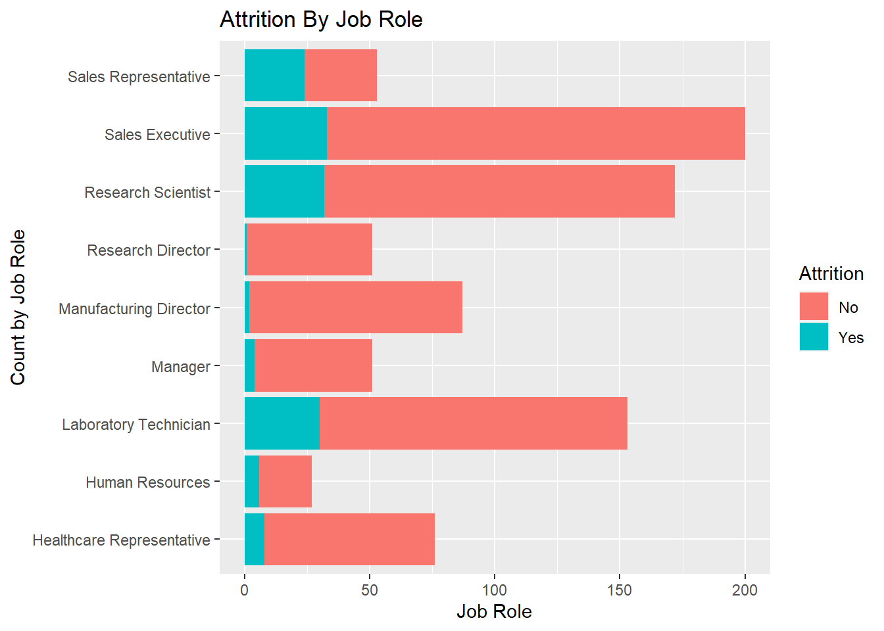
Attrition by Job Role
Analysis of Attrition by Job role
Looking at the plot of Attrition By Job Role gives misleading inference
Indicates Sales Executive, Research Scientist and Laboratory Technician have highest turnover by count
If we look at percent attrition by Job Role, we get a different picture. Looking at it this way, we see the top 3 turnover roles are
Sales Representative (45.3%)
Human Resources (22.2%)
Laboratory Technician (19.6)

Slide 11
Monthly income Regression Model
Multiple Linear Regression: Model Selection
Forward Selection
Backward Selection
Stepwise Selection

Slide 12
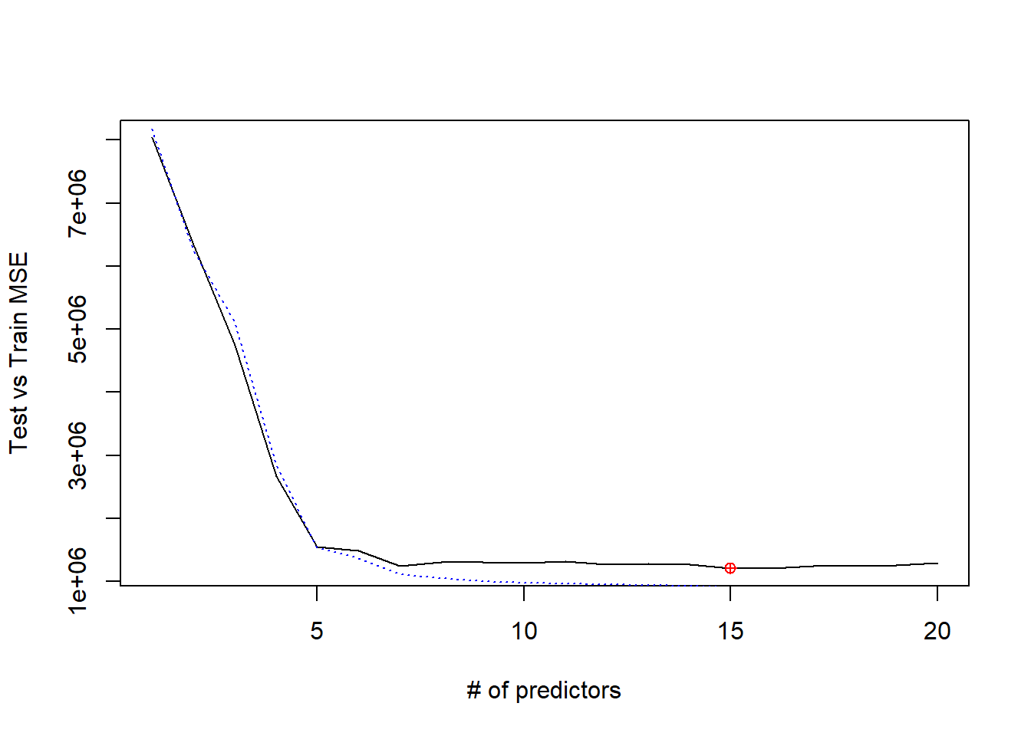
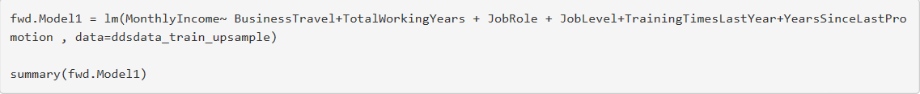
MLR Cont…
Forward Selection model has the lowest RMSE of 948.32 at around 15 variables

Slide 13
Conclusion
Classification of Attrition
Attrition can be classified with a model that has
Accuracy : 86.01
Sensitivity: 85.13
Specificity : 86.89
There does appear to be a pattern of high turnover in the following job roles:
Sales Representative
Human Resources
Laboratory Technician
Prediction of Monthly Income
Monthly income can be predicted with a model that has
Adjusted R-Squared: 0.9527
RMSE: 948.32

