Slide 1

Affine Analytics Machine Learning Challenge
Submission by Balaji B

Slide 2
Data Analysis And Exploration – Relation among tables
Deals
(7245 accounts,
26029 deals)
17883 deals
in common
1179 accounts
in common
n
Deal_Prop
(20350 deals,
19701 prop)
Account
(2756 accounts)
2727 accounts
in common
n
18298 properties in common
Properties
(18298 properties)
Acc_Prop
(2727 account,
70350 deals,
63001 properties)
14613 properties in common

Slide 3
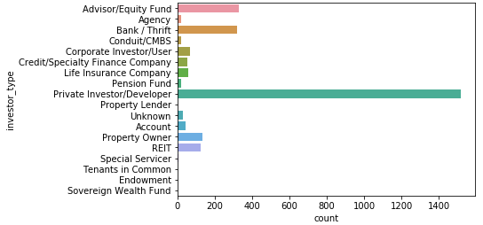
Data Analysis And Exploration – Account Table
Primary key: id_accs
investor_type
Means: type of investor such as bank, fund, private investor.
Relation with other variables are explained in coming slides.
Self explaining count plot describes frequencies of popular and rare investors clearly.

Slide 4
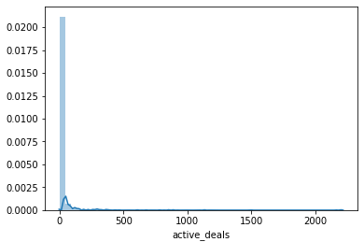
Data Analysis And Exploration – Account Table
active_deals
Means: Deals currently in pipeline
High frequency of zeros indicate most accounts does not have active deals.
Gives relation,
active_deals = num_deals_as_client + num_deals_as_investor
active_deals is highly correlated with number_of_related_deals (0.9738), num_deals_as_investor (0.97068) variables.
Its logical since num_of_related_deals and num_deals_as_investor are contributing in total active_deals.
Note: Pearson method is used to compute correlation

Slide 5
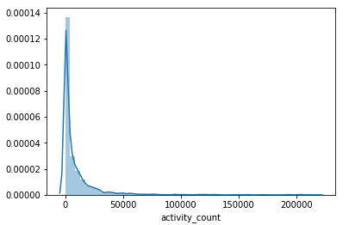
Data Analysis And Exploration – Account Table
activity_count
Means: Aggregate number of activities
Similar to active_deals, activity_count also positively skewed and peaked at zero.
It makes sense when considering deals as activities.

Slide 6
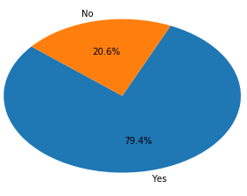
Data Analysis And Exploration – Account Table
buyer_book
Means: Preference on Investment Advisory
Most account prefer Investment Advisory
Mostly those who prefer Investment Advisory also prefer Debt deals (loan_sales_book)
But Bank/Thrift, Corporate Investor/User (investor_type) are less likely to prefer Investment Advisory
Note: relations among the categorical variables are derived using contingency tables.

Slide 7
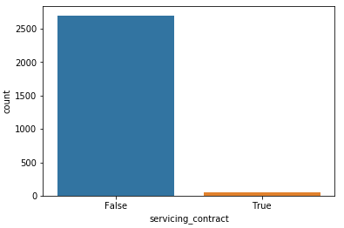
Data Analysis And Exploration – Account Table
servicing_contract
Means: have a contract to service their loans ?
Account having loan serving contract is very rare.
Most Life Insurance Company ,Conduit/CMBS (investment_type) accounts are serving contract(servicing_contract)
foreign Investors are less likely to serve contract
those who serve contract mostly prefer Debt deals(lender_book) and Loan Sale deals(loan_sales_book)

Slide 8
Data Analysis And Exploration – Account Table
Low Variance variables
Variable name | Variance in % | Variance in record count
correspondent | 0.54 | 15 out of 2756 records
Cmbs | 0.25 | 7 out of 2756 records
master_servicer | 0.07 | 2 out of 2756 records
loan_servicing | 0.036 | 1 out of 2756 records
consultant | 0.0 | All records holds Boolean Value False.

Slide 9
Data Analysis And Exploration – Account Table
Other Correlations…
num_of_deals_as_client & number_of_won_deals_as_client - 0.98
num_deals_as_investor & number_of_related_deals - 0.91
number_of_properties & number_of_related_properties - 0.91
Few more points…
Relatively most account prefer Debt deals (lender_book) along with Loan Sale deals (loan_sales_book).
Only investor_type have few missing values.

Slide 10
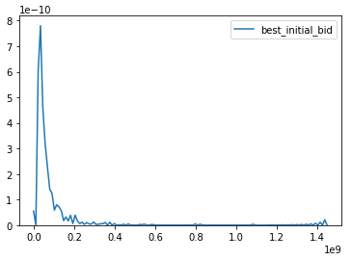
Data Analysis And Exploration – Opportunity Table
Primary key: id_deals
Has relation to Account table on id_accs variable.
best_initial_bit
Means: best bid made by the customer
As the distribution represents, best_initial_bit is peaked at 0.
Mostly, it is 0 when platform is 'Debt' or 'Loan Sales' or 'Securities'.

Slide 11
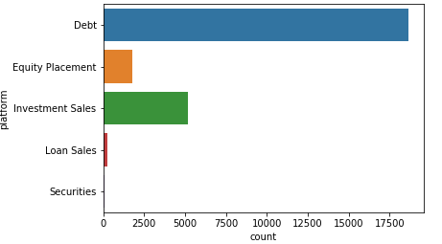
Data Analysis And Exploration – Opportunity Table
platform & deal_type
Means: platform - platform to which deals belongs to.
deal_type is totally depends on platform.
Moreover, it has one-to-many relationship.
1
n
platform
deal_type

Slide 12
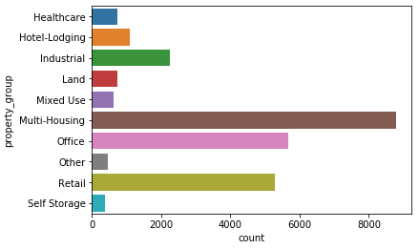
Data Analysis And Exploration – Opportunity Table
property_group & property_type
property_group is generalization of property_type where as property_type have micro level categories.
On priority, we can drop one.

Slide 13
Data Analysis And Exploration – Opportunity Table
Few more points…
Strong positive correlations among date variables closedate, date_closed, accounting_date
Low variable in variable deal_update_flag(0.31 %)
Notably, variable debt_yield has 46.78% missing value.
Variable fiscal represent month & year of the deal, but there is already separate variables to represent fiscal quarter(fiscalquarter), fiscal year(fiscalyear). So we can drop it.
As variable id_deals.1 is exact copy of id_deals, dropping the variable is necessary.

Slide 14
Data Analysis And Exploration – Properties Table
Primary key: id_props
Has relation to Opportunity table on id_deals variable.
Mainly, there are three set of variables defined in this table.
Variables that describes Geographical information
Variables that describes Physical structure
Variables that describes Prize
Few variables such as building_tax_expenses not giving structured data. Hence, Variable selection is necessary before applying any algorithm.

Slide 15
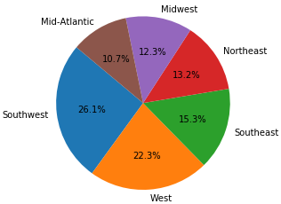
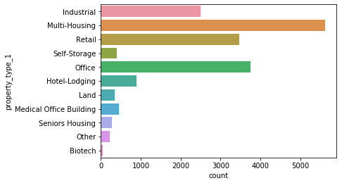
Data Analysis And Exploration – Properties Table
1. Geographical information
It is defined in variables county, city, market, region__c.
It has unique 708 countries, 2343 cities, 257 markets and 6 regions.
2. Physical structure
It is defined in variables num_buildings, num_floors, num_parking_spaces, occupancy_rate, size_acres, size_sf, size_units and property_type_1

Slide 16
Data Analysis And Exploration – Properties Table
3. Prize
Prize details about properties are defined in variables price_per_sq_ft, price_per_unit, sale_amount__c.
As it is merely make sense, these variables shares high correlation to each others.
Here Physical, Prize variable have missing values in very high frequency. Few variable even has values ~ 30 – 70 % of missing value in total record.
Geographical variables have almost no missing values. And Values in Physical, Prize variable are highly depends on Geographical variables.
Hence, simple approach to handle this problem is applying descriptive statistics based on Geographical groups.

