Slide 1
Reading
b
Team 14
a
-untold story of vasya
Suvarshitha T
Sruthi Chowdary A
Chuda mani K
Pavan Rohit P
Balaji Ch
c

Slide 2
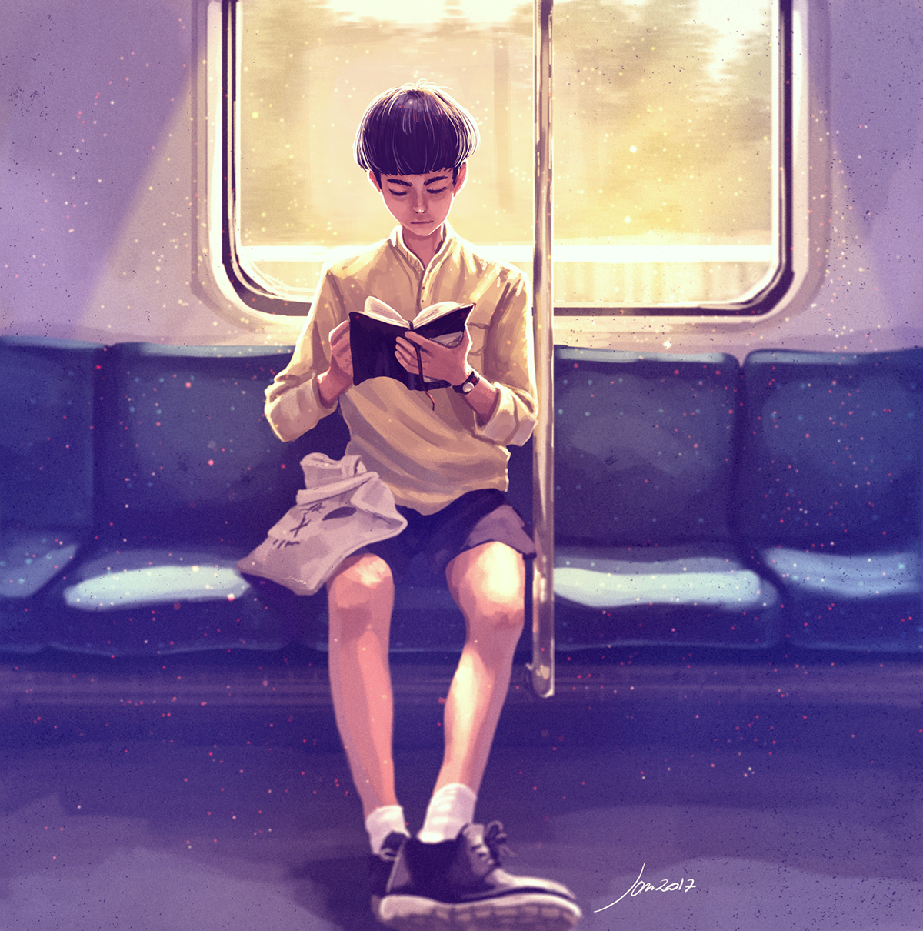
ABSTRACT
a
b
In the allotted project there is a boy named Vasya. Vasya has got selected
to Olympics and started to travel in a train. There he have to travel n hours
in the train. He has n hours to travel in the train . in that n hours he has
decided to read a book in the train . but he didn’t want to read the book
continuously for a long time . so he decided to spend k hours out of n hours
to read the book . He may not read the book continuously for k hours .
Unfortunately, the lighting in the train is not stable. As he is travelling in
way which is completely filled with the tunnels in its way the lighting is not
that stable in his way. The brightness inside the train is measured from
integers 0 to 100. Here 0 means very dark and 100 depicts the higher
brightness of light inside the train. Here we need to find the minimum level of
Light and the indexes of the array(journey) in which Vasya will read at.
c

Slide 3
Sample input 1
5 3
20 10 30 40 10
Sample output 1
20
1 3 4
Sample input 2
6 5
90 20 35 40 60 100
Sample output 2
35
1 3 4 5 6
b
c

Slide 4
contents
01
02
03
04
b
Introduction
Class diagram
Here you could describe the topic of the section
Here you could describe the program in diagramatic way
Implementation
conclusion
Here you implement
the progam
Here you could conclude the topic
a
c

Slide 5
Introduction
b
c
a
This project contains an implementation of 'READING' using Dev C++. In this project the user reads the array elements of journey and lighting from the console and find the brightness of the lighting and index values of array. Each integer will be between 1 to 1000, inclusively.

Slide 6
Concepts
c
a
For loop in C
Array in C
In this for loop there are three parts- initialization, condition, increment or decrement.
Array in C can be defined as a method of clubbing multiple entities of similar type into a larger group. These entities or elements can be of int, float, char, or double data types.
b

Slide 7
Concepts
c
a
CONDITIONAL STATEMENTS-SIMPLE IF
CONDITIONAL STATEMENTS-IF ELSE
‘if’ keyword is used to execute a set of statements when the logical condition is true.
If the condition is true if part executes and if the condition is false, else part executes.
b

Slide 8
Class diagram
start
b[i]==c[j]
Print j+1
Read n,k,a[i]
Assign small,l
b[l]=c[j+1]
l++
stop
b[i]=small
b[l]=c[j] l++
c[i]=a[i]
c[j]>c[j+1]
b[i]<small

Slide 9

Implementation
#include <stdio.h>
int main()
{
int n,k,i,j;
scanf("%d %d",&n,&k);
int a[n],b[k],c[n];
for(i=0;i<n;i++)
{
scanf("%d", &a[i]);
}
for(i=0;i<n;i++)
{
c[i]=a[i];
}

Slide 10
int l=0; for (j=0;j<n;j++) { if(c[j]>c[j+1]) { b[l]=c[j]; l++; } else { b[l]=c[j+1]; l++; } } printf("OUTPUT:\n"); int small=b[0];
for (i=1;i<k;i++) { if (b[i]<small) { small=b[i]; }} printf("%d",small); printf("\n"); for (i=0;i<k;i++) { for(j=0;j<n;j++){ if (b[i]==c[j]) { printf("%d ",j+1); break; }
}
} return 0; }

Slide 11
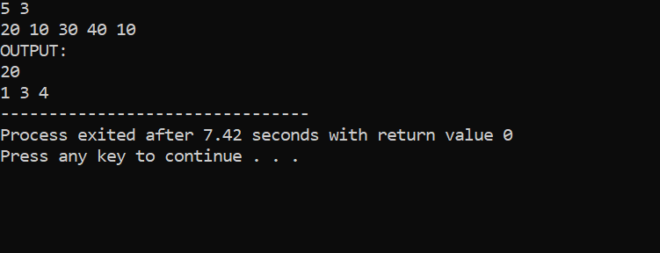
Result 1

Slide 12
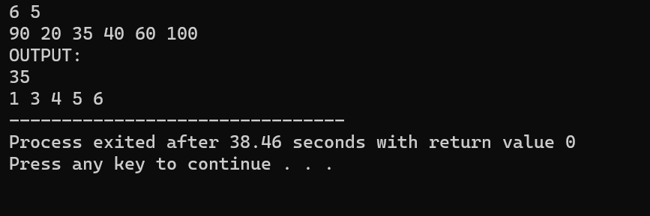
Result 2

Slide 13
Conclusion
a
b
We have attempted to design and implement "Reading". The presence of many built-in class methods takes care of much functionality and reduces the job of coding as well as makes the implementation simpler. We have implemented the project making it as user-friendly and error free as possible. We regret any errors that may have inadvertently crept in.
c

Slide 14
Thank you
a
b
Signing of team 14
c

