Slide 1
Document management using rag
Balaji Chandrasekaran
Sr. Data scientist
Ingram Micro

Slide 2


Retrieval-Augmented Generation
Challenges of LLMs
How RAG helps
Retrieving Relevant Information: When you ask a question, RAG first searches for relevant information from an external knowledge base, like a document database or search engine.
Informing the LLM: This retrieved information is then presented to the LLM along with your original question.
Improved Output: With this additional context, the LLM can generate a more accurate and reliable response, potentially:
Limited Knowledge: LLMs are trained on massive amounts of data, but they can still lack specific or up-to-date information.
Hallucination: Sometimes, LLMs can "make things up" based on their statistical patterns, leading to inaccurate or misleading information.
Data Leakage: If the training data contained private or sensitive information, it could be leaked through the LLM's responses.

Slide 3
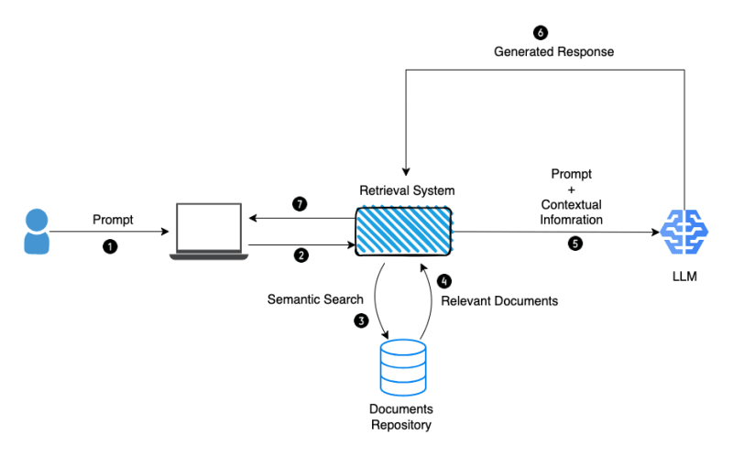

Slide 4
Retrieval + Generation
Information retrieval is crucial to RAG applications (Retrieval-Augmented Generation) for several key reasons:
Domain-Specific Knowledge
Reduced Bias and Hallucination
Improved User Trust and Transparency
Increased Efficiency and Control

Slide 5
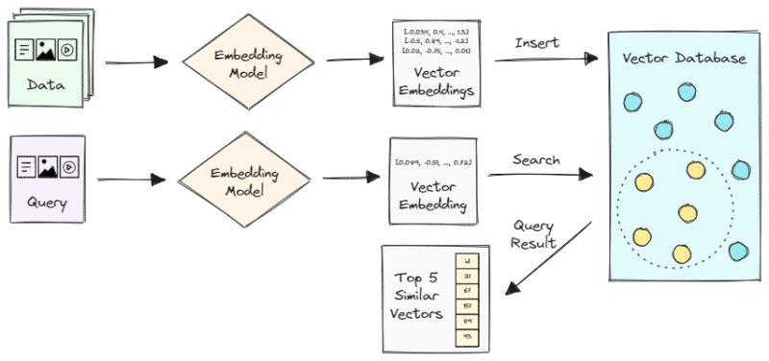
Vector search
A technique used in information retrieval and machine learning to find similar items in a dataset

Slide 6
Why LangChain is required to build a RAG
Building Blocks: LangChain offers all the necessary components for building an RAG application, from simple to complex. It handles the retrieval aspect, which involves fetching relevant information based on the user's query, a crucial but often complex stage.
Simplified Development: It streamlines the development process by providing pre-built modules and functionalities, saving you time and effort compared to building everything from scratch.
Flexibility: LangChain supports various data sources, including text, code, and SQL data, allowing you to build RAG applications for different use cases.
Efficiency: It uses efficient data structures and algorithms to handle large amounts of data and make the retrieval process faster.
Scalability: LangChain can be easily scaled to handle growing data volumes and application complexity.

Slide 7
Components of LangChain:
Schema: Defines fundamental data types and structures used across the codebase, including Text, ChatMessages, Examples, and Document
Models: Large language models (LLMs) trained on vast text and code datasets for tasks like text generation, language translation, and answering queries
Prompts: Used to format user input so that language models can understand it, providing context or instructions for the model
Indexes: Databases holding information about the training data for LLMs, including text of documents, metadata, and connections
Memory: Facilitates storage and retrieval of chat history in conversational systems, crucial for effective interactions
Chains: Serve as conduits linking multiple LangChain components together, facilitating automatic amalgamation of various LLM calls and actions
Agents: Leverage LLMs to make intelligent decisions and perform specific actions, ranging from simple tasks to complex operations

Slide 8
DEMO

