Slide 1
HADOOP
What is Hadoop?
Hadoop is a software to reliable and scalable store and process Big Data
Runs on Commodity Hardware
Low cost Per BG
Ability to store Petabytes of data in single cluster
Hadoop was invented at yahoo and inspired by Googles GFS(google file system)
And Google’s Map Reduce Papers
Its Open Source and Maintained under the Apache umbrella.

Slide 2
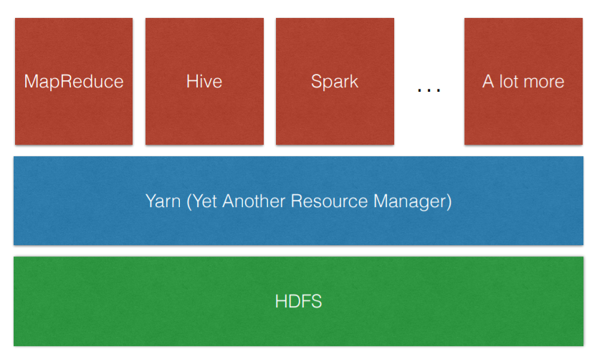
ARCHITECTURE
HDFS, the Hadoop Distributed File System, stores the data within cluster
Yarn is the interface you submit your applications to, it manages cluster resources like CPU and MEM for you
Applications can be submitted using any of the processing engines built on top of Hadoop
One of the simplest distributed application you can write is counting the words of a text file stored in HDFS using the MapReduce framework
Spark is one the newest processing engines

Slide 3
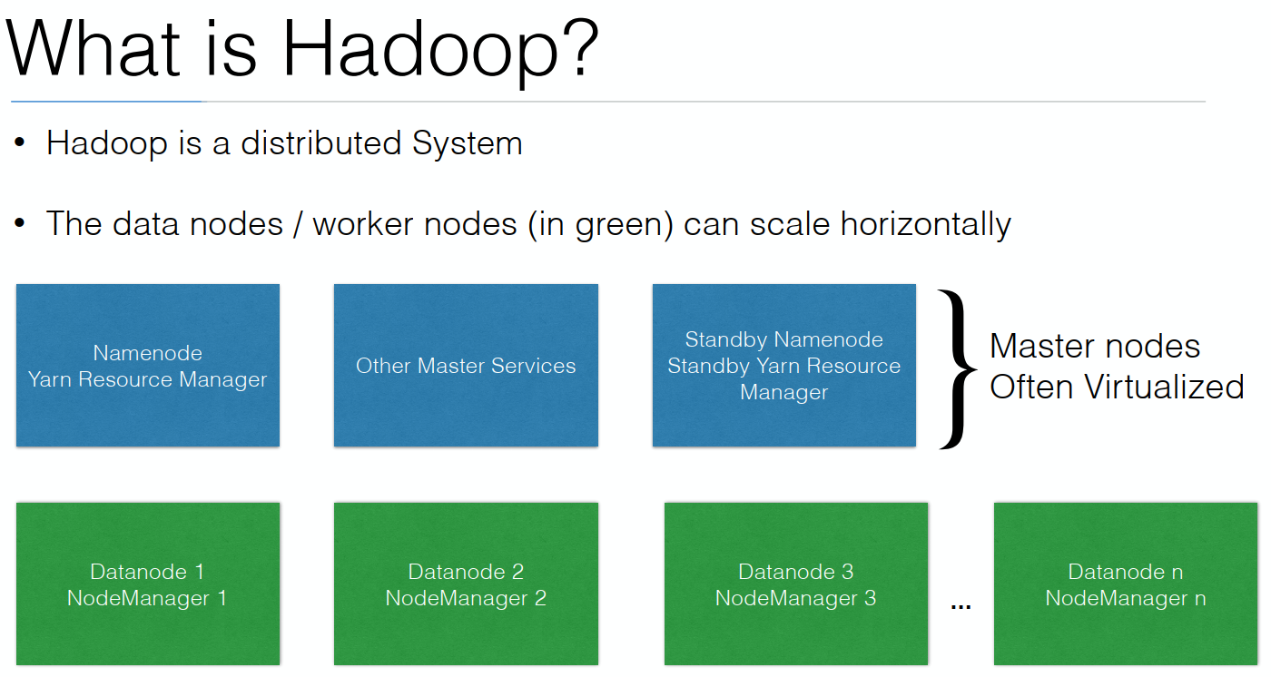
What is Hadoop?
Hadoop is a distributed system
There are data nodes are also called workers
Which are horizontally scaled
Our data will be stored on the green nodes and our process will run.
The services responsible for the data itself is called the data node service.
The service which are responsible for running applications is the node manager.
Our applications are executed on the worker nodes in green
Master Nodes (Blue) run the maximum services for the cluster.
Master Nodes don’t scale horizontally
It also runs a Yarn Resource Manager, responsible for giving our services necessary resources

Slide 4
What is Hadoop? • Hadoop is very different than a single machine system
• By having multiple nodes to store data and do processing on, the developer cannot assume to have access to all data at the same time
•
Developers will have to change the way they develop to be able to write applications for Hadoop
• Hadoop will automatically recover from a node failure. This means that code within the application possibly gets executed twice

Slide 5
HDP Installation
•How do you get started with Hadoop?
•You can download the HDP Sandbox from http://www.hortonworks.com
•You can install the full Hadoop distribution on:
•Your own machine (using Vagrant)
•On Cloud (for instance AWS, Azure)
•Using manual install

Slide 6
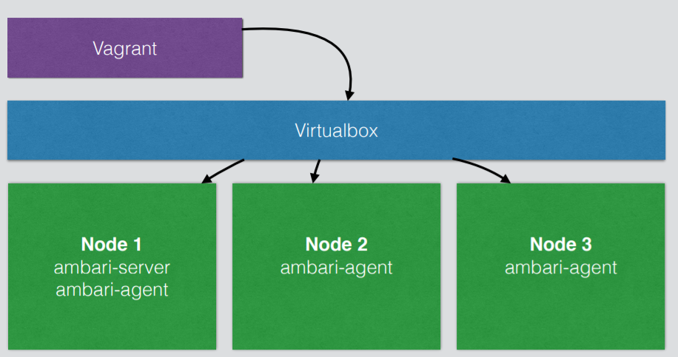
There are different HDP installs:
• Manual install
• Using apt-get and yum for ambari-server / ambari-agent
• Manual provisioning of the cluster through the Ambari UI
•Unattended install
• Using automation tools to install ambari-server / ambari-agent
• Using blueprints to push a setup and configuration to the cluster
Installing in a standalone machine – laptop/desktop
To install a real cluster you need a minimum of 3 nodes
• Using Vagrant and Virtualbox, you can create 3 virtual nodes on your workstation
• Every node will have 2 GB of memory
• If you have more memory in your machine, give them 4 GB

Slide 7
WHAT IS VAGRANT
Vagrant can create and configure virtual development environments
• Lightweight
• Reproducible – can be copied
• Portable - can be moved
• Wrapper around VirtualBox, KVM, AWS, Docker, VMWare, Hyper-V
• Create identical development environments for Operations and Developers
• No more “works on my machine”
• Disposable environments

Slide 8
GETTING STARTED WITH VAGRANT
• Vagrant will come out of the box with support for VirtualBox
• To launch the 3 node cluster, go to the folder where you downloaded it and type: $ $vagrant up node1 node2 node3
• To suspend the machines
$vagrant suspend
• To remove the machines and the data (when you don’t need it anymore)
$vagrant destroy
VAGRANT FILE
• A project has a Vagrant file with the configuration
• It marks the root directory of your project
• It describes the kind of machine and resources needed for the project to run and what software to install
• To change network settings, memory or CPU, open the Vagrant file in notepad (or equivalent) and make the necessary changes

Slide 9
• You can download Virtualbox and Vagrant from:
• https://www.virtualbox.org/
• https://www.vagrantup.com/
• You will need my Vagrantfile to launch the Virtual Machines
• https://github.com/wardviaene/hadoop-ops-course/archive/master.zip
• Download these files and put them somewhere you can remember e.g. C:\hadoop on Windows or in your home directory on MacOSX/Linux

Slide 10
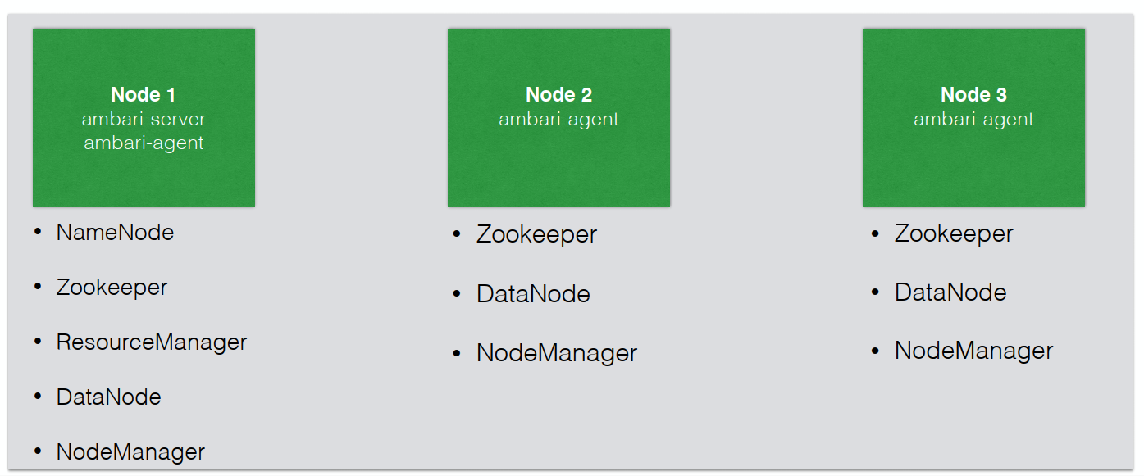
Installation • Ambari-server on node1 will install and configure all the nodes

