Slide 1
Selenium IDE

Slide 2
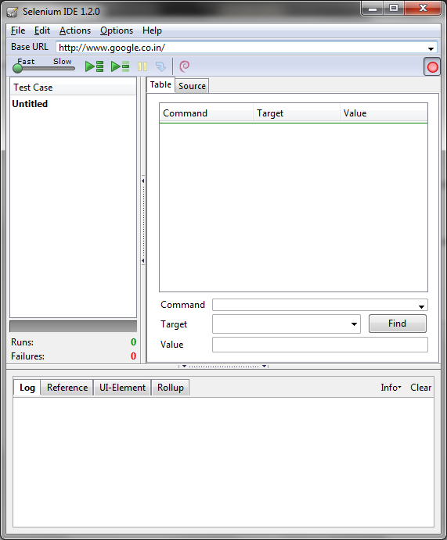
Selenium IDE - Introduction
Selenium IDE is a Firefox add-in used for record and play the test cases
Recorded script by default generate HTML code, it can changed to Java, C#, PHP, Ruby language
Test scripts code can be customized based on the requirement.
Selenium IDE is used to find the object properties.
It can be used for simple test case automation
Multiple test case can be executed using Selenium IDE
“Log” functions will display the error message and information message of test execution

Slide 3
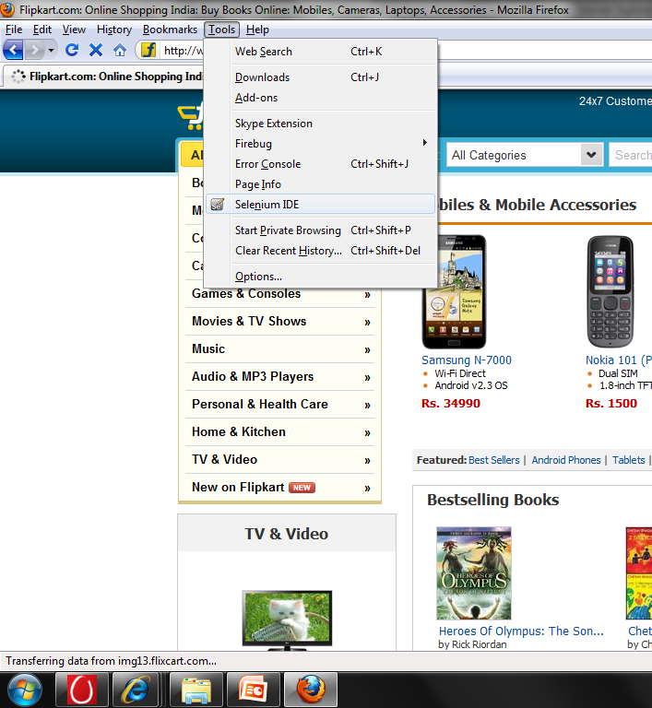
Selenium IDE - Installation
Download the Selenium IDE from the http://seleniumhq.org/download/
Install the Selenium IDE add-on in the Firefox browser
Click on the ‘Install Now’ in the add-on window pop-up
Restart the Firefox browser
Go to the Tools menu and check it the Selenium IDE
Click on the Selenium IDE, it opens the Selenium IDE tool.

Slide 4
Selenium IDE – Interface Features
Menu Bar
Create Test case and Test Suite
Save/Open the Test case
Copy, Paste and Delete the command
Record and Play, Clipboard Format
Action bar
Speed Control: controls how fast your test case runs.
Run All: Runs the entire test suite when a test suite with multiple test cases is loaded
Runs the currently selected test.
Allows stopping and re-starting of a running test case
Allows you to “step” through a test case by running it one command at a time.
Records the user’s browser actions

Slide 5
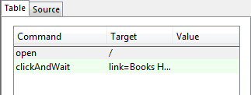


Selenium IDE – Interface Features(Cont…)
Testcase pane
It displays the ‘table’ format and source code
By default, HTML code will be displayed in the source code
The Command, Target, and Value entry fields display the currently selected command along with its parameters
‘Find’ button highlights the target of the locator on the page
Log/Reference/UI-Element/Rollup Pane
Log -Test case, error messages and information messages are displayed, useful for debugging
Reference - Reference pane will display documentation on the selenese command
UI-Element - Mapping between a meaningful name for a page element
Rollup - set of Selenium commands that are grouped into one single command

Slide 6
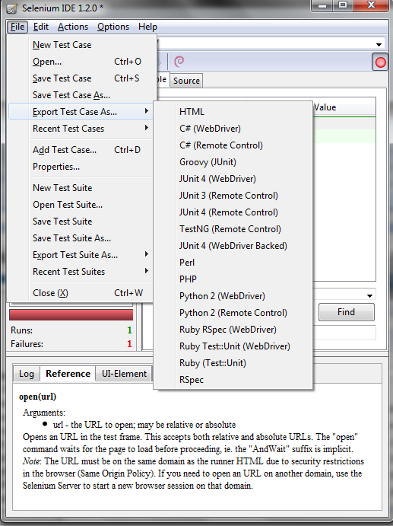
Selenium IDE – Export Features
A most interesting feature of Selenium IDE: export to Selenium RC.
Selenium IDE is able to export test cases in the following formats:
HTML
Java (Junit 3/4)
Java(TestNG)
Groovy (Junit)
C#
Perl
Python
PHP
Ruby (Rspec)
Ruby(Test/Unit)
You can export test-cases or the entire test-suite.

Slide 7
Test cases & Test Suites
Test Cases :
Selenium IDE produces test cases that are written in a DSL (Domain Specific Language) called Selenese.
Selenese tests are simple xHTML tables of 3 columns and as many rows that there are steps in your test.
The rule for these commands is:
Command- A method on the first column: the action to perform
Target - A locator on the second column: the subject of the method (ie: what element is acted upon)
Value - A value on the third one: the value to be passed to the method (what to type in a text field for instance)
Test Suite: A test suite is a collection of tests. It runs all the tests in a test suite as one continuous batch-job.
Test suite are also expressed as HTML files
The test-suite only references test-case files as anchor elements
The anchors are nested inside a table of 1 column and as many rows as there are test-cases in the test-suite

Slide 8
Running Test cases
The IDE allows many options for running your test case. Execution of test cases is very flexible in the IDE.
Some of the options are:
Run a Test Case
Click the Run button to run the currently displayed test case.
Run a Test Suite
Click the Run All button to run all the test cases in the currently loaded test suite.
Stop and Start
The Pause button can be used to stop the test case while it is running.
Stop in the Middle
Set a breakpoint in the test case to cause it to stop on a particular command.
Start from the Middle
IDE to begin running from a specific command in the middle of the test case.
Run Any Single Command
Double-click any single command to run it by itself.

Slide 9
Selenium Command
The Selenium API defines dozens of commands that can be categorized into the following:
Actions :
Actions are commands that change the state of the application like clicking links or buttons, select an option in a <select> or type a character sequence in a given textbox.
Accessors :
Accessors inspect the state of the application and store values in variables.
Assertions:
It is like Accessor, but they verify that the state of the application conforms to what is expected. Examples include “make sure the page title is X” and “verify that this checkbox is checked”.
assert : if assertion fails, test is aborted and marked as failed : assertTitle(pattern) will fail if the title of the page doesn’t correspond to the pattern argument.
verify : if a verification fails, the test doesn’t stop but a trace will be printed in the log.
waitFor : these commands pause the test until a condition is satisfied or a timeout is reached.

Slide 10
Commonly used Selenium Command
To conclude our introduction of Selenium, we’ll show you a few typical Selenium commands, the most commonly used commands for building tests.
open
opens a page using a URL.
click/clickAndWait
performs a click operation, and optionally waits for a new page to load. verifyTitle/assertTitle
verifies an expected page title.
verifyTextPresent
verifies expected text is somewhere on the page.
verifyElementPresent
verifies an expected UI element, as defined by its HTML tag, is present on the page.
verifyText
verifies expected text and its corresponding HTML tag are present on the page.
verifyTable
verifies a table’s expected contents.
waitForPageToLoad
pauses execution until an expected new page loads. Called automatically when clickAndWait is used.
waitForElementPresent
pauses execution until an expected UI element, as defined by its HTML tag, is present on the page.

Slide 11
Locator
For many Selenium commands, a target is required. This target identifies an element in the content of the web application, and consists of the location strategy followed by the location in the format locatorType=location.
Identifier
Id
Name
Link
DOM
XPath
CSS
UI-element

Slide 12
Locator - Identifier
works with the id and name attributes of your html tags. Let’s consider the following source code:
<html>
<body>
<form id="loginPage">
<input name="username" type="text"/>
<input name="password" type="password"/>
<input name="submit" type="submit" value=“Login"/>
</form>
</body>
</html>
Valid locators for this snippet are :
identifier=loginPage
identifier=username
submit
PROS:
This strategy doesn’t rely on the structure of the page and will work even if it changes.
CONS:
Easily matches several elements: try to name your username field as loginPage

Slide 13
Locator - Id
The Id strategy looks for an element in the page having an id attribute corresponding to the specified pattern. <form id=“loginPage" /> will be matched by a locator like id=loginpage or just loginPage
<html>
<body>
<form id="loginPage">
<input name="username" type="text"/>
<input name="password" type="password"/>
<input name="submit" type="submit" value=“Login"/>
</form>
</body>
</html>
PROS:
Each id is supposed to be unique so no chance of matching several elements
CONS:
Works well only on elements with fixed ids and not generated ones

Slide 14
Locator - Name
The name locator type will locate the first element with a matching name attribute. If multiple elements have the same value for a name attribute, then you can use filters to further refine your location strategy.
<html>
<body>
<form id="loginPage">
<input name="username" type="text"/>
<input name="password" type="password"/>
<input name="submit" type="submit" value=“Login"/>
<input name="submit" type=“button" value=“Cancel"/>
</form>
</body>
</html>
name=“username”
name=“submit” value=“Login”
name=“submit” type=“button”
PROS:
Each id is supposed to be unique so no chance of matching several elements
CONS:
Works well only on elements with fixed ids and not generated ones

Slide 15
Locator - xPath
XPath is the language used for locating nodes in an XML document. As HTML can be an implementation of XML (XHTML), Selenium users can leverage this powerful language to target elements in their web applications.
Since only xpath locators start with “//”, it is not necessary to include the xpath= label when specifying an XPath locator.
PROS:
Allows very precise locators
CONS:
Slower than CSS
Relies on browser’s XPath implementation which is not always complete (especially on IE) and as such is not recommended for cross-browser testing

Slide 16
Locator - Link
This is a simple method of locating a hyperlink in your web page by using the text of the link. If two links with the same text are present, then the first match will be used.
<html>
<body>
<p>Are you sure you want to do this?</p>
<a href="continue.html">Continue</a>
<a href="cancel.html">Cancel</a>
</body>
<html>
link=Continue (4)
link=Cancel (5)
PROS:
Link locator will select only the anchor elements
Link Locator will be useful in the navigation testing
CONS:
Need to specify the text of the link before

Slide 17
Locator - DOM
The DOM strategy works by locating elements that matches the javascript expression refering to an element in the DOM of the page.
Since only dom locators start with “document”, it is not necessary to include the dom= label when specifying a DOM locator.
dom=document.getElementById('loginForm') (3)
dom=document.forms['loginForm'] (3)
dom=document.forms[0] (3)
document.forms[0].username (4)
PROS:
JavaScript allows to build the dynamic locators
CONS:
It relies on the structure of the page

Slide 18
Locator - CSS
CSS (Cascading Style Sheets) is a language for describing the rendering of HTML and XML documents. CSS uses Selectors for binding style properties to elements in the document. These Selectors can be used by Selenium as another locating strategy.
css=form#loginForm
css=input[name="username"]
css=input.required[type="text"]
css=input.passfield
css=#loginForm input[type="button"]
PROS:
It is much faster than XPath
Provides a good balance between structure and attributes
Allows for selection of elements by their surrounding context
CONS:
They tend to be more complex and require a steeper learning curve

Slide 19
Type of Locator
Locators can be classified into two categories:
Structure-based locators: locators that rely on the structure of the page to find elements.
XPath
DOM
CSS
Attributes-based locators: locators that relies on the attributes of the elements to locate them
Identifier
Id
Name
Link
CSS
Most experienced Selenium users recommend CSS as their locating strategy of choice as it’s considerably faster than Xpath. It is the most flexible and gives a good balance between using structure and attributes to find the elements.

Slide 20
Matching Patterns - Globbing
There are three types of patterns: globbing, regular expressions, and exact
Globbing Patterns:
Most people are familiar with globbing as it is utilized in filename expansion at a DOS or Unix/Linux command line such as ls *.c
* which translates to “match anything,” i.e., nothing, a single character, or many characters.
[aeiou] matches any lowercase vowel
[0-9] matches any digit
[a-zA-Z0-9] matches any alphanumeric character
To specify a globbing pattern parameter for a Selenese command, you can prefix the pattern with a glob: label
Command | Target | Value
click | link=glob:Film*Television Department
verifyTitle | glob:*Film*Television*

Slide 21
Matching Patterns - Regular Expression
Regular expression patterns are the most powerful of the three types of patterns that Selenese supports.
Regular expression patterns in Selenese need to be prefixed with either regexp: or regexpi:. The former is case-sensitive; the latter is case-insensitive
Regular expression patterns allow a user to perform many tasks that would be very difficult otherwise
Command | Target | Value
verifyTextPresent | regexp:Sunrise: *[0-9]{1,2}:[0-9]{2} [ap]m
Sunrise:* | The string Sunrise: followed by 0 or more spaces
[0-9]{1,2} | 1 or 2 digits (for the hour of the day)
: | (no special characters involved)
[0-9]{2} | 2 digits (for the minutes) followed by a space [
[ap]m | “a” or “p” followed by “m” (am or pm)

Slide 22
Matching Patterns - Exact
The exact type of Selenium pattern is of marginal usefulness.
The exact: prefix could be used to create an exact pattern
It uses no special characters at all. So, if you needed to look for an actual asterisk character (which is special for both globbing and regular expression patterns)
Command | Target | Value
select | //select | exact:Real *

Slide 23
Store Commands and Selenium Variables
The plain store command is the most basic of the many store commands and can be used to simply store a constant value in a selenium variable
To access the value of a variable, enclose the variable in curly brackets ({}) and precede it with a dollar sign like this.
storeElementPresent
It simply stores a boolean value–”true” or “false”–depending on whether the UI element is found.
storeText
StoreText corresponds to verifyText. It uses a locater to identify specific page text.
storeEval
StoreEval allows the test to store the result of running the script in a variable.
Command | Target | Value
store | test@test.com | email
Command | Target | Value
type | Id=email | ${email}

Slide 24
Debugging
Debugging means finding and fixing errors in your test case. This is a normal part of test case development
Breakpoints and Startpoints
select a command, right-click, and from the context menu select Toggle Breakpoint.
Stepping Through a Testcase
Find Button
The Find button is used to see which UI element on the currently displayed webpage (in the browser) is used in the currently selected Selenium command.
Page Source for Debugging
Simply right-click the webpage and select ‘View->Page Source.
Locator Assistance
Useful for learning more about locators, and is often needed to help one build a different type of locator than the type that was recorded

Slide 25
Thank You

