Slide 1
Selenium Remote Control

Slide 2
Selenium Remote control
Selenium IDE may seem a productive and efficient tool for writing test-cases, it lacks many essential features of a testing tool:
Conditional statements
Loops
Logging
Exception handling
Reporting
Test fixtures and data-driven tests
Test dependencies
Taking screenshots
Browser support
Selenium RC is the answer to a more powerful test-suite for your applications.
It follows a client/server model allowing client libraries to execute tests on a browser controlled by the server.

Slide 3
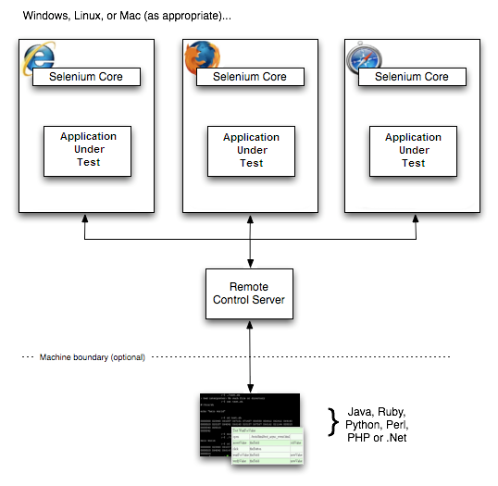
How Selenium RC Works
The Selenium Server which launches and kills browsers, interprets and runs
The Selenese commands passed from the test program, and acts as an HTTP proxy, intercepting and verifying HTTP messages passed between the browser and the AUT.
Client libraries which provide the interface between each programming language and the Selenium RC Server.
Server passes the Selenium command to the browser using Selenium-Core JavaScript commands

Slide 4
Selenium Server
Selenium Server receives Selenium commands from your test program, interprets them, and reports back to your program the results of running those tests.
Selenium server is the program that drives the browser
It embeds Selenium Core framework and injects it into the browser
It communicates with the running test client and drives the browser
Client tests sends commands that the server interpretes in order to drive the browser
The server sends back results to the client
Client and server communicates via HTTP GETs and POSTs so you can easily plug into
Server is configurable at startup via command-line options. use java -jar selenium-server.jar
Use any programming language that can send HTTP requests to automate Selenium tests on the browser

Slide 5
Client Libraries
Client libraries provides the API to program tests and execute them on the server
The client library takes a Selenese command and passes it to the Selenium Server for processing a specific action or test against the application under test (AUT)
Supported API implementation exists in:
Java
.Net
PHP
Python
Perl
Ruby

Slide 6
Selenium RC Installation
Prerequisites
A JVM installed on the system
Eclipse
The Selenium RC archive
Firefox browser
The Selenium RC server is simply a Java jar file (selenium-server-standalone-<version-number>.jar), which doesn’t require any special installation. Just downloading the zip file and extracting the server in the desired directory is sufficient.
Running Selenium Server
Go to the directory where Selenium RC’s server is located and run the following from a command-line console.
java -jar selenium-server-standalone-<version-number>.jar

Slide 7
Using the Java Client Driver
Download Selenium java client driver zip from the SeleniumHQ.
Extract selenium-java-<version-number>.jar file
Open Eclipse Java
Create a java project.
Add the selenium-java-<version-number>.jar files to your project as references.
Add to your project classpath the file selenium-java-<version-number>.jar.
From Selenium-IDE, export a script to a Java file and include it in your Java project, or write your Selenium test in Java using the selenium-java-client API. The API is presented later in this chapter. You can either use JUnit, or TestNg to run your test, or you can write your own simple main() program.
Run Selenium server from the console.
Execute your test from the Java IDE or from the command-line.

Slide 8
Start Browser
Opens the browser and represents that browser by assigning a “browser instance” to a program variable. This program variable is then used to call methods from the browser.
DefaultSelenium("localhost", 4444, "*iexplore", "http://www.google.co.in/")
The parameters required when creating the browser instance are:
host
Specifies the IP address of the computer where the server is located. Usually, this is the same machine as where the client is running, so in this case localhost is passed.
port
Specifies the TCP/IP socket where the server is listening waiting for the client to establish a connection.
browser
The browser in which you want to run the tests. This is a required parameter.
url
The base url of the application under test.

Slide 9
Reporting Results
Selenium RC does not have its own mechanism for reporting results. Rather, it allows you to build your reporting customized to your needs using features of your chosen programming language.
Test Reports in Java
Java has two commonly used test frameworks, JUnit and TestNG.
If Selenium Test cases are developed using JUnit then JUnit Report can be used to generate test reports.
If Selenium Test cases are developed using TestNG then no external task is required to generate test reports. The TestNG framework generates an HTML report which list details of tests.
ReportNG is a HTML reporting plug-in for the TestNG framework. It is intended as a replacement for the default TestNG HTML report. ReportNG provides a simple, colour-coded view of the test results.

Slide 10
Firefox profile
Firefox profile to be created, if your tests has the https certificate or having some addons installed
Create a separate Firefox profile, follow this procedure.
Open the Windows Start menu
select “Run”
Then type and enter one of the following:
firefox.exe -profilemanager
firefox.exe -P

Slide 11
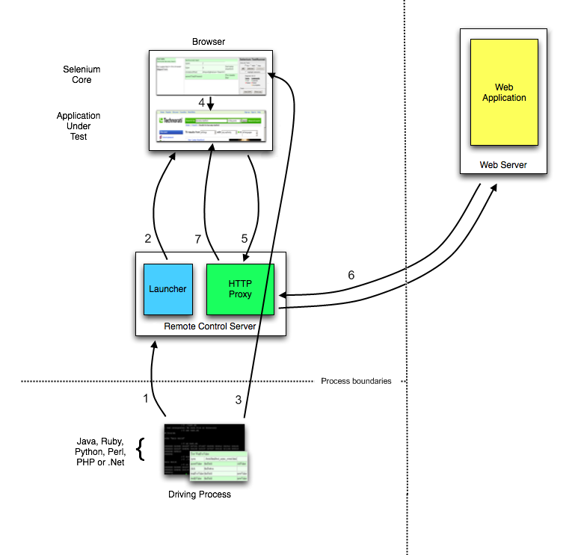
Proxy Injection
In Proxy Injection Mode, the Selenium Server acts as a client-configured HTTP proxy , that sits between the browser and the Application Under Test.

Slide 12
Proxy Injection
As a test suite starts in your favorite language, the following happens:
The client/driver establishes a connection with the selenium-RC server.
Selenium RC server launches a browser (or reuses an old one) with a URL that injects Selenium-Core’s JavaScript into the browser-loaded web page.
The client-driver passes a Selenese command to the server.
The Server interprets the command and then triggers the corresponding JavaScript execution to execute that command within the browser.
Selenium-Core instructs the browser to act on that first instruction, typically opening a page of the AUT.
The browser receives the open request and asks for the website’s content from the Selenium RC server (set as the HTTP proxy for the browser to use).
Selenium RC server communicates with the Web server asking for the page and once it receives it, it sends the page to the browser masking the origin to look like the page comes from the same server as Selenium-Core (this allows Selenium-Core to comply with the Same Origin Policy).
The browser receives the web page and renders it in the frame/window reserved for it.

Slide 13
Troubleshooting Common Problems
Selenium RC there’s a few potential problems that are commonly encountered.
Unable to Connect to Server
Test program cannot connect to the Selenium Server, an exception will be thrown in your test program
Unable to Load the Browser
Selenium Cannot Find the AUT
Firefox Refused Shutdown While Preparing a Profile
Versioning Problems
Error message: “(Unsupported major.minor version 49.0)” while starting server
To check double-check your java version, run this from the command line.
404 error when running the getNewBrowserSession command

Slide 14
Handling Browser Popup Windows
There are several kinds of “Popups” that can be thrown during a Selenium test.
Selenium commands may not be able to close these popups if they are initiated by the browser and not by the AUT.
Each type of popup needs to be addressed differently.
HTTP basic authentication dialogs: These dialogs prompt for a username/password to login to the site.
SSL certificate warnings: Selenium RC automatically attempts to spoof SSL certificates when it is enabled as a proxy
modal JavaScript alert/confirmation/prompt dialogs: Selenium tries to conceal those dialogs from you (by replacing window.alert, window.confirm and window.prompt) so it won’t stop the execution

Slide 15
Junit
Junit is the reference unit-testing framework for Java
The framework allows you to test your applications using specific classes containing the logic performing actions on the tested classes and checking the results
Eclipse provides support for Junit, so we’ll be using that
It uses annotation like @BeforeTest, @Test, @AfterTest, etc…
It execute the multiple test cases in the suite
Junit can generate the test execution report.

Slide 16
Thank You

