Slide 1


Malla Reddy Vishwavidyapeet
Department/Course details :
B-Tech - CSM (AI&ML)
Presented by
B.Yashwith Singh :25MVCSMR0203
M.Balaji Ganesh:25MVCSMR0241
B.Nikhill:25MVCSMR0204
D.Shashikiran:25MVCSMR0212

Slide 2


Sudoku
Solver Arena:
Visualizing Backtracking and Constraint Checking
Interactive Algorithm-Centric Prototype

Slide 3






Problem Statement
and Objectives
Build an interactive Sudoku solver
that accepts puzzles and validates entries
Visualize backtracking step-by-step
with visible decisions and undo actions
Demonstrate key algorithms: backtracking and constraint checking
Compare algorithm behavior across multiple approaches
Objective
Gain a clear understanding of DAA (Design and Analysis of Algorithms) concepts through visualization

Slide 4
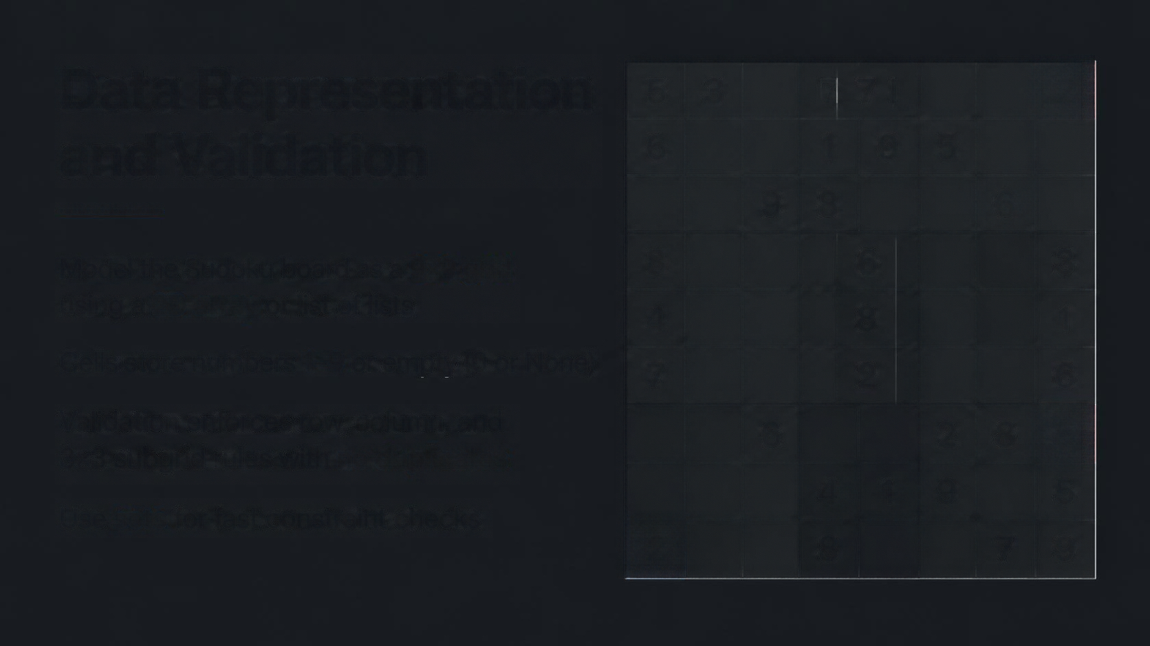




Data Representation and Validation
5
3
7
7 I
2
6
1
9
5
9
8
6
Model the Sudoku board as a 9×9 grid
using a 2D array or list of lists
8
6
3
4
8
1
Cells store numbers 1–9 or empty (0 or None)
7
2
6
Validation enforces row, column, and
3×3 subgrid rules with no duplicates
6
2
8
5
4
1
9
5
Use sets for fast constraint checks
2
8
7
9

Slide 5
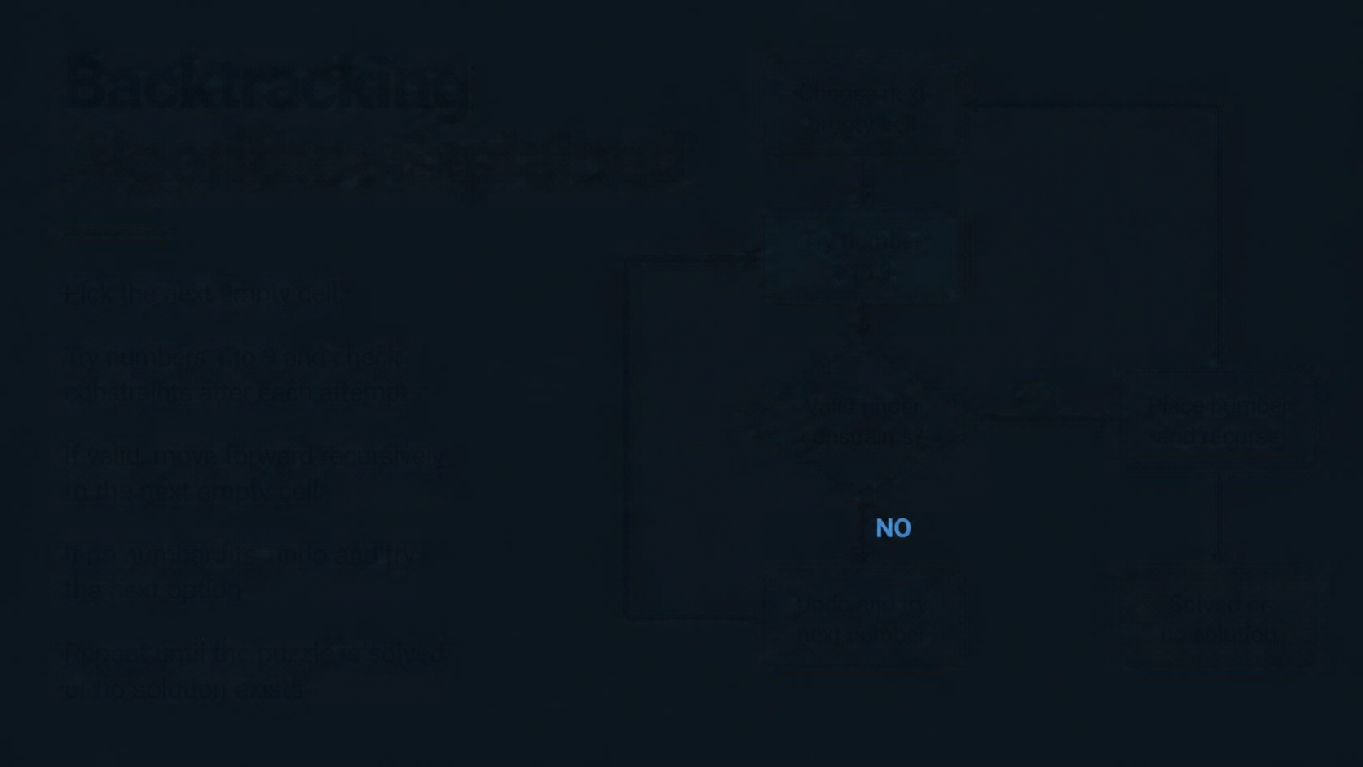













Backtracking
Choose next empty cell
Algorithm Explained
Try number
1 to 9
Pick the next empty cell
Try numbers 1 to 9 and check constraints after each attempt
Valid under constraints?
YES
Place number and recuse
If valid, move forward recursively to the next empty cell
If no number fits, undo and try the next option
Undo and try next number
Solved or
no solution
Repeat until the puzzle is solved or no solution exists

Slide 6



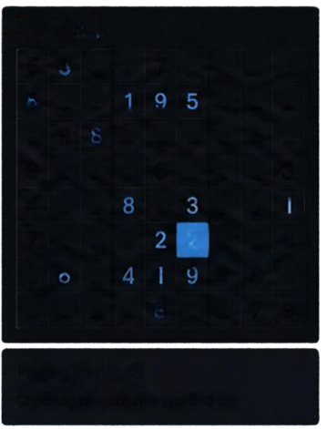

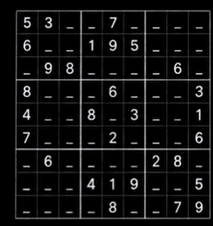
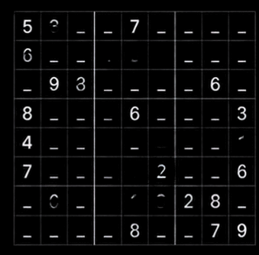


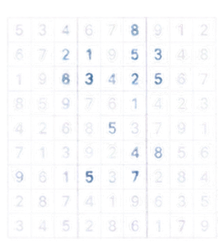



Visualizing the Solver
in Action
Input Puzzle
Current Step
Backtrack Log
Step 36: Undo 5 at R6C6
Step 34: Undo 8 at R5C4
Step 29: Undo 7 at R4C7
Step 21: Undo 1 at R2C2
Watch the solver place numbers,
check constraints, and backtrack
See each guess, undo, and progress toward the solution
Solved Puzzle
Enter any puzzle and explore the
search step by step
Solve
Solver Status
Placing 2 at R6C5
Built with Python, Streamlit,
HTML/CSS/JS for interactivity
Step: 37
Assignments: 24
Backtracks: 6
Status: Searching...
Checking row, column, and 3×3 box
Numbers Tried
1X
2
3X 4X 5X

Slide 7
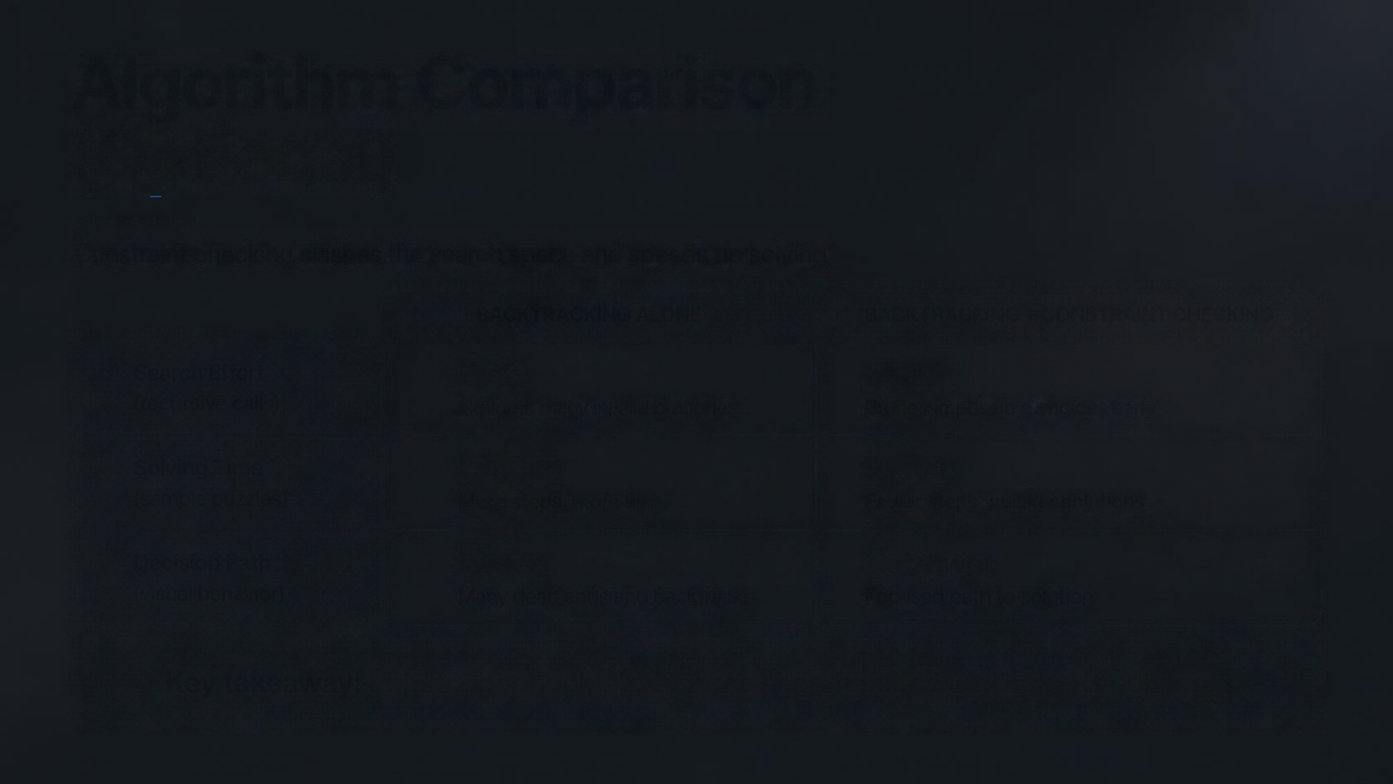





Algorithm Comparison
(Optional)
Constraint checking slashes the search space and speeds up solving
BACKTRACKING ALONE
BACKTRACKING + CONSTRAINT CHECKING
Search Effort
(recursive calls)
High
Explores many invalid branches
Lower
Prunes impossible choices early
Solving Time
(sample puzzles)
Longer
More steps, more time
Faster
Fewer steps, quicker solutions
Decision Path
(visual behavior)
Wider
Many dead ends and backtracks
Narrower
Focused path to solution
Key takeaway: constraint checking reduces search space and speeds solving.

Slide 8


Summary and Next Steps
Interactive visualization makes backtracking and constraints easy to grasp
Clear visibility into algorithm decisions
and undo logic
Extend with new algorithms, stronger validation, and performance optimization
Try the prototype and explore
the solver in action

Slide 9
Thank You

