Slide 1

~ G.B.S.S.BALAJI

Slide 2
ABSTRACT
This paper presents a simple and affordable solution to improve comfort and energy efficiency in household ceiling fans. In many parts of South India, ceiling fans are widely used instead of air conditioners due to their lower cost and power consumption. However, conventional fans require manual speed adjustment and cannot respond automatically to changes in room temperature. To overcome this limitation, a temperature-based automatic fan speed control system using an Arduino microcontroller is proposed.
The system continuously measures ambient temperature and humidity using a DHT11/DHT22 sensor. Based on the sensed values, the Arduino controls a servo motor that rotates the knob of a capacitive fan regulator to adjust the fan speed accordingly. As the room temperature increases, the fan speed rises automatically, and as the temperature decreases, the speed is reduced to maintain comfort. The use of a capacitive regulator minimizes heat loss compared to resistive regulators, improving overall energy efficiency. This approach provides a practical, low-cost solution for enhanced comfort and energy savings in everyday household applications.

Slide 3
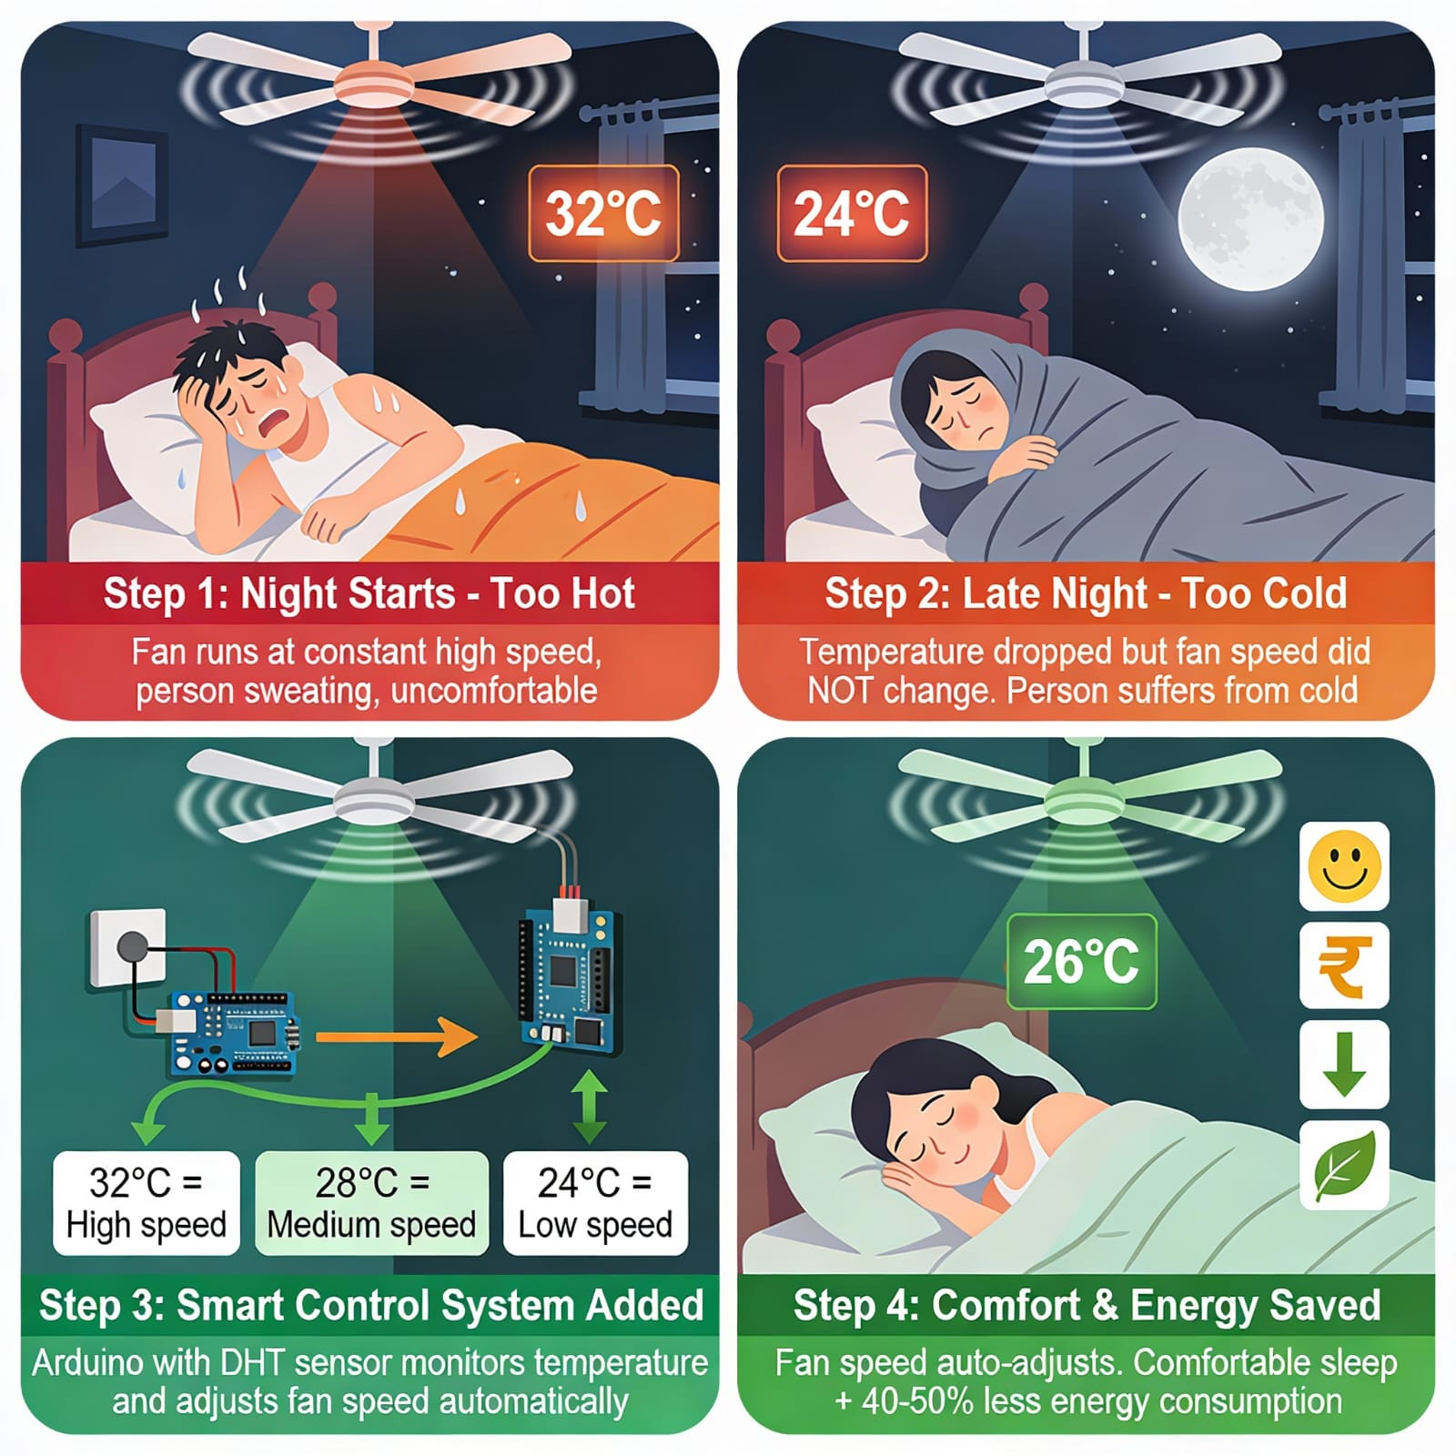
INTRODUCTION
Ceiling fans are widely used in South India
Manual speed control causes discomfort at night
Automatic fan controller solves this issue
Uses Arduino and DHT sensor
Automatically adjusts fan speed
Improves comfort and saves energy
Capacitive regulator reduces power loss

Slide 4
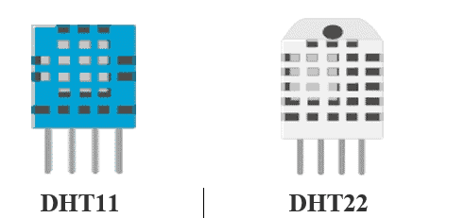
METHODOLOGY
Methodology
System Overview:
Arduino Uno (or alternatives like Arduino Nano, ESP32) reads room temperature.
Automatically adjusts fan speed via a servo motor that turns the existing knob.
Sensor Setup:
DHT22 sensor measures temperature and humidity in real time.
Data is sent to the microcontroller for automatic fan control.
DHT sensor

Slide 5
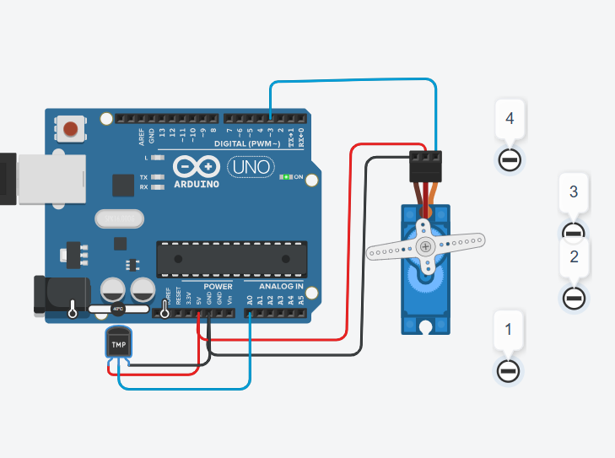
METHODOLOGY
Servo Connection & Control Logic
Servo motor fixed to fan regulator, different angles control fan speed like manual knob. Arduino reads temperature and sets servo angle:
Cool → Low speed Warm → Medium speed Hot → High speed
Software Implementation
Arduino IDE with Servo library used.
Temperature mapped to servo angles.

Slide 6
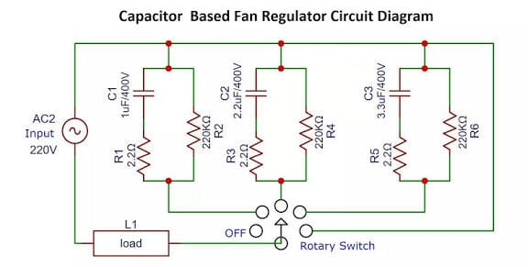
METHODOLOGY
Capacitive Regulator
Efficient fan speed control using capacitors instead of resistive regulators.
Changes phase difference between voltage and current to adjust effective power to the fan.
Different capacitor values allow multiple speed levels (low, medium, high) without wasting energy.
Advantages:
Energy Efficient: Minimal power loss as heat.
Smooth Operation: Stable speed without sudden drops.
Durable: Simple design ensures long life and reliable performance.

Slide 7
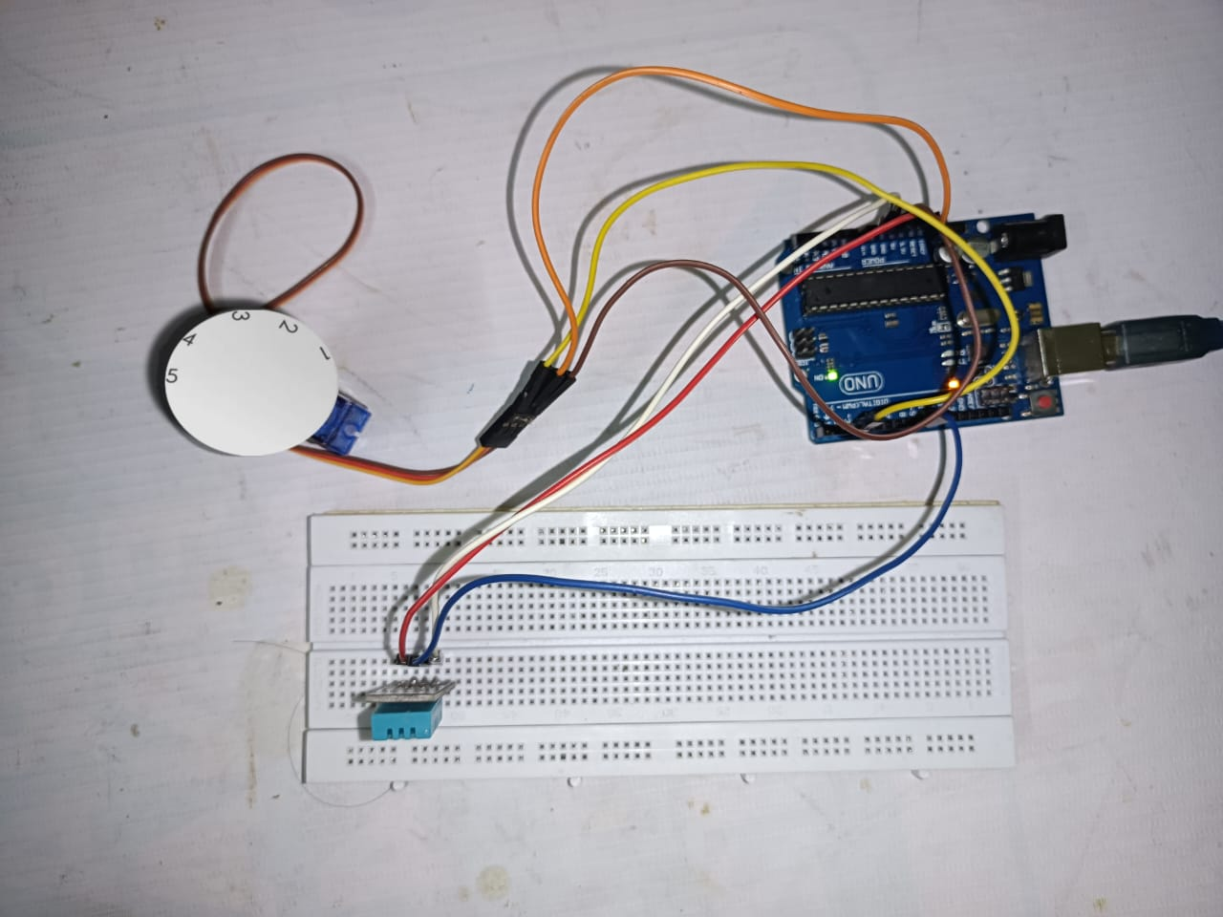
RESULTS
Level | Temperature | Speed(rpm)
1 | <25 | 200
2 | 25-35 | 280
3 | 35-45 | 370
4 | >45 | 420+
capacitive Regulator Levels
Four levels controlled by servo motor based on temperature.
Each level has a specific fan RPM:
Low RPM: Slow fan, less air, saves power.
Medium RPMs: Moderate breeze.
High RPM: Strong breeze, higher airflow.
Practical connections using Microcontroller

Slide 8
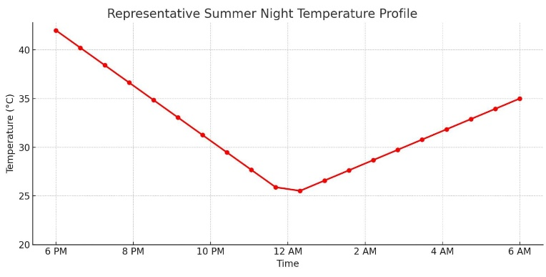
RESULTS

Slide 9
CONCLUSION
The developed system successfully automates the ceiling fan speed based on room temperature changes. It eliminates the need for manual adjustments during the night, enhancing user comfort. By using a capacitive regulator, the design achieves significant energy savings compared to resistive control. The servo-based mechanism ensures smooth and accurate speed transitions.
Testing proved that the fan speed adapts effectively to varying temperature levels.
The Term paper demonstrates how simple microcontroller systems can solve daily-life problems efficiently.
It is affordable, easy to implement, and suitable for typical Indian households.
Future improvements may include builtin model or smartphone-based control for added convenience.

Slide 10
REFERENCES
[1] S. Ragul, S. Yuvaraj, V. Vijayabalan, and B. Venkatasamy, “Design and implementation of automatic speed control of ceiling fan through PWM technique with optocoupler to reduce energy consumption,” in Proc. 3rd Int. Conf. Computer Science and Software Engineering (IC3SE), IEEE, 2024, doi: 10.1109/IC3SE62002.2024.10593059.
[2] S. Ragul, S. Yuvaraj, V. Vijayabalan, and B. Venkatasamy, “IoT based smart controller for ceiling fan,” in Proc. 7th Int. Conf. Trends in Electronics and Informatics (ICOEI), IEEE, 2023, doi: 10.1109/ICOEI56765.2023.10125708.
[3] S. Das, S. Pal, T. Mukhopadhyay, and S. Nath, “Automatic temperature controlled fan,” Int. J. Recent Research in Electrical and Electronics Engineering, vol. 11, no. 3, 2024, doi: 10.5281/zenodo.13353749.
[4] Tinkercad, “Brilliant Kup Wluff circuit design,” Tinkercad, [Online]. Available: https://www.tinkercad.com/things/2HP8O5T4YkD-brilliant-kup-wluff/editel. Accessed: 2024.
[5] Stack Exchange, “Fan speed control using relays,” Electronics Stack Exchange, 2022. [Online]. Available: https://electronics.stackexchange.com/questions/637693/fan-speed-controlusing-relays.
[6] Open-Meteo, “Historical weather API,” Open-Meteo, [Online]. Available: https://open-meteo.com/en/docs/historical-weather-api.
[7] A. K. Patil, “Design and implementation of Arduino based temperature sensing device,” Int. J. Research Publication and Reviews (IJRPR), vol. 3, no. 12, pp. 1407–1409, Dec. 2022.

Slide 11


Slide 12


