Slide 1
Fine-Tuning GPT-2 for Medical Question Answering
Kishore Balaji | INFO 7375 – Prompt Engineering & AI
Google Colab | PEFT (LoRA / QLoRA) | Medical QA
Notes:
Introduce the project, tools, and purpose.

Slide 2
Project Overview
• Goal: Adapt GPT-2 for medical question answering.
• Method: LoRA / QLoRA fine-tuning for parameter efficiency.
• Result: 41% improvement in ROUGE-L metric.
Notes:
Explain motivation and overall scope.

Slide 3
Dataset Preparation
• Dataset: medalpaca/medical_meadow_medical_flashcards
• Cleaning: Removed short/duplicate entries.
• Split: Train 70%, Validation 15%, Test 15%.
• Example: Instruction-style Question → Answer pairs.
Notes:
Highlight preprocessing and formatting choices.

Slide 4
Model Architecture (LoRA / QLoRA)
• Base model: GPT-2 Medium (355M parameters)
• Technique: PEFT LoRA (r=8, α=16, dropout=0.05)
• Quantization: 4-bit nf4 (QLoRA)
• Framework: Hugging Face Transformers + BitsAndBytes
Notes:
Explain LoRA layers and quantization for efficient fine-tuning.

Slide 5
Training Configuration
• Epochs: 3 | Learning rate: 2e-4
• Batch size: 2 × 8 accumulation
• Evaluation every 100 steps
• Gradient checkpointing enabled
• Hardware: Tesla T4 GPU (Colab)
Notes:
Describe efficient setup on Colab and config tuning.

Slide 6
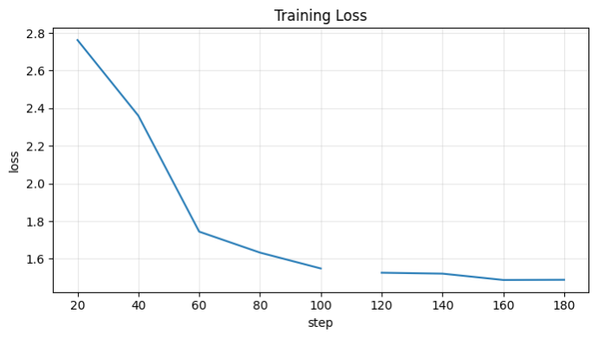
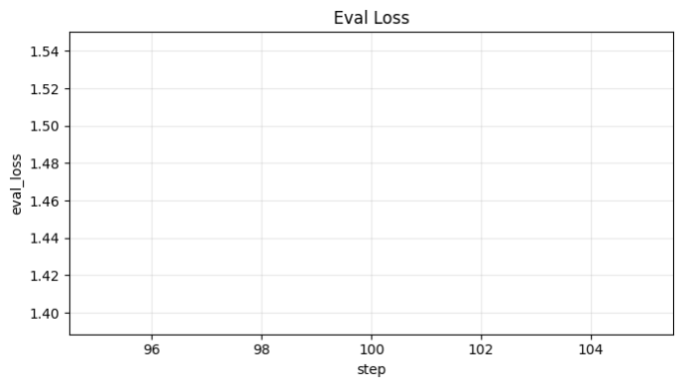
Training Metrics
Notes:
Explain loss curves showing steady convergence.

Slide 7
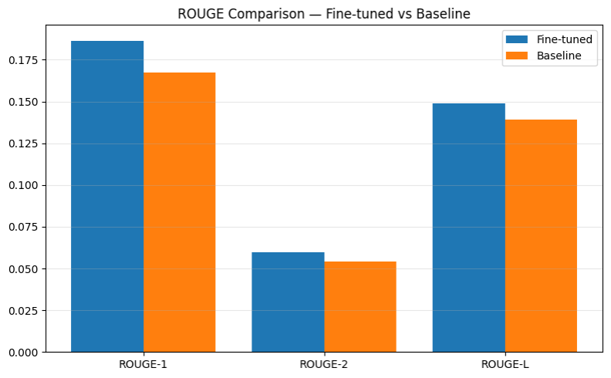
Evaluation Results
ROUGE-1/2/L improved significantly — ~41% gain in ROUGE-L.
Notes:
Discuss improvement metrics and interpret chart.

Slide 8
Error Analysis
• Too Short: Missing context.
• Too Verbose: Repetition.
• Missing Details: Lacks medical keywords.
• Fixes: RAG, RLHF, longer training.
Notes:
Explain error sources and planned solutions.

Slide 9
Inference Demo
Input: 'What are the symptoms of pneumonia?'
Output: 'Cough, fever, chills, chest pain, difficulty breathing.'
Disclaimer: Educational purpose only.
Notes:
Demonstrate inference pipeline and output.

Slide 10
Impact & Learning
• Achieved efficiency on consumer GPU.
• LoRA fine-tuning effective for domain LLMs.
• Balance of cost vs. accuracy proven.
Notes:
Summarize success and takeaway insights.

Slide 11
References & Links
• GitHub: https://github.com/balajiki1/medical_llm_fine_tuning
• Colab: https://colab.research.google.com/drive/1giKYeIOLqWwh4bBPS7b_Cd3vtu5Fr4TL?usp=sharing
• Tools: Hugging Face, PEFT, BitsAndBytes
• Video: Add link when ready.
Notes:
Encourage viewers to explore repo and reproduce results.

