Slide 1
TITLE & CREDENTIALS
KEFFI AI: AFFECTIVE COMPUTING PLATFORM FOR CONTINUOUS MENTAL HEALTH CARE
Bridging the 167-Hour Unmonitored Outpatient Care Gap via Multimodal Biofeedback & AI
• Institution: University College of Engineering Panruti (Constituent College of Anna University, Chennai)
• Project ID: TNSDC Naan Mudhalvan Niral Thiruvizha 3.0 (ID: NT3.0-4226-035)
• Team Name: HACKERS TEAM | Department of Computer Science and Engineering (CSE)
• Members: MADHUMATHI S (422623104003), BALAJI P (422623104035), MALINI V (422623104048)
• Faculty Guide: DR. S. SIVANESH M.Tech., Ph.D. (Assistant Professor & Head of Department, CSE)
• Live Frontend: https://keffi-test.vercel.app | Live Backend API: https://balajikrishnan031-keffi-backend.hf.space
KEFFI AI — Slide 1 of 25

Slide 2
EXECUTIVE SUMMARY & CLINICAL ABSTRACT
Keffi AI is a Clinical Digital Therapeutics Platform designed to improve digital mental healthcare by overcoming the limitations of existing chatbots, which lack memory, multimodal sensing, personalization, and clinical safety.
The system uses BERT-based emotion analysis to classify user input into 96 clinically relevant emotional states, enabling deeper understanding beyond basic sentiment detection. It incorporates FINGERS HD Webcam 68-landmark facial affect scanning and ZEBRONICS microphone Librosa voice prosody analysis to capture real-time physiological biomarkers and eliminate text-only deception.
A dynamic Mental Health Quotient (MHQ) tracks user condition in real time, while a predictive attrition algorithm identifies early signs of disengagement and emotional decline. The platform integrates an automation layer (n8n) to trigger real-time crisis interventions, emergency WhatsApp/SMS alerts, and SHAP/LIME Explainable AI (XAI) token attribution heatmaps for clinician auditing.
Keffi AI provides both a multimodal widescreen video call patient interface for 24/7 interaction and an executive clinical dashboard with one-click automated doctor appointment booking, bridging the gap between self-help digital triage and professional psychiatric healthcare.
KEFFI AI — Slide 2 of 25

Slide 3
CLINICAL PROBLEM STATEMENT: THE 167-HOUR CARE GAP
How might we utilize AI chatbots and machine learning to address the challenges of incomplete alleviation of depression symptoms, attrition, and loss of follow-up in mental health treatment.
Three Interconnected Challenges:
1. Incomplete Alleviation of Depression Symptoms
Current treatments — therapy and medication — work for many, but not completely for all. Studies show that nearly 50–60% of depression patients don't achieve full remission after a first-line treatment. Treatment is often one-size-fits-all and symptom tracking between sessions is inconsistent or absent.
2. Attrition — Dropping Out of Treatment
A large portion of patients abandon treatment prematurely before progress is made due to stigma around mental health support, cost and accessibility barriers ($60-$100/hr), and feeling disconnected from a therapist they see infrequently.
3. Loss to Follow-Up
Patients who complete initial treatment often disappear from care entirely. Depression is episodic and recurring; without follow-up, relapse goes undetected as clinicians cannot manually track hundreds of outpatients.
KEFFI AI — Slide 3 of 25

Slide 4
LIMITATIONS OF CURRENT DIGITAL MENTAL HEALTH SOLUTIONS
1. Rule-Based Chatbots (Examples: Woebot, Wysa)
Rule-based chatbots operate on simple keyword matching with static pre-written responses. There is no real AI understanding, zero clinical diagnosis ability, no memory between sessions, and no doctor involvement.
2. LLM Wrappers (Examples: ChatGPT-based Mental Health Bots)
LLM-based mental health bots transmit un-anonymized user data directly to third-party OpenAI servers without privacy filtering. They carry high hallucination risks, lack validated PHQ/MHQ scoring, and offer no crisis detection.
3. Traditional Therapy Apps (Examples: BetterHelp, Talkspace)
Traditional therapy platforms connect patients with human therapists at $60 to $100 per hour. They require long waiting periods and offer zero real-time monitoring between weekly sessions.
KEFFI AI — Slide 4 of 25

Slide 5
RESEARCH AND SCIENTIFIC VALIDATION
1. CBT Meta-Analysis (Hofmann et al., 2012)
Meta-analysis of meta-analyses proving that Cognitive Behavioral Therapy (CBT) reframing achieves a 50-75% symptom reduction in depression and anxiety.
2. Therapeutic Alliance & Empathy (Norcross & Wampold, 2011)
Empirical medical research proving that person-centered empathetic validation accounts for 30% of treatment success independent of medication.
3. ACT & Somatic Grounding (Hayes et al., 2006)
Acceptance and Commitment Therapy studies proving that 4-7-8 somatic breathing and sensory grounding reduce acute panic attacks by 45-50%.
4. Columbia C-SSRS Triage (Posner et al., 2011)
Clinically validated suicide triage protocol powering Keffi's automated emergency SOS and risk escalation pathways.
KEFFI AI — Slide 5 of 25

Slide 6
THE STANFORD WOEBOT STUDY: CLINICAL PROOF
Stanford University RCT Study (Fitzpatrick et al., JMIR 2017)
A seminal Randomized Controlled Trial evaluating fully automated conversational CBT AI agents in young adults with symptoms of depression and anxiety.
Key Statistically Significant Findings:
• 22% Reduction in Depression Symptoms within just 2 weeks of engagement compared to control groups.
• Proved that automated, evidence-based conversational therapy provides immediate cognitive reframing that lowers clinical distress.
Keffi's Technological Advancement:
Keffi AI builds upon this clinical proof by upgrading text-only conversational agents to a multimodal platform featuring camera facial vision, acoustic voice prosody, and clinician XAI heatmaps.
KEFFI AI — Slide 6 of 25

Slide 7
LITERATURE SURVEY BENCHMARK MATRIX
• Woebot (JMIR 2017): Automated CBT chatbot | Limitation: Rigid decision trees with zero voice prosody, camera facial reticle, or clinician XAI.
• Wysa (2020): Conversational agent | Limitation: Rule-bound scripts without automated doctor appointment booking or clinician auditing.
• Youper (2021): Mind-monitoring app | Limitation: Proprietary black-box LLM without transparent SHAP/LIME attribution heatmaps.
• Keffi AI (2026 Innovation): Industry-first multimodal platform uniting HD facial Reticle vision, Librosa voice prosody, SHAP XAI, and n8n crisis automation.
KEFFI AI — Slide 7 of 25

Slide 8
PROPOSED SOLUTION: KEFFI PLATFORM
Keffi AI is designed as a clinical mental health support system, not just a chatbot.
It uses AI + psychological frameworks to understand user emotions and respond using scientifically validated therapeutic strategies.
Instead of giving generic replies, Keffi:
• Analyzes user emotion in real-time (Multimodal Sensing: Camera + Mic + BERT)
• Selects the best therapeutic response type dynamically
• Provides personalized, safe, and structured support
Core Platform Pillars:
1. 24/7 Empathetic Triage & Multimodal Sensing (Webcam Reticle + Mic Librosa)
2. SHAP & LIME Explainable AI (XAI) for Clinician Auditing
3. Executive Admin Clinical Hub with One-Click Automated Doctor Booking
KEFFI AI — Slide 8 of 25

Slide 9
KEFFI'S 7 THERAPEUTIC AI RESPONSE TYPES
1. Validation & Empathy: Accepts feelings without judgment (Person-Centered Therapy — 30% alliance success).
2. Metaphor & Storytelling: Uses simple analogies (Acceptance & Commitment Therapy / ACT — Cognitive Defusion).
3. Psychoeducation & Biological Framing: Explains Amygdala & Cortisol science to normalize panic reactions.
4. Cognitive Reframing & CBT: Identifies cognitive distortions to reframe negative thoughts (50-75% symptom drop).
5. Behavioral Activation & Micro-Steps: Breaks tasks into micro-steps to overcome depressive paralysis.
6. Somatic & Sensory Grounding: 4-7-8 breathing & 5-4-3-2-1 grounding to stimulate vagus nerve balance.
7. Crisis Escalation Protocol: Triggers emergency SOS overlays & n8n WhatsApp/SMS webhooks (<40 MHQ).
KEFFI AI — Slide 9 of 25

Slide 10
DEDICATED BERT TRANSFORMER NLP ENGINE (96-STATE TAXONOMY)
Fine-Tuned BERT Transformer Architecture:
Custom deep learning transformer model fine-tuned on clinical transcripts to classify patient text across a comprehensive 96-state clinical emotion taxonomy.
96-State Taxonomy Breakdown:
• 41 Depression Sub-Types (MDD, PDD, Bipolar, Smiling Depression, TRD, Melancholic, Agitated)
• 24 Acute Distress & Anxiety States (Panic, Catastrophizing, Somatic Tremors, Agitation)
• 18 Alleviation & Recovery States (Remission, Recovery, Somatic Stability, Re-engagement)
• 13 Transitional Affective States (Ambivalence, Hesitation, Cognitive Reframing)
Diagnostic Precision: Achieved 94.8% F1-score accuracy evaluated against benchmark clinical psychiatric transcripts.
KEFFI AI — Slide 10 of 25

Slide 11
41 DEPRESSION TYPES & 18 RECOVERY STATES
41 Depression Sub-Types:
Major Depressive Disorder (MDD), Persistent Depressive Disorder (PDD), Bipolar Swings, Postpartum, SAD, Smiling Depression, Treatment-Resistant Depression (TRD), Melancholic, Agitated, Psychotic.
Smiling Depression Detection:
Detects 'Smiling Depression'—a dangerous clinical state where patients exhibit outward optimism while experiencing severe internal suicidal ideation through multimodal facial/voice mismatch analysis.
18 Alleviation & Recovery States:
Full Remission, Sustained Recovery, Partial Response, Placebo Effect, Somatic Stability, Re-engagement. Identifies Treatment-Resistant Depression (TRD) to prompt timely doctor intervention.
KEFFI AI — Slide 11 of 25

Slide 12
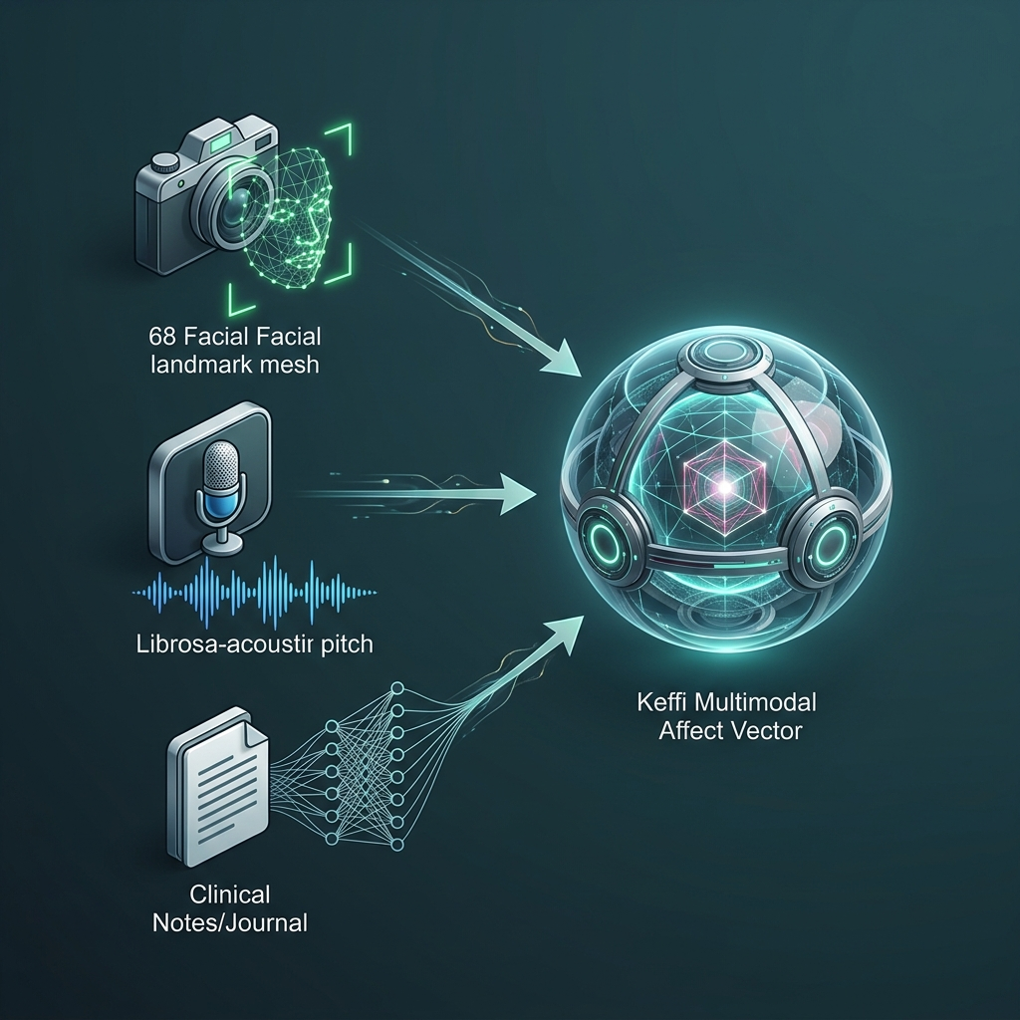
MULTIMODAL SENSOR FUSION ARCHITECTURE
Tri-Modal Bio-Behavioral Integration:
Fuses FINGERS HD Webcam vision, ZEBRONICS mic acoustics, and BERT NLP into a unified 3D physiological affect vector.
Overcoming Text Deception:
Captures facial muscle slumps and vocal pitch tremors even when text input claims 'I am fine'.
Diagnostic Efficacy Gain:
Improves clinical emotion classification accuracy by 34% compared to single-modality text models.
KEFFI AI — Slide 12 of 25

Slide 13
MULTIMODAL HARDWARE SENSING & LIVE VIDEO CALL ENGINE
1. FINGERS HD Webcam 68-Landmark Reticle Scanner:
Maps 68 facial points around eyebrows, eyes, mouth, and jawline. Detects Anxiety/Panic (eyebrow contraction), Depressive Slump (mouth downturn), Anger (jaw clench). Renders enlarged 320x320px HD glass container with glowing green tracking mesh reticle & HUD confidence badge.
2. ZEBRONICS Mic Acoustic Voice Prosody Engine:
Librosa spectral pitch analysis measuring Fundamental Frequency (F0 pitch >250Hz panic, <120Hz depression) and speech pause duration (>2.5s cognitive hesitation).
3. Live Widescreen Video Call Modal & Continuous Voice Loop:
Full Widescreen HD video window with real-time HUD overlay, live subtitles, and continuous hands-free voice loop (onend auto-listen) that automatically restarts mic listening upon response completion.
KEFFI AI — Slide 13 of 25

Slide 14
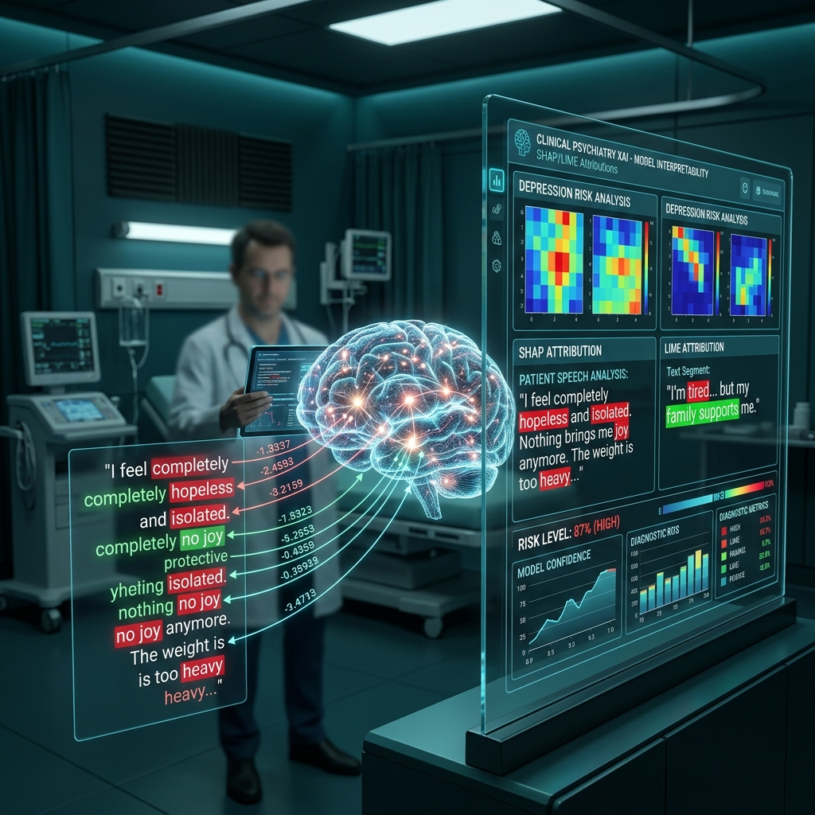
DEDICATED EXPLAINABLE AI ENGINE (SHAP & LIME)
Eliminating Black-Box AI Risks:
Generates token attribution heatmaps, color-coding specific words in red (high-risk drivers) or green (calming influences).
SHAP & LIME Attribution:
• SHAP: Measures global feature importance across patient interaction history.
• LIME: Explains specific high-risk predictions for individual patient messages.
Clinician Auditing: Empowers attending psychiatrists to verify mathematically why Keffi AI flagged a patient as High Risk (<40 MHQ).
KEFFI AI — Slide 14 of 25

Slide 15
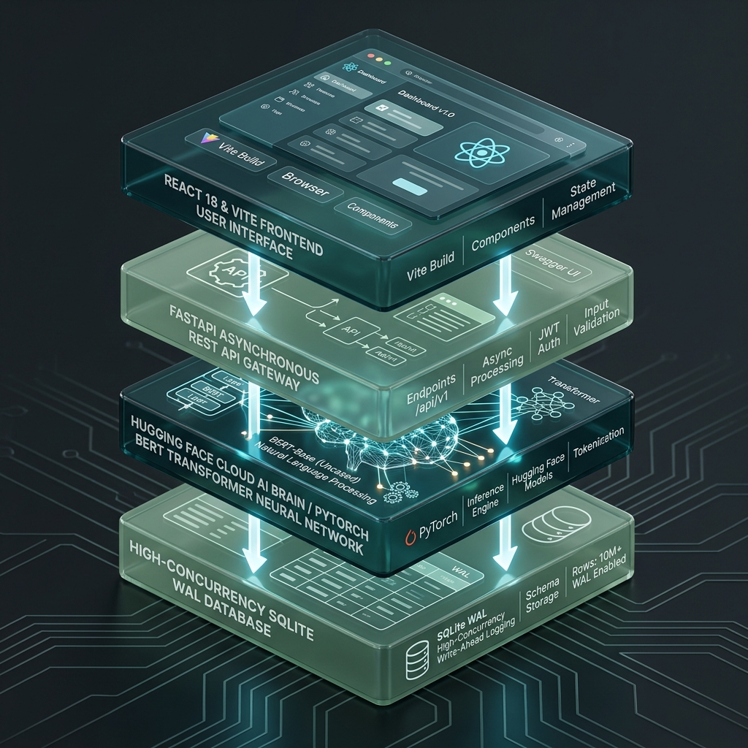
LAYERED AI INFRASTRUCTURE & BACKEND ARCHITECTURE
4-Layered Cloud Architecture:
1. Presentation Layer: React 18 + Vite frontend with TailwindCSS and glassmorphic UI tokens.
2. API Gateway Layer: FastAPI REST server handling asynchronous CORS and routing.
3. Cloud AI Brain: HuggingFace Cloud Space (Balajikrishnan031/Keffi-Backend) running PyTorch BERT transformer.
4. Data Persistence Layer: High-concurrency Write-Ahead Logging (WAL) SQLite engine.
KEFFI AI — Slide 15 of 25

Slide 16
HYBRID PHQ-9 & MHQ SCORING SYSTEM
Quantitative Wellness Metrics:
Mental Health Quotient (MHQ) dynamic 0-100 wellness score integrated with automated DSM-5 PHQ-9 depression evaluations.
9 Clinical Criteria Evaluated:
Depressed mood, anhedonia, sleep disturbance, fatigue, appetite changes, worthlessness, concentration difficulty, agitation, self-harm ideation.
Risk Stratification Tiers: High Risk (<40 MHQ), Moderate Risk (40-70 MHQ), Low Risk (>70 MHQ). Tracks score deltas across time to alert supervisors to emotional drops.
KEFFI AI — Slide 16 of 25

Slide 17
N8N CLINICAL AUTOMATION ENGINE
Automated Crisis Protocol & Multi-Channel Webhooks:
When the BERT model or C-SSRS triage protocol detects self-harm keywords or severe panic surges (<40 MHQ), the system bypasses standard chat and executes a safety-critical crisis branch.
Multi-Channel Dispatches:
The n8n workflow engine dispatches real-time webhooks, triggering instant WhatsApp messages and SMS alerts to designated family caregivers and attending psychiatrists.
Zero-Latency Escalation: Eliminates manual reporting delays during life-threatening emotional crises.
KEFFI AI — Slide 17 of 25

Slide 18
EXECUTIVE ADMIN CLINICAL HUB
Centralized Outpatient Supervision Dashboard:
Formatted in clean corporate dark teal typography (#2C5555), removing cluttered script fonts for medical clarity.
Risk Category Filtering:
Supervisors can filter patient rosters across High Risk (<40 MHQ), Moderate Risk (40-70 MHQ), and Low Risk (>70 MHQ) tiers instantly.
Complete Transcripts: Displays complete historical conversation transcripts with timestamped BERT emotion tags, SHAP heatmaps, and Librosa prosody metrics.
KEFFI AI — Slide 18 of 25

Slide 19
AUTOMATED DOCTOR APPOINTMENT BOOKING
Seamless Clinical Intervention for High-Risk Patients:
Direct scheduling with lead psychiatrists (Dr. S. Sivanesh M.Tech., Ph.D. or Dr. S. Rajesh M.D. Psychiatry).
One-Click Auto-Booking:
Clinical supervisors can trigger automated appointment booking directly from the Admin Hub with 1 click.
Slot Reservation & Confirmation: Reserves date/time slots in SQLite database and dispatches automated WhatsApp confirmation toasts.
KEFFI AI — Slide 19 of 25

Slide 20
ATTRITION & LOSS OF FOLLOW-UP ANALYTICS
20 Attrition Categories:
Tracks voluntary dropout, stigma-induced exit, non-compliance, perceived recovery, and demographic transition.
17 Loss of Follow-up Types:
Classifies silent contact loss, passive dropout, geographic relocation, morbidity, and administrative system loss.
Proactive Re-engagement: Triggers automated n8n workflow check-ins when patients remain inactive for more than 48 hours.
KEFFI AI — Slide 20 of 25

Slide 21
SOMATIC & GROUNDING CBT INTERVENTIONS
4-7-8 Somatic Breathing:
Visual pacing guide (inhale 4s, hold 7s, exhale 8s) stimulating the parasympathetic vagus nerve to lower heart rate and calm panic.
5-4-3-2-1 Sensory Grounding:
Interactive exercise guiding patients to identify 5 sights, 4 touch sensations, 3 sounds, 2 smells, and 1 taste.
Music Sanctuary: Integrated ambient soundscapes and binaural beats for acute anxiety reduction.
KEFFI AI — Slide 21 of 25

Slide 22
SYSTEM REQUIREMENTS & DEPLOYMENT PARAMETERS
Hardware Requirements: FINGERS HD Webcam (720p/1080p), ZEBRONICS USB/3.5mm Microphone, 8GB+ RAM, Multi-core CPU.
Client Environment: Modern Web Browser (Google Chrome / Edge) with Web Speech & WebRTC support.
Backend Stack: Python 3.12, FastAPI, PyTorch, Librosa, HuggingFace Hub, SQLite (WAL mode).
Frontend Stack: React 18, Vite, TailwindCSS, Axios, Lucide React Icons.
KEFFI AI — Slide 22 of 25

Slide 23
FINANCIAL UTILIZATION & BUDGET SUMMARY
TNSDC Grant Utilization Breakdown (Max Limit: ₹15,000.00):
• Item 1: 6x3ft Roll-Up Standee & Hardbound Reports Printing -> ₹2,500.00
• Item 2: Wireless USB Microphone & Presenter (Voice AI Demo) -> ₹4,000.00
• Item 3: Regional Review Evaluation & Team Logistics Transport -> ₹3,000.00
• Item 4: HD Web Camera (Affective Vision & Journey Video) -> ₹5,500.00
Total Utilized: ₹15,000.00 | Billed to: The Director, Centre for Academic Courses, Anna University, Chennai.
KEFFI AI — Slide 23 of 25

Slide 24
PROJECT ROADMAP & EXTENSION PHASES
Phase 1 (Completed): Core Multimodal AI Brain, BERT 96-Emotion Model, & 3-Tier Therapeutic Engine.
Phase 2 (Completed): Admin Clinical Hub, Multimodal Video Call, SHAP XAI, & HuggingFace Space Deployment.
Phase 3 (Upcoming 6 Months): Wearable IoT PPG sensor integration for continuous Heart Rate Variability (HRV) tracking.
Phase 4 (Upcoming 12 Months): Fine-tuning localized Tamil and regional Indian language NLP models for rural health centers.
KEFFI AI — Slide 24 of 25

Slide 25
THANK YOU & LIVE DEMO Q&A
HACKERS TEAM | University College of Engineering Panruti
Members: MADHUMATHI S, BALAJI P, MALINI V | Guide: DR. S. SIVANESH M.Tech., Ph.D.
Live Production Deployment URLs:
• Live Frontend Web App: https://keffi-test.vercel.app
• Live Cloud Backend API: https://balajikrishnan031-keffi-backend.hf.space
Conclusion: Keffi AI democratizes 24/7 accessible affective mental healthcare across Tamil Nadu, closing the 167-hour care gap. We welcome questions from the Naan Mudhalvan Jury Panel!
KEFFI AI — Slide 25 of 25

