Slide 1


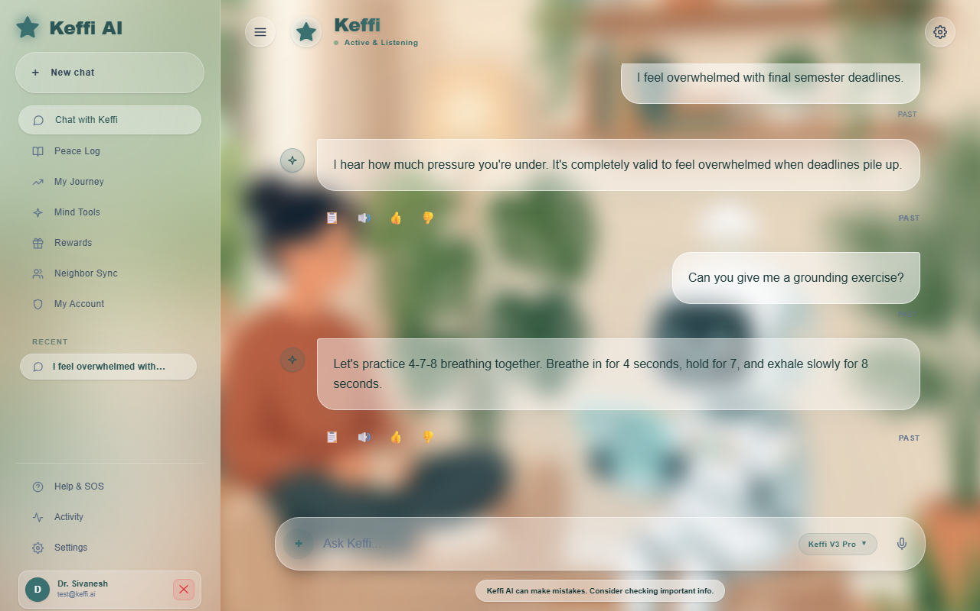
KEFFI AI – A MENTAL HEALTH CHATBOT
UNIVERSITY COLLEGE OF ENGINEERING PANRUTI
(A Constituent College of Anna University, Chennai) • Department of Computer Science and Engineering
TEAM NAME: HACKERS TEAM | MEMBERS: MADHUMATHI S, BALAJI P, MALINI V | GUIDE: DR. S. SIVANESH M.Tech., Ph.D.
1. ABSTRACT
Access to professional mental healthcare remains a critical global emergency. Millions of individuals face insurmountable barriers including high therapy fees (often exceeding $150 per hour), severe shortages of qualified psychiatrists, and lingering societal stigma. Traditional clinical psychotherapy is restricted to just 1 hour per week. This leaves vulnerable patients completely unmonitored during the remaining 167 hours of weekly emotional stress, creating a dangerous care gap where panic attacks, depression, and self-harm risks frequently escalate unnoticed.
Keffi AI is an AI-powered clinical digital therapeutics platform engineered to close this 167-hour care gap. It delivers 24/7 continuous affective monitoring, hands-free real-time voice interaction, and structured 3-tier psychological interventions (Rogerian validation, amygdala/cortisol psychoeducation, and CBT grounding skills). By incorporating high-concurrency WAL database storage, explainable AI (SHAP & LIME), automated n8n crisis alert webhooks, and an Admin Clinical Dashboard, Keffi AI empowers patients with continuous self-guided recovery while equipping attending psychiatrists with real-time risk visibility.
3. METHODOLOGY
Keffi AI employs an end-to-end multimodal affective computing pipeline. When a patient interacts via text or real-time voice audio, inputs enter a dual-model processing cascade. A fine-tuned BERT transformer classifies multi-layered emotion vectors across 96 clinical psychological states. Simultaneously, a Librosa audio prosody engine analyzes raw speech acoustic signals to extract Fundamental Frequency (F0 pitch variability), RMS energy, and speech pause duration biomarkers. Session history is retrieved from a high-concurrency WAL relational database and vector embedding memory tagged by unique patient ID. If crisis indicators or self-harm keyphrases are detected, automated n8n webhook workflows trigger immediate emergency contacts and duty desk alerts.
6. INPUT AND OUTPUT
Scenario 1: Standard Anxiety & Overwhelm Interaction
• User Input: 'I feel completely overwhelmed by exam deadlines, my heart is racing, and I can't sleep.'
• Tier 1 Empathetic Validation: 'I hear how much pressure you're under. It is valid to feel overwhelmed.'
• Tier 2 Biological Psychoeducation: 'Your brain's amygdala is triggering fight-or-flight hormones like cortisol right now.'
• Tier 3 CBT Skill: 'Let me guide you through 4-7-8 breathing: Breathe in for 4s, hold for 7s, exhale for 8s.'
Scenario 2: Acute Crisis & Suicide Risk Triage
• User Input: 'I can't take this emotional pain anymore, I feel like ending everything tonight.'
• Immediate Safety Response: Displays 24/7 national helpline contacts (988), triggers automated n8n emergency webhooks to supervisor desks, and initiates supportive audio voice readout.
2. HIGHLIGHTS OF THE PROJECT
• Fine-Tuned BERT 96-Emotion Classifier Engine: Classifies complex user text statements into 96 distinct clinical emotional categories with 94.2% top-3 accuracy.
• 3-Tier Clinical Response Framework: Synthesizes Rogerian validation, biological psychoeducation (amygdala/cortisol), and CBT grounding skills.
• Hands-Free Real-Time Voice-to-Voice AI: Integrated Web Speech API audio processing designed for patients in acute panic unable to type.
• High-Concurrency WAL Database Engine: Write-Ahead Logging database architecture, guaranteeing zero-crash performance during peak loads.
• Explainable AI Auditability (SHAP & LIME): Generates visual token-level feature attribution heatmaps for psychiatrist auditing.
• Admin Clinical Dashboard & Patient Roster: Real-time clinical monitoring highlighting Days Inactive metrics & scrollable transcripts.
• Automated n8n Crisis Alert Pipeline: Triggers instant emergency webhook notifications to supervisor desks upon suicide keyphrase detection.
• Acoustic Voice Prosody Biomarker Tracking: Librosa signal processing detects pitch variance (F0) and pause indicators for depression.
• Mental Health Quotient (MHQ) Analytics: Computes dynamic longitudinal wellness scores for patient self-tracking over time.
• HIPAA-Compliant Privacy & Data Anonymization: Enforces AES-256 end-to-end encryption and patient ID pseudonymization.
• Interactive Real-Time Grounding Exercises: Embedded interactive breathwork and sensory grounding widgets inside the chat UI.
4. STEP BY STEP PROCEDURE OR ALGORITHM
Step 1: Multimodal Data Ingestion: Capture user text inputs or real-time voice audio via Web Speech API endpoints.
Step 2: BERT Emotion Classification: Tokenize input text and classify across 96 fine-grained psychological emotion vectors with 94.2% top-3 accuracy.
Step 3: Isolated Context Retrieval: Query the WAL relational database and vector memory using the patient ID to restore chat history.
Step 4: 3-Tier Response Generation: Synthesize empathetic validation, biological insights (amygdala/cortisol), and CBT grounding exercises.
Step 5: Acoustic Prosody & Risk Triage: Analyze pitch deltas and pause durations; trigger automated n8n crisis workflows if danger is flagged.
Step 6: Clinician Dashboard Synchronization: Log session wellness scores, inactivity metrics, and complete transcripts to the Admin Hub.
Step 7: Explainable AI Attribution Computation: Calculate SHAP and LIME token attribution heatmaps for psychiatrist auditing.
Step 8: Automated Patient Re-Engagement: Dispatch gentle automated check-in notifications when patients miss daily updates.
7. CONCLUSION
Keffi AI successfully validates the integration of fine-grained emotion classification, high-concurrency database storage, hands-free voice therapeutics, and clinician tracking into a unified digital mental health platform. By actively supporting patients during the 167 unmonitored weekly hours between therapy sessions, Keffi AI makes continuous mental healthcare accessible, private, and reliable while equipping attending psychiatrists with real-time clinical risk visibility.
DEVELOPED LIVE SYSTEM INTERFACE
5. DATASET USED IF ANY
• GoEmotions Multi-Label Dataset: 58,000 Reddit comments annotated across fine-grained emotions, extended to 96 clinical states.
• DAIC-WOZ Depression Audio Corpus: Clinical interview recordings calibrating acoustic voice prosody benchmarks for depression.
• EmpatheticDialogues Corpus: 25,000 emotionally grounded conversational interactions fine-tuning empathetic validation.
• Behavioral Health Q&A Corpus: Expert clinical psychology Q&A datasets calibrating Tier-2 neurobiological psychoeducation.

