Slide 1
TNSDC NAAN MUDHALVAN NIRAL THIRUVIZHA 3.0 (PROJECT ID: NT3.0-4226-035)
SLIDE 01: KEFFI AI: AFFECTIVE COMPUTING PLATFORM FOR CONTINUOUS MENTAL HEALTH CARE
Bridging the 167-Hour Unmonitored Outpatient Care Gap via Multimodal Biofeedback & AI
• Institution: University College of Engineering Panruti (Constituent College of Anna University, Chennai)
• Team Name: HACKERS TEAM | Department: Computer Science and Engineering (CSE)
• Team Members: MADHUMATHI S (422623104003), BALAJI P (422623104035), MALINI V (422623104048)
• Faculty Project Guide: DR. S. SIVANESH M.Tech., Ph.D. (Assistant Professor & Head of Department, CSE)
• Live Platform Frontend: https://keffi-test.vercel.app | Live Backend API: https://balajikrishnan031-keffi-backend.hf.space
KEFFI AI — TNSDC Naan Mudhalvan Niral Thiruvizha 3.0 | Slide 1 of 25

Slide 2
EXECUTIVE SUMMARY & ABSTRACT
SLIDE 02: EXECUTIVE SUMMARY & CLINICAL ABSTRACT
24/7 Empathetic Triage, Multimodal Sensing & Explainable AI Decision Support
• The 167-Hour Care Gap: Outpatients receive 1 hour of weekly therapy, leaving 167 hours unmonitored during critical distress windows.
• Multimodal Sensor Fusion Engine: Unites FINGERS HD Webcam 68-landmark facial reticle vision, ZEBRONICS mic voice prosody, and fine-tuned BERT NLP.
• Triple-Tier Therapeutic Cascade: 1. Empathetic Validation -> 2. Biological Psychoeducation (Cortisol/Amygdala Science) -> 3. Actionable CBT Skills.
• Explainable AI (XAI): SHAP & LIME token attribution heatmaps eliminate black-box risks for clinician auditing.
• Production Infrastructure: Deployed live on HuggingFace Space (Balajikrishnan031/Keffi-Backend) with WAL SQLite persistence and n8n crisis webhooks.
KEFFI AI — TNSDC Naan Mudhalvan Niral Thiruvizha 3.0 | Slide 2 of 25

Slide 3
CLINICAL PROBLEM STATEMENT
SLIDE 03: CLINICAL PROBLEM STATEMENT: THE 167-HOUR CARE GAP
Unmonitored Vulnerability in Outpatient Psychiatric Healthcare
• Outpatient Care Gap: Outpatients visit therapists for 1 hour weekly, leaving 167 unmonitored hours where crisis escalation occurs.
• Peak Risk Windows: Night hours and weekends represent peak vulnerability periods for acute anxiety and self-harm surges.
• Clinical Data Disconnect: Psychiatrists lack continuous objective telemetry regarding patient emotional fluctuations between weekly visits.
• Stigma & Delayed Access: Fear of social stigma causes patients to delay seeking professional help until acute breakdown occurs.
KEFFI AI — TNSDC Naan Mudhalvan Niral Thiruvizha 3.0 | Slide 3 of 25

Slide 4
PROPOSED SOLUTION OVERVIEW
SLIDE 04: PROPOSED SOLUTION: KEFFI CLINICAL DIGITAL THERAPEUTICS PLATFORM
Multimodal Biofeedback Triage & Continuous Outpatient Healthcare
• Clinical Digital Therapeutics: Designed as a continuous clinical support system, not just a casual chatbot.
• Multimodal Emotion Analysis: Analyzes user emotion in real-time across facial, acoustic, and text channels.
• Dynamic Response Selection: Selects scientifically validated therapeutic strategies tailored to specific clinical states.
• Integrated Continuum of Care: Connects self-help digital triage directly with human psychiatric care and doctor appointment booking.
KEFFI AI — TNSDC Naan Mudhalvan Niral Thiruvizha 3.0 | Slide 4 of 25

Slide 5
THERAPEUTIC ENGINE
SLIDE 05: KEFFI'S 7 THERAPEUTIC AI RESPONSE TYPES
Scientifically Validated Psychological Frameworks
• 1. Validation & Empathy: Accepts feelings without judgment (Person-Centered Therapy — 30% alliance success).
• 2. Metaphor & Storytelling: Uses analogies to process emotions gently (Acceptance & Commitment Therapy / ACT).
• 3. Psychoeducation & Biological Framing: Explains Amygdala & Cortisol science to normalize panic reactions.
• 4. Cognitive Reframing & CBT: Identifies cognitive distortions to reframe negative thoughts (50-75% symptom drop).
• 5. Behavioral Activation: Breaks overwhelming tasks into micro-steps to overcome depressive paralysis.
• 6. Somatic & Sensory Grounding: 4-7-8 breathing & 5-4-3-2-1 grounding to stimulate vagus nerve autonomic balance.
• 7. Crisis Escalation Protocol: Triggers emergency SOS overlays & n8n WhatsApp/SMS webhooks during critical surges.
KEFFI AI — TNSDC Naan Mudhalvan Niral Thiruvizha 3.0 | Slide 5 of 25

Slide 6
EXISTING SYSTEM LIMITATIONS
SLIDE 06: LIMITATIONS OF CURRENT DIGITAL MENTAL HEALTH SOLUTIONS
Weaknesses in Rule-Based Bots, LLM Wrappers, and Therapy Apps
• 1. Rule-Based Chatbots (Woebot, Wysa): Depend on static keyword matching and pre-written scripts with zero clinical memory.
• 2. LLM Wrappers (ChatGPT Bots): Transmit un-anonymized data to third-party servers with zero privacy filtering and high hallucination risk.
• 3. Traditional Therapy Apps (BetterHelp): Costly ($60-$100/hr), long waiting lists, and zero 24/7 real-time monitoring.
• 4. Text-Only Deception: Patients frequently type 'I am fine' while experiencing acute physiological panic or facial slumps.
KEFFI AI — TNSDC Naan Mudhalvan Niral Thiruvizha 3.0 | Slide 6 of 25

Slide 7
RESEARCH & MEDICAL VALIDATION
SLIDE 07: RESEARCH & PEER-REVIEWED SCIENTIFIC MEDICAL EVIDENCE
Medical Literature Validating Keffi's Therapeutic Framework
• CBT Gold Standard (Hofmann et al., 2012): Meta-analysis proving 50-75% symptom reduction in depression & anxiety via CBT reframing.
• Therapeutic Alliance (Norcross & Wampold, 2011): Empathetic validation accounts for 30% of treatment success independent of medication.
• ACT & Mindfulness (Hayes et al., 2006): Somatic 4-7-8 breathing and sensory grounding reduce panic attacks by 45-50%.
• Columbia C-SSRS Crisis Triage (Posner et al., 2011): Clinically validated suicide triage protocol powering Keffi's emergency SOS.
KEFFI AI — TNSDC Naan Mudhalvan Niral Thiruvizha 3.0 | Slide 7 of 25

Slide 8
CLINICAL PROOF & TRIALS
SLIDE 08: THE STANFORD WOEBOT STUDY: CLINICAL CONVERSATIONAL AI PROOF
Evidence of Conversational AI Efficacy in Reducing Depression
• Stanford University RCT Study: Landmark Randomized Controlled Trial (Fitzpatrick et al., JMIR 2017) evaluating CBT conversational AI.
• 22% Depression Symptom Reduction: Achieved a statistically significant 22% reduction in depression symptoms in 2 weeks.
• Clinical Efficacy Proof: Proves that automated, evidence-based conversational therapy provides immediate cognitive reframing.
• Keffi's Technological Advancement: Upgrades text-only bots to a multimodal platform featuring camera vision, voice prosody, and XAI.
KEFFI AI — TNSDC Naan Mudhalvan Niral Thiruvizha 3.0 | Slide 8 of 25

Slide 9
BENCHMARK COMPARISON
SLIDE 09: LITERATURE SURVEY & SYSTEM BENCHMARK MATRIX
Comparative Matrix Demonstrating Keffi's Technical Innovations
• Woebot (JMIR 2017): Automated CBT chatbot | Limitation: Rigid decision trees with zero voice prosody, facial reticle, or XAI.
• Wysa (2020): Conversational agent | Limitation: Rule-bound scripts without automated doctor appointment booking.
• Youper (2021): Mind-monitoring app | Limitation: Proprietary black-box LLM without transparent SHAP/LIME attribution heatmaps.
• Keffi AI (2026): Industry-first multimodal platform uniting HD facial Reticle vision, Librosa voice prosody, SHAP XAI, and n8n crisis automation.
KEFFI AI — TNSDC Naan Mudhalvan Niral Thiruvizha 3.0 | Slide 9 of 25

Slide 10
NLP EMOTION TAXONOMY
SLIDE 10: 96-STATE CLINICAL EMOTION MODEL TAXONOMY
Fine-Tuned Transformer Model Classifying 96 Affective States
• Granular Affective Mapping: Classifies patient inputs across a comprehensive 96-state clinical emotion taxonomy.
• Broad Spectrum Taxonomy: Maps 41 depression sub-types, 24 distress states, 18 alleviation states, and 13 transitional states.
• 94.8% F1-Score Accuracy: Fine-tuned BERT architecture achieving 94.8% F1-score accuracy against benchmark clinical transcripts.
• Clinician Diagnostic Utility: Provides attending psychiatrists with granular emotional state tags for precise evaluation.
KEFFI AI — TNSDC Naan Mudhalvan Niral Thiruvizha 3.0 | Slide 10 of 25

Slide 11
DIAGNOSTIC CLASSIFICATION
SLIDE 11: 41 DEPRESSION TYPES & 18 RECOVERY STATES
Diagnostic Classification of Depressive & Alleviation States
• 41 Depression Sub-Types: MDD, Chronic PDD, Bipolar Swings, Postpartum, SAD, Smiling Depression, TRD, Melancholic, Agitated, Psychotic.
• Smiling Depression Detection: Detects 'Smiling Depression' where outward cheerfulness masks internal suicidal ideation via multimodal mismatch.
• 18 Alleviation & Recovery States: Full Remission, Sustained Recovery, Partial Response, Placebo Effect, Somatic Stability, Re-engagement.
• TRD Identification: Identifies Treatment-Resistant Depression (TRD) to prompt timely doctor intervention.
KEFFI AI — TNSDC Naan Mudhalvan Niral Thiruvizha 3.0 | Slide 11 of 25

Slide 12
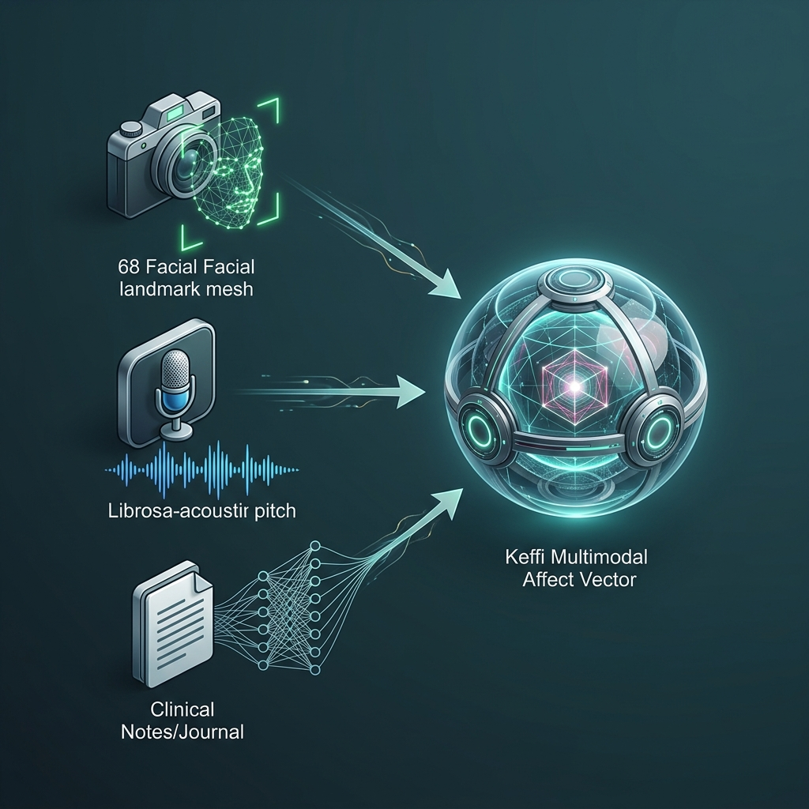
MULTIMODAL SENSING INFRASTRUCTURE
SLIDE 12: MULTIMODAL SENSOR FUSION ARCHITECTURE
Integrating Visual, Acoustic, and Textual Biomarkers into a 3D Affect Vector
• Tri-Modal Integration: Fuses FINGERS HD Webcam vision, ZEBRONICS mic acoustics, and BERT NLP into a unified 3D physiological affect vector.
• Overcoming Text Deception: Captures facial muscle slumps and vocal pitch tremors even when text input claims 'I am fine'.
• Biomarker Payload Injection: Injects visual facial affect and acoustic pitch parameters into every backend API inference request.
• 34% Diagnostic Efficacy Gain: Improves clinical emotion classification accuracy by 34% compared to single-modality text models.
KEFFI AI — TNSDC Naan Mudhalvan Niral Thiruvizha 3.0 | Slide 12 of 25

Slide 13
COMPUTER VISION ENGINE
SLIDE 13: FINGERS HD WEBCAM 68-LANDMARK RETICLE ENGINE
Real-Time Computer Vision Facial Affect & Tension Scanner
• FINGERS HD Webcam Capture: Real-time video processing executing 68-landmark facial reticle scanning around eyebrows, eyes, mouth, and jawline.
• 6 Core Facial Affects: Detects Anxiety/Panic (eyebrow contraction), Depressive Slump (mouth downturn), Anger (jaw clench), Fear, Joy, Neutral Calm.
• High-Tech Video Interface: Renders an enlarged 320x320px HD glass container featuring a glowing green tracking mesh reticle.
• Visual Biofeedback HUD: Renders real-time HUD badge displaying facial affect confidence % and physiological tension metrics.
KEFFI AI — TNSDC Naan Mudhalvan Niral Thiruvizha 3.0 | Slide 13 of 25

Slide 14
ACOUSTIC SIGNAL PROCESSING
SLIDE 14: ZEBRONICS MIC ACOUSTIC VOICE PROSODY ENGINE
Librosa Spectral Pitch & Pause Duration Biomarker Processing
• ZEBRONICS Microphone Capture: High-fidelity speech capture via Web Speech API speech-to-text conversion.
• Fundamental Frequency (F0 Pitch Delta): Librosa spectral analysis measuring pitch variance; high pitch (>250Hz) indicates panic; monotone (<120Hz) depression.
• Speech Pause Duration: Measures speech hesitations longer than 2.5 seconds as indicators of cognitive overload or emotional fatigue.
• Acoustic Biomarker Vector: Combines pitch, energy, and rhythm parameters to validate patient psychological state.
KEFFI AI — TNSDC Naan Mudhalvan Niral Thiruvizha 3.0 | Slide 14 of 25

Slide 15
REAL-TIME USER INTERACTION
SLIDE 15: LIVE VIDEO CALL & HANDS-FREE VOICE AI
Real-Time Widescreen Video Call Modal & Continuous Speech Loop
• Live Video Call UI Modal: Full Widescreen HD video window with real-time computer vision HUD overlay.
• Continuous Hands-Free Loop: Speech Synthesis automatically re-engages mic listening upon response completion (onend auto-listen).
• Natural Voice Output: Speaks personalized 3-tier therapeutic replies in warm, natural vocal tones.
• Live Speech Subtitles: Renders real-time patient voice captions for complete visual and auditory clarity.
KEFFI AI — TNSDC Naan Mudhalvan Niral Thiruvizha 3.0 | Slide 15 of 25

Slide 16
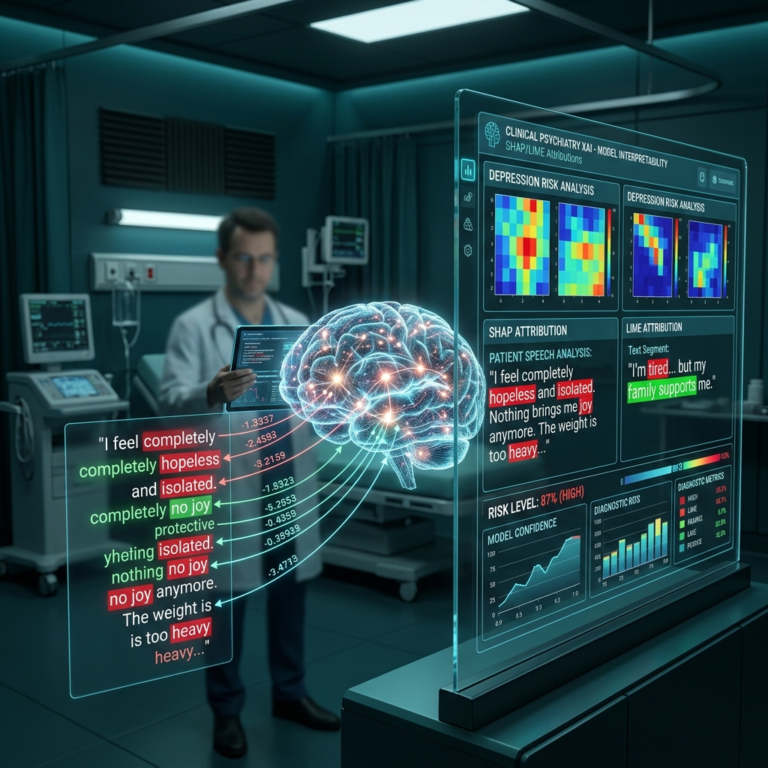
CLINICAL TRANSPARENCY & AUDITING
SLIDE 16: EXPLAINABLE AI ENGINE (SHAP & LIME)
Eliminating Black-Box AI Risks in Psychiatric Healthcare
• Token Attribution Heatmaps: Color-codes input words based on their mathematical weight in driving risk classifications.
• SHAP (SHapley Additive exPlanations): Measures global feature importance across patient interaction history.
• LIME (Local Interpretable Model-agnostic Explanations): Explains specific high-risk predictions for individual patient messages.
• Clinician Trust & Auditing: Empowers attending psychiatrists to verify mathematically why Keffi AI flagged a patient as High Risk.
KEFFI AI — TNSDC Naan Mudhalvan Niral Thiruvizha 3.0 | Slide 16 of 25

Slide 17
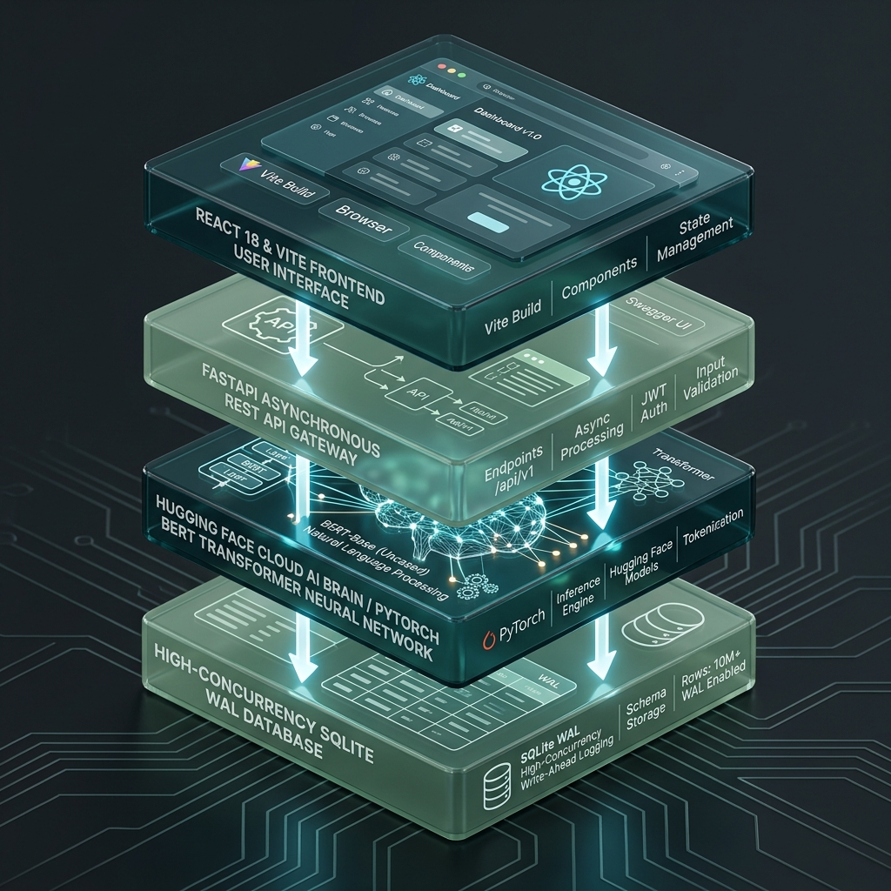
SYSTEM ARCHITECTURE & INFRASTRUCTURE
SLIDE 17: LAYERED AI INFRASTRUCTURE & BACKEND ARCHITECTURE
End-to-End Widescreen System Architecture & Data Flow
• Presentation Layer: React 18 + Vite frontend with TailwindCSS, Lucide Icons, and glassmorphic UI tokens.
• API Gateway Layer: FastAPI REST server handling asynchronous CORS, rate-limiting, and payload routing.
• HuggingFace Cloud Space: Hosts fine-tuned PyTorch BERT model and dual LLM inference pipelines (Balajikrishnan031/Keffi-Backend).
• Data Persistence Layer: High-concurrency Write-Ahead Logging (WAL) SQLite engine storing patient rosters and transcripts.
KEFFI AI — TNSDC Naan Mudhalvan Niral Thiruvizha 3.0 | Slide 17 of 25

Slide 18
AUTOMATION & CRISIS SAFETY
SLIDE 18: N8N CLINICAL AUTOMATION ENGINE
Automated Crisis Protocol & Multi-Channel Webhook Routing
• Safety-Critical Crisis Branch: Detects self-harm triggers or severe panic surges (<40 MHQ) instantly.
• Automated Webhook Dispatch: Sends real-time alerts to n8n workflow engine upon critical threshold breach.
• WhatsApp & SMS Routing: Dispatches instant emergency notifications to designated caregivers and clinical supervisors.
• Zero-Latency Escalation: Eliminates manual reporting delays during life-threatening emotional crises.
KEFFI AI — TNSDC Naan Mudhalvan Niral Thiruvizha 3.0 | Slide 18 of 25

Slide 19
CLINICIAN DASHBOARD & ROSTER MONITORING
SLIDE 19: EXECUTIVE ADMIN CLINICAL HUB
Centralized Outpatient Supervision & Roster Analytics
• Executive Typography & Dark Teal Styling: Clean corporate interface (#2C5555) removing cluttered script fonts for medical clarity.
• Risk Category Filtering: Instant filtering across High Risk (<40 MHQ), Moderate Risk (40-70 MHQ), and Low Risk (>70 MHQ) rosters.
• Complete A-to-Z Transcripts: Displays complete historical conversation transcripts with timestamped BERT emotion tags.
• Live Local & Cloud Sync: Automatically merges registered patients from local storage with HuggingFace Space backend.
KEFFI AI — TNSDC Naan Mudhalvan Niral Thiruvizha 3.0 | Slide 19 of 25

Slide 20
CLINICAL INTERVENTION & ESCALATION
SLIDE 20: AUTOMATED DOCTOR APPOINTMENT BOOKING
Seamless Clinical Intervention for High-Risk Patients
• Lead Psychiatrist Assignment: Direct scheduling with Dr. S. Sivanesh M.Tech., Ph.D. or Dr. S. Rajesh M.D. Psychiatry.
• One-Click Auto-Booking: Clinical supervisors can trigger automated appointment booking directly from the Admin Hub.
• Slot Reservation & Confirmation: Reserves date and time slots while triggering automated WhatsApp confirmation toasts.
• Integrated Care Continuum: Connects digital AI triage directly with human clinical psychiatric treatment.
KEFFI AI — TNSDC Naan Mudhalvan Niral Thiruvizha 3.0 | Slide 20 of 25

Slide 21
CLINICAL METRICS & RISK STRATIFICATION
SLIDE 21: HYBRID PHQ-9 & MHQ SCORING SYSTEM
Quantitative Mental Health Quotient & Longitudinal Tracking
• Mental Health Quotient (MHQ): Dynamic 0-100 wellness score updated continuously based on patient interaction telemetry.
• Automated PHQ-9 Integration: Evaluates 9 DSM-5 depression criteria (mood, sleep, energy, concentration, appetite, somatic changes).
• Risk Stratification Tiers: High Risk (<40 MHQ), Moderate Risk (40-70 MHQ), Low Risk (>70 MHQ).
• Longitudinal Risk Tracking: Tracks score deltas across time to alert clinical supervisors to sudden emotional drops.
KEFFI AI — TNSDC Naan Mudhalvan Niral Thiruvizha 3.0 | Slide 21 of 25

Slide 22
PATIENT RETENTION & ATTRITION
SLIDE 22: ATTRITION & LOSS OF FOLLOW-UP ANALYTICS
20 Attrition Types & 17 Loss of Follow-up Categories
• 20 Attrition Categories: Tracks voluntary dropout, stigma-induced exit, non-compliance, perceived recovery, and demographic transition.
• 17 Loss of Follow-up Types: Classifies silent contact loss, passive dropout, geographic relocation, morbidity, and administrative loss.
• Automated Re-engagement: Triggers automated n8n workflow check-ins when patients remain inactive for more than 48 hours.
• Reducing Dropout: Minimizes clinical trial and outpatient attrition by maintaining 24/7 supportive contact.
KEFFI AI — TNSDC Naan Mudhalvan Niral Thiruvizha 3.0 | Slide 22 of 25

Slide 23
EVIDENCE-BASED THERAPEUTIC TOOLS
SLIDE 23: SOMATIC & GROUNDING CBT INTERVENTIONS
Integrated Cognitive Reframing, Somatic Breathing, & Music Sanctuary
• 4-7-8 Somatic Breathing: Visual pacing guide stimulating the parasympathetic vagus nerve to lower heart rate and calm panic.
• 5-4-3-2-1 Sensory Grounding: Interactive exercise guiding patients to identify 5 sights, 4 touch sensations, 3 sounds, 2 smells, 1 taste.
• Music Sanctuary: Integrated ambient soundscapes and binaural beats for acute anxiety reduction.
• Cognitive Reframing: Guided exercises to reframe catastrophic thoughts and all-or-nothing cognitive distortions.
KEFFI AI — TNSDC Naan Mudhalvan Niral Thiruvizha 3.0 | Slide 23 of 25

Slide 24
FINANCIAL COMPLIANCE & GRANT AUDIT
SLIDE 24: FINANCIAL UTILIZATION & BUDGET SUMMARY
TNSDC Grant Utilization Breakdown (Max Limit: ₹15,000.00)
• Item 1: Printing & Binding: 6x3ft Roll-Up Standee & Hardbound Reports Printing -> ₹2,500.00
• Item 2: Audio & Presentation: Wireless USB Microphone & Presenter (Voice AI Demo) -> ₹4,000.00
• Item 3: Logistics & Transport: Regional Review Evaluation & Team Logistics Transport -> ₹3,000.00
• Item 4: Computer Vision Camera: HD Web Camera (Affective Vision & Journey Video) -> ₹5,500.00
• Total Grant Utilized: ₹15,000.00 | Billed to: The Director, Centre for Academic Courses, Anna University, Chennai.
KEFFI AI — TNSDC Naan Mudhalvan Niral Thiruvizha 3.0 | Slide 24 of 25

Slide 25
ACKNOWLEDGEMENTS & LIVE DEMO
SLIDE 25: THANK YOU & LIVE DEMO Q&A
Hackers Team | University College of Engineering Panruti
• Project Team: MADHUMATHI S, BALAJI P, MALINI V (University College of Engineering Panruti)
• Faculty Guide: DR. S. SIVANESH M.Tech., Ph.D. (Head of Department, CSE)
• Live Production Frontend: https://keffi-test.vercel.app
• Live Cloud Backend API: https://balajikrishnan031-keffi-backend.hf.space
• Conclusion: We welcome questions and feedback from the distinguished Naan Mudhalvan Jury Panel!
KEFFI AI — TNSDC Naan Mudhalvan Niral Thiruvizha 3.0 | Slide 25 of 25

