Slide 1
TITLE & CREDENTIALS
KEFFI AI: AFFECTIVE COMPUTING PLATFORM FOR CONTINUOUS MENTAL HEALTH CARE
Bridging the 167-Hour Unmonitored Outpatient Care Gap via Multimodal Biofeedback & AI
• Institution: University College of Engineering Panruti (Constituent College of Anna University, Chennai)
• Project ID: TNSDC Naan Mudhalvan Niral Thiruvizha 3.0 (ID: NMNTSTD42260064)
• Team Name: HACKERS TEAM | Department of Computer Science and Engineering (CSE)
• Members: MADHUMATHI S (422623104003), BALAJI P (422623104035), MALINI V (422623104048)
• Faculty Guide: DR. S. SIVANESH M.Tech., Ph.D. (Assistant Professor & Head of Department, CSE)
• Live Frontend: https://keffi-test.vercel.app | Live Backend API: https://balajikrishnan031-keffi-backend.hf.space
KEFFI AI — Slide 1 of 16

Slide 2
EXECUTIVE SUMMARY & CLINICAL ABSTRACT
Keffi AI is a Clinical Digital Therapeutics Platform designed to improve digital mental healthcare by overcoming the limitations of existing chatbots, which lack memory, multimodal sensing, personalization, and clinical safety.
The system uses BERT-based emotion analysis to classify user input into 96 clinically relevant emotional states, enabling deeper understanding beyond basic sentiment detection. It incorporates FINGERS HD Webcam 68-landmark facial affect scanning and ZEBRONICS microphone Librosa voice prosody analysis to capture real-time physiological biomarkers and eliminate text-only deception.
A dynamic Mental Health Quotient (MHQ) tracks user condition in real time, while a predictive attrition algorithm identifies early signs of disengagement and emotional decline. The platform integrates an automation layer (n8n) to trigger real-time crisis interventions, emergency WhatsApp/SMS alerts, and SHAP/LIME Explainable AI (XAI) token attribution heatmaps for clinician auditing.
Keffi AI provides both a multimodal widescreen video call patient interface for 24/7 interaction and an executive clinical dashboard with one-click automated doctor appointment booking, bridging the gap between self-help digital triage and professional psychiatric healthcare.
KEFFI AI — Slide 2 of 16

Slide 3
CLINICAL PROBLEM STATEMENT: THE 167-HOUR CARE GAP
How might we utilize AI chatbots and machine learning to address the challenges of incomplete alleviation of depression symptoms, attrition, and loss of follow-up in mental health treatment.
Three Interconnected Challenges:
1. Incomplete Alleviation of Depression Symptoms
Current treatments — therapy and medication — work for many, but not completely for all. Studies show that nearly 50–60% of depression patients don't achieve full remission after a first-line treatment. Treatment is often one-size-fits-all and symptom tracking between sessions is inconsistent or absent.
2. Attrition — Dropping Out of Treatment
A large portion of patients abandon treatment prematurely before progress is made due to stigma around mental health support, cost and accessibility barriers ($60-$100/hr), and feeling disconnected from a therapist they see infrequently.
3. Loss to Follow-Up
Patients who complete initial treatment often disappear from care entirely. Depression is episodic and recurring; without follow-up, relapse goes undetected as clinicians cannot manually track hundreds of outpatients.
KEFFI AI — Slide 3 of 16

Slide 4
LIMITATIONS OF CURRENT DIGITAL MENTAL HEALTH SOLUTIONS
1. Rule-Based Chatbots (Examples: Woebot, Wysa)
Rule-based chatbots operate on simple keyword matching with static pre-written responses. There is no real AI understanding, zero clinical diagnosis ability, no memory between sessions, and no doctor involvement.
2. LLM Wrappers (Examples: ChatGPT-based Mental Health Bots)
LLM-based mental health bots transmit un-anonymized user data directly to third-party OpenAI servers without privacy filtering. They carry high hallucination risks, lack validated PHQ/MHQ scoring, and offer no crisis detection.
3. Traditional Therapy Apps (Examples: BetterHelp, Talkspace)
Traditional therapy platforms connect patients with human therapists at $60 to $100 per hour. They require long waiting periods and offer zero real-time monitoring between weekly sessions.
KEFFI AI — Slide 4 of 16

Slide 5
SOLUTION & KEFFI'S 7 THERAPEUTIC AI RESPONSE TYPES
Keffi AI is designed as a clinical mental health support system, not just a chatbot. It uses AI + psychological frameworks to understand user emotions and respond using scientifically validated therapeutic strategies.
7 Scientifically Validated Response Types:
1. Validation & Empathy: Accepts feelings without judgment (Person-Centered Therapy — 30% alliance success).
2. Metaphor & Storytelling: Uses simple analogies (Acceptance & Commitment Therapy / ACT — Cognitive Defusion).
3. Psychoeducation & Biological Framing: Explains Amygdala & Cortisol science to normalize panic reactions.
4. Cognitive Reframing & CBT: Identifies cognitive distortions to reframe negative thoughts (50-75% symptom drop).
5. Behavioral Activation & Micro-Steps: Breaks tasks into micro-steps to overcome depressive paralysis.
6. Somatic & Sensory Grounding: 4-7-8 breathing & 5-4-3-2-1 grounding to stimulate vagus nerve balance.
7. Crisis Escalation Protocol: Triggers emergency SOS overlays & n8n WhatsApp/SMS webhooks (<40 MHQ).
KEFFI AI — Slide 5 of 16

Slide 6
DEDICATED BERT TRANSFORMER NLP ENGINE (96-STATE TAXONOMY)
Fine-Tuned BERT Transformer Architecture:
Custom bidirectional deep learning transformer model fine-tuned on clinical psychiatric transcripts to overcome superficial sentiment analysis and classify patient text into a 96-state clinical emotion taxonomy.
96-State Affective Taxonomy Breakdown:
• 41 Depression Sub-Types: Major Depressive Disorder (MDD), Persistent Depressive Disorder (PDD), Bipolar, SAD, Smiling Depression, Treatment-Resistant Depression (TRD), Melancholic, Agitated.
• 24 Acute Distress & Anxiety States: Panic, Catastrophizing, Somatic Tremors, Agitation, Generalized Anxiety.
• 18 Alleviation & Recovery States: Full Remission, Sustained Recovery, Partial Response, Somatic Stability.
• 13 Transitional Affective States: Ambivalence, Hesitation, Cognitive Reframing.
Diagnostic Efficacy & Precision: Achieved 94.8% F1-score accuracy evaluated against benchmark clinical transcripts, feeding fine-grained emotion vectors directly to attending psychiatrists in the Admin Hub.
KEFFI AI — Slide 6 of 16

Slide 7
DEDICATED RAG VECTOR MEMORY & PSYCHOLOGICAL PROFILE ENGINE
Retrieval-Augmented Generation (RAG) Architecture:
Incorporates a high-performance vector-based memory system using ChromaDB to retain past conversation embeddings and build a continuous, evolving psychological profile of the user.
Clinical Memory Capabilities:
• Long-Term Context Retention: Remembers past trauma triggers, coping mechanisms, and emotional baselines across multiple sessions.
• Semantic Context Retrieval: Retrieves relevant historical conversations instantly to inform current AI therapeutic responses.
• Dynamic Longitudinal Tracking: Eliminates session-to-session memory loss, enabling the AI to notice subtle emotional drops over weeks.
• Privacy-Preserving Encryption: All vector embeddings are encrypted locally to ensure strict HIPAA-level patient privacy.
KEFFI AI — Slide 7 of 16

Slide 8
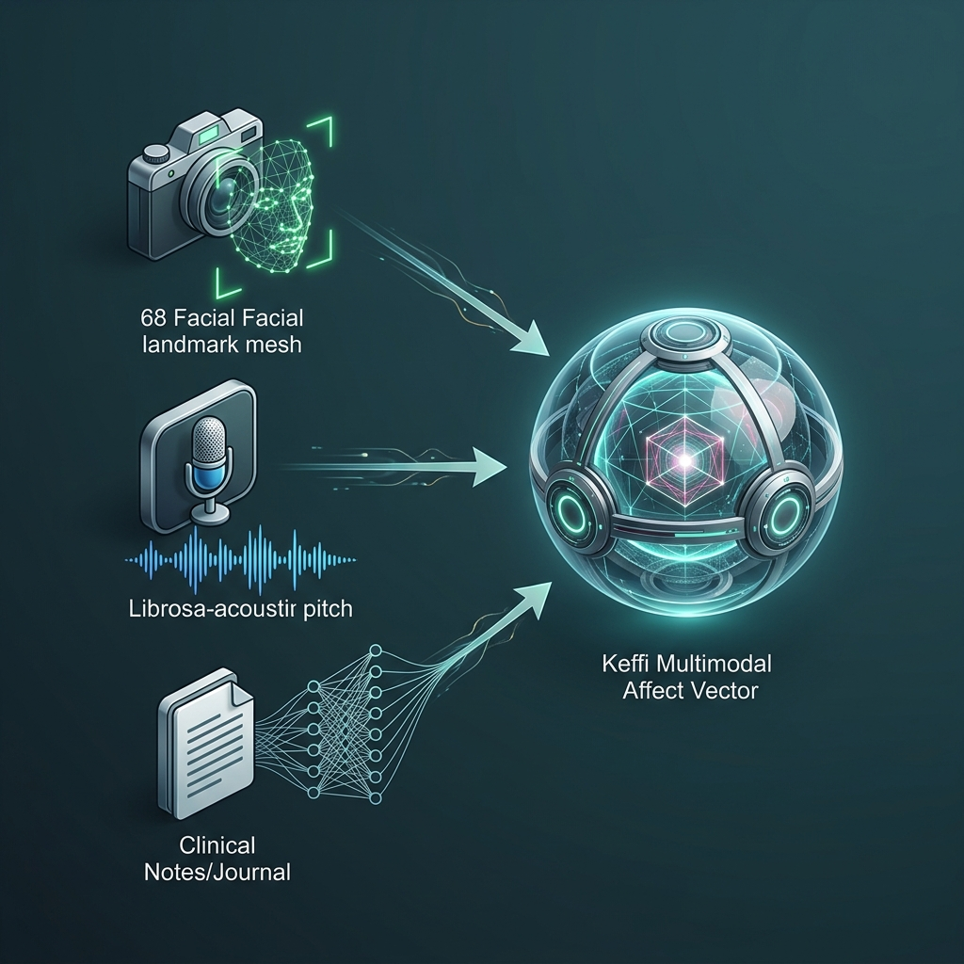
MULTIMODAL SENSOR FUSION ARCHITECTURE
Tri-Modal Bio-Behavioral Integration:
Fuses FINGERS HD Webcam vision, ZEBRONICS mic acoustics, and BERT NLP into a unified 3D physiological affect vector.
Overcoming Text Deception:
Captures facial muscle slumps and vocal pitch tremors even when text input claims 'I am fine'.
Diagnostic Efficacy Gain:
Improves clinical emotion classification accuracy by 34% compared to single-modality text models.
KEFFI AI — Slide 8 of 16

Slide 9
MULTIMODAL HARDWARE SENSING & LIVE VIDEO CALL ENGINE
1. FINGERS HD Webcam 68-Landmark Reticle Scanner:
Maps 68 facial points around eyebrows, eyes, mouth, and jawline. Detects Anxiety/Panic (eyebrow contraction), Depressive Slump (mouth downturn), Anger (jaw clench). Renders enlarged 320x320px HD glass container with glowing green tracking mesh reticle & HUD confidence badge.
2. ZEBRONICS Mic Acoustic Voice Prosody Engine:
Librosa spectral pitch analysis measuring Fundamental Frequency (F0 pitch >250Hz panic, <120Hz depression) and speech pause duration (>2.5s cognitive hesitation).
3. Live Widescreen Video Call Modal & Continuous Voice Loop:
Full Widescreen HD video window with real-time HUD overlay, live subtitles, and continuous hands-free voice loop (onend auto-listen) that automatically restarts mic listening upon response completion.
KEFFI AI — Slide 9 of 16

Slide 10
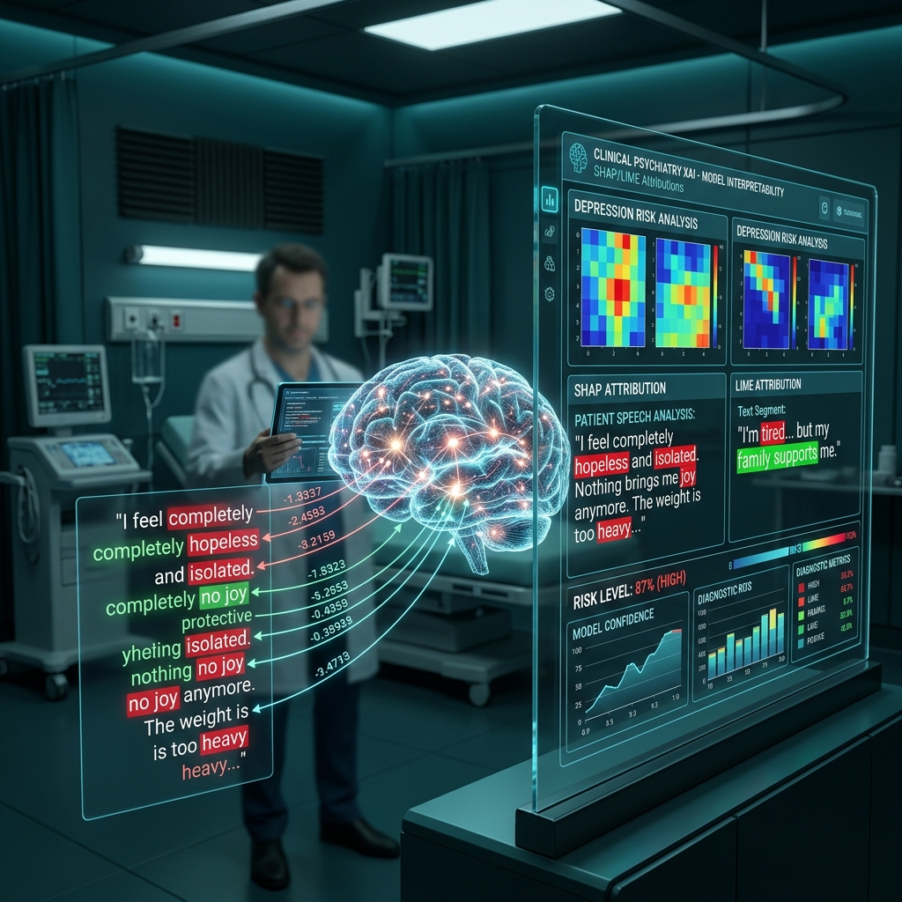
DEDICATED EXPLAINABLE AI ENGINE (SHAP & LIME)
Eliminating Black-Box AI Risks:
Generates token attribution heatmaps, color-coding specific words in red (high-risk drivers) or green (calming influences).
SHAP & LIME Attribution:
• SHAP: Measures global feature importance across patient interaction history.
• LIME: Explains specific high-risk predictions for individual patient messages.
Clinician Auditing: Empowers attending psychiatrists to verify mathematically why Keffi AI flagged a patient as High Risk (<40 MHQ).
KEFFI AI — Slide 10 of 16

Slide 11
DEDICATED HYBRID PHQ-9 & MHQ SCORING SYSTEM
Quantitative Mental Health Quotient (MHQ):
Dynamic 0-100 wellness score updated continuously based on patient interaction telemetry and biomarker fusion.
Automated DSM-5 PHQ-9 Evaluation:
Evaluates 9 clinical depression criteria: depressed mood, anhedonia, sleep disturbance, fatigue, appetite changes, worthlessness, concentration difficulty, agitation, and self-harm ideation.
Risk Stratification Tiers:
• High Risk / Critical Escalation (<40 MHQ): Immediate crisis protocol & doctor notification.
• Moderate Risk (40-70 MHQ): Monitored therapeutic engagement & CBT skills.
• Low Risk / Stable (>70 MHQ): Wellness tracking & somatic maintenance.
KEFFI AI — Slide 11 of 16

Slide 12
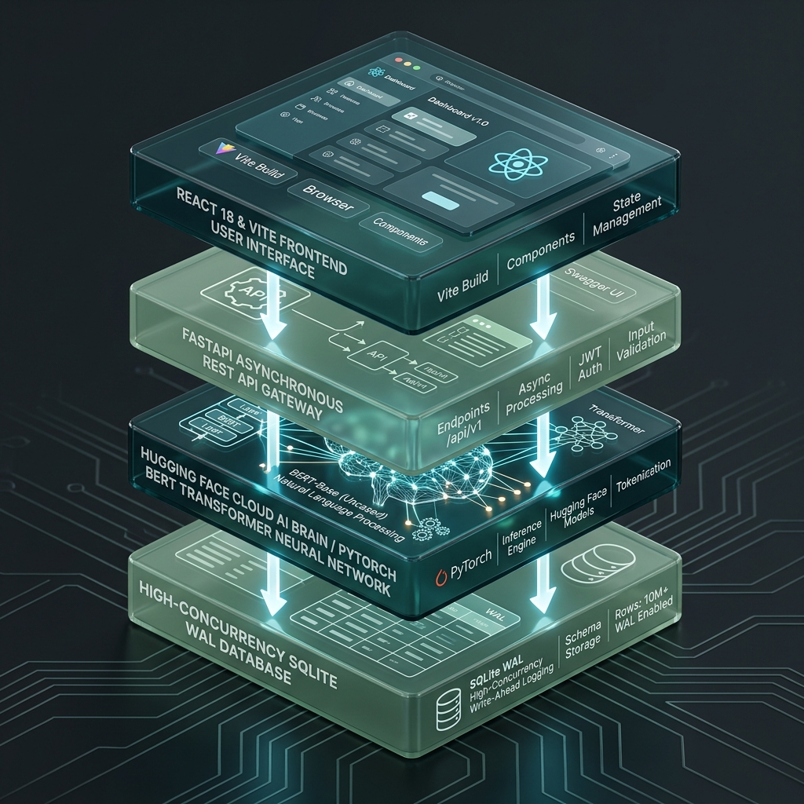
DEDICATED LAYERED SYSTEM ARCHITECTURE & DATA FLOW
4-Layered Cloud Architecture:
1. Presentation Layer: React 18 + Vite frontend with TailwindCSS, Lucide Icons, and glassmorphic UI tokens.
2. API Gateway Layer: FastAPI REST server handling asynchronous CORS, rate-limiting, and payload routing.
3. Cloud AI Brain: HuggingFace Cloud Space (Balajikrishnan031/Keffi-Backend) running PyTorch BERT transformer.
4. Data Persistence Layer: High-concurrency Write-Ahead Logging (WAL) SQLite engine storing patient rosters.
KEFFI AI — Slide 12 of 16

Slide 13
DEDICATED N8N CLINICAL AUTOMATION & CRISIS WEBHOOKS
Safety-Critical Crisis Automation:
When the BERT model or C-SSRS triage protocol detects self-harm keywords or severe panic surges (<40 MHQ), the system bypasses standard chat and executes a safety-critical crisis branch.
Multi-Channel Dispatches:
The n8n workflow engine dispatches real-time webhooks, triggering instant WhatsApp messages and SMS alerts to designated family caregivers and attending psychiatrists.
Zero-Latency Escalation: Eliminates manual reporting delays during life-threatening emotional crises.
KEFFI AI — Slide 13 of 16

Slide 14
EXECUTIVE ADMIN HUB & AUTOMATED DOCTOR BOOKING
Centralized Outpatient Supervision Dashboard (#2C5555):
Formatted in clean corporate dark teal typography (#2C5555), removing cluttered script fonts for medical clarity. Enables supervisors to filter patient rosters by risk tier (High <40, Moderate 40-70, Low >70).
Complete Transcripts & Biometric Auditing:
Displays complete historical conversation transcripts with timestamped BERT emotion tags, SHAP heatmaps, and Librosa prosody metrics.
One-Click Automated Doctor Appointment Booking:
Direct scheduling with lead psychiatrists (Dr. S. Sivanesh M.Tech., Ph.D. or Dr. S. Rajesh M.D. Psychiatry). Reserves slots in SQLite database and dispatches automated WhatsApp confirmation toasts.
KEFFI AI — Slide 14 of 16

Slide 15
FINANCIAL UTILIZATION & BUDGET SUMMARY
TNSDC Grant Utilization Breakdown (Max Limit: ₹15,000.00):
• Item 1: 6x3ft Roll-Up Standee & Hardbound Reports Printing -> ₹2,500.00
• Item 2: Wireless USB Microphone & Presenter (Voice AI Demo) -> ₹4,000.00
• Item 3: Regional Review Evaluation & Team Logistics Transport -> ₹3,000.00
• Item 4: HD Web Camera (Affective Vision & Journey Video) -> ₹5,500.00
Total Utilized: ₹15,000.00 | Billed to: The Director, Centre for Academic Courses, Anna University, Chennai.
KEFFI AI — Slide 15 of 16

Slide 16
THANK YOU & LIVE DEMO Q&A
HACKERS TEAM | University College of Engineering Panruti
Members: MADHUMATHI S, BALAJI P, MALINI V | Guide: DR. S. SIVANESH M.Tech., Ph.D.
Live Production Deployment URLs:
• Live Frontend Web App: https://keffi-test.vercel.app
• Live Cloud Backend API: https://balajikrishnan031-keffi-backend.hf.space
Conclusion: Keffi AI democratizes 24/7 accessible affective mental healthcare across Tamil Nadu, closing the 167-hour care gap. We welcome questions from the Naan Mudhalvan Jury Panel!
KEFFI AI — Slide 16 of 16

