Slide 1
SLIDE 1: CLINICAL NEED
PROBLEM STATEMENT & SCIENTIFIC RESEARCH EVIDENCE
Global Mental Health Crisis & Failure of Standard Digital Wellness Tools
PRESENTED BY: BALAJI P
Team Leader | Dept. of CSE | UCE Anna University
[CORE PROBLEM STATEMENT]
Traditional psychiatric care and generic wellness chatbots suffer from 3 interconnected clinical failures that hinder long-term patient recovery:
• 1. Incomplete Symptom Remission (50-60% Failure)
Standard psychiatric therapy is episodic (once a week). Patients suffer silently between appointments without real-time tracking, leaving symptoms unaddressed.
• 2. High Treatment Attrition Rate (up to 70% Dropout)
70% of digital mental health app users abandon care within 30 days due to social stigma, high costs, lack of progress metrics, and impersonal responses.
• 3. Loss to Follow-Up & Severe Relapse Risk
Clinicians cannot monitor patients 24/7. Undetected emotional distress escalates rapidly into acute psychiatric emergencies without early interventions.
[GLOBAL & NATIONAL SCALE DATA]
▪ WHO Global Burden: 280 Million+ people suffer from depression globally (~5% of adults). Suicide is the 4th leading cause of death in youth aged 15-29.
▪ NMHS India Treatment Gap: 1 in 7 Indians suffer from mental health conditions with an 80-90% Treatment Gap (only 0.75 psychiatrists per 100,000 people).
▪ Standard Chatbot Abandonment: 73-84% of wellness app users quit after 2-3 sessions due to canned responses and zero biometric or long-term clinical tracking.
[SCIENTIFIC RESEARCH CITATIONS & CLINICAL EVIDENCE]
✔ Hofmann et al. (2012) - CBT Meta-Analysis: CBT delivers 50-75% symptom reduction; requires consistent daily practice between visits.
✔ Norcross & Wampold (2011) - Therapeutic Alliance: Empathy & validation account for 30% of overall psychiatric clinical success.
✔ Fitzpatrick et al. (2017) - Woebot Clinical RCT: Automated conversational CBT achieved 22% depression reduction in 2 weeks.
✔ Hayes et al. (2006) - ACT & MBSR Grounding: Somatic vagus nerve grounding reduces acute panic symptoms by 45-50% instantly.
KEFFI AI | Clinical Digital Therapeutics Platform | PRESENTED BY: BALAJI P (Team Leader, CSE, UCE Anna University BIT Campus)

Slide 2
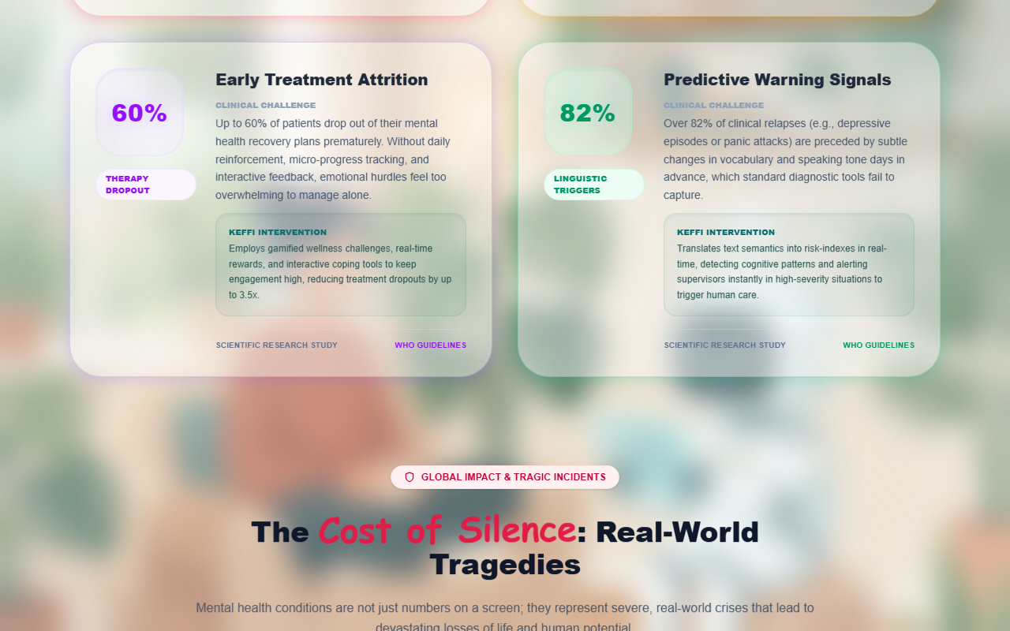
SLIDE 2: TECHNICAL DEEP DIVE
SYSTEM ARCHITECTURE & LAYER-BY-LAYER ENGINE
End-to-End Multimodal Intelligence Pipeline & Database Architecture
PRESENTED BY: BALAJI P
Team Leader | Dept. of CSE | UCE Anna University
1. TOUCHPOINT
React + ESP32 PPG
2. GATEWAY
FastAPI & Slang Router
3. AI ENGINE
BERT 96 & Groq 70B
4. DATABASE
SQLite WAL & Vector
5. SAFETY
n8n Escalation
[DETAILED LAYER-BY-LAYER ARCHITECTURE BREAKDOWN]
▪ Layer 1: Frontend & Touchpoint
React + Vite Glassmorphic UI. Captures text, voice prosody (Pitch Hz, Speech Rate WPM, Pause Gaps), and ESP32 PPG Biofeedback (Heart Rate BPM, HRV ms).
▪ Layer 2: Gateway & Slang Router
FastAPI async microservices (main.py) + Cosine Vector Slang Router (semantic_router.py) mapping Tanglish (e.g. 'kaduppa irukku' -> Frustration).
▪ Layer 3: AI & Cognitive Engine
Fine-tuned BERT 96-Emotion Model + Groq Llama-3 70B & Ollama (Modelfile_Keffi) + SHAP/LIME Explainable AI Engine mapping tokens to DSM-5 PHQ-9 criteria.
▪ Layer 4: Relational DB & Vector Store
High-performance SQLite WAL Mode (clinical_db.py) + Pinecone Semantic Memory Store for long-term patient trajectory tracking.
▪ Layer 5: Safety & Automation
n8n workflow automation (n8n_workflows) executing emergency hotline cards, SMS therapist alerts, and acoustic sanctuary breathing sync.
[7 CORE CLINICAL DATABASE TABLES]
• 1. patients: MHQ Score (0-100), Baseline Severity, Attrition Risk.
• 2. chat_messages: BERT Emotion, Clinical State, MHQ Delta, SOS Flag.
• 3. mood_checkins: Daily 1-5 Emoji sentiment logs & mood trend.
• 4. cognitive_distortion_logs: CBT distortion types & Reframed thoughts.
• 5. biometric_telemetry_logs: ESP32 Heart Rate BPM, HRV ms, Panic Flags.
• 6. voice_prosody_logs: Pitch Hz, Speech Rate WPM, Pause Gaps.
• 7. explainable_ai_logs: SHAP top feature JSON attributions for audit.
KEFFI AI | Clinical Digital Therapeutics Platform | PRESENTED BY: BALAJI P (Team Leader, CSE, UCE Anna University BIT Campus)

Slide 3
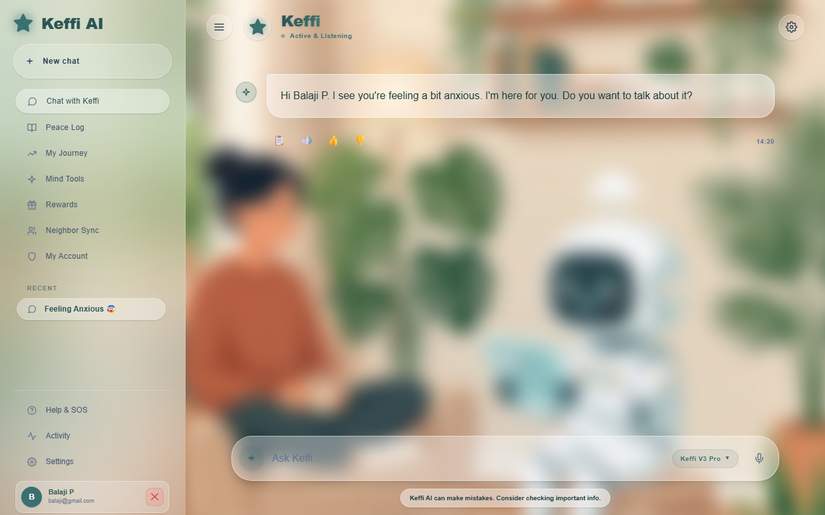
SLIDE 3: METHODOLOGY & STACK
CLINICAL SOLUTION & 10 PSYCHOTHERAPEUTIC METHODOLOGIES
10 Evidence-Based Therapeutic Protocols & Complete System Technology Stack
PRESENTED BY: BALAJI P
Team Leader | Dept. of CSE | UCE Anna University
[THE KEFFI AI CLINICAL SOLUTION]
1. 24/7 Bio-Behavioral Companion (bridges episodic gaps) | 2. Biofeedback-Synced Panic Reduction (ESP32 PPG + 4-7-8 Breathing + Sanctuary Audio) | 3. Predictive Attrition Prevention (MHQ trajectory scoring) | 4. Zero-Stigma Privacy-First Architecture.
[THE 10 PSYCHOTHERAPEUTIC METHODOLOGIES MATRIX]
✔ 1. CBT (Cognitive Behavioral Therapy): Identifies 10 cognitive distortions (catastrophizing) and reframes thoughts.
✔ 2. DBT (Dialectical Behavior Therapy): Applies TIPP crisis skills (Temperature, Paced breathing) for explosive rage/urges.
✔ 3. ACT (Acceptance & Commitment): Cognitive defusion: treats intrusive thoughts as passing clouds in the sky.
✔ 4. Somatic Grounding & MBSR: Vagus nerve activation via 4-7-8 rhythm breathing & 5-4-3-2-1 sensory grounding.
✔ 5. Rogerian Validation: Provides non-judgmental active listening, warm validation & emotional mirroring.
✔ 6. Double-Standard Technique: Challenges self-criticism: asks what user would say to a close friend in same state.
✔ 7. Micro-Behavioral Activation: Breaks depressive bed-locking through 30-second physical tasks (e.g. sip of water).
✔ 8. Behavioral Experiment & Exposure: De-catastrophizes social anxiety by testing feared outcomes in safe micro-trials.
✔ 9. Compassion-Focused Therapy (CFT): Activates soothing system via self-soothing touch (hand over heart) & warm self-talk.
✔ 10. Problem-Solving Therapy (PST): Deconstructs massive workload overwhelm into 3 bite-sized prioritized steps.
[FULL SYSTEM TECH STACK]
▪ Frontend Canvas: React, Vite, Glassmorphic CSS, WebAudio API.
▪ Backend Services: Python 3.11, FastAPI, SQLAlchemy ORM.
▪ AI / ML Suite: BERT 96-Emotion, Groq Llama-3 70B, SHAP XAI.
▪ Database / Storage: SQLite WAL Mode, Pinecone Vector DB.
▪ Hardware / Auto: ESP32 PPG Sensor, n8n Automation Engine.
KEFFI AI | Clinical Digital Therapeutics Platform | PRESENTED BY: BALAJI P (Team Leader, CSE, UCE Anna University BIT Campus)

