Slide 1


SMART INDIA HACKATHON 2026
IDEA SUBMISSION (SOFTWARE EDITION)
Problem Statement ID : SIH26094
Problem Statement Title : AI-Powered Dynamic Mental Health Monitoring and
Distress Prediction System for Victims of Atrocities
Ministry / Organization : Ministry of Social Justice and Empowerment (MoSJE)
Department : Department of Social Justice and Empowerment
Theme : MedTech / BioTech / HealthTech (AI/ML & Cloud)
PS Category : Software
Team ID : 141444
Team Name (Registered on portal) : DEKO
Team Leader : BALAJI P (balajikrishnan031@gmail.com | +91 9342636595)
Team Members : NAVANEETHAM V, MALINI V, DHAVAN R G (IV Year),
DEEBIKA S, DHARA R (II Year) - B.E CSE
College / Institute : University College of Engineering, Panruti (Anna University)

Slide 2
DEKO
Team 141444
PROPOSED SOLUTION: KEFI AI DYNAMIC DISTRESS & CRISIS SHIELD
PROPOSED SOLUTION & CORE CAPABILITIES:
• Continuous Post-Complaint Care: Proactively monitors atrocity victims (SC/ST PoA Act 1989 / NHAA 14566) across legal trial & rehabilitation phases with automated check-ins.
• Omnichannel Multimodal Ingestion: Hooks into NHAA 14566 SIP lines, Citizen Web portal, Chatbot API, SMS & Mobile App with DPDP-compliant consent.
• Dynamic Distress Scoring (DDS 0–100): Continuous multi-vector metric DDS = 0.25E + 0.20V + 0.15B + 0.15H + 0.10C + 0.15T combining emotion valence, vocal tremor, behavior & legal delays.
• 72-Hour Longitudinal Crisis Forecasting: Computes distress trend velocity (dDDS/dt) over 7-day rolling window to forecast crisis 72 hours prior to acute escalation.
• 3-Tier Risk Bands & Action Matrix: 0–30: Self-help grounding audio | 31–60: Tele-counselling intervention | 61–100: Real-time emergency alert to DM / SP dashboard & crisis dispatch.
• Explainable AI (XAI) & Human Gate: SHAP/LIME point attributions (+24 threat cue, +18 vocal tremor, +15 case delay) ensure auditable decision transparency.
Victim Experience & Multichannel Hub (14566, Web, Chatbot & App)
• Omnichannel Multi-Access: Direct toll-free 14566 calling, Citizen Web portal, Tanglish Chatbot & Mobile App SDK.
• Tanglish & Multilingual AI: Native support for Tanglish (Tamil-English), Tamil, Hindi & English with voice dialogue.
• Calm Space & Silent Sanctuary: Interactive emotion wheel, Box Breathing (4-4-4-4) & non-verbal Silent Mode tracking.
District Magistrate, Police & Tele-Counsellor Command (Triage & Case Action)
• Unified Real-Time Distress HUD: District map visualizes victim distress velocity, hotspot clusters & overdue relief.
• Automated Red-Band Alerts: Real-time emergency escalation to DM, SP & designated counsellors when score > 60.
• Statutory Relief Tracking: Tracks Section 15A witness protection protocols and Rule 12(4) stage-wise relief disbursement.
72-Hour Crisis Early Warning
Distress velocity (dDDS/dt) predicting crises 72 hours prior.
Tanglish & Low-Bandwidth Mode
Full offline grounding audio, low-data layout & SMS fallback.
3-Tier Multi-Agency Action Matrix
Self-help -> Tele-counselling -> DM/SP witness protection.
@SIH Idea submission- Template 2

Slide 3
DEKO
Team 141444
TECHNICAL APPROACH & SYSTEM ARCHITECTURE
Idea / System Architecture Flow:
Technical Stack & Security:
• Speech & Emotion DSP: Python (NumPy, SciPy, Librosa) 20ms frames, vocal tremor analysis.
• AI / NLP & Predictive Engine: Hugging Face Transformers BERT, velocity forecasting (dDDS/dt), XAI.
• Telemetry & Secure Ledger: FastAPI ASGI server, PostgreSQL, Redis cache, AES-256 GCM vault.
1. Omnichannel Ingest
14566 SIP PRI lines, WebRTC mic, Chatbot API & Mobile App SDK (8/16kHz PCM)
2. Multimodal Signal Extraction
Vocal acoustic prosody (pitch tremor Hz, jitter %, pause duration) + BERT fear valence
3. Dynamic Distress Scoring (0–100)
Continuous formula: DDS = 0.25E + 0.20V + 0.15B + 0.15H + 0.10C + 0.15T
Workflow Comparison Matrix:
WORKFLOW FEATURE | CONVENTIONAL WORKFLOW | KEFI AI PLATFORM
Voice Triage | Manual assessment & referral | ✔ Proactive Care Scheduled check-ins
Multilingual & Channels | Varies by channel & availability | ✔ 22+ Languages Tanglish / Web / 14566
Triage Framework | No standardized composite index | ✔ Mathematical DDS 0–100 multi-signal metric
Emergency Escalation | Manual emergency workflow | ✔ 72h Early Warning Predictive velocity dDDS/dt
4. 72h Crisis Forecast & Explainable AI
Time-series trend velocity (dDDS/dt) predicts crisis 72h prior + SHAP point attributions
5. Automated 3-Tier Risk Action Dispatch
0–30: Self-help grounding audio | 31–60: Tele-counselling | 61–100: Emergency DM/SP alert
20ms Frame Acoustic DSP
Linear PCM stream ingestion, pitch & vocal micro-tremor extraction.
Mathematical DDS Architecture
DDS = 0.25E + 0.20V + 0.15B + 0.15H + 0.10C + 0.15T multi-signal.
Multi-Agency Integration Layer
112/medical/protection/legal integrations demonstrated through prototype adapters.
@SIH Idea submission- Template 3

Slide 4
DEKO
Team 141444
FEASIBILITY AND VIABILITY ANALYSIS
PROBLEM VS SOLUTION
ANALYSIS OF THE FEASIBILITY:
• Technical Feasibility: Prototype benchmarked with initial acoustic DSP & NLP inference latency below 250ms.
• Operational Feasibility: Seamless integration with MoSJE NHAA 14566 PRI lines, Web portal & App.
• Legal & Ethical Feasibility: Aligned with SC/ST PoA Act 1989 (Sec 15A & Rule 12(4)) and DPDP Act 2023.
VIABILITY & SCALABILITY:
• Cost Viability: Projected prototype operating cost: <₹0.15 per check-in; zero costly hardware required.
• Reliability & Scalability: High-availability cloud architecture with offline caching, Low Internet Mode & fallback.
✖ PROBLEMS
• Subjective Triage: Check-ins are irregular, subjective, and absent during legal delays.
• Delayed Detection: Distress escalation goes unnoticed until acute harm occurs.
• Witness Threats: Coercion goes undetected, causing witness hostility in court.
• Disconnected Logs: Paper registers leave DM & SP unaware of localized crisis trends.
• High Workload: Manual welfare follow-up is impossible across thousands of cases.
✔ SOLUTION
• Objective Scoring: Automated continuous monitoring via mathematical DDS metric (0–100).
• 72h Early Warning: Longitudinal velocity (dDDS/dt) alerts counsellors 72h prior to crisis.
• Threat Screening: NLP flags coercion keywords ('dhamki', 'withdraw') for Sec 15A protection.
• Unified HUD: Live map alerts DM, SP & MoSJE to localized distress velocity spikes.
• 70%+ Overhead Cut: Automated check-ins and AI triage free officers for high-risk care.
High-Availability Architecture
Tested prototype; sub-250ms median API latency; automated failover.
DPDP Act 2023 & Rules 2025
SHA-256 tamper-evident audit ledger & AES-256 GCM encrypted audio vault.
Fail-Safe & Low-Confidence
Deterministic P1 safety override + low-confidence human verification fallback.
@SIH Idea submission- Template 4

Slide 5
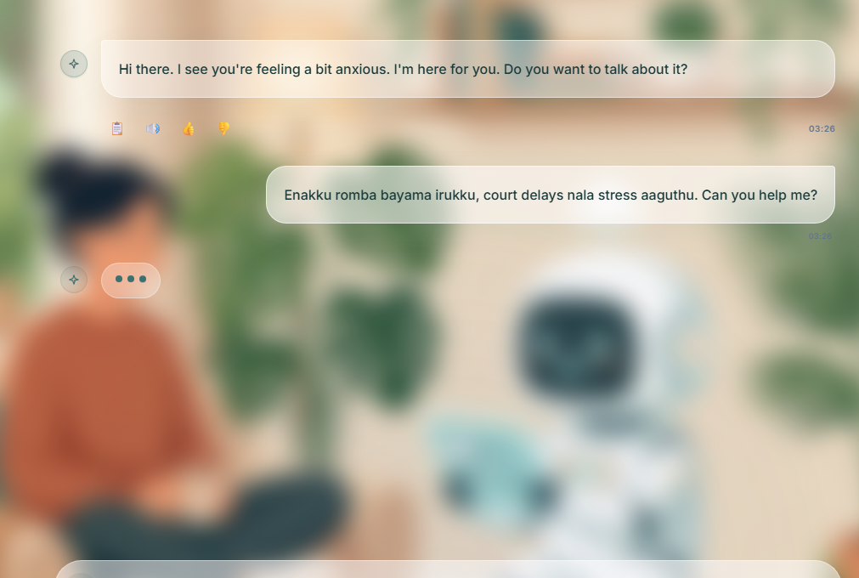
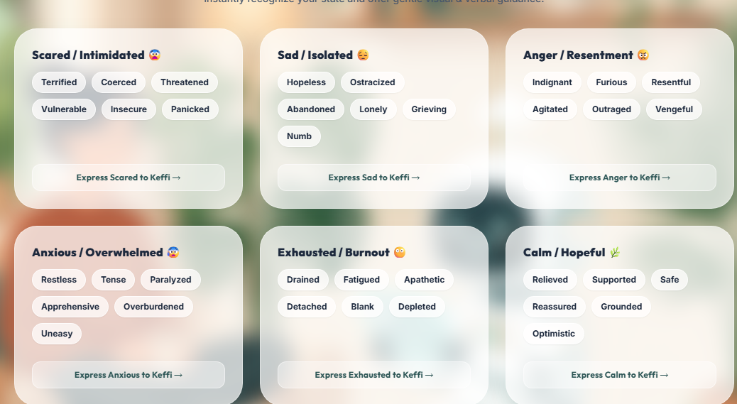
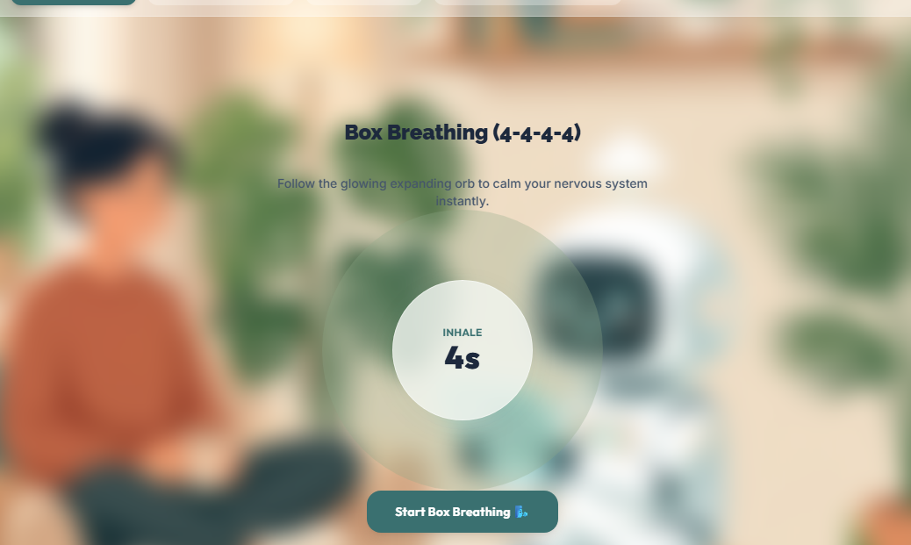
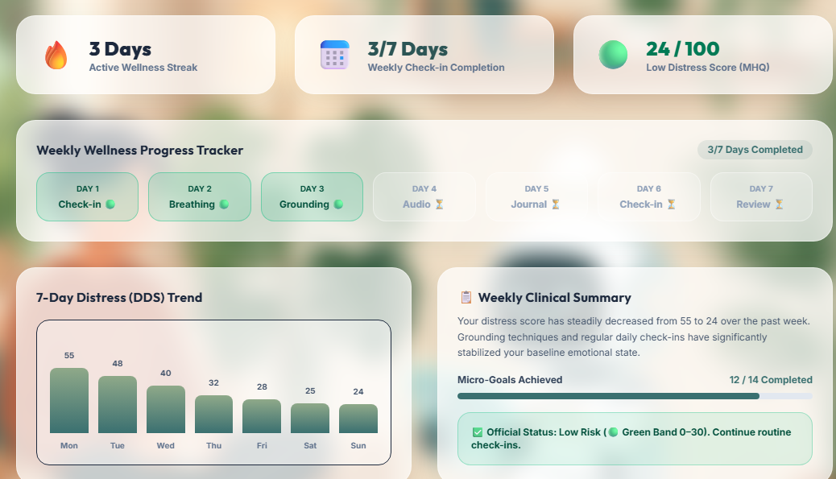
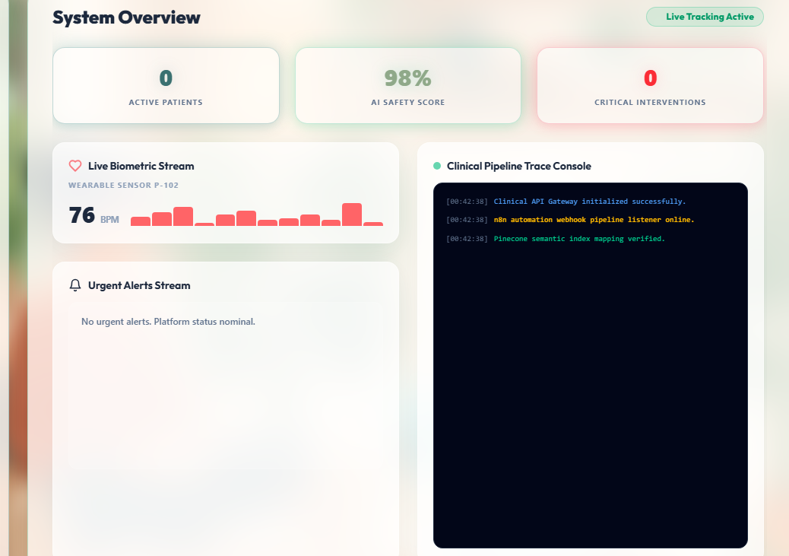
DEKO
Team 141444
IMPACT, BENEFITS & EXPECTED OUTCOMES
Key Impacts on Victims & Institutions:
01. 72-Hour Suicide & Crisis Prevention: Critical distress detected 72h prior, enabling timely tele-counselling & Sec 15A protection.
02. Single-Window Trauma Continuity: Victim recounts ordeal once; structured statutory dossier routed to all departments.
03. Witness Protection & Justice Trust: Real-time threat detection triggers Sec 15A protection, reducing hostile witness rates.
04. Rule 12(4) Relief & Rehab Tracking: Supports stage-wise relief, sanction and 7-day monitoring + welfare coordination.
05. 70%+ Administrative Overhead Cut: Automated check-ins and smart triage free officers for complex crisis response.
PS Expected Outcomes Compliance Matrix:
PS EXPECTED OUTCOME | KEFI AI IMPLEMENTATION | STATUS
1. Early Identification | Automated scheduled check-ins via IVRS 14566, Chatbot, SMS & Web portal | ✔ Addressed
2. Counselling & Rehab | Mathematical formula DDS (0–100) combining 6 trauma signals & delay factors | ✔ Addressed
3. Victim-Centric Redress | 72-hour crisis velocity forecasting (dDDS/dt) predicting acute trauma before escalation | ✔ Addressed
4. Resource Allocation | 3-Tier risk dispatch: DM/SP emergency alert, tele-counselling & self-help grounding | ✔ Addressed
5. Enhanced Responsiveness | DPDP Act 2023 compliance, AES-256 encryption, OTP consent & audit trail | ✔ Addressed
Outcome 1: Tanglish Chatbot
Outcome 2: Emotion Wheel
Outcome 3: Calm Sanctuary
Outcome 4: 7-Day DDS Trend
Outcome 5: Officer HUD
@SIH Idea submission- Template 5

Slide 6
DEKO
Team 141444
RESEARCH, REFERENCES & TEAM DETAILS
Statutory Acts & Policy References:
• Scheduled Castes & Scheduled Tribes (PoA) Act, 1989: Section 15A & Section 18A.
• SC & ST (PoA) Rules, 1995: Rule 12(4) — Relief and Rehabilitation statutory framework.
• Digital Personal Data Protection: DPDP Act, 2023 and DPDP Rules, 2025 for data consent.
• National Helpline Integration: MoSJE National Helpline Against Atrocities (NHAA 14566).
Scientific Research & AI Citations:
• Acoustic Emotion Prosody: Scherer, K. R. (2003). Vocal communication of emotion.
• Voice Tremor & Distress: Mendoza, J. et al. (2019). Acoustic biomarkers of PTSD. IEEE TAC.
• Explainable AI (XAI): Lundberg, S. M. & Lee, S.-I. (2017). Unified SHAP approach. NeurIPS.
• Clinical Trauma Criteria: American Psychological Association (APA) - DSM-5 PTSD Criteria.
TEAM DEKO (TEAM ID: 141444) — UNIVERSITY COLLEGE OF ENGINEERING, PANRUTI
TEAM MEMBER | STREAM | BRANCH | YEAR | PROJECT ROLE & KEY RESPONSIBILITY
BALAJI P (Team Leader) | B.E | CSE | IV Year | System Architect, Dynamic Distress Scoring (DDS) & Predictive Engine Lead
NAVANEETHAM V | B.E | CSE | IV Year | Multilingual Tanglish NLP, Bhashini ASR & Emotion Wheel Architecture Lead
MALINI V | B.E | CSE | IV Year | Full-Stack Web Portal, Calm Space & Silent Sanctuary Lead
DHAVAN R G | B.E | CSE | IV Year | DM/SP Dashboard, Automated Alert Matrix & Incident Dispatch Lead
DEEBIKA S | B.E | CSE | II Year | Cloud Security, AES-256 GCM Audio Vault & DPDP Rules 2025 Compliance Lead
DHARA R | B.E | CSE | II Year | Rule 12(4) Relief Tracking, IVRS 14566 Integration & Citizen Portal UI Lead
@SIH Idea submission- Template 6

