Slide 1
M2:Unit-1 - Inheritance, Packages, Interfaces &Exception handling

Slide 2
Syllabus
Inheritance Basic ,Types of inheritance, Member access rules, Usage of super key word, Method overriding, Using final, Abstract classes, Differences between abstract classes and interfaces, Defining an interface, Implementing interface, Applying interfaces, Variables in interface and Extending interfaces. Defining , creating and accessing a package ,Importing packages ,Access control in package

Slide 3
Inheritance-Introduction
Inheritance is an important feature of object oriented programming.
Inheritance can be defined as the process where one class acquires the properties methods and fields of another class.
The class which inherits the properties of other is known as subclass/derivedclass/child class
the class whose properties are inherited is known as superclass/baseclass/parentclass.
Inheritance provides the idea of reusability, i.e., a code once written can be used again and again in a number of new classes

Slide 4
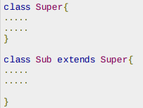
extends Keyword :
extends is the keyword used to inherit the properties of a class.
syntax of extends keyword.

Slide 5
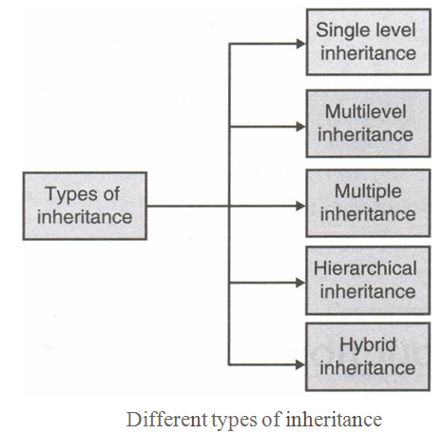
Types of Inheritance
Inheritance is generally of five types : single level, multilevel, multiple, hierarchical and hybrid.

Slide 6
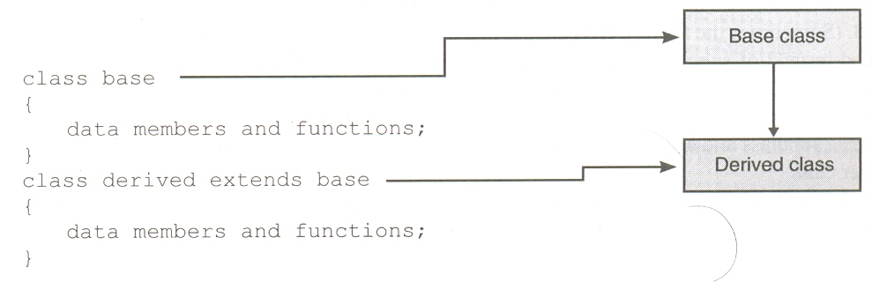
Single-level Inheritance
In single level inheritance, there is just one base and one derived class. It is represented as follows:

Slide 7
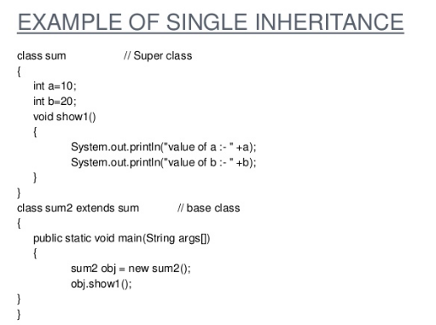

Slide 8
Multilevel Inheritance
In multilevel inheritance, there is one base class and one derived class at the same time at one level.
At the next level, the derived class becomes base class for the next derived class and so on. This is shown as:

Slide 9
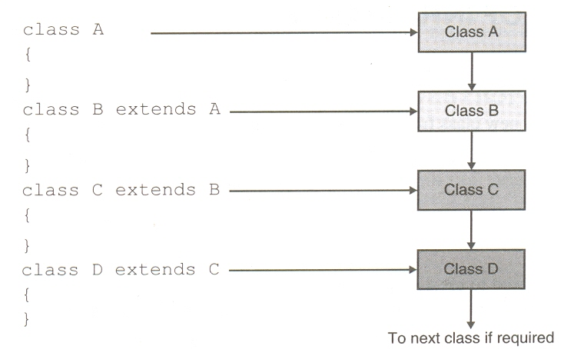

Slide 10
The class A and class B together form one level, class B and class C together form another level and so on.
For class B, class A is the parent and for class C, class B is the parent; thus in this inheritance level, A can be called the grandparent of class C, and class C the grandchild of class A

Slide 11
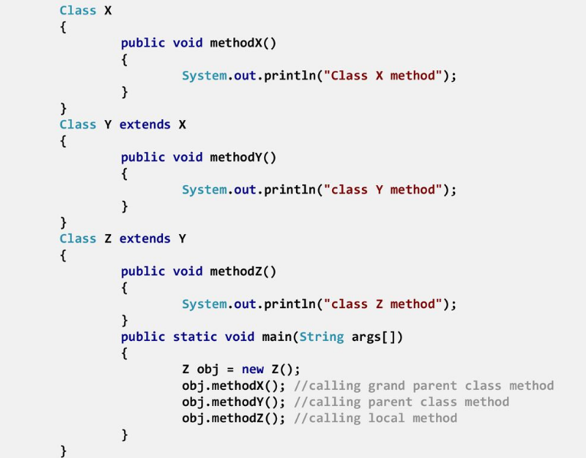

Slide 12
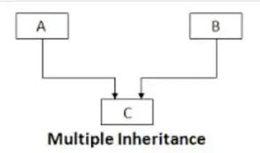
Multiple Inheritance
In a multiple inheritance, a child can have more than one parent, i.e., a child can inherit properties from more than one class.
Java does not support Multiple inheritance ,to implement this we can use the concept of interfaces

Slide 13

Unfortunately, Java does not support the multiple inheritances through classes though it supports using interfaces
That is, in Java one cannot write the following syntax:
class A { } class B { }
class C extends A extends B{ }

Slide 14
Hierarchical Inheritance
In this type of inheritance, multiple classes share the same base class.
That is, numbers of classes inherit the properties of one common base class.
The derived classes may also become base classes for other classes.

Slide 15
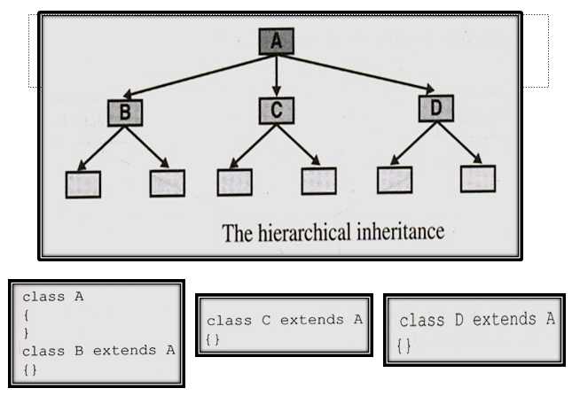

Slide 16
Hybrid Inheritance
Hybrid Inheritance is a combination of both Single Inheritance and Multiple Inheritance.
Since in Java Multiple Inheritance is not supported directly we can achieve Hybrid inheritance also through Interfaces only.

Slide 17
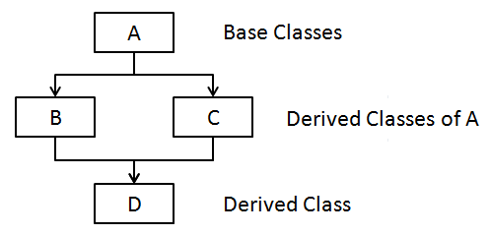

Slide 18
Why use inheritance in java
For Method Overriding (so runtime polymorphism can be achieved).
For Code Reusability.

Slide 19
Super Keyword
The super keyword in java is a reference variable that is used to refer parent class objects.
The keyword “super” came into the picture with the concept of Inheritance.
Whenever the base class version of the function is called which is overridden in the derived class, the super keyword can be used.
The super keyword always refers to the immediate base class

Slide 20
class SuperKeyword {
int a = 120;
}
class Keyword extends SuperKeyword {
int a = 180;
void display() {
System.out.println(“Value of a is: " + super.a); }
}
class SuperKeywordforVariable{
public static void main(String[] args) {
Keyword k = new Keyword();
k.display();
} }

Slide 21
class Base {
void message() {
System.out.println("This is Base class"); }
}
class Derived extends Base {
void message() {
System.out.println("This is derived class"); }
void display() {
message(); // call current class message() method
super.message(); // call parent class message() method
} }
class SuperKeywordforMethod{
public static void main(String args[]) {
Derived d = new Derived();
d.display(); } }

Slide 22
class Parent {
Parent() { System.out.println("Parent class Constructor");
} }
class Child extends Parent {
Child() {
super(); // call parent class constructor
System.out.println(“Child class Constructor");
} }
class SuperKeywordforConstructor{
public static void main(String[] args) {
Child c = new Child();
} }

Slide 23
class Base {
Base( ) {
System.out.println("insideparent“);
}
}
class Derived extends Base {
int x;
Derived(int x1) {
super( );
x= x1; }
void Display( ) {
System.out.println("x = "+x);
}
}
public class ConstructorEg{
public static void main(String[] args) {
Derived d = new Derived(10);
d.Display();
} }
o/p:inside parent
x = 10

Slide 24
Access Specifiers(protected Keyword)
class P{
protected int a=10;
void dis( ){ System.out.println("this is parent class variable"+a); }
}
class C extends P{
void dis1( ){ System.out.println("this is child class variable"+a); }
}
class Main{
public static void main(String[] args){
C o=new C();
o.dis();
o.a=20;
o.dis1();
} }
Note:for member access rules refer Access specifiers in Unit-1

Slide 25
Method Overriding
In method overriding, a base class method is overridden in the derived class.
That is, the same method is written with the same signature as of the base class method but different implementation.
In method overloading, arguments and type of arguments are used to distinguish between two functions, but in method overriding no such distinction can be made.

Slide 26
When a method in a subclass has the same name, same parameters or signature and same return type(or sub-type) as a method in its super-class, then the method in the subclass is said to override the method in the super-class.
Method overriding is one of the way by which java achieve Run Time Polymorphism
The version of a method that is executed will be determined by the object that is used to invoke it.
This process in which call to the overridden method is resolved at runtime is known as Dynamic method dispatch
In method overriding, the signature of the two methods must match. This is shown in the program given below.

Slide 27
Class A{
void dis(){
System.out.println(“this is class A”);
}}
Class B extends A{
void dis(){
System.out.println(“this is class B”);
}}
Class Demo{
P.S.V.main(String args[]){
B b=new B();
b.dis();
}}
o/p: this is class B

Slide 28
Class A{
void dis(){
System.out.println(“this is class A”);
}}
Class B{
void dis(){
System.out.println(“this is class B”);
}}
Class Demo{
P.S.V.main(String args[]){
B b=new B();
b.dis();
A a=new A();
a.dis();
}}
o/p: this is class B
this is class A

Slide 29
Usage of Java Method Overriding
Method overriding is used to provide the specific implementation of a method which is already provided by its superclass.
Method overriding is used for runtime polymorphism
Rules for Java Method Overriding
The method must have the same name as in the parent class
The method must have the same parameter as in the parent class.
There must be an IS-A relationship (inheritance).

Slide 30
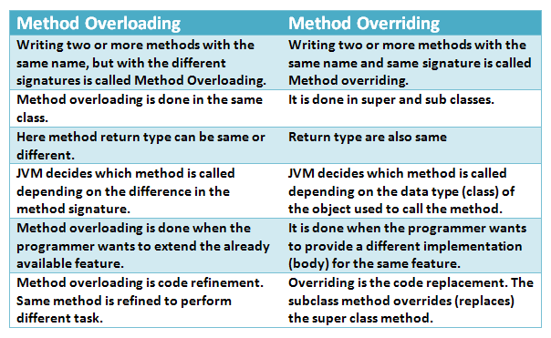

Slide 31
Dynamic Method Dispatch
Dynamic method dispatch is the mechanism by which a call to an overridden method is resolved at run time, rather than compile time.
Binding is the process of linking the function call with the place where function definition is actually written so that when a function call is made, it can be ascertained where the control has to be transferred.
Binding is also called linking, and is of two types:
1. Static binding
2. Dynamic binding.
1)Static binding :When at compile time, it is known which function will be called in response to a function call, the binding is said to be static binding, compile time binding or early binding

Slide 32
2)Dynamic Binding:At run time, the decision is taken as to which function is to be called in response to a function call. This type of binding is known as late binding, runtime binding or dynamic binding.
When an overridden method is called through a superclass reference,Java determines which version(superclass/subclasses) of that method is to be executed based upon the type of the object being referred to at the time the call occurs. Thus, this determination is made at run time.
At run-time, it depends on the type of the object being referred to (not the type of the reference variable) that determines which version of an overridden method will be executed

Slide 33
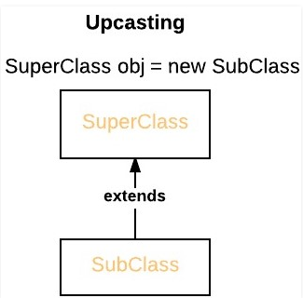
A superclass reference variable can refer to a subclass object. This is also known as upcasting. Java uses this fact to resolve calls to overridden methods at run time.

Slide 34
class A {
void dis() {
System.out.println("Inside A's method");
}
}
class B extends A {
void dis() {
System.out.println("Inside B's method");
}
}
class C extends A
{
void dis() {
System.out.println("Inside C's method");
}
}

Slide 35
class Dispatch {
public static void main(String args[]) {
A a = new A(); // object of type A
B b = new B(); // object of type B
C c = new C(); // object of type C
A ref_var; // obtain a reference of type A
ref_var = a; // ref refers to an A object
ref_var.dis(); // calling A's dis()
ref_var = b; // now ref refers to a B object
ref_var.dis(); // calling B's dis()
ref_var = c; // now ref refers to a C object ref_var.dis(); // calling C's dis()
} }
o/p: Inside A's method
Inside B's method
Inside C's method

Slide 36
In Java, we can override methods only, not the variables(data members), so runtime polymorphism cannot be achieved by data members. For example :
class A {
int x = 10;
}
class B extends A {
int x = 20;
}
class Demo {
public static void main(String args[]) {
B b=new B();
A a = new A();
A ref;
ref=a;
System.out.println(ref.x);
ref=b;
System.out.println(ref.x);
}
}
O/p:10
10

Slide 37
class A{
void dis(){System.out.println(“class A");}
}
class B extends A{
void dis(){System.out.println(“class B");}
public static void main(String args[]){
A a = new B();//upcasting
a.dis();
A a1=new A();
a1.dis();
}
}
o/p:class B
class A

Slide 38
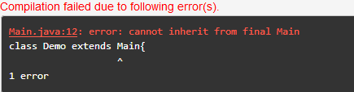
Final Keyword for class
final class Main{ }
class Demo extends Main{
void demo () {
System.out.println ("My Method");
}
public static void main (String args[]) {
Demo obj = new Demo ();
obj.demo ();
}}
Note:
for Final keyword refer UNIT-1

Slide 39
Class A{
Final Void show(){//method declared as final
System.out.println(“class A”);
}}
Class B extends A{
Void show(){
System.out.println(“class B”);
}}
Class Demo{
Public static void main(String args[]){
B b=new B();
B.show();
}}
o/p:compile time error

Slide 40
Abstraction
Abstraction is a process of hiding the implementation details and showing only functionality to the user.
Nothing but it shows only essential things to the user and hides the internal details
Eg:Sending an email.
Two Ways to achieve Abstraction
Abstract class
Interface

Slide 41
Abstract class
A class which is declared with the abstract keyword is known as an abstract class .
An abstract class can have abstract and non-abstract methods
Syntax of abstract class
abstract class A{ }
Abstract Method:
A method which is declared as abstract and does not have implementation is known as an abstract method.
Syntax of abstract method
abstract void dis();//no implementation

Slide 42
Rules:
An abstract class must be declared with an abstract keyword.
It can have abstract and non-abstract methods.
It cannot be instantiated.
It can have constructors and static methods also.
It can have final methods which will force the subclass not to change the body of the method.

Slide 43
abstract class Super{
abstract void show();
final void dis(){ System.out.println(“inside super class”);}
}
class Sub extends Super{
void show(){
System.out.println(“Abstract classes");
}
public static void main(String args[]){
Super obj = new Sub();
obj.show();
obj.dis();
}
}
o/p:Abstract classes
inside super class

Slide 44
abstract class A{
abstract void dis();}
class B extends A{
void dis1(){
System.out.println("class B");
} }
class Demo{
public static void main(String args[]){
A a=new B();
a.dis1();
}}
o/p://----------Note:error occurs ---no overriding-----//
>>>>Compile by: javac Demo.java
>>>>.40.1/Demo.java:3: error: B is not abstract and does not override abstract method dis() in A
class B extends A{
^
1 error

Slide 45
//Abstract classes using constructors
abstract class A {
A() {
System.out.println(“A’s constructor");
}
abstract void dis();
}
class B extends A{
B() {
System.out.println(“B’s constructor ");
}
Void dis() { System.out.println(“B’s dis() method "); }
}
class Main {
public static void main(String args[]) {
A a = new B();
}
}
o/p: A’s constructor
B’s constructor

Slide 46
Interfaces
An interface is just like Java Class, but it only has static constants and abstract method.
Java uses Interface to implement multiple inheritance.
A Java class can implement multiple Java Interfaces. All methods in an interface are implicitly public and abstract
A class that implements an interface must implement all the methods declared in the interface.

Slide 47
An interface is declared by using the “interface” keyword. It provides total abstraction; means all the methods in an interface are declared with the empty body
Syntax:
interface interface_name{
…………….
// declare methods that abstract
………….
}

Slide 48
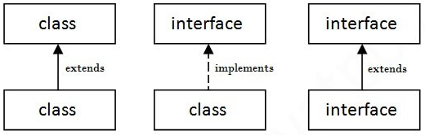
relationship between classes and interfaces
In the below fig
a class extends another class
a class implements an interface.
an interface extends another interface,
(A) (B) (C)

Slide 49
//Implementing interfaces
interface InterfaceExample{
void print();
}
class Demo implements InterfaceExample{
public void print(){
System.out.println("Hello");
}
public static void main(String args[]){
InterfaceExample obj = new Demo();
obj.print();
}
}
o/p:Hello

Slide 50
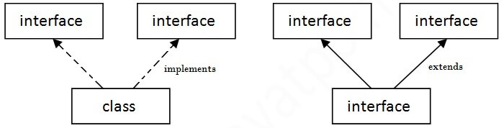
Multiple inheritance in Java by interface
If a class implements multiple interfaces, or an interface extends multiple interfaces, it is known as multiple inheritance.

Slide 51
interface A{
void print();
}
interface B{
void show();
}
class Demo implements A,B{
public void print(){ System.out.println("Hello"); }
public void show(){ System.out.println("Welcome"); }
public static void main(String args[]){
Demo obj = new Demo();
obj.print();
obj.show();
}
}
o/p:Hello
Welcome

Slide 52
Interface inheritance
//A class implements an interface, but one interface extends another interface.
interface A{
void print();
}
interface B extends A{
void show();
}
class Demo implements B{
public void print(){System.out.println("Hello");}
public void show(){System.out.println("Welcome");}
public static void main(String args[]){
Demo obj = new Demo();
obj.print();
obj.show();
}
}

Slide 53
Static and default method in Interface
interface Drawable{
void draw();
default void msg(){System.out.println("default method");}
static int cube(int x){return x*x*x;}
}
class Rectangle implements Drawable{
public void draw(){System.out.println("drawing rectangle");}
}
class TestInterfaceDefault{
public static void main(String args[]){
Drawable d=new Rectangle();
d.draw();
d.msg();
System.out.println(Drawable.cube(3));
}}

Slide 54
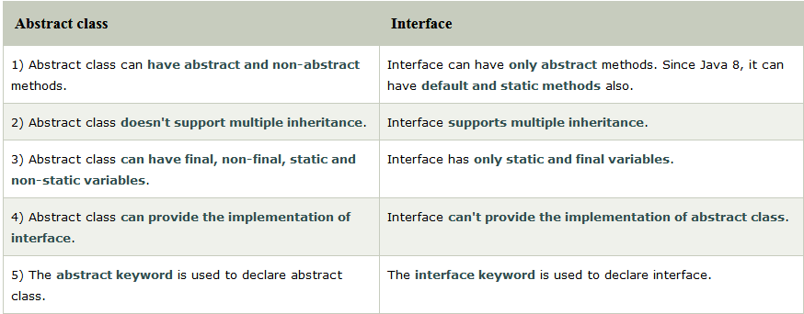

Slide 55
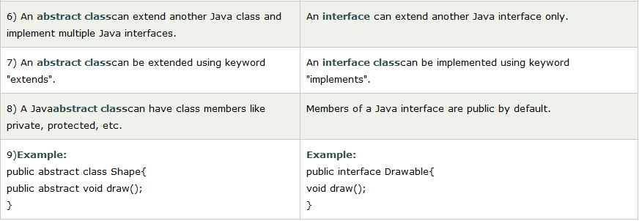

Slide 56
Package in Java
Introduction:
In java, programmers can create several classes &Interface. After creating these classes and interface, it
is better if they are divided into some groups
depending on their relationship.
Thus, the classes and interface which handle similar or same task are put into the same directory or folder, which is also known as package.
Packages act as “containers” for classes. A package
represents a directory that contain related group of
classes & interface

Slide 57
Packages are used in Java in order to prevent naming conflicts, to control access, to make searching/locating and usage of classes,interfaces, enumerations and annotations easier, etc.
A package provides a mechanism for grouping a variety of similar types of classes, interfaces and sub-packages.
Grouping is based on functionality.
Package names are dot separated, e.g., java.lang.
Resolving naming conflict of classes by prefixing the class name with a package name.
com.zzz.Circle and com.yyy.Circle are two distinct classes

Slide 58
Advantage of Java Package
1) Java package is used to categorize the classes and interfaces so that they can be easily maintained.
2) Java package provides access protection.
3) Java package removes naming collision.

Slide 59
TYPES OF PACKAGES
There are basically 2 types of java packages.
They are as follow :
System Packages or Java API
User Defined Packages.

Slide 60
SYSTEM PACKAGES /JAVA API
As there are built in methods , java also provides inbuilt packages which contain lots of classes and interfaces.
These classes inside the packages are already defined & we can use them by importing relevant package in our program
Java has an extensive library of packages, a programmer need not think about logic for doing any
task. For everything, there are the methods available
in java

Slide 61
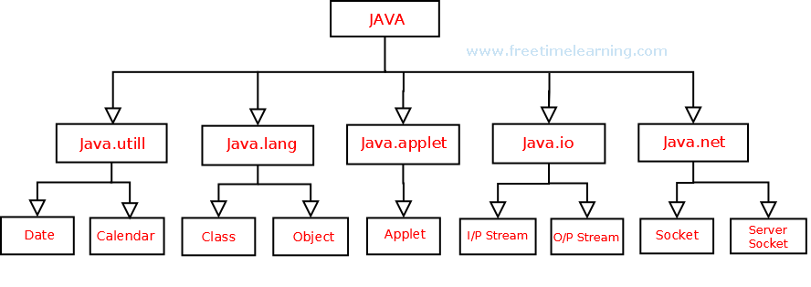

Slide 62
java.lang - Contains classes for primitive types, strings, mathfunctions, threads, and exception
java.util - Contains classes such as vectors, hash tables, date etc.
java.io - Stream classes for I/O
java.awt - Classes for implementing GUI – windows, buttons,menus etc.
java.net - Classes for networking
java. Applet - Classes for creating and implementing applets

Slide 63
USER DEFINED PACKAGES :
The users of the Java language can also create their own packages.
They are called user-defined packages. User defined packages can
also be imported into other classes & used exactly in the same way as
the Built in packages.
i) Creating User Defined Packages
Syntax :
package packageName;
public class className
{
- - - - - - - - - - - - -
// Body of className
- - - - - - - - - - - -
}
We must first declare the name of the package using the package
keyword followed by the package name.
This must be the first statement in a Java source file. Then define a classes as normally as define a class

Slide 64
STEPS FOR CREATING PACKAGE :
To create a user defined package the following steps
should be involved :-
1: Declare the package at the beginning of a file using
the syntax :-
package packageName;
2: Define the class that is to be put in the package &
declare it public.
3: Create a subdirectory under the directory where the
main source files are stored.
4: Store the listing as the classname.java file in the
subdirectory created.
5: Compile the file. This create .class file in the
subdirectory.

Slide 65
Example
package p1;
public class C1{
public static void main(String args[]){
System.out.println("package creation");
}
}

Slide 66
How to compile java package
javac -d directory javafilename
Ex:javac -d . C1.java (The -d switch specifies the destination where to put the generated class file)
How to run java package
java directory.javafilename
Ex:java p1.C1

Slide 67
How to access package from another package?
There are three ways to access the package from outside the package.
import package.*;
import package.classname;
fully qualified name.

Slide 68
1) Using packagename.*
If you use package.* then all the classes and interfaces of this package will be accessible but not subpackages.
The import keyword is used to make the classes and interface of another package accessible to the current package

Slide 69
//save by A.java
package pack;
public class A{
public void msg(){System.out.println("Hello");}
}
//save by B.java
package mypack;
import pack.*;
class B{
public static void main(String args[]){
A obj = new A();
obj.msg();
}
}

Slide 70
2) Using packagename.classname
If you import package.classname then only declared class of this package will be accessible.
package pack;
public class A{
public void msg(){System.out.println("Hello");}
}
//save by B.java
package mypack;
import pack.A;
class B{
public static void main(String args[]){
A obj = new A();
obj.msg();
}
}

Slide 71
3)Using fully qualified name
If you use fully qualified name then only declared class of this package will be accessible. Now there is no need to import. But you need to use fully qualified name every time when you are accessing the class or interface.
It is generally used when two packages have same class name e.g. java.util and java.sql packages contain Date class.

Slide 72
package pack;
public class A{
public void msg(){System.out.println("Hello");}
}
//save by B.java
package mypack;
class B{
public static void main(String args[]){
pack.A obj = new pack.A();//using fully qualified name
obj.msg();
}
}

Slide 73
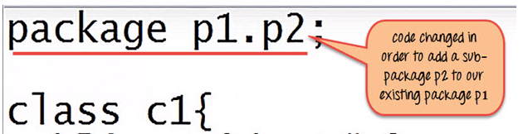

Creating Sub packages
create a sub package p2 within our existing java package p1. Then we will modify our code as
Compile the file

Slide 74
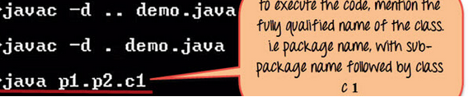
To execute the code mention the fully qualified name of the class i.e. the package name followed by the sub-package name followed by the class name –

