Slide 1

Transaction Processing Concepts
22CS201-DBMS Dept. of CSE
1

Slide 2
Contents
Transaction:
Introduction to Transaction Processing
Transaction and System Concepts
Desirable Properties of Transactions
Characterizing Schedules based on serializability
Department of Computer Science & Engineering
2

Slide 3
Transaction
A transaction is a program including a collection of database operations, executed as a logical unit.
In other words, a transaction is focusing on executing a series of operations as a single unit of work.
It is an atomic process that is either performed into completion entirely or is not performed at all.
Department of Computer Science & Engineering
3

Slide 4
Transaction
In general transaction has two boundaries begin transaction and end transaction.
It includes insertion, deletion, modification, or retrieval operation in an application program.
Department of Computer Science & Engineering
4

Slide 5

Transaction processing systems
Transaction processing systems are systems with “large databases and hundreds of concurrent users” that are executing database transactions.
Examples of such systems are
    Reservations
    Banking
    Stock markets
    Supermarkets
Transaction require high availability and fast response time for hundreds of concurrent users.
Department of Computer Science & Engineering
5

Slide 6
Basic database access operations
read_item() − reads data item from storage to main memory.
write_item() − write the modified value from main memory to storage.
Department of Computer Science & Engineering
6

Slide 7
Example
BEFORE T: X: 500 | Y: 200
Transaction T
T1 | T2
read_item(X) | read_item(Y)
X:=X-100 | Y:=Y+100
write_item(X) | write_item(Y)
After T: X:400 | Y: 300
Department of Computer Science & Engineering
7

Slide 8
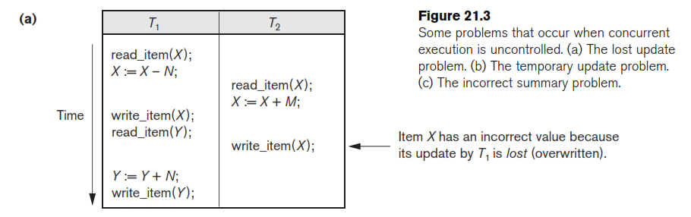
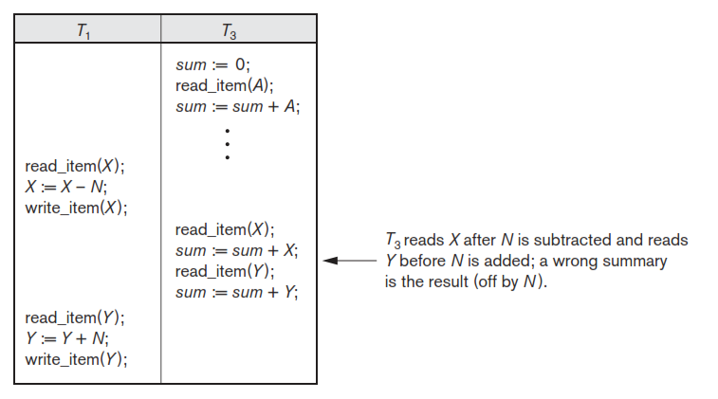
Why Concurrency Control Is Needed

Slide 9
Transaction Operations
The low level operations performed in a transaction are −
begin_transaction − A marker that specifies start of transaction execution.
read_item or write_item − Database operations that may be interleaved with main memory operations as a part of transaction.
end_transaction − A marker that specifies end of transaction.
commit − A signal to specify that the transaction has been successfully completed and will not be undone.
rollback − A signal to specify that the transaction has been unsuccessful and so all temporary changes in the database are undone. A committed transaction cannot be rolled back.
Department of Computer Science & Engineering
9

Slide 10
Transaction and system concepts
Transaction states:
  Active state
  Partially committed state
  Committed state
  Failed state
  Terminated State
Department of Computer Science & Engineering
10

Slide 11
States
Active State − The initial state where the transaction enters is the active state. The transaction remains in this state while it is executing read or write operations.
Partially Committed − The transaction enters this state after the last statement of the transaction has been executed.
Department of Computer Science & Engineering
11

Slide 12
States
Committed − The transaction enters this state after successful completion of the transaction and system checks have issued commit signal.
Failed − The transaction goes from partially committed state or active state to failed state when it is discovered that normal execution can no longer proceed or system checks fail.
Rollback/Aborted − This signals that the transaction has ended unsuccessfully, so that any changes or effects that the transaction may have applied to the database must be undone.
Department of Computer Science & Engineering
12

Slide 13
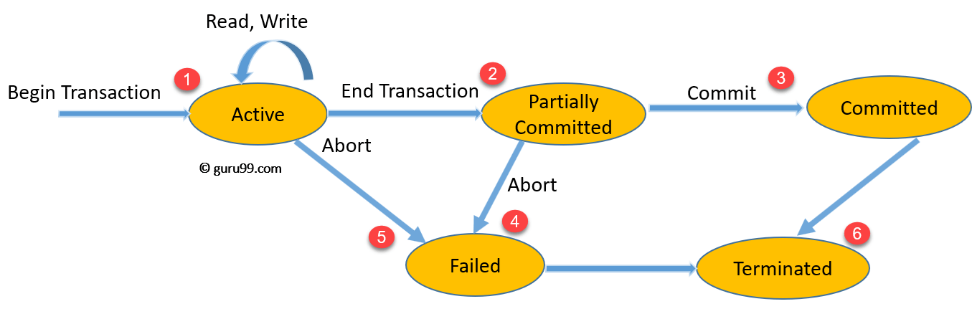
Transaction States or State Transition Diagram
Department of Computer Science & Engineering
13

Slide 14
System log
To keep a track of all transaction operations system maintains log
Transaction refers unique transaction-id
Department of Computer Science & Engineering
14

Slide 15
In these entries, T refers to a unique transaction-id that is generated automatically by the system for each transaction and that is used to identify each transaction:
[start_transaction, T]: Indicates that transaction T has started execution.
[write_item, T, X, old_value, new_value]: Indicates that transaction T has changed the value of database item X from old_value to new_value.
[read_item, T, X]: Indicates that transaction T has read the value of database item X.
[commit, T]: Indicates that transaction T has completed successfully, and affirms that its effect can be committed (recorded permanently) to the database.
[abort, T]: Indicates that transaction T has been aborted.

Slide 16
DESIRABLE PROPERTIES OF TRANSACTIONS
ACID Properties
      A-Atomicity
      C-Consistency
      I- Isolation
      D- Durability
Department of Computer Science & Engineering
16

Slide 17
Atomicity − Ensures that either all the operations in a transaction are completed, or none of them are.
  Example: If you are transferring money between two bank accounts, the amount should be deducted from one account and added to another in a single transaction. If one operation fails, the entire transaction is rolled back.
Consistency − A transaction should take the database from one consistent state to another consistent state. It should not adversely affect any data item in the database.
17

Slide 18
Isolation − A transaction should be executed as if it is the only one in the system. There should not be any interference from the other concurrent transactions that are simultaneously running.
  Example: If two people are booking the last seat on a flight at the same time, one should not see the incomplete state of the other's transaction, which might result in overbooking.
Durability − Once a transaction completes successfully, the changes it has made into the database should be permanent even if there is a system failure.
18

Slide 19
Durability(cont..)
Durability Features to consider for durability:
  Recovery to the most recent successful commit after a database software failure.
  Recovery to the most recent successful commit after an application software failure.
  Recovery to the most recent successful commit after a CPU failure.
19

Slide 20
Schedules
Topics:
  Serial, Non-serial Schedules
  Serializability Schedules - Conflict & View
  Characteristics of a Schedule
Department of Computer Science & Engineering
20

Slide 21
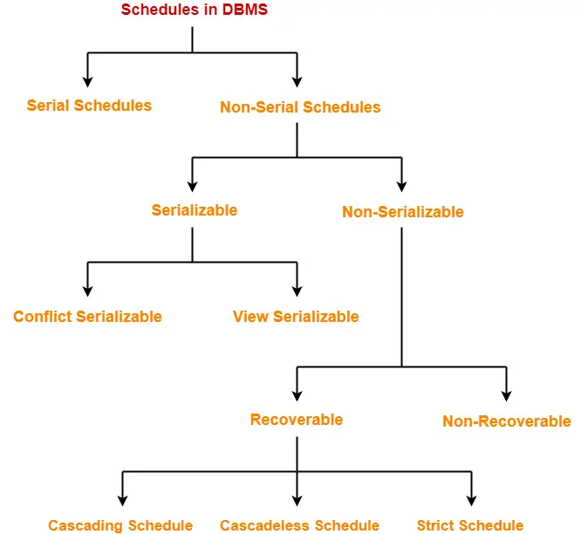

Slide 22
Schedules based on serializability
Schedule:
The order of execution of operations from the various transactions is known as a schedule.
A sequences of instructions that specify the chronological order in which instructions of concurrent transactions are executed.
22

Slide 23
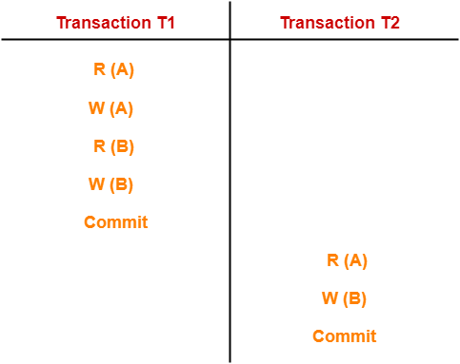
Serial Schedule
A schedule S is serial if, for every transaction T participating in the schedule, all the operations of T are executed consecutively in the schedule.
23

Slide 24
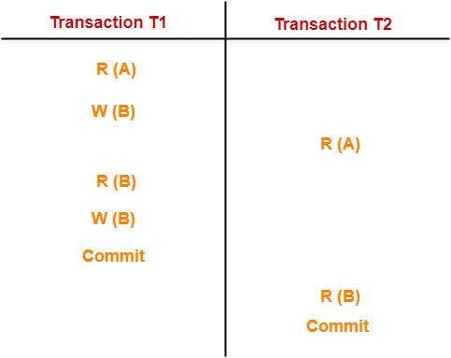
Non-Serial Schedule
Multiple transactions execute concurrently.
Operations of all the transactions are interleaved or mixed with each other.
24

Slide 25
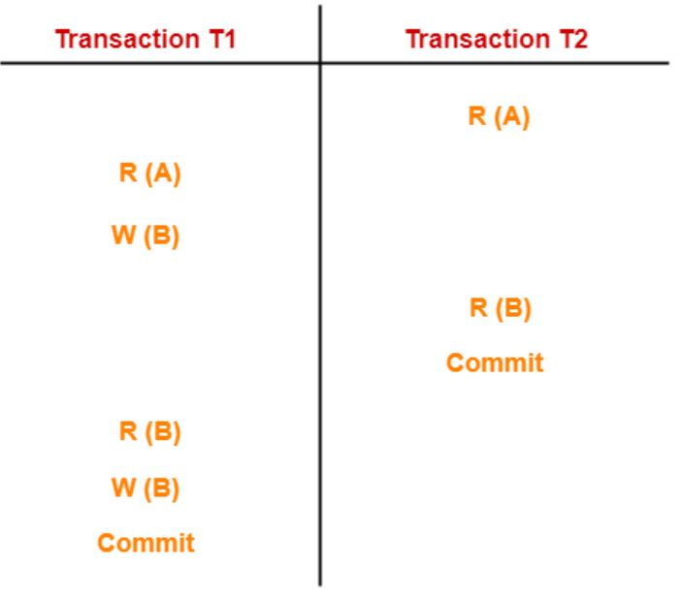
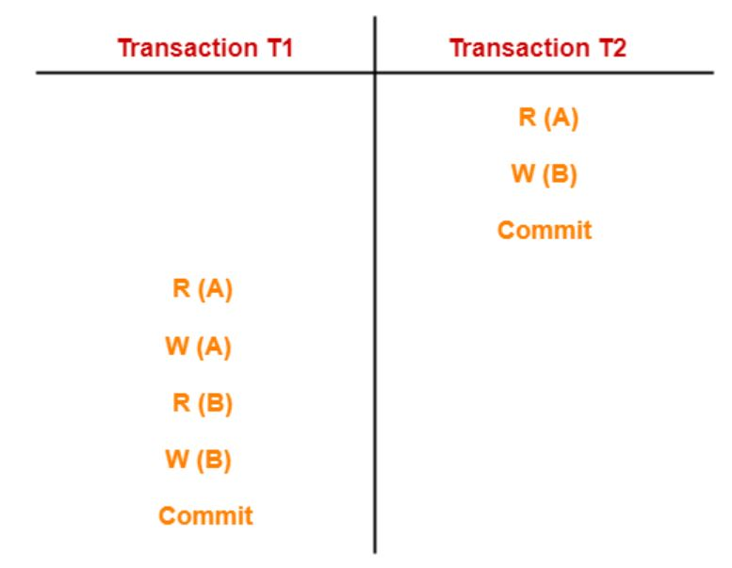
Identify the type of serializability?

Slide 26

Finding Number of Schedules
Consider there are n number of transactions T1, T2, T3 …. , Tn with N1, N2, N3 …. , Nn number of operations, respectively.
Total Number of Schedules-
Total Number of Serial Schedules- It is all possible permutations of n transactions = N!
Total Number of Non-Serial Schedules-
Total number of schedules – Total number of serial schedules
((N1 + N2 + N3 + ..... + Nn)! / (N1! * N2! * N3! * ... * Nn!)) - (N!)

Slide 27
EXAMPLES
Ques: 1:
Consider there are three transactions with 2, 3, 4 operations respectively, and find-
How many total schedules are possible?
How many serial schedules are possible?
How many non-serial schedules are possible?

Slide 28
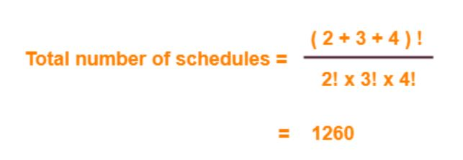
Serial schedules
= Number of different ways of arranging 3 transactions
= 3! = 6
Non-Serial Schedules :
Total number of schedules – Total number of serial schedules
= 1260 – 6
= 1254

Slide 29
Advantages of Serial Schedule:
  Never creates inconsistency.
Disadvantages of Serial Schedule:
  Poor throughput.
  No. of transactions complete per unit time is very less.
  Poor resource utilization.
Advantages of Non - Serial Schedule:
  Better throughput.
  Better resource utilization.
  No. of transactions complete per unit time is more number.
Disadvantages of Non - Serial Schedule:
  Creates inconsistency.

Slide 30
The Non-Serial Schedule can be divided further into:
  Serializable and
  Non-Serializable.

Slide 31
SERIALIZABILITY
Some non-serial schedules may lead to inconsistency of the database.
Serializability is a concept that helps to identify which non-serial schedules are correct and will maintain the consistency of the database.

Slide 32
Serializable Schedules-
If a given non-serial schedule of ‘n’ transactions is equivalent to some serial schedule of ‘n’ transactions, then it is called as a serializable schedule.
A serializable schedule helps in improving both resource utilization and CPU throughput. These are of two types:
  Conflict Serializable
  View Serializable

Slide 33
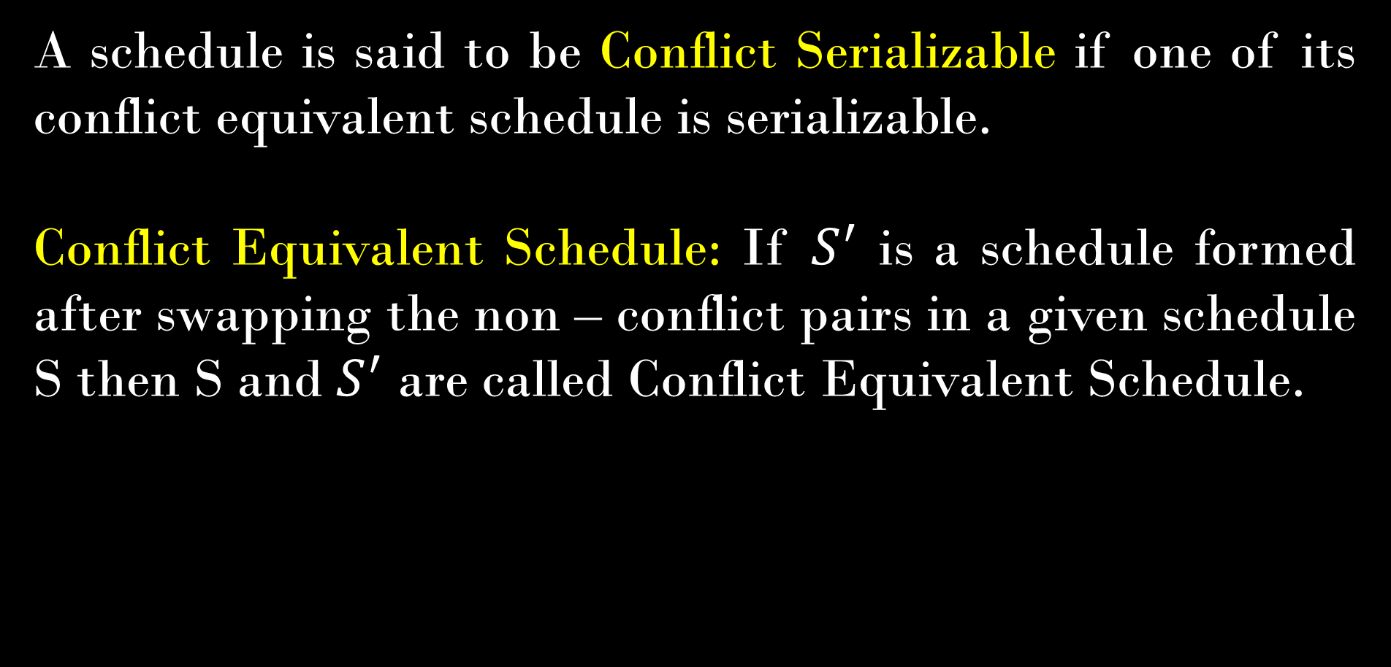
Conflict serializable schedules
A schedule is said to be Conflict Serializable if one of its conflict equivalent schedule is serializable.
Conflict Equivalent Schedule: If $S^{′}$ is a schedule formed after swapping the non – conflict pairs in a given schedule S then S and $S^{′}$ are called Conflict Equivalent Schedule.
33

Slide 34
Conflict pairs and Non – Conflict pairs
Conflict Pairs:
R(A) W(A) W(A) W(A) R(A)
W(A) R(A) W(A) R(A) W(A)
34

Slide 35
Why are they Conflict pairs?
If the order of execution of these conflict pairs are inverted then the output or the result gets changed.
i.e., if R(A)
W(A)
if W(A)
R(A)

Slide 36
Non – Conflict pairs
Non - Conflict Pairs:
R(A) R(A) W(A) W(A) R(A)
R(B) R(A) W(B) R(B) W(B)
36

Slide 37
Finding a Conflict Equivalent schedule
S1
T1 T2
R(A)
W(A)
R(A)
R(B)
W(B)
R(B)
Non - Conflict Pair
Conflict Pair
This order can not swapped
37

Slide 38


Finding a Conflict Equivalent schedule
${S1}^{′}$
T1 T2
R(A)
W(A)
R(B)
W(B)
R(A)
R(B)
Order of Non - Conflict Pair is swapped.
If we see this schedule all the operations of T1 is performed then T2 is started then it is called Serializable schedule.
${S1}^{′}$ is a Conflict equivalent schedule to S1. Therefore S1 is a Serializable schedule
38

Slide 39
View serializable schedules
If the given schedule is Conflict serializable then we can say that the schedule is Serializable.
If we given schedule is not conflict serializable then we can check for view serializability. If it is true then that the schedule is Serializable, otherwise the schedule is Non – Serializable.
39

Slide 40

View serializable schedules
A Schedule is said to be view serializable, if it has an equivalent “View Equivalent” Schedule.
View Equivalent Schedule: A schedule $S^{′}$is said to be view equivalent schedule to S if it satisfies the following three conditions:
        Initial Read
        Read Write Sequence
        Final Update
40

Slide 41
View Equivalent Schedules
Schedules S1 and S2 are called view equivalent if the following three conditions hold true for them.
“Initial readers must be same for all the data items”.
“Final writers must be same for all the data items”.
“Write-read(Update Read) sequence must be same.”

Slide 42
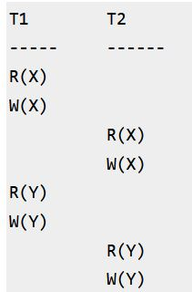
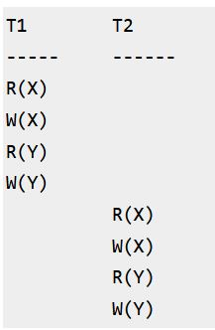
S1
S2

Slide 43
1.Initial Read
2. Final Write
3. Update Read
Since, above all conditions met, we can say S1 and S2 are View Equivalent.

Slide 44
Checking Whether a Schedule is View Serializable Or Not
Method-01:
If the given schedule is conflict serializable, then it is surely view serializable.
If the given schedule is not conflict serializable, then it may or may not be view serializable. Go and check using other methods
Method-02:
No blind write means not a view serializable schedule. (Writing without reading is called as a blind write).
Method-03:
In this method, try finding a view equivalent serial schedule.
By using the above three conditions, write all the dependencies.
Then, draw a graph using those dependencies.
If there exists no cycle in the graph, then the schedule is view serializable otherwise not.

Slide 45
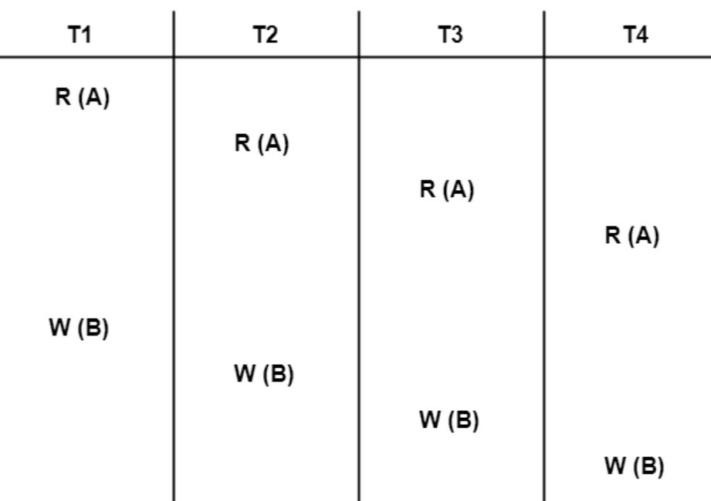
Problem-01:
Check whether the given schedule S is view serializable or not-

Slide 46
Step-01:Checking Whether S is Conflict Serializable Or Not-
List all the conflicting operations and determine the dependency between the transactions-
W₁(B) , W₂(B) (T₁ → T₂)
W₁(B) , W₃(B) (T₁ → T₃)
W₁(B) , W₄(B) (T₁ → T₄)
W₂(B) , W₃(B) (T₂ → T₃)
W₂(B) , W₄(B) (T₂ → T₄)
W₃(B) , W₄(B) (T₃ → T₄)

Slide 47
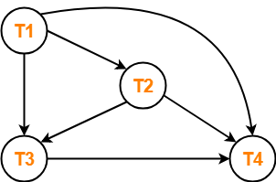
There exists no cycle in the precedence graph.
Therefore, the given schedule S is conflict serializable.
Thus, we conclude that the given schedule is also view serializable.

Slide 48
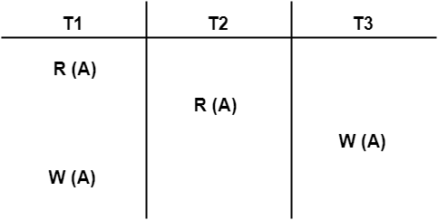
PROBLEM 2:-Check whether S is view serializable or not

Slide 49
Steps to build a Precedence Graph
Analyze the given schedule:
Transactions: T1​, T2​, and T3​
Operations:
  T1 : R(A),W(A)
  T2 : R(A)
  T3 : W(A)
Conflicting operations:
List all the conflicting operations and determine the dependency between the transactions-
  R1(A) , W3(A) (T1 → T3)
  R2(A) , W3(A) (T2 → T3)
  R2(A) , W1(A) (T2 → T1)
  W3(A) , W1(A) (T3 → T1)

Slide 50
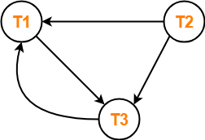
Conflict or not?
Clearly, there exists a cycle in the precedence graph.
Therefore, the given schedule S is not conflict serializable.
Since, the given schedule S is not conflict serializable, so, it may or may not be view serializable.
To check whether S is view serializable or not, let us use another method.
Let us check for blind writes.

Slide 51
Blind Write exists or not?
There exists a blind write W₃ (A) in the given schedule S.
Therefore, the given schedule S may or may not be view serializable.

Slide 52
Let us derive the dependencies
and then draw a dependency graph
T1 first reads A but T3 updates A first.
So, T1 must execute before T3.
Thus, we get the dependency T1 → T3.
Final updation on A is made by the transaction T1.
So, T1 must execute after all other transactions.
Thus, we get the dependency (T2, T3) → T1.
There exists no write-read sequence.

Slide 53
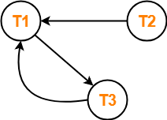
Drawing a Dependency Graph-
T1 → T3.
(T2, T3) → T1.
There exists a cycle in the dependency graph.
Thus, we conclude that the given schedule S is not view serializable.

Slide 54
Problem-04:
Check whether the given schedule S is view serializable or not. If yes, then give the serial schedule.
S : R₁(A) , W₂(A) , R₃(A) , W₁(A) , W₃(A)

Slide 55
Non - Serializable schedule
The non-serializable schedule is divided into two types,
    Recoverable and
    Non-recoverable Schedule.

Slide 56
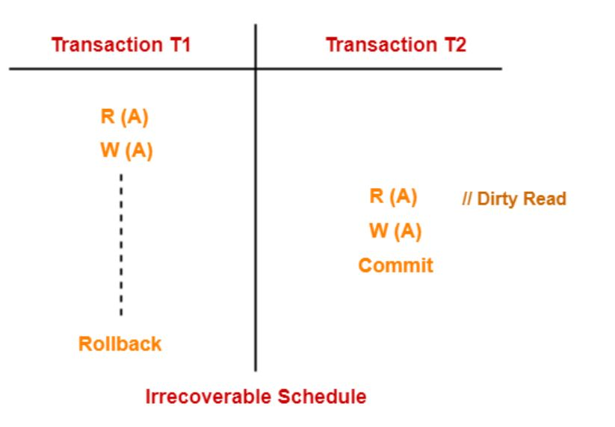
Non - Recoverable Schedules
Example: Consider the following schedule involving two transactions T₁ and T₂.
T2 read the value of A written by T1, and committed.
T1 later aborted, therefore the value read by T2 is wrong, but since T2 committed, this schedule is non-recoverable.

Slide 57
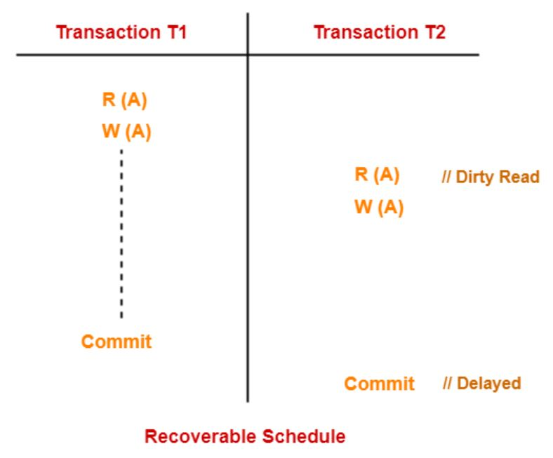
Recoverable Schedules
Schedules in which transactions commit only after all transactions whose changes they read commit are called recoverable schedules.
In other words, if some transaction Tj is reading value updated or written by some other transaction Ti, then the commit of Tj must occur after the commit of Ti.
Example – Consider the following schedule involving two transactions T1 and T2.

Slide 58
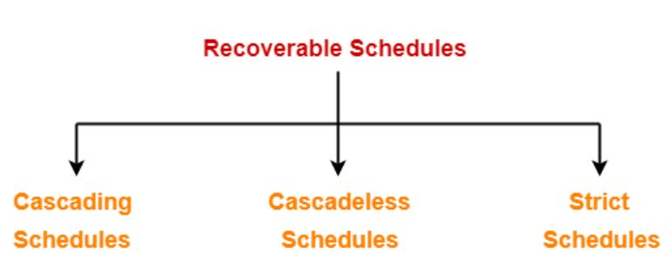
Types of Recoverable Schedules

Slide 59
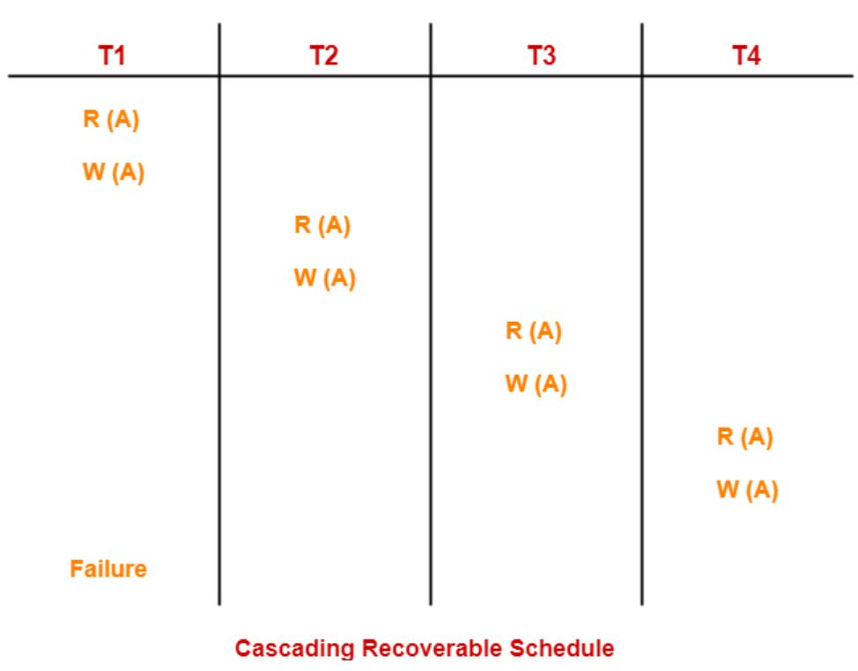
CASCADING SCHEDULES
When there is a failure in one transaction and this leads to the rolling back or aborting other dependent transactions, then such scheduling is referred to as Cascading Schedule or Cascading Rollback or Cascading Abort.

Slide 60
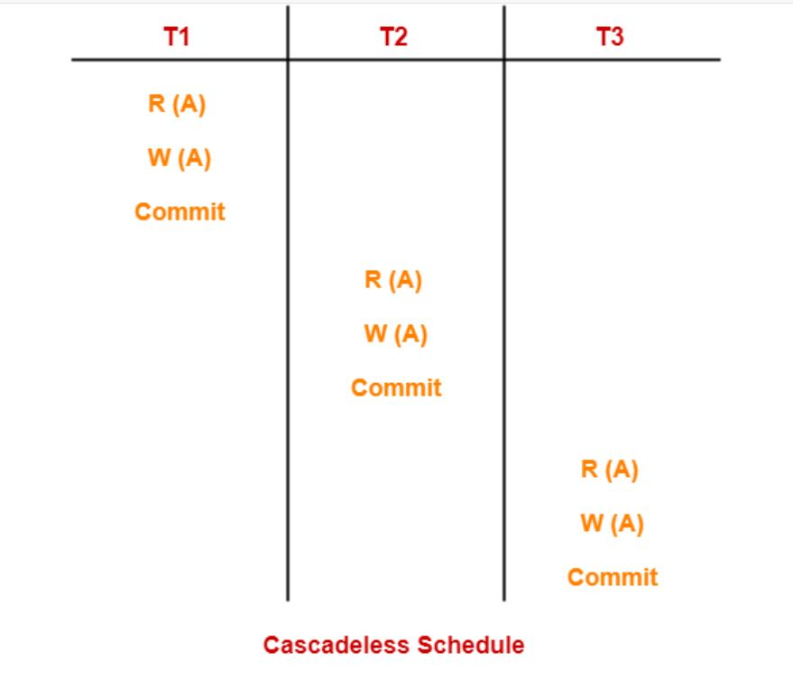
CASCADELESS SCHEDULES
Cascadeless schedule allows only committed read operations.

Slide 61
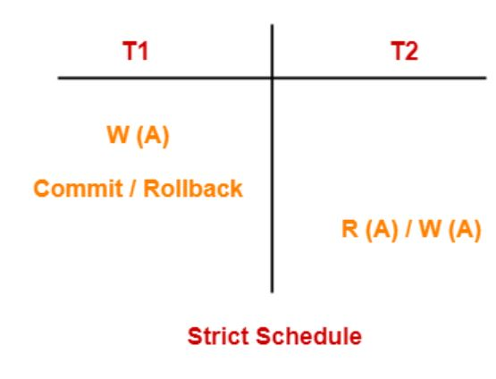
STRICT SCHEDULES
Transaction is neither allowed to read nor write a data item until the last transaction that has written it is committed or aborted, then such a schedule is called as a Strict Schedule.

Slide 62
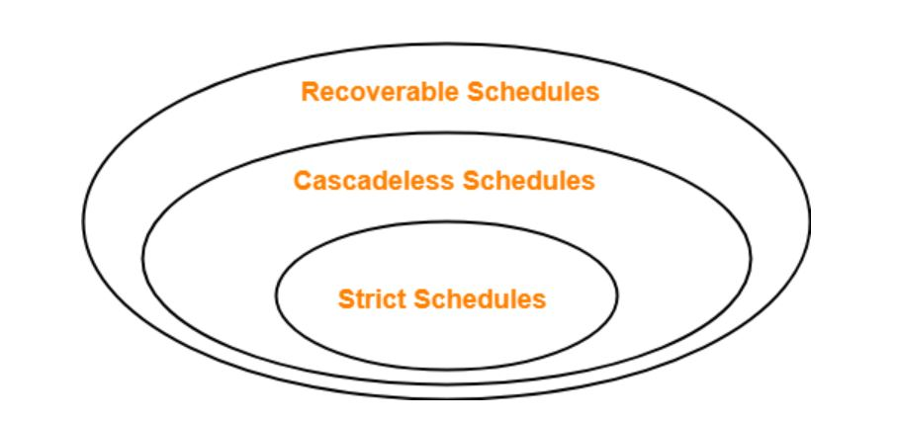
Strict schedules are stricter than cascadeless schedules.
All strict schedules are cascadeless schedules.
All cascadeless schedules are not strict schedules.

Slide 63
THANK YOU
22CS201-DBMS Dept. of CSE

