Slide 1

HOW YOUTUBERS MAKE MONEY? FIVE DESIGN SHEET
BALAJI MOHAN
29301092
FIT5147
Sections © 2016 CENGAGE Learning All rights reserved

Slide 2
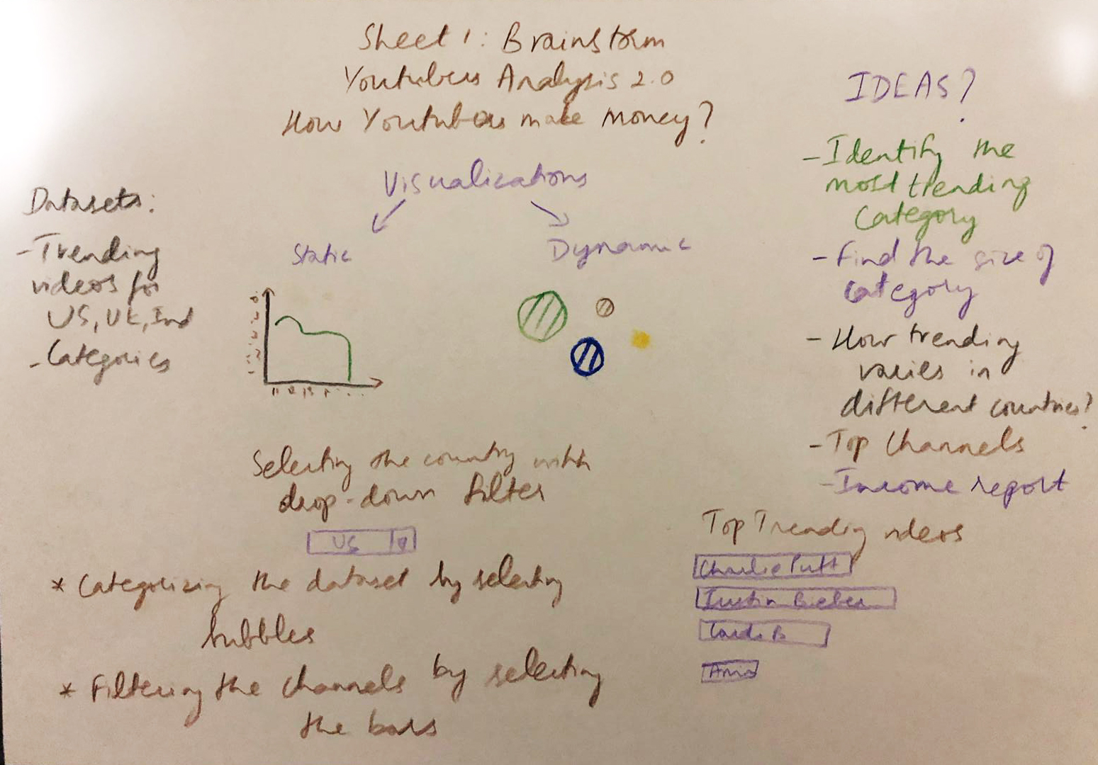

Slide 3
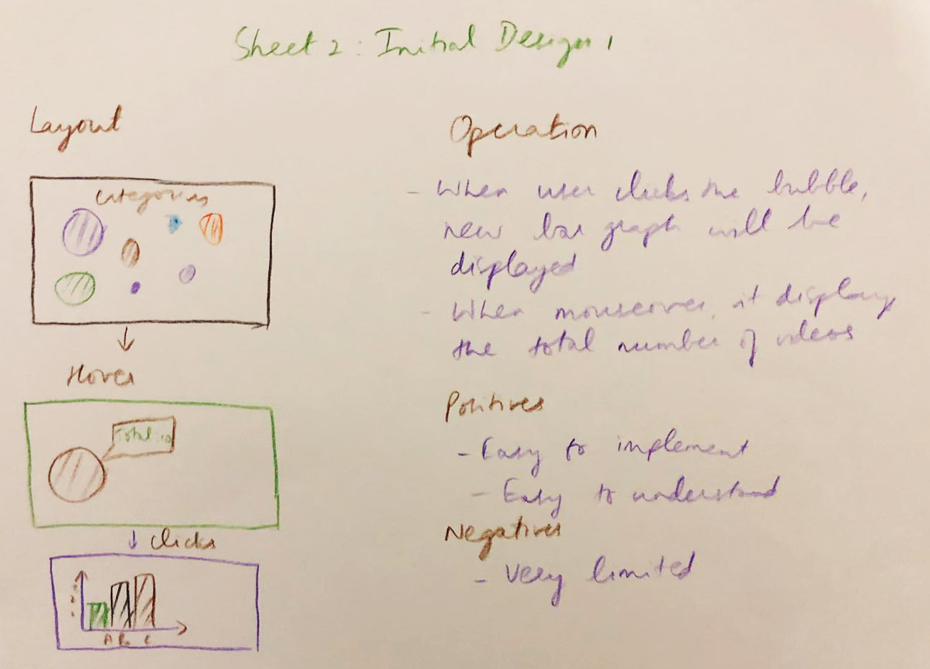

Slide 4
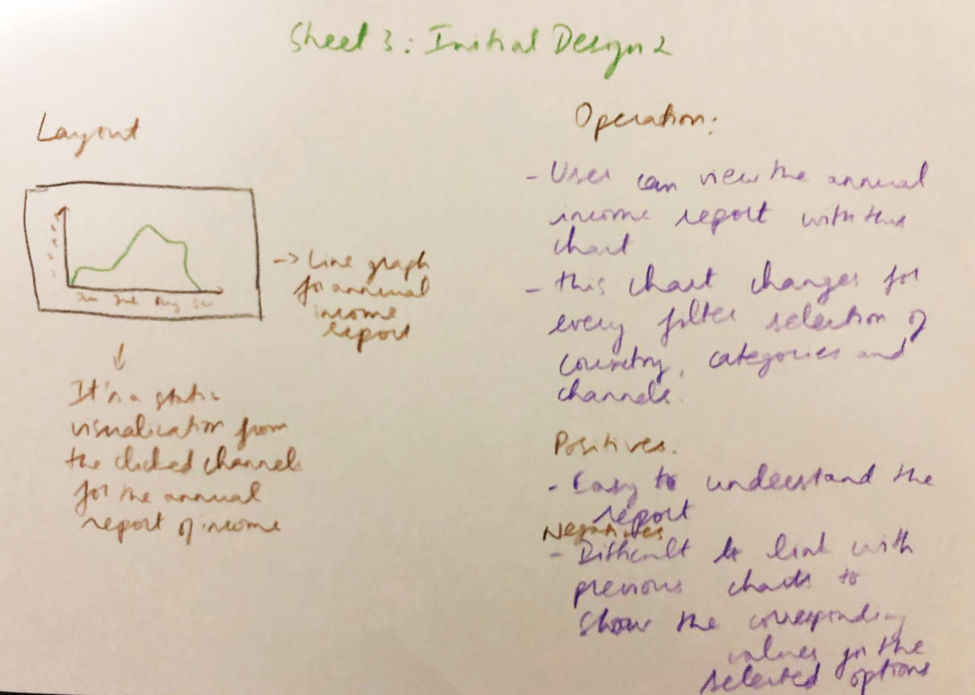

Slide 5
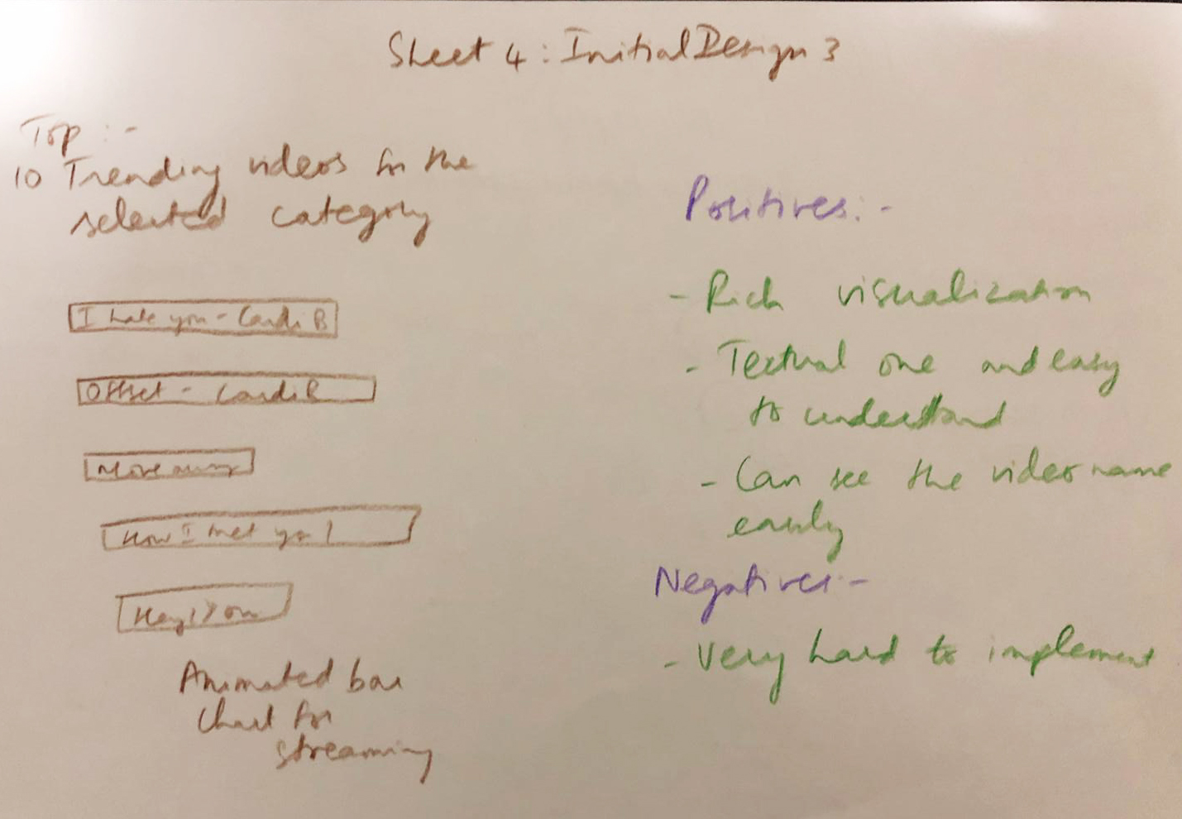

Slide 6
