Slide 1
An Analysis of the Gamma Function: Γ(x)
ETERNITY Project: Deliverable 1
Satya Sri Balaji Moturu (40270420)
SOEN 6011: Software Engineering Processes
July 14, 2025

Slide 2
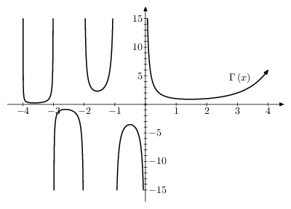

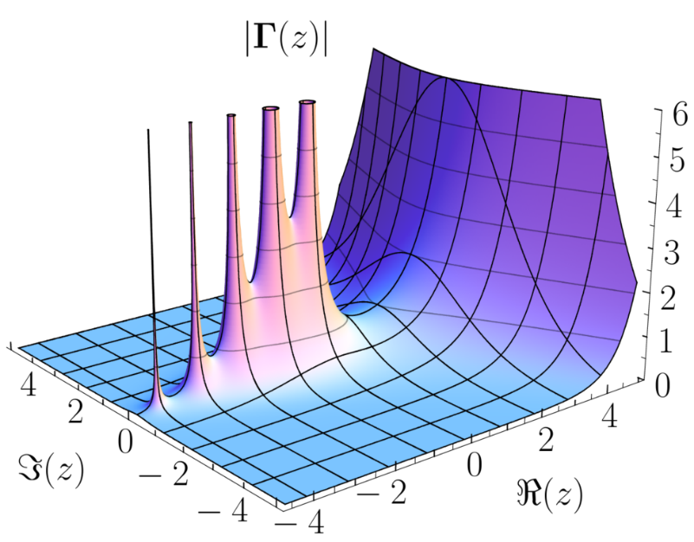
Introduction to the Gamma Function
The Gamma function, denoted as Γ(x), generalizes the factorial function to real and complex numbers [1].
It is defined by the integral:
Here, t is the integration variable, and x is the input parameter to the Gamma function.
For any positive integer n, Γ(n) = (n-1)! [2].
Γ(x), x ∈ ℤ, n ≤ 0 is undefined.
It plays a vital role in probability, statistics, physics, and engineering [3].

Slide 3
Context of Use Model
Context of Use: The Scientific Calculator
Technical Environment:
Electronic device or software application supporting advanced mathematical operations [5]
Includes trigonometric, logarithmic, exponential, and transcendental functions
Utilizes floating-point arithmetic and supports scientific notation [5]
Non-Technical Environment:
Users: Students, engineers, scientists
Context: Academic, research, and professional environments
Objective: Simplify complex calculations reliably and accessibly

Slide 4
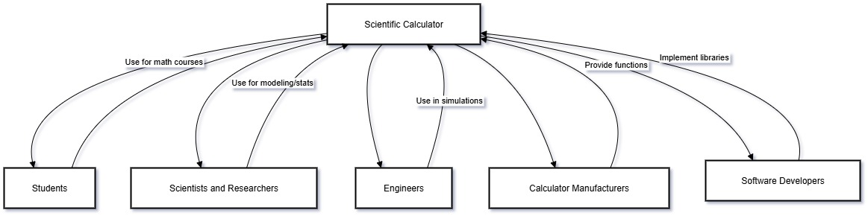
Key stakeholders
Primary Users:
Students (high school/university): Require support for advanced mathematics
Scientists and researchers: Use it for modeling and statistical analysis [3]
Engineers: Apply in simulations, fluid dynamics, and signal processing
Acquirers and Developers:
Calculator manufacturers: Provide comprehensive functionality
Software developers: Implement scientific libraries and tools

Slide 5
Functional & Non-Functional Requirements
[FR-01] The system shall accept any real number input x, excluding non-positive integers [1].
[FR-02] The system shall compute Γ(x) using a numerical approximation with at least 5 decimal places of precision.
[FR-03] For any positive integer n, the system shall ensure that Γ(n) = (n-1)! [3].
[FR-04] The system shall return exact known values for specific inputs, such as Γ(0.5) = √π [4].
[NFR-01] The result shall be computed and displayed within one second.
[NFR-02] The function shall be accessible via a labeled menu item or CLI option.
[NFR-03] The system shall maintain at least 99% accuracy for all valid inputs.
[NFR-04] Invalid inputs shall trigger a user-friendly error message.

Slide 6
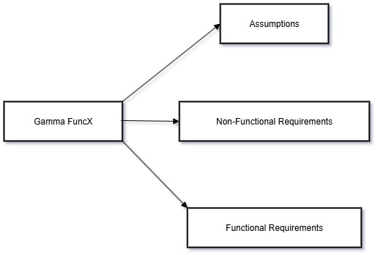
Assumptions
[A-01] Users are expected to understand advanced mathematical functions and input constraints.
[A-02] The system’s processor is assumed capable of high-precision floating-point calculations.
[A-03] The Gamma function is implemented using a numerical approximation method, such as the Lanczos algorithm [8].

Slide 7
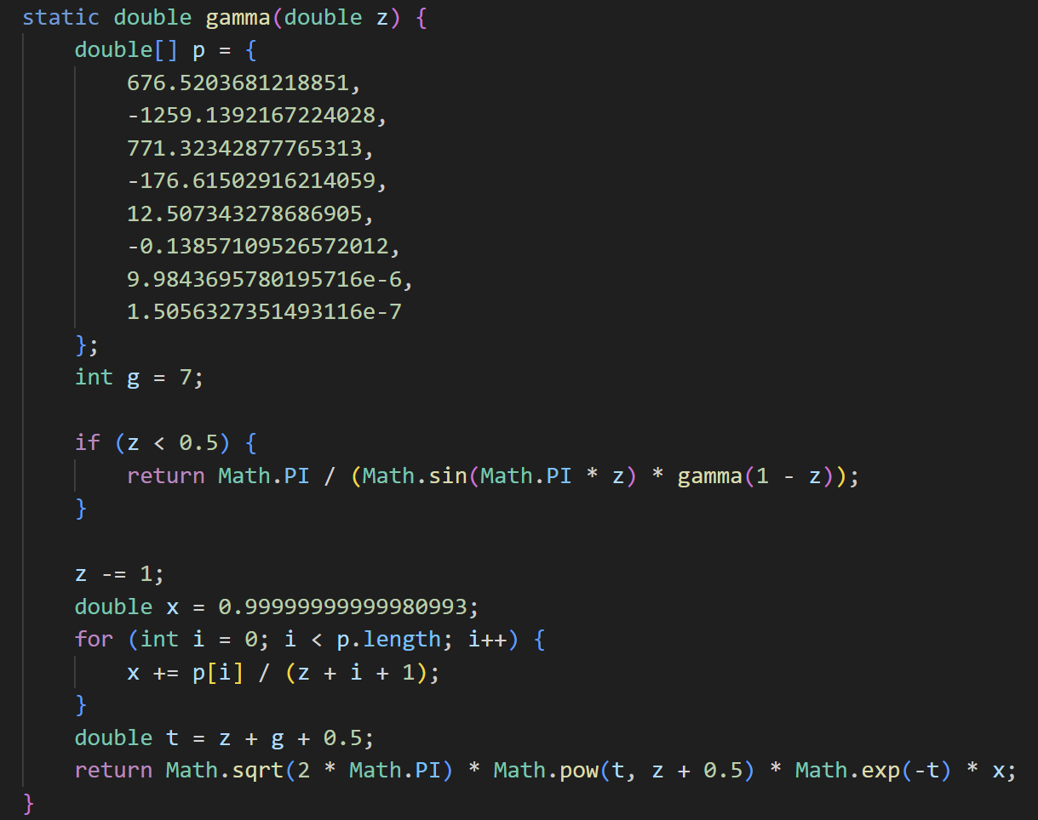
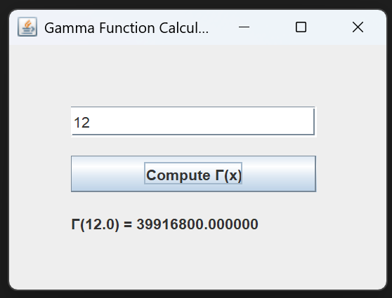
Code Implementation
Designed a minimal Java Swing UI for a textual user interface.
Implemented the Gamma function using the Lanczos approximation to support functional requirements like accuracy and known values.
Ensured responsiveness and cross-platform compatibility as part of the non-functional requirements.
Validated user input and handled edge cases like non-positive integers to meet reliability expectations.
The code structure reflects: simplicity, clarity, and readiness for further GUI enhancements in future deliverables.

Slide 8
Conclusion
The Gamma function generalizes the factorial to real and complex numbers, supporting a wide range of scientific computations [1].
A thorough context of use was established, identifying typical users like students, scientists, and engineers, and situating the function within a calculator environment [5][6].
Functional and non-functional requirements were modeled using ISO/IEC/IEEE 29148 standards, ensuring traceability, completeness, and consistency.
The Java implementation, featuring a minimal Swing-based UI, satisfies D1’s requirement for a textual interface and supports CLI usability [2].
The backend uses the Lanczos approximation, enabling accurate Gamma computation across most real inputs while maintaining good performance.
Error handling and response time were implemented in line with non-functional requirements such as usability, reliability, and performance.
Overall, this implementation lays a strong foundation for future deliverables involving expanded UI or integration into scientific computing platforms.

Slide 9
Conclusion
[1] Wikipedia. Gamma Function. https://en.wikipedia.org/wiki/Gamma_function
[2] Math is Fun. Gamma Function. https://www.mathsisfun.com/numbers/gamma-function.html
[3] StatLect. Gamma Function. https://www.statlect.com/mathematical-tools/gamma-function
[4] Mathematics LibreTexts. Gamma Function. https://math.libretexts.org/Bookshelves/Differential_Equations/
[5] ResearchGate. Scientific Calculator Overview.
[6] Quora. Features of Scientific Calculators.
[7] Kansas State University (ksu.edu). Gamma function graphs.
[8] Weisstein, Eric W. Gamma Function. Wolfram MathWorld. https://mathworld.wolfram.com/GammaFunction.html
[9] Perplexity AI. https://www.perplexity.ai/

