Slide 1
An Analysis of the Gamma Function: Γ(x)
ETERNITY Project: Deliverable 2
Satya Sri Balaji Moturu (40270420)
SOEN 6011: Software Engineering Processes
July 28, 2025

Slide 2
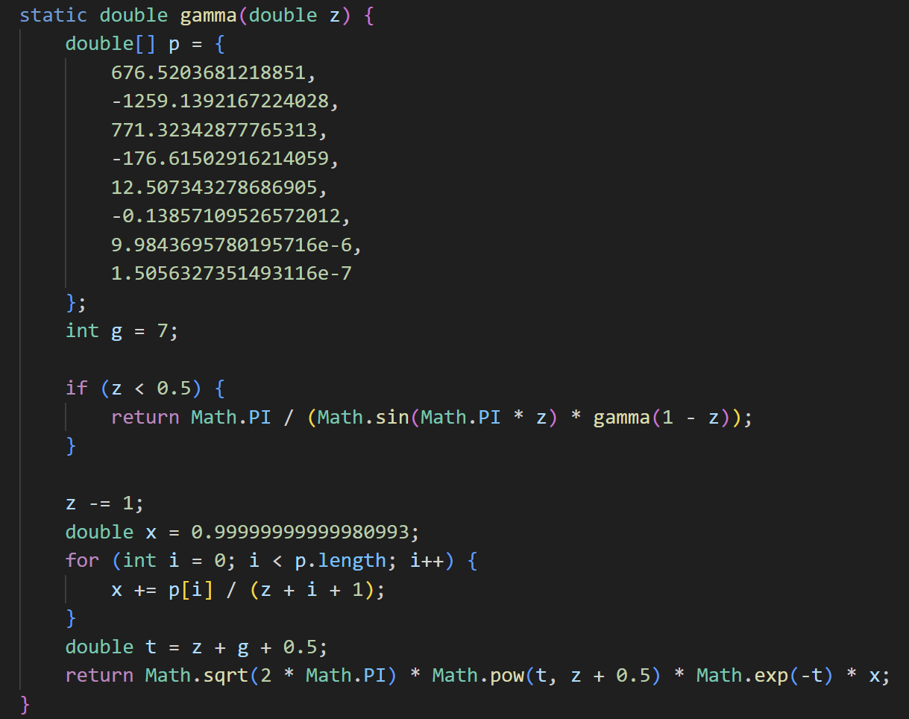
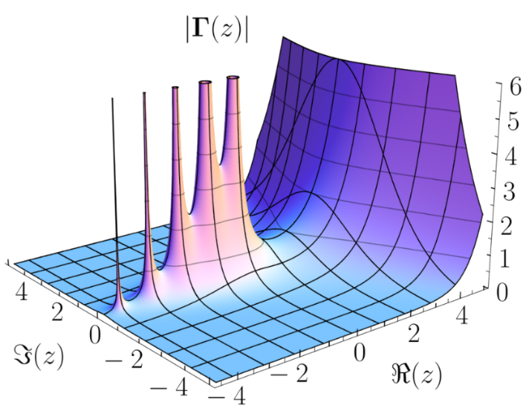
Introduction
This deliverable builds upon D1, where the Gamma function (Γ(x)) was defined, its context modeled, and its implementation introduced using a java function.
In D2, the focus shifts toward enhancing the system through:
A more interactive and intuitive Graphical User Interface (GUI)
Detailed design documentation using UML
A defined testing strategy to ensure correctness
Emphasis on software quality attributes such as usability, reliability, and maintainability
The goal is to refine the Gamma function calculator into a more complete, robust, and user-friendly application.

Slide 3
User Persona
Persona Profile:
Name: John
Profession: Aerospace Engineer
Workplace: Canadian Space Agency
Role: Works on trajectory modeling and simulation tools for rocket launches and orbital mechanics
Use of Gamma Function in Work:
Frequently uses Gamma distributions in probabilistic modeling (e.g., engine reliability, material fatigue).
Requires accurate Γ(x) values as part of internal formulas within simulation and statistical tools.
Pain Points / Challenges:
Manual computation or reliance on Python tools is slow or error-prone under field conditions.
Standard scientific calculators often return "Math Error" or give no explanation when input is invalid.
Needs clear messaging, support for non-integer values, and fast performance on common hardware.
Needs:
A quick, accurate way to compute Gamma values without relying on complex software.
Interface that allows safe testing of formulas during real-time simulations or prototyping.

Slide 4
GUI Evolution: Interactive
The Gamma function calculator interface has been redesigned for better interaction and clarity.
A text field captures the user’s numeric input, and a clearly labeled button triggers the computation.
Results are displayed in a dedicated output area, with values formatted to six decimal places for precision and readability.
To improve robustness, the system now detects invalid inputs such as non-positive integers and displays clear messages (e.g., “Undefined for x ≤ 0 (integer)”).
The layout is compact, intuitive, and responsive - ensuring ease of use for both casual and advanced users.
This refined interface supports fast interaction and contributes to the overall usability and reliability of the application.

Slide 5
Updated Design Architecture
The application is structured using a modular design approach [8], separating concerns between input handling, logic processing, and validation.
Key components:
This structure enhances maintainability and supports clean code principles [8].
It also allows for easier unit testing and future extensions, such as switching to a graphical calculator or web-based UI.
Component | Responsibility
UI Module | Manages user input, handles button clicks, and displays output clearly.
GammaCalculator | Computes Γ(x) using the Lanczos approximation for precision and stability.
Input Validator | Detects undefined cases (e.g., x = 0, -1, -2) and prevents invalid calculations.

Slide 6
Testing Strategy & Results
The system was tested using a manual input-output validation approach for a range of values, including:
Positive integers (e.g., Γ(5) = 24.000000)
Non-integers (e.g., Γ(2.5) ≈ 1.329340)
Edge values (e.g., Γ(0.5) ≈ √π ≈ 1.772454) [4]
Invalid inputs (e.g., -1 → Error: "Undefined for x ≤ 0 (integer)")
Test results were checked against known values and reliable sources [1][3].
Inputs were handled gracefully, ensuring no crashes or unhandled exceptions occurred during execution.
Precision was verified up to 6 decimal places for most valid inputs.
The clear separation between logic and UI allowed isolated testing of the Gamma computation method, improving confidence in correctness [8].

Slide 7
Quality Considerations
The system addresses several key software quality attributes [8]:
These quality aspects were considered during both design and implementation to ensure a dependable and extensible tool.
Attribute | Description
Usability | Simple UI layout, clear buttons, and user-friendly error messages for ease of use.
Reliability | Validates input to prevent undefined outputs and ensures consistent behavior.
Accuracy | Implements the Lanczos approximation with results accurate to six decimal places.
Maintainability | Modular design allows logic and UI updates without affecting the entire system.
Performance | Computation completes within 1 second for standard inputs.

Slide 8
Updated Requirements After Implementation
[FR-01 Revised] The function accepts real numbers except non-positive integers; input validation is explicitly enforced in the GUI.
[FR-02 Revised] Output precision is maintained at six decimal places for readability and performance. (Initially it was 5)
[FR-05 New] The system shall display a clear error message when Γ(x) is undefined, improving usability.
[NFR-02 Updated] The function is now modularly designed, supporting testing and extension without UI modification.
[NFR-05 New] GUI components shall use accessible fonts, padding, and intuitive layout for visual clarity.
[A-04 New] It is assumed that the user runs the application on a system that supports Java Swing.
[A-05 New] It is assumed that the application is used in scientific or academic contexts with a basic understanding of Γ(x).

Slide 9
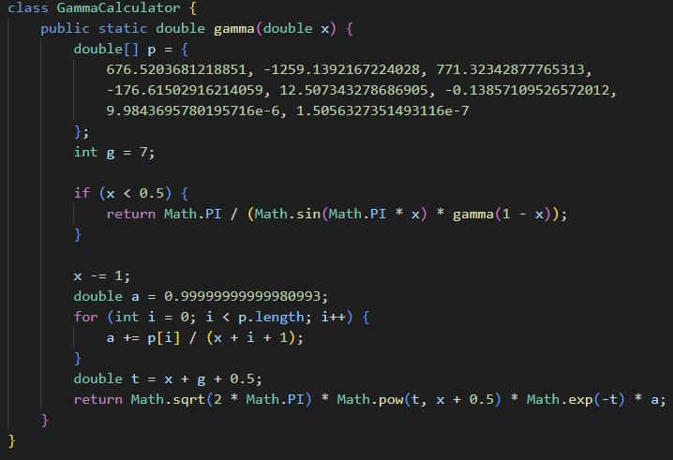
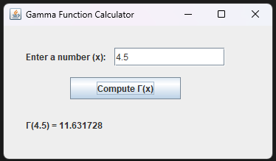
Code Implementation
The Gamma function is implemented using a Lanczos approximation algorithm wrapped inside a method:
static double gamma(double x)
Input validation checks for undefined values (e.g., x ≤ 0 and x is an integer) and shows an appropriate message.
Java Swing components (JTextField, JButton, JLabel) are used to create a lightweight GUI.
The result is displayed in a formatted label with six decimal precision, ensuring clarity and accuracy [10].
The logic is modular, separating computation from user interaction, which supports easier debugging and reuse [8].

Slide 10
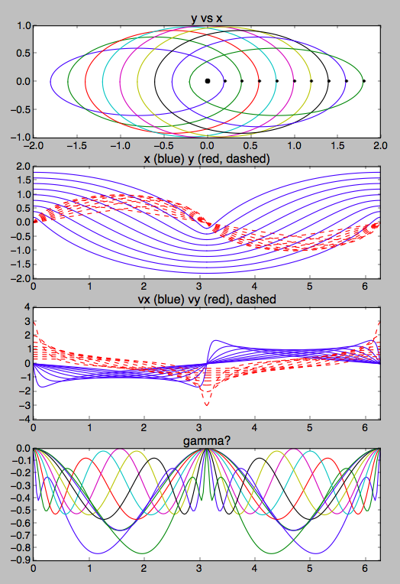
Positive Outcomes for the User
The interface allows quick and hassle-free computation of Γ(x)
Proper input validation avoids confusion from undefined or invalid entries
Accurate results improve reliability in scientific and engineering workflows
The modular design enables easy reuse in larger calculator or simulation tools
Clear result formatting and error messaging enhance user confidence
Lightweight setup eliminates the need for external libraries or complex platforms

Slide 11
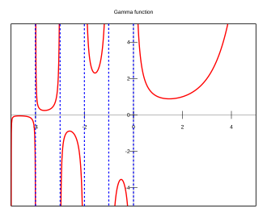
Conclusion
The Gamma function was implemented with attention to accuracy, usability, and performance.
A structured design and modular code allowed separation of UI, validation, and computation logic [8].
The GUI was refined to offer a clear, interactive experience and appropriate feedback for invalid inputs.
Testing confirmed reliable results for valid inputs and proper error handling for undefined cases [3][10].
Overall, this deliverable transforms a mathematical function into a robust, user-friendly tool, setting the stage for future feature integration or platform expansion.

Slide 12
References
[1] Wikipedia. Gamma Function. https://en.wikipedia.org/wiki/Gamma_function
[2] Math is Fun. Gamma Function. https://www.mathsisfun.com/numbers/gamma-function.html
[3] StatLect. Gamma Function. https://www.statlect.com/mathematical-tools/gamma-function
[4] Mathematics LibreTexts. Gamma Function. https://math.libretexts.org/Bookshelves/Differential_Equations/
[5] ResearchGate. Scientific Calculator Overview.
[6] Quora. Features of Scientific Calculators.
[7] Kansas State University (ksu.edu). Gamma function graphs.
[8] ISO/IEC/IEEE 29148:2018 – Systems and software engineering - Life cycle processes - Requirements engineering.
[9] Weisstein, Eric W. Gamma Function. Wolfram MathWorld. https://mathworld.wolfram.com/GammaFunction.html
[10] Perplexity AI. https://www.perplexity.ai/

