Slide 1
An Initiative by
BHERUNDA
www.royalsync.com
Chief Innovators
Vasantha Goodera | Satish Shekar
EXECUTIVE SUMMARY
Idea
Royal Sync will be the first digitally verified "Family Tree" platform which would grow automatically after endorsing only your first family (Parents, partner, siblings and dependents) in a secure manner.
Competitive Advantage
Our intellectual property will disrupt the current market for family tree and isolated products and services, which would make us the cost leader in this segment. Royal Sync will not only connect you, coupled with user engagement modules to explore and get notified.
Traction
Our platform has a "Patent Pending" Status. Currently in ideation stage, we plan to launch our product in December 2019 to reach 5,000 subscribing users by June-July 2020.
Vision
Our vision is to build a genealogy (Family Tree + DNA Services) platform who are logically grouped to seamlessly engage and discover their genealogy path growing. We also would use communities to leverage our platform for their community activities. We aim to reach a million subscribing users in

Slide 2
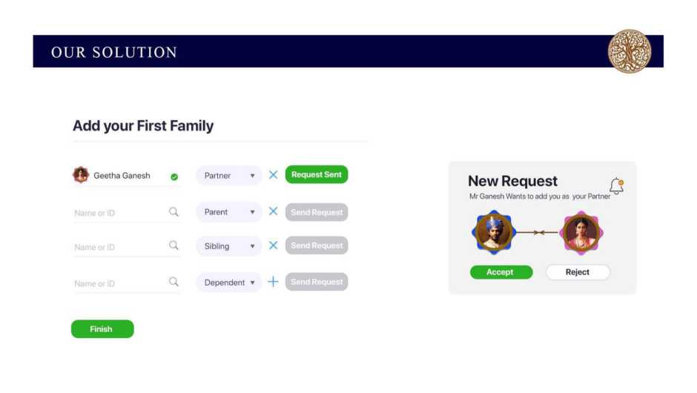
FY 22-23.
THE PROBLEM / MARKET SIZE
In India, there are no native platform for family, community to connect in a secure manner. At the moment they are leveraging on social media platforms and what's app groups. A Family Tree platform would give an opportunity to connect, engage, store/share and discover. Such digital assets would be a lifetime value for every individual.
Globally there are only handful platforms who gives DNA services, such services can be rendered only after getting users under family block to map their DNA and find their missing ancestor link or record heredity health data. Royal Sync would be a suitable platform for giving DNA services.
The market leader in Genealogy space is ancystry.com with over 60 million family tree and 2.7 million paying customers. The total revenue in the year 2016 was $540 million.
The market size in India is unknown for this segment; but few articles have narrated if such a service is rendered we could account a minimum of 100 million users and 50%-60% as paying customers for family tree and 3%-5% for DNA Services.
Royal sync will be the first genealogy platform on blockchain whose epitome being "Family Tree" which would be an asset for the existing Genealogy players.

Slide 3
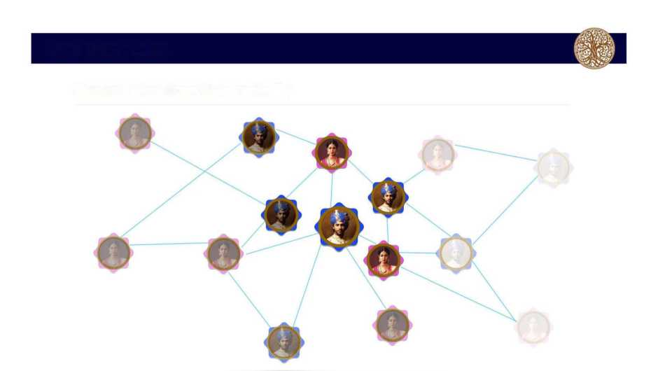
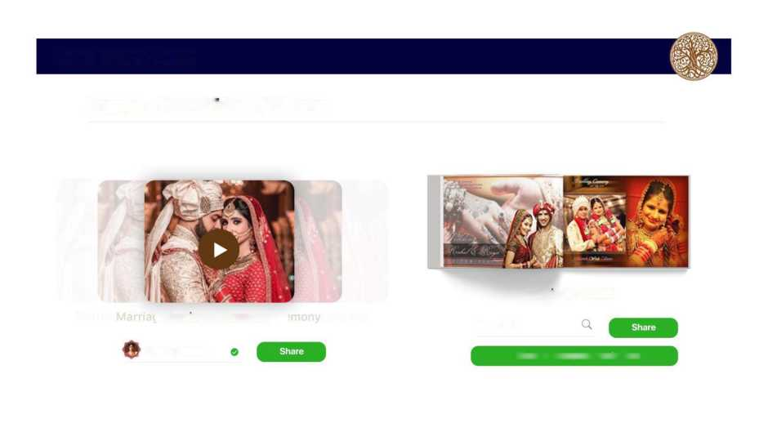
OUR SOLUTION
See your Tree Grow Automatically
OUR SOLUTION
Engage - Share Videos / Albums
Marriage Ceremony
Marriage Album
Geetha Ganesh
Name or ID
Share to Complete Family Tree

Slide 4
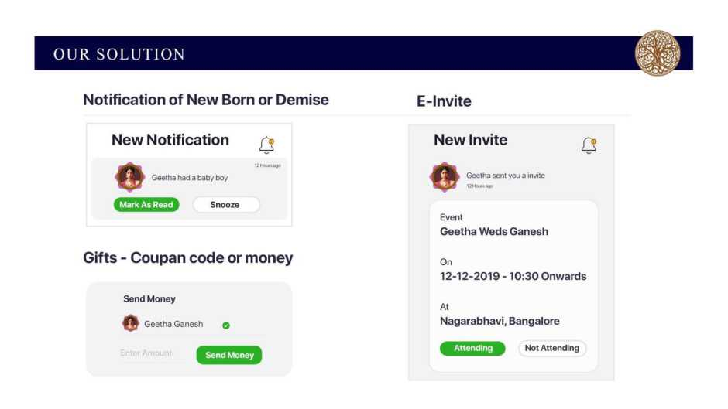
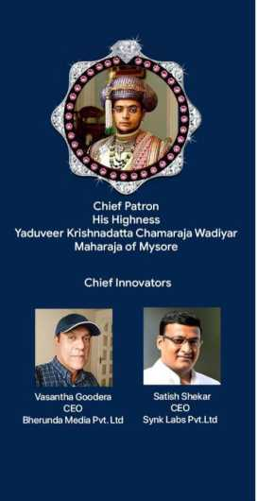






ADVISORS
Prof. S Sadagopan
Prof V Sridhar
Prof Uttam Kumar
Prof Ramesh S
TEAM
Latha HS
Karthik Kittu
Suhas Gopinath
CSO - Chief Strategy Officer
Chairman Globa Is. Inc.S. Co-founder Happy EMI
Amrutha
Director
Synk Labs Pvt Ltd
Chief Product Officer Founder CEO
CulKey
Chief Cultural Office Dance.member -CID UNESCO
Chief Technology Officer Co-founder
Campus Time
VALUE PROPOSITION Digital Repository
All family members life time memory in the form of video/album would be stored for the future generations to access the same.

Slide 5
Notifications
Apart from regular birthday, anniversary, etc. the real notification for a family is about and addition & deletion in a family tree to be informed.
Voucher Wallet
During any occasion, members of the family can send gift voucher from the registered vendors to bride/groom, etc.
Family Analytics
This is a space where we could extensively use Machine Learning and Artificial Intelligence to generate many analytical points and project the possibility.
Community
Any community can leverage on our platform for the operations and also identify families belonging to a certain caste/sub-caste.
Census
It's learnt that GOI spend 12,000 crore for accumulating census data. Royal Sync could be a valuable data provider for such data in the future.
COMPETITIVE ADVANTAGE
Cost Leadership
Royal Sync platform provides a verified family tree solution at practically negligible cost as compared to substitute products like the matrimonial sites which is limited to know the bride and groom of given community.
Differentiation
With use of blockchain technology platform for verified family tree, we are disrupting the traditional methods of verifying an individual before he/she is registered in the family tree through request/accepting the relationship and have created a new segment in this space. Such digitally verified credentials will be a lifetime value for individuals.
Economies of scale
Royal Sync has the potential to venture to many other related modules like partnering with DNA Services provider and partnering with retail brands and jewellery players for gift coupons, etc.

Slide 6
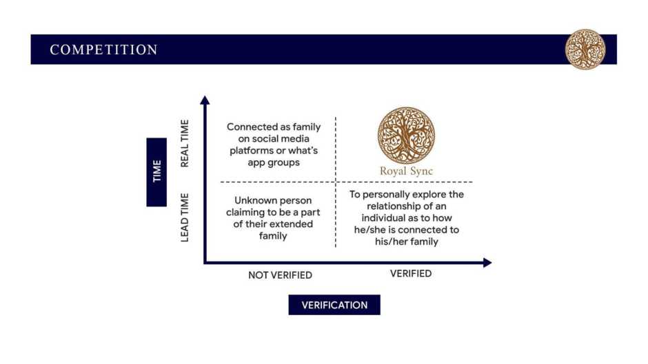
HOW THE IDEA GOT IGNITED
April 2019 His Highness YKC Wadiyar visited IIIT-B, our team got connected
MAY 2019 Mr Satish Shekar (SS) and Mr Karthik Kittu (KK) visited Mr Vasa
We (SS+KK) asked what's the one task you feel is important for our King and Mysore Place apart from social media & App's?
We are exploring; but YKC intents to have a digital family tree to showcase the kingdoms lineage, do you have any product or solution?
We have been researching & working on this for over a year, we have evaluated the existing and substitute platforms & we have a Idea.
Wow, that's a coincidence Explains the concept in mind and how blockchain
technology is a strategic fit
Holistically absorbs the idea and shares his experience of horses pedigree chart, family tree from his 25 years of horse racing experience and from 30 years of his professional experience in Japan he narrated how family name plays a vital role and the importance of family tree.
JUNE 2019 Submits a draft concept note
JULY / AUGUST 2019 2019 Brainstroming & Diving deeper into the concept
OCTOBER 2019 Submits final proposal with financials to angel Investor.
This is how the idea of "Royal Sync" was born.

Slide 7
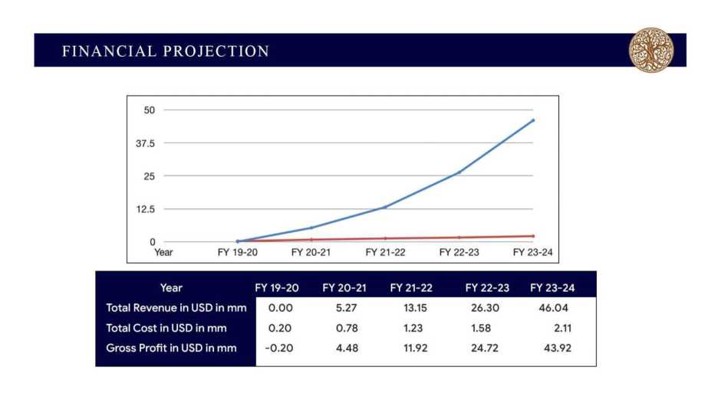
KEY PERFORMANCE INDICATORS
No. of Customers
To reach 4500 subscribing members who would also purchase storage space to reach ROI. In 5 years we aim to reach 20 million subscribing members.
Customer acquisition cost
Our acquisition cost is calculated at $1.5 per paying subscriber for FY 19-20 and gradually reduced to $0.43 in FY 22-23
Lifetime value
Create a digital repository of a family, hence creating a lifetime value for an individual
Customer Retention Strategy
Low cost internet access will force housewife's to spend more time in this platform to view video/album of family occasions rather than viewing what's app forwards and share chat. We are confidant that they would get addicted to this platform. Moreover, notifications of new born or demise of a family member will be in real time.
Funds and Proposed Valuation

Slide 8
Funds Required
For the first phase we are looking at INR 8.5 million for technology development of web based platform using blockchain technology. Once we reach 4500 paying customers then we would build mobile application at the cost INR 5.2 million which could be funded from the revenue earned as projected in the financials.
Investors in pipeline
We have approached Google and Microsoft accelerators who would not only fund us but also help us in penetrating the product across the globe and help us partner with DNA platforms.
Funds Utilisation
80% off the fund received would be used for technology development and the rest would be for management and admin cost.
Revenue Projection
It's estimated that our ROI would be at a point when 4500 subscribing members are registered, who would also subscribe to storage of 100 GB for their digital assets. At this point we would breakeven. Which is projected in FY 20-21, specifically June-July 2020 as per projections.
Valuation
Will be done in the month of August - September 2020.
Royal Sync Product Partners Belfrics
A blockchain technology company, head quartered in Kuala Lumpur, Malyasia having operations in Singapore, Bahrain, Kenya, India, Nigeria, UAE, Kenya. Belfrics is a multi Vertical group into DLT development, Custom blockchain development based on blockchain infrastructure like Belrium, Ethereum, and other blockchain framework, has been growing since 2014. https://www.belfricsbt.com/
Yosync
A blockchain digital identity platform who has partnered with Belfrics and MOSIP (an IIIT-B imitative) for global identity on blockchain. Currently MOSIP has signed a contract with Morocco for creating their national ID in line with Aadhaar. https://www.mosip.io/
Culkey Foundation
Culkey aim to be your Digital Assistant to empower you to customise your access to traditions, beliefs and customs. and Unlock the 'money value of a given time' by connecting to your

Slide 9
roots.Culkey will partner with communities to onboard them to Royal Sync and also give them their community-specific calendar, customs, rituals, etc. to connect to their roots.
ACCOMPLISHMENTS
Synk Labs Pvt Ltd has signed an exclusive contract with BelfricsBT SDN BHD for blockchain services.
We have also got the base architecture ready for implementation and first copy of UI/UX designs
We also would be using Yosync for blockchain digital identity with belfrics blockchain
We have partnered with Badge Labs LLP for cyber security requirements at the architectural stage.
We have completed the requirement study and once funded we can start the development work and the estimated time to release beta version is 75-90 days.
Partnership and Exit Option
Royal Sync is a concept where both partnerships and exit option could be considered.
In case of partnerships, we could sign an exclusive contract with certain retailers for voucher service and also allow them to leverage on our database with user consent to sell their products and services during occasions, anniversaries, birthdays, etc.
With the aim of expanding Royal Sync to communities and census collection point we could expect and strategic partnerships, merger or buy out in FY 23-24
A investor who would also look at financial projection would know that the ROI is in FY 20-21 and profits from the month of February - March 2021 keeping in mind the additional spend for mobile application from the revenue generated.

Slide 10
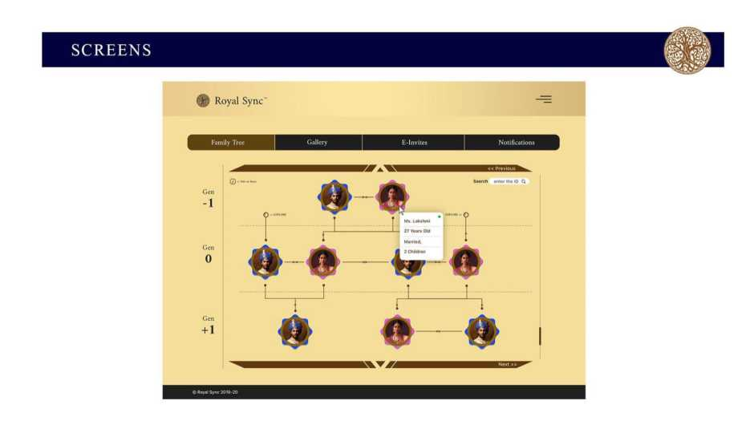
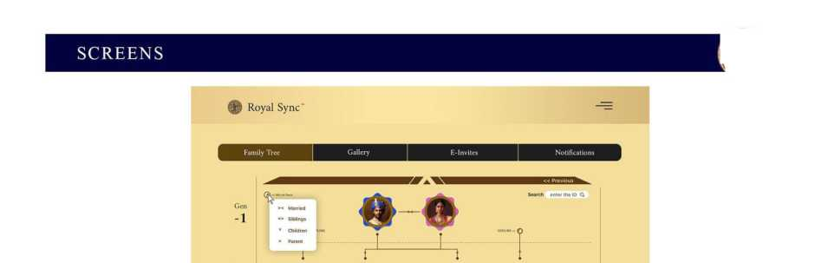

Slide 11
