Slide 1
Visualization of Test Information to Assist Fault Localization
James A. Jones, Mary Jean Harrold, John Stasko
Presenter: Aditi Singh Noata

Slide 2
Introduction
Reducing faults consumes 50% - 80% of software development and maintenance efforts and debugging is the most crucial component of this process.
Techniques that can reduce the time to locate faults can significantly improve cost and quality of software development and maintenance.
General approach in debugging:
  Identify the statements executed by failed test cases.
  Narrow search by selecting suspicious statements.
  Hypothesize about the suspicious faults.

Slide 3
Identifying suspicious statements in a program
Debugging tools to manually trace the program with an input , encounter a point of failure and then backtrack to find causes.
  Drawbacks to this approach:
    Manual process of fault identification is slow.
    = > fully/partially automate process.
    Local rather than a global view of the software.
    = > global and local view
    Results based on one program execution.
    = > Many executions for complex relationships in system.

Slide 4
Focus of this paper
Color program statements according to their participation in testing.
Tool-TARANTULA implements this visualization technique.
The results of the empirical studies to verify.

Slide 5
Color Mapping Methodology
Consider a software system S with the test suite T and a test case t in T
Inputs to color mapping visualization :
  Source code S
  Pass / fail results when each test case t is executed over S
  Code coverage of executing S with each test t in T.
E.g: 1 P 1 2 3 12 13 14 15 …….
2 F 1 4 5 6 7 8 9 10………..
First field – test case number in suite T
Second field – result pass/fail
Third field– program statement

Slide 6
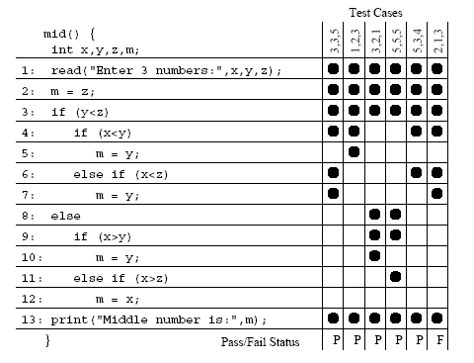
Faulty Median Program

Slide 7
Approaches to coloring the source code
Two approaches to color the source code:
  Discrete approach
  Continuous approach
  Discrete approach:
  It uses three colors : Red, Green and Yellow to color the statements.
  Statement in failed execution - colored Red.
  Statement in passed execution - colored Green.
  Both passed and failed execution - colored Yellow.
  Ineffective – not many faults marked.

Slide 8
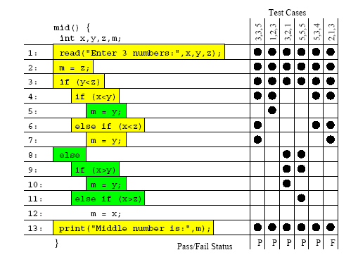
Discrete Three Color mapping

Slide 9

Continuous color mapping
Key idea – color lies within spectrum
from red ( 0 ) to yellow ( middle color ) to green ( 120 )
Percentage of the passed / failed test cases that execute a statement.
= > If higher % of passed test cases - Green.
= > If higher % of failed test cases - Red.
= > If higher % of both passed and failed - Yellow.

Slide 10

Continuous Color mapping equation
%passed(s) passed test cases (s) / total passed test cases in the test suite.
%failed(s) failed test cases(s) / total failed test cases in the test suite.
Color range : green color – red color.

Slide 11
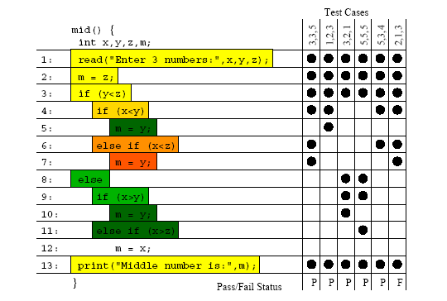
Continuous Mapping Example

Slide 12
Brightness component of color mapping
Contribution of each statement during the testing.
If all the test cases in either Pass/Fail - full brightness.
Statement high % failed test cases likely to be more faulty than others.
=> Encoded bright red to attract users attention.
Bright Green statements show more confidence in their correctness.

Slide 13
Advantage of Brightness Component
Statements S1 and S2 executed by 10 failed test cases and 0 passed test cases.
S1: %passed(S1) = 0 i.e. never executed by any passed test case.
% failed(S1) = 100% , executed by all the 10 failed test cases.
S2: %passed(S2) = 0 i.e. never executed by any passed test case.
%failed(S2) = 10% , executed by 1 of the 10 failed test cases.
COLOR MAPPING EQUATION marks S1,S2 Red
BRIGHTNESS EQUATION S1 ( more critical ) Bright Red
S2 ( less critical ) Dark Red

Slide 14
Prototype
TARANTULA maps each statement to a line of pixels.
Application is written in Java with 3600 lines of code.
Inputs : Source code and results of executing a test suite on system.
Operates in six modes:
Continuous , Discrete , No coloration (default mode)
Three modes: To focus passed , failed or both test cases.

Slide 15
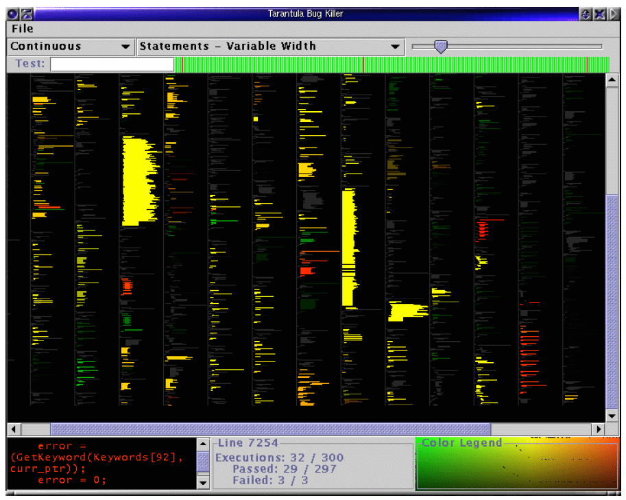
Tarantula Bug Killer

Slide 16
Empirical studies
Space program, written in C with 1000 test suites.
Effectiveness of color mapping technique tries to answer two questions:
  How often faulty statement(s) colored red or in reddish color?
  = > How often it fails to color the faulty statements red i.e. how often this technique produces false negatives.
  How often non-faulty statements in program red or reddish in color?
  = > it produces false positives or colors nonfaulty statements as red.

Slide 17
Study – 1: Single fault versions
20 versions of program were considered each containing a different single fault.
Bar chart was plotted with each bar representing one version.
The size of each segment = % of times that faulty statements fell into that color partition across all test suites.
For e.g across all 1000 test suites, version 20 had approx. 3% of its faulty statements given colors within partition 1.
For first question:most of the statements colored in red.
For second question: less than 20% of the nonfaulty statements in red.

Slide 18
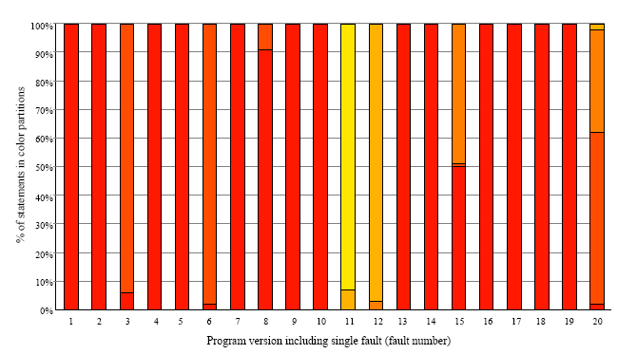
Program version - single fault.
Faulty statements colored

Slide 19
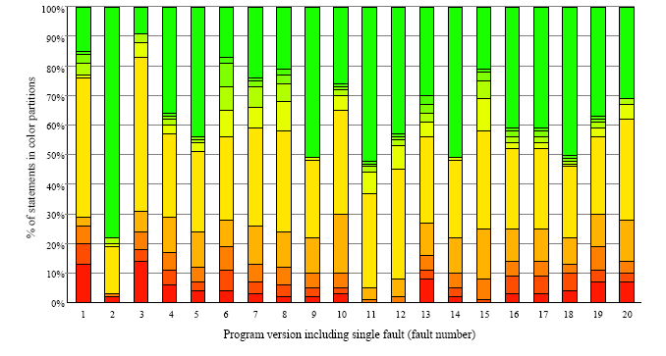
Program version - single fault
Non - faulty statements colored

Slide 20
Study – 2: Multiple fault versions
40 Multi-fault versions of space were used : 10 with two faults, 10 with three faults, 10 with four faults and 10 with five faults.
Observations : effectiveness of the technique to color the faulty statements as red ( first question )declines as the number of faults are increased.
To answer second question: For multi- fault versions less than 20% nonfaulty statements were colored red. Further study done to find that.

Slide 21
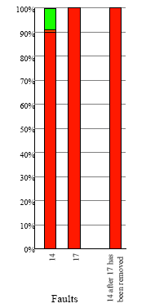
Effectiveness of Color Mapping Technique
User can iteratively remove the discovered faults, retest and reapply the technique until the test suite passes all the test cases.

Slide 22
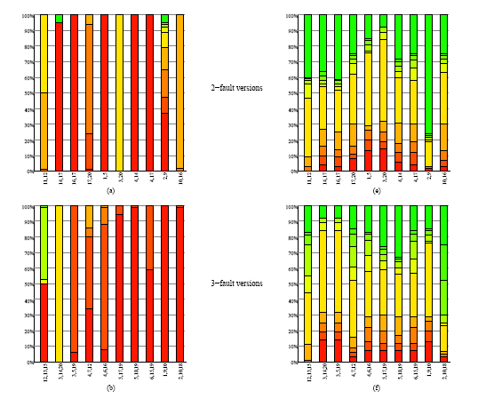
2 and 3 - fault version program

Slide 23
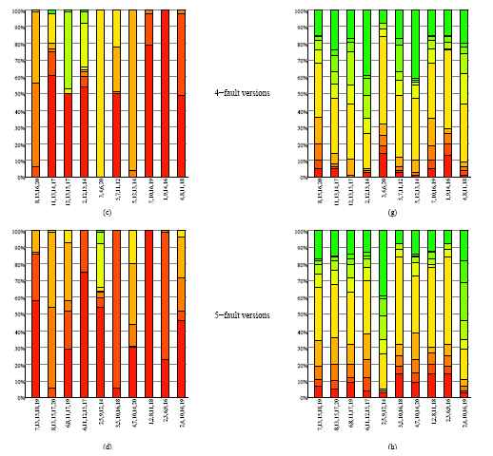
4 and 5 - fault version program

Slide 24
Future work
As in study –2 the coloration of some faulty statements in green range can help to identify the faults iteratively.
Some faults can’t be identified by TARANTULA like the variable declaration statements ,which are faulty statements but are not marked red .
Red non-faulty statements and their proximity to the faulty statements.
Brightness component in their study.
Zoomable interface to the user in tarantula
Providing TARANTULA an ability of dynamic update and editing.

Slide 25
Conclusion
Present a new technique that uses color to detect suspicious statements.
Develop an application in java called – Tarantula to realize the visualization of the mapping and are presently working to enhance its capabilities.
Perform two studies with single and multiple faults in various program versions to prove the effectiveness of the color mapping technique.

Slide 26
References:
http://www.cc.gatech.edu/aristotle/Publications
http://xsuds.agreenhouse.com/html-man/coverpage.html.

