Slide 1
Rigorous Data Flow Testing Through
Output Influences
Evelyn Duesterwald
Rajiv Gupta
Mary Lou Soffa
Balaji Ganesan, March 2005

Slide 2
Overview:
Motivation
Output influencing and testing
Dependence graphs
Output slices
Data flow coverage
Conclusion

Slide 3
Motivation
A critical issue for uncovering program errors during testing is the effectiveness of a testing criterion.
Effectiveness of existing data flow criteria is limited due to the assumption that merely exercising def-use pairs implies correctness.
Typically an incorrect def-use pair is detected if its erroneous effect is reflected in the output.
Ex: optimizing compiler.
Idea: take the output influence into consideration.

Slide 4
Output Influencing and Testing
What is output influencing ?
  A program component to be considered tested must have demonstrated evidence of correctness through its contribution to the program output
OI is used to refine previous data flow testing criteria by requiring that an exercised def-use pair influences the computation of atleast one correct output value to be considered tested
All-du vs. OI-all-du criterion

Slide 5
Output Influencing and Testing
Use slicing to capture output influencing def-use pairs
What are output slices ?
  Contain statements that directly or indirectly affect the computation of output values
Static output slice is good enough but yields conservative information for arrays and pointers – use dynamic slice for them

Slide 6
Slicing Techniques
Can you name any ?
Static slicing:
  Iteratively solving a set of data flow equations over the control flow graph
  Program dependence graph – slicing reduces to a vertex reachability problem
Dynamic slicing:
  Solving data flow equations over the generated execution trace
  Based on dependence graphs – dynamic slice is not an executable subset of the program

Slide 7
Slicing Techniques
This paper follows the dependence graph based approach.
Slice is an executable subset of the program.
Existing dynamic dependence graphs form dynamic expansion of a static graph.
But our interest is to use dynamic dependence info for arrays and pointers.
Use dynamic subset of the static graph with respect to a specific execution.

Slide 8
Example
n = 4 and a = (0,0,0,4)
(1) input (n,a);
(2) i := 2;
(3) p := 1;
(4) m = a[p];
(5) while i<n do begin /* should correctly be i<=n */
(6) if a[p] <= a[1] then /* should correctly be a[p] <= a[i] */
(7) p := i;
(8) a[i] := a[i] + a[i -1];
(9) i := i + 1;
EndWhile
/* Omitted m := a[p]; */
(10) output(‘min is’ m);
(11) output(‘sum is’ a[n]);

Slide 9
Static Slice
(1) input (n,a);
(2) i := 2;
(3) p := 1;
(4) m = a[p];
(5) while i<n do begin
(8) a[i] := a[i] + a[i -1];
(9) i := i + 1;
EndWhile
(10) output (‘min is’ m);
(11) output (‘sum is’ a[n]);

Slide 10
Dynamic Slice
(1) input (n,a);
(2) i := 2;
(3) p := 1;
(4) m = a[p];
(10) output (‘min is’ m);
(11) output (‘sum is’ a[n]);

Slide 11
Dependence Graphs
An output slice is extracted from a program’s dependence graph.
Dependence graph represents the control and data dependences among statements.
Major portion of slicing technique is the construction of the dependence graph
Control dependence information – program structure.
Data dependence – three methods

Slide 12
Dependence Graphs
Control dependence
  s₁ is control dependent on s₂, if s₂ is a control predicate and control reaches s₁ depending on the result of evaluating s₂.
Data dependence
  Statically data dependent
    s₁ on s₂ if s₂ contains a definition of a variable v and s₁ uses v and control may reach s₁ after s₂
  Dynamically data dependent
    s₁ on s₂ with respect to program input I if, during the execution on I, s₂ computes a value used in s₁

Slide 13
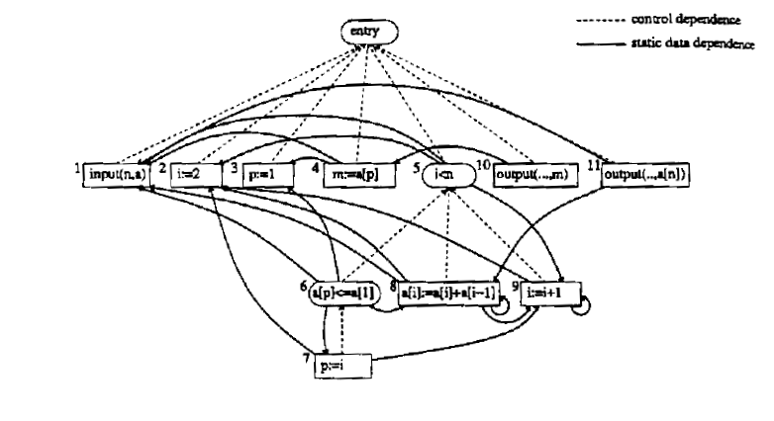
Static Data Dependence G_{s}:

Slide 14
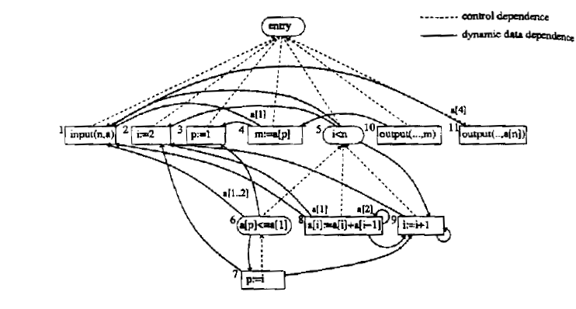
Dynamic Data Dependence G_{d}:

Slide 15
Combining Static and Dynamic Dependence graph G_{s/d}:
Why should we combine ?
  Move as much work to compile time as possible.
Static dependence graph is constructed partially at compile time and dynamic info is added at run-time.
Set of variables V in a program is partitioned into two sets V₁ and V_{2.}
  Static data flow info for V_{1.}
  Dynamic dependence edges of V_{2.}
How to partition V ?
  Array references in one and scalar variables in other
  Pointers and the variables they point to in one and the rest in the other

Slide 16
Output Slices
Static output-slice of P wrt S → subprogram P’ of P that when executed computes the same values in S as P does.
Dynamic output slice → subprogram P’’ that when executed on Input I, computes the same values in S as P does.
Extract slices from respective dependence graphs.
Subgraph:
  n₁ is reachable from n₂ → path from n₂ to n_{1.}
  e = (n₁, n₂) is reachable from n → path starting at n containing e.
Given dependence graph G = (N,E) for program P and a set of output nodes S in G, the output slice is the subgraph G/S = (N’,E’) where.

Slide 17
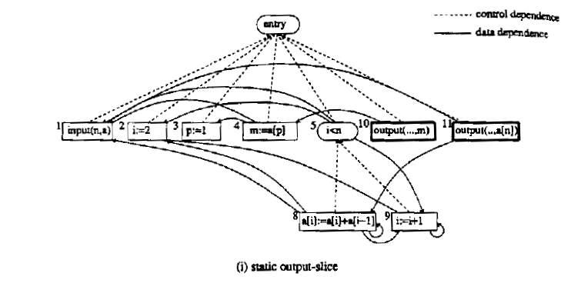
Static Output Slice

Slide 18
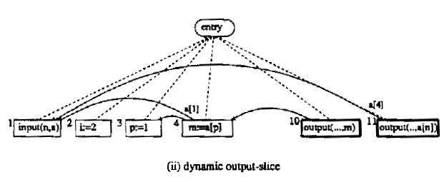
Dynamic Output Slice

Slide 19
Data Flow Coverage
Goal: cover as many def-use pairs as possible
Infeasible def-use pairs → no test case exists
Two critical issues:
  Appropriate test case generation
  Accurate data flow coverage determination

Slide 20
Cover Set
For program P and test case t,
Cover(t):
  Subset of the potential def-use pairs in P.
  Contains only pairs that had influence on the computation of atleast one correct output value produced by t.
Three approaches to compute cover set:
  Static output slices and cover set.
  Dynamic output slices and cover set.
  Combined static and dynamic output slices.

Slide 21
Conclusion
Introduced the concept of output influence as a refinement to existing data flow testing criteria.
It allows for a more rigorous approach to data flow testing.
Presented several techniques based on slicing to compute output influencing def-use pairs in a test case.

Slide 22
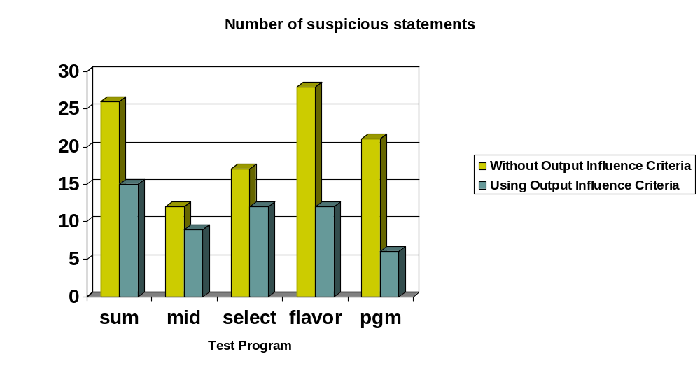

Slide 23
