Slide 1
Effectively Prioritizing Tests in Development Environment
Amitabh Srivatsava and Jay Thiagarajan
Microsoft Research

Slide 2
Acknowledgement
Some slides have been used from the author’s presentation.

Slide 3
Test Case Prioritization
Test case prioritization techniques schedule test cases in an order that increases their effectiveness in meeting some performance goal.
Ex: rate of fault detection, code coverage.

Slide 4
Overview
Motivation
Related work
Echelon features
Echelon architecture
Performance
Improvements
Conclusion

Slide 5
Motivation
Testing accounts for a substantial portion of development cost.
Early detection of defects saves time and resources.
Need to prioritize test cases so that defects are detected early.
New defects are most likely to be from recent code changes.
An effective strategy is to focus testing efforts on parts of the program affected by changes.

Slide 6
Related Work
Test selection and prioritization
  Source code differencing
  Data and control flow analysis
  Coarse grained modified code entities
Test minimization
  Permanently discard tests

Slide 7
Related Work
Source code differencing
  Unix diff – simple and fast
  Erroneously mark a procedure as changed when a variable was simply renamed
  Fail to determine set of affected procedures when definitions in a header file, such as macro definitions and method definitions were modified

Slide 8
Related Work
Data and control flow analysis
  Discussed in the previous presentation
  Flow analysis is expensive on large commercial programs
Coarse grained modified code entities
  Test tube method – Bell labs
  May select more tests than statement or control flow based techniques

Slide 9
Echelon
A test prioritization system which prioritizes the application’s given set of tests based on what changes have been made to the program.

Slide 10
Echelon – Key Features
Prioritizes tests based on changes made to the program.
Computes changes between programs at a very fine granularity – basic blocks.
Uses a fast, simple algorithm.
Operates at the binary level. Hence easier to integrate into the development process.
Scales well to large systems.
Produces list of code not covered by any existing test cases. New tests will be needed for them.

Slide 11
Echelon Architecture
Echelon is part of Magellan test effectiveness tool set.
Magellan test effectiveness infrastructure.
  Infrastructure for storing, analyzing and reporting information about a test process.
  SQL server based repository for coverage information and symbols.
  Reporting tools with graphical user interface to map data to the source code.
  Blender – migrate from old to new version.

Slide 12
Echelon Architecture
Binary modification infrastructure – Vulcan.
    Provides static and dynamic binary code modification.
    Uniform abstraction.
  BMAT.
    Hashing based algorithm.
    Algorithm first matches procedures then blocks within each procedure.

Slide 13
Echelon System
Vulcan/BMAT
Old Binary
Binary Change Analysis
New Binary
Coverage Analysis
Old Binary
Coverage
Magellan
Test Prioritization
Prioritized list of test cases
List of impacted blocks not covered by existing tests

Slide 14
Binary Change Analysis
Old version
Old Modified
Old unchanged
New

Slide 15
Coverage Analysis
Determine which impacted blocks are covered by an existing test.
Old modified blocks – simply see if they were covered in the old version.
New blocks – a test may cover a new block if it covers atleast one of its immediate predecessor and successor blocks.
If predecessor or successor is a new block – iterate further.

Slide 16
Coverage Analysis
New block
Already covered block

Slide 17
Coverage Analysis
Limitations.
  Will miss if there is a path from a predecessor to successor that did not go through the new block.
    Use arc coverage or branch prediction.
  If new block is a target of an indirect call, predecessors are not visible in the static graph.
    Relax the condition that predecessor block should be executed. Successor should suffice.

Slide 18
Test Case Prioritization
Detects minimal sets of test cases that are likely to cover the impacted blocks.
Uses a greedy iterative algorithm for test selection.
Assigns weights to tests based on coverage.
Picks tests based on their weights and groups them into sequences.

Slide 19
Algorithm
Input:
TestList: set of tests Coverage (t) : set of blocks covered by test t ImpactedBlkSet: set of new and old modified blocks
Output:
a set of sequences Seq

Slide 20
Algorithm
while (any t in TestList covers any block in ImpactedBlkSet)
{ CurrBlkSet = ImpactedBlkSet Start a new sequence Seq while (any t in TestList covers any block in CurrBlkSet ) { for each t in TestList compute { Weight(t) = count[CurrBlkSet ∩ Coverage(t)] } Select test t in TestList with maximum weight Add t to current sequence Seq Remove t from TestList CurrBlkSet = CurrBlkSet – Coverage (t) } } Put all remaining tests in TestList in a new sequence Seq

Slide 21
Echelon: Test Selection
Impacted Block Map
Set 1
Weights
T1
T1
5
T2
T2
2
2
Set 2
T3
T3
4
0
4
T5
T4
1
0
1
0
1
Set 3
T5
3
0
3
1
T4
Denotes that a trace T covers the impacted block

Slide 22
Performance
How many sequences of tests ?
How many tests in each sequence ?
How accurate ?
  How many blocks were predicted to be covered but were not covered ?
  How many blocks were predicted to be not covered but were actually covered

Slide 23
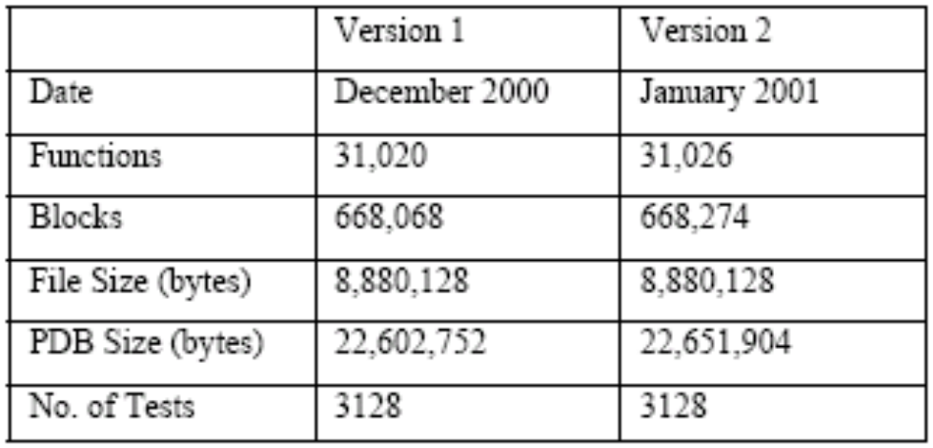
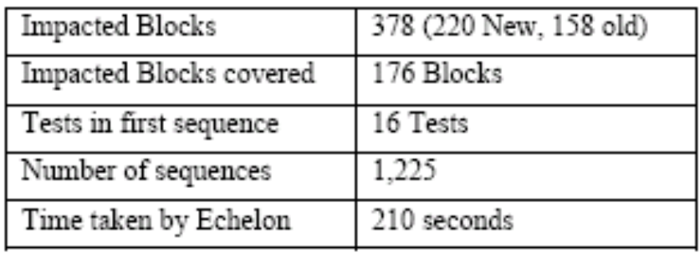
Program Information

Slide 24
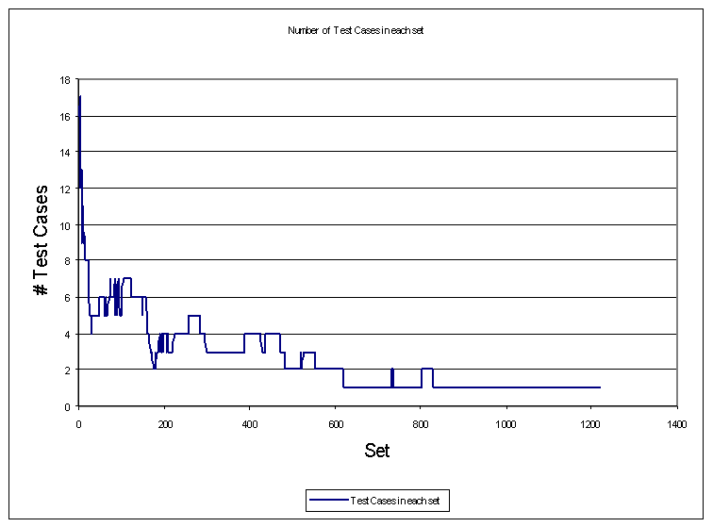
Number of tests in each sequence

Slide 25
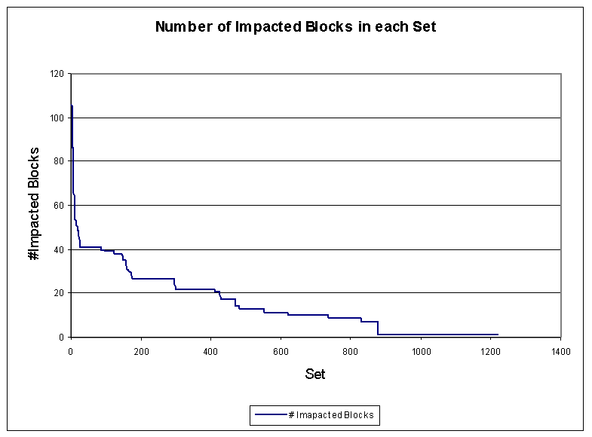
Number of impacted blocks in each sequence

Slide 26
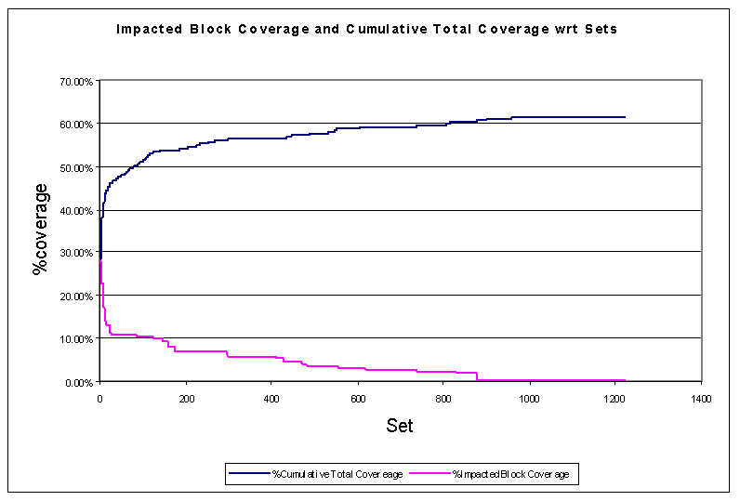
Cumulative Coverage and Impacted Coverage

Slide 27
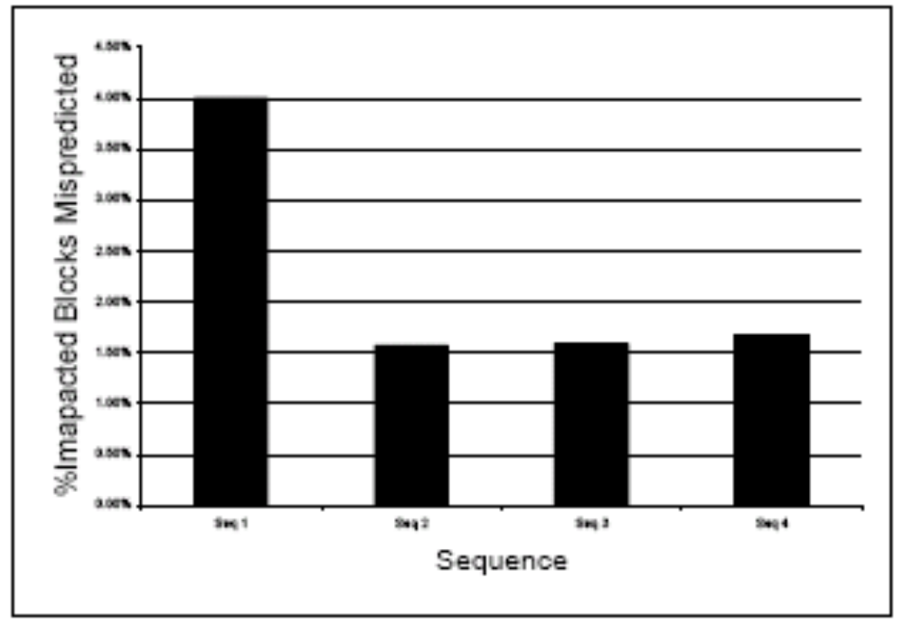
Accuracy: Predicted blocks not covered
4.50 %
0.00 %

Slide 28
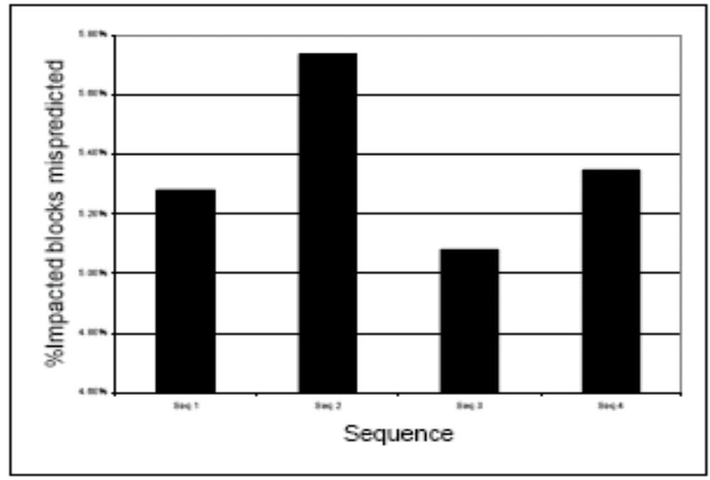
Accuracy: Blocks covered but not predicted
5.80 %
4.60 %

Slide 29
Effectiveness of Echelon
Measure: early detection of defects by running the tests in specified order.
Number of unique defects detected by each sequence.

Slide 30
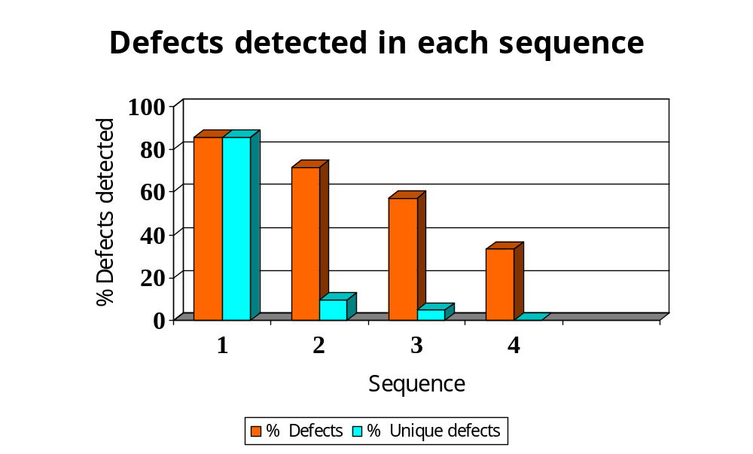
Effectiveness

Slide 31
Improvements
Use performance information from the development process to guide testing decisions
  Real time testing: Application spends most of its time on certain critical programs.
Extensions to prioritization algorithm
  Calculations of weights can be extended – traces with higher historical fault detection can be given additional weight
  Include time each test takes into calculation

Slide 32
Summary
Binary based test prioritization approach can effectively prioritize tests in large scale development environment
Simple heuristic with program change in fine granularity works well in practice
Currently integrated into Microsoft Development process

Slide 33
Effectively Prioritizing Tests in Development Environment
Amitabh Srivatsava and Jay Thiagarajan
Microsoft Research

