Slide 1
🛡 SplunkSentinel
AI-Powered Autonomous SOC Analyst
"From alert storm to actionable intelligence — in seconds."
Built on Splunk's complete AI ecosystem.

Slide 2
THE PROBLEM
SOC teams are drowning
4,484
67%
197 days
$4.88M
alerts / day for an average enterprise SOC
of alerts ignored — analysts can't keep up
mean time to detect a breach
average cost of a data breach
The alert storm isn't a technology problem — it's an intelligence problem.
SplunkSentinel · AI-Powered Autonomous SOC Analyst
2

Slide 3
THE SOLUTION
Five AI agents. One autonomous SOC analyst.
SplunkSentinel deploys 5 specialized agents that collaborate to transform raw Splunk security data into prioritized, investigated, and actionable intelligence — in real time.
Human-AI collaboration: agents handle the noise, analysts focus on decisions.
SplunkSentinel · AI-Powered Autonomous SOC Analyst
3

Slide 4
HOW IT WORKS
The Agent Pipeline
TRIAGE
→
INVESTIGATE
→
TIMELINE
→
FORECAST
→
RESPOND
Agent | Job
Triage | Score, prioritize & deduplicate alerts (MITRE ATT&CK)
Investigation | Auto-generate SPL, correlate evidence across indexes
Timeline | Reconstruct the attack kill chain
Forecast | Predict anomaly windows ahead of time
Response | Generate playbooks with executable SPL
SplunkSentinel · AI-Powered Autonomous SOC Analyst
4

Slide 5
DIFFERENTIATOR
Powered by ALL 5 Splunk AI Capabilities
Capability | How We Use It
Splunk MCP Server | Secure, protocol-compliant data access for every query
Foundation-Sec-1.1-8B | Security reasoning for triage, investigation & response
Cisco Deep Time Series Model | Anomaly forecasting & risk windows
Python SDK AI | Custom alert actions & modular inputs in Splunk
AI Assistant | Natural language → SPL query generation
Not one Splunk AI feature — all five, working together.
SplunkSentinel · AI-Powered Autonomous SOC Analyst
5

Slide 6
DEMO
Live Demo Highlights
Moment | What You See
Triage | Thousands of alerts scored & prioritized in seconds
Investigate | SPL auto-generated, evidence correlated, confidence scored
Timeline | Full kill chain: Initial Access → Lateral Movement → Exfiltration
Forecast | Predicted anomaly windows on a live chart
Respond | Ready-to-run remediation playbook with SPL
All streamed live to a premium React SOC dashboard via WebSocket.
SplunkSentinel · AI-Powered Autonomous SOC Analyst
6

Slide 7
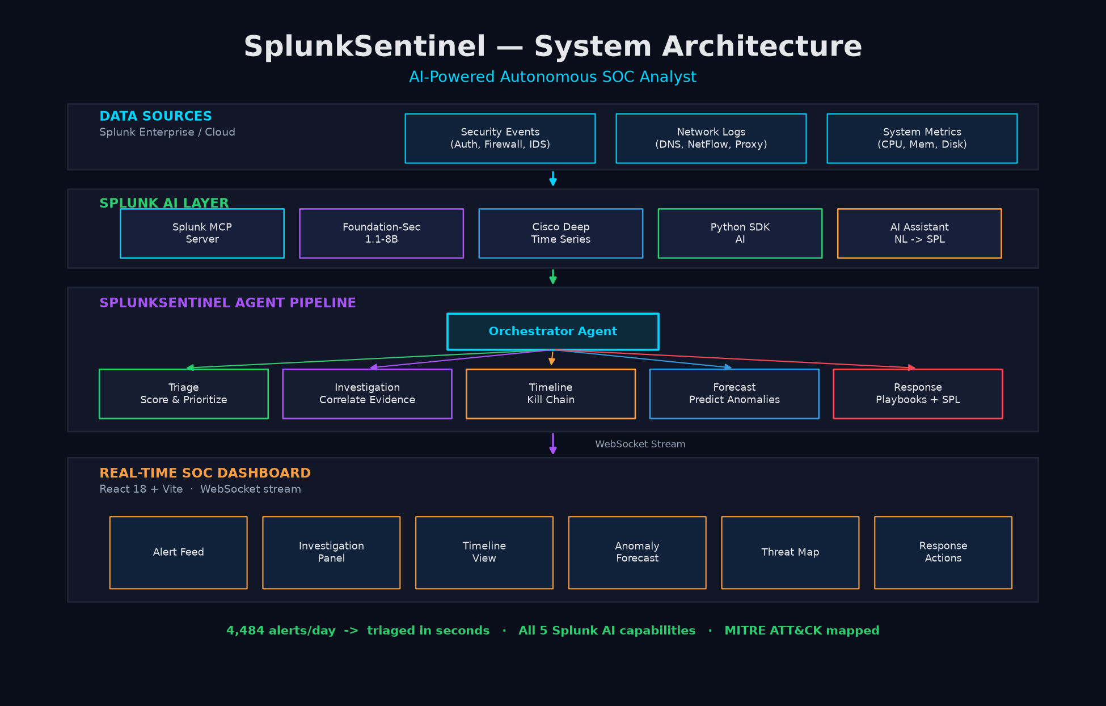
SYSTEM DESIGN
Architecture
• Data → Splunk MCP Server
• Orchestrator routes work
• 5 specialist agents
• Foundation-Sec + Cisco DTSM wired per agent
• Streamed to dashboard over WebSocket
SplunkSentinel · AI-Powered Autonomous SOC Analyst
7

Slide 8
ENGINEERING
Tech Stack
Layer | Technology
Backend | Python 3.11+, FastAPI, WebSocket
Frontend | React 18, Vite
AI | Foundation-Sec-1.1-8B, Cisco DTSM
Integration | Splunk MCP Server, Python SDK AI, AI Assistant
Frameworks | MITRE ATT&CK
Deployment | Docker Compose (one command)
SplunkSentinel · AI-Powered Autonomous SOC Analyst
8

Slide 9
VALUE
Why It Wins
• Autonomous, end-to-end — triage to remediation, no human babysitting
• Uses all 5 Splunk AI capabilities — deep ecosystem integration
• Explainable — evidence, MITRE mapping & confidence on every output
• Zero-friction demo — docker-compose up, no live Splunk needed
• Real impact — collapses 197-day detection into seconds of triage
SplunkSentinel · AI-Powered Autonomous SOC Analyst
9

Slide 10
ROADMAP
What's Next
• SOAR integration — automated response execution
• Multi-tenant — isolated pipelines per SOC team
• Custom agent training — fine-tune on org-specific threats
• Compliance reporting — SOC 2, HIPAA, PCI-DSS
• Threat hunting mode — proactive, not reactive
SplunkSentinel · AI-Powered Autonomous SOC Analyst
10

Slide 11
🛡 SplunkSentinel
From Alert Storm to Actionable Intelligence
5 Agents · All 5 Splunk AI Capabilities · One Autonomous SOC Analyst
The future of security operations is autonomous.

