Slide 1

Title : Automated Resume Ranking and Suggestion System
Student Name: Balaji Patil
Student ID: 2520080065)
Cluster : 1
Section: 3
Under the Guidance of
Supervisor Name: Deepika
Assistant Professor
Department of CSE

Slide 2
Abstract
AI Resume Analyzer is a web-based application designed to evaluate and improve resumes using intelligent analysis.
Provides a secure login system with username/password authentication and Google login support for easy access.
Allows users to upload resumes in PDF or TXT format for automated processing and evaluation.
Uses AI-based text analysis to calculate a resume score based on keywords, structure, and relevance.
Generates personalized suggestions and improvements to help users enhance their resumes for better job opportunities.

Slide 3
Existing System
The traditional resume screening process is mostly manual or recruiter-based, where HR professionals review resumes individually.
Recruiters often scan resumes quickly, which may cause important skills or qualifications to be overlooked.
Resume evaluation is usually time-consuming, especially when a large number of applications are received.
There is no automated scoring system to measure how well a resume matches job requirements.
Many candidates submit resumes that are not optimized for Applicant Tracking Systems (ATS), reducing their chances of being shortlisted.

Slide 4
Proposed System
The proposed system is a web-based AI Resume Analyzer that automatically evaluates resumes and provides improvement suggestions.
It provides a secure login system with username/password authentication and Google login for easy access.
Users can upload resumes in PDF or TXT format for automated analysis.
The system uses AI-based algorithms to analyze resume content, keywords, skills, and formatting.
It generates a resume score based on relevance to industry standards and job requirements.

Slide 5
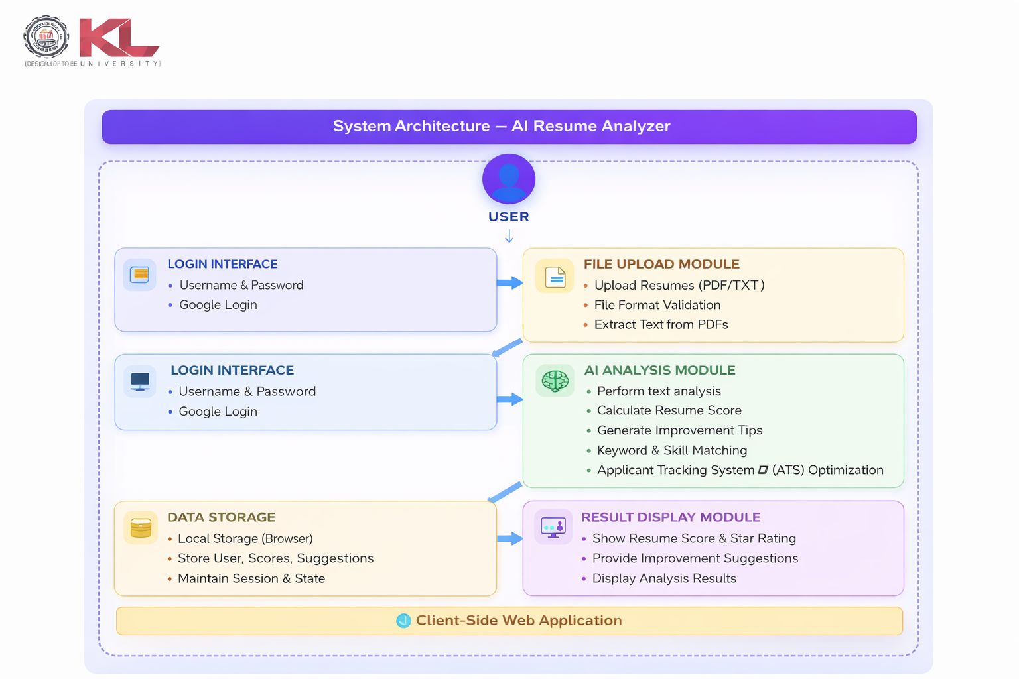
System Architecture

Slide 6
Project Modules
Login / User Authentication Module
Provides access for users to log in and access the system dashboard. Supports username & password authentication and Google login for easy access.
Resume Upload Module
Allows users to upload resumes in PDF or TXT format for analysis. Performs file validation and prepares the document for text extraction.
Resume Analysis Module
Uses AI-based text processing to analyze resume content. Identifies skills, projects, experience, certifications, and academic details.

Slide 7
Resume Scoring Module
Calculates a resume score based on keywords, skills, and structure. Provides a star rating system to evaluate overall resume quality.
Suggestion & Improvement Module
Generates personalized suggestions to improve resume quality. Recommends adding skills, projects, certifications, and experience if missing.
Result Display Module
Displays resume score, star rating, and improvement suggestions. Provides clear feedback to help users enhance their resumes.
Data Storage Module
Stores user session data and analysis results using browser local storage. Ensures quick and efficient access to resume evaluation results.

Slide 8
Objectives
To develop an AI-powered resume analysis system that evaluates resumes automatically.
To enable users to upload resumes in PDF or TXT format for automated analysis.
To implement resume text extraction using JavaScript and PDF.js for processing resume content.
To analyze resumes based on skills, projects, experience, certifications, and academic performance.
To generate a resume score and star rating that reflects the overall quality of the resume.
To provide intelligent suggestions to improve resume strength and job readiness.
To design a simple, responsive, and user-friendly web interface using HTML, CSS, and JavaScript.

Slide 9

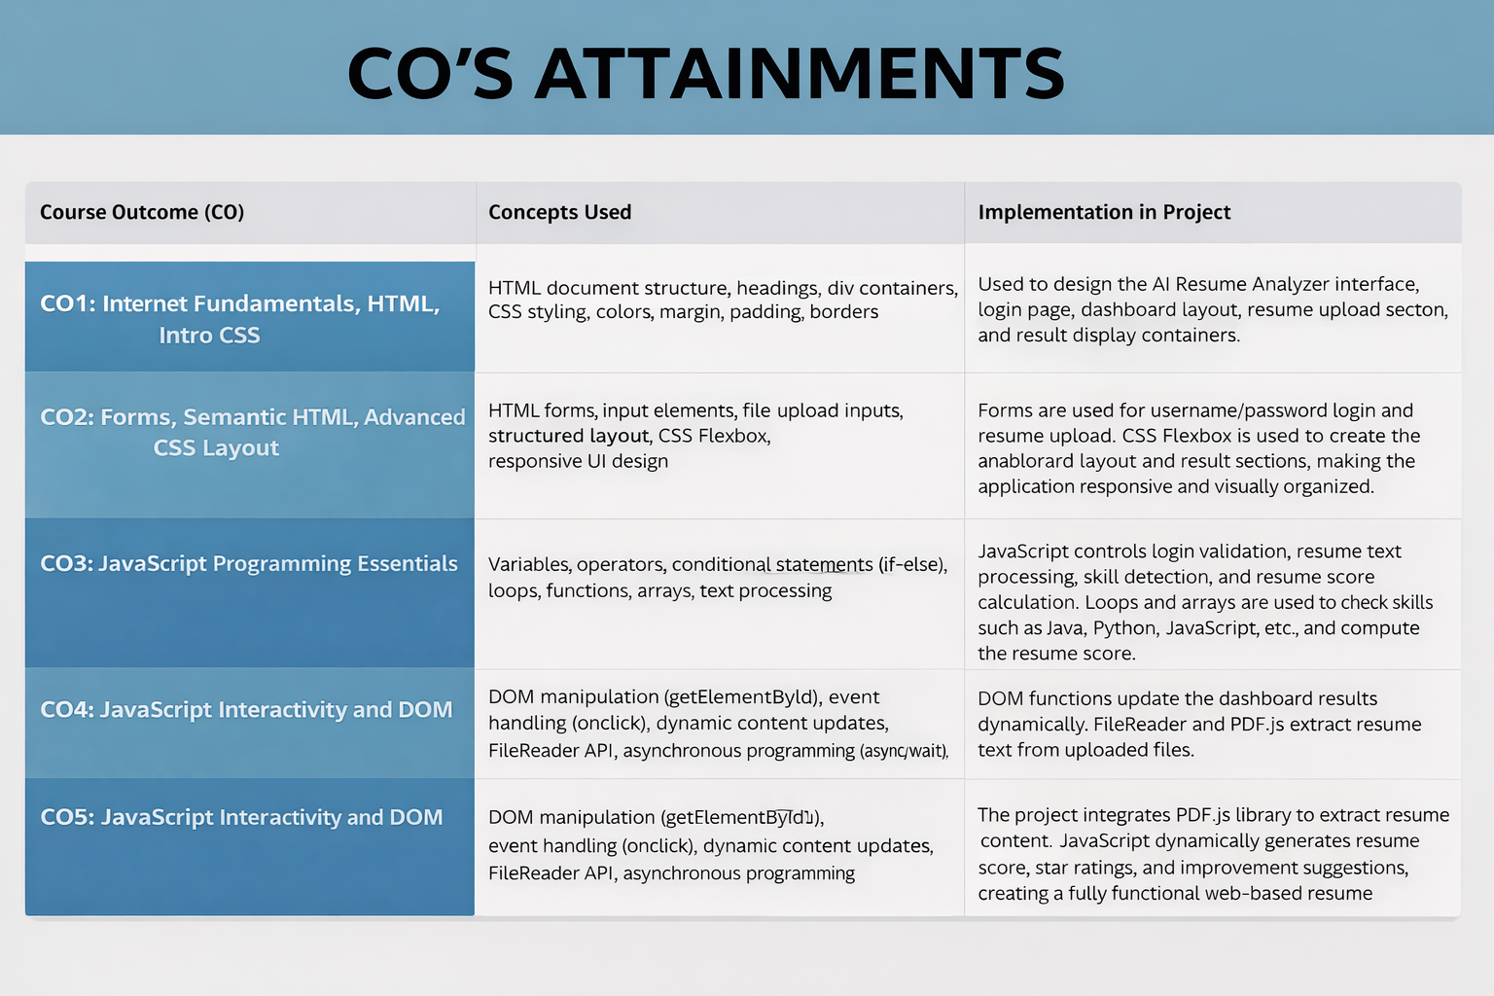

Slide 10

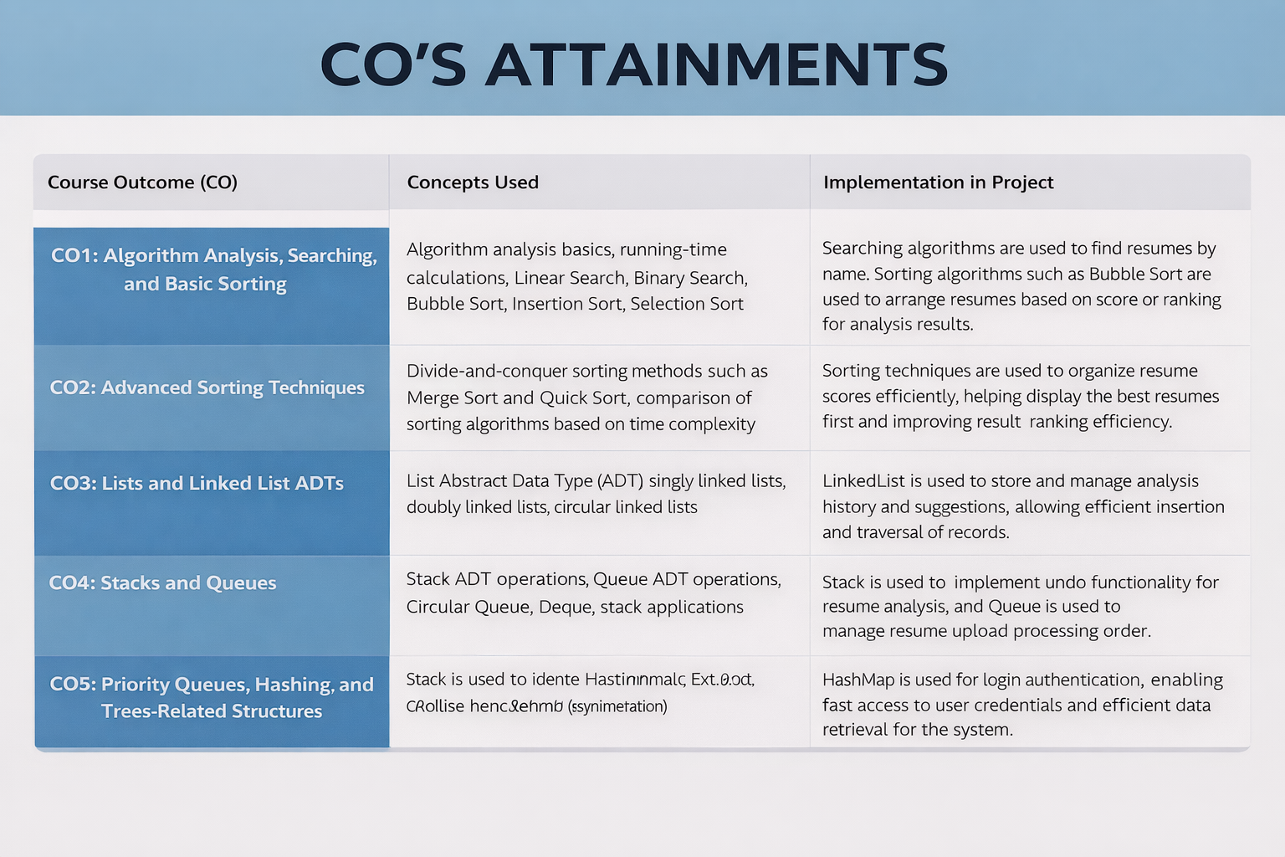

Slide 11
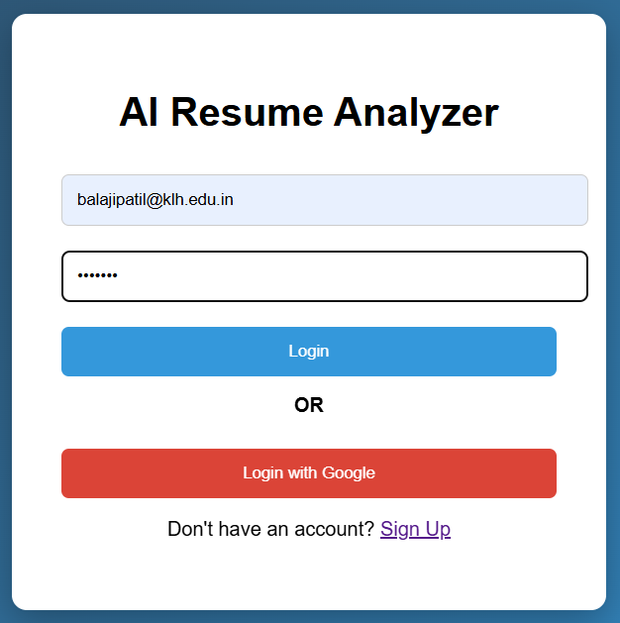
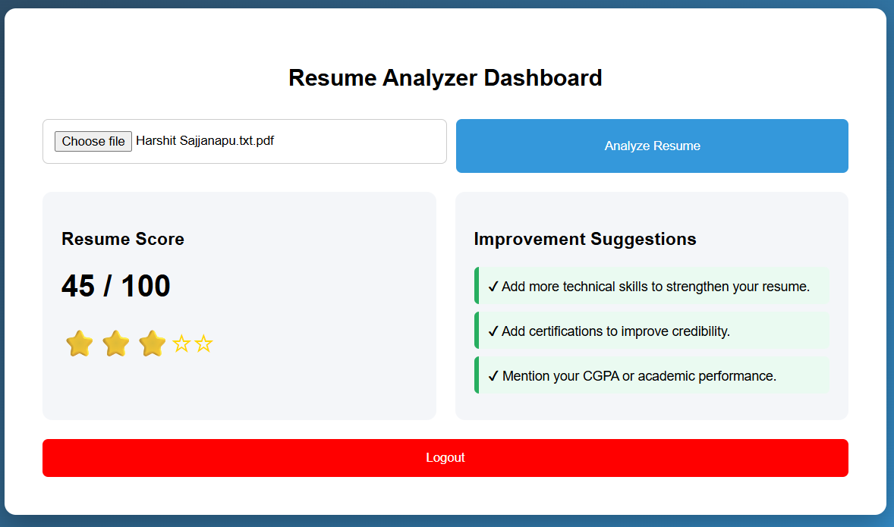
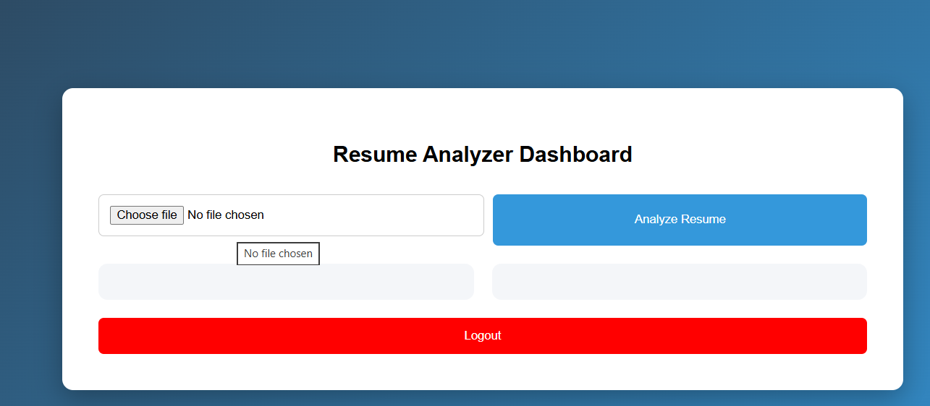
Screenshots for FWD & DSA

Slide 12
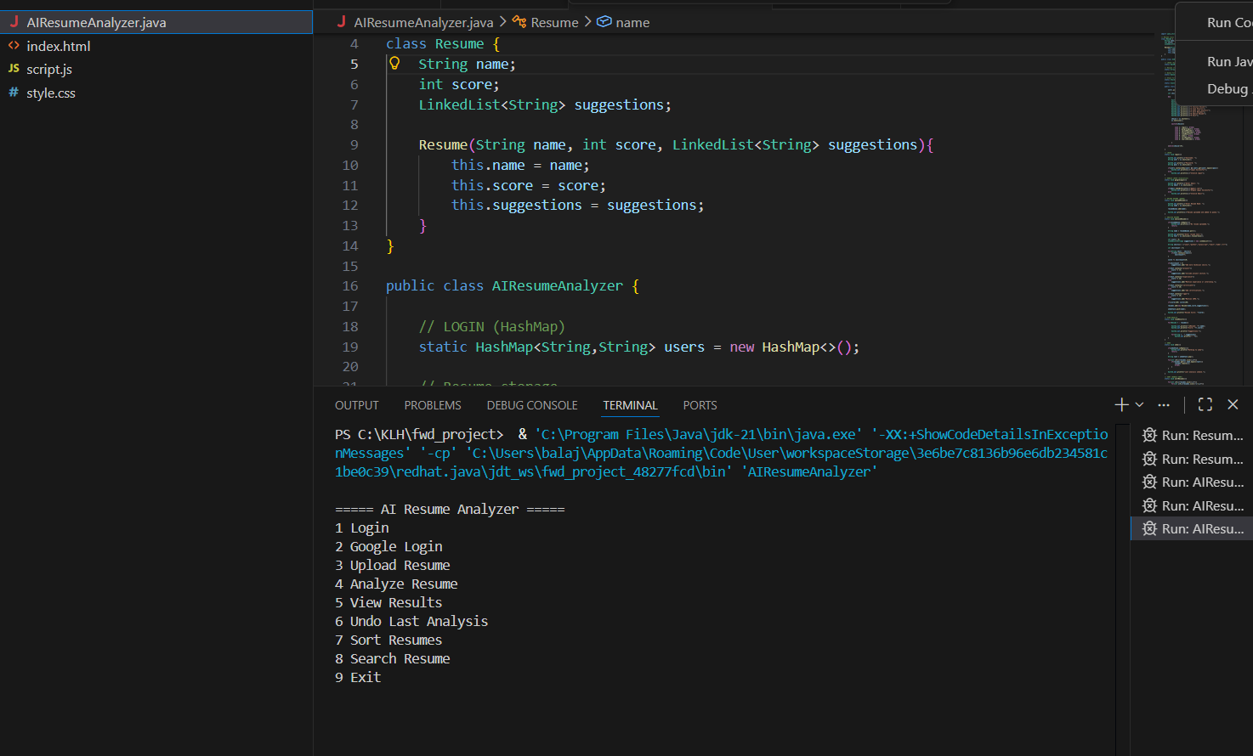

Slide 13
Conclusion
The AI Resume Analyzer provides an efficient and user-friendly solution for analyzing resumes and evaluating their overall quality automatically.
The system allows users to upload resumes in PDF or TXT format, extract resume content, and analyze important elements such as skills, projects, experience, and certifications.
The AI Resume Analyzer generates a resume score and star rating, helping users understand the strength of their resume.
The system also provides personalized suggestions to improve resume quality, enabling users to create more professional and impactful resumes.
Overall, the AI Resume Analyzer simplifies resume evaluation and helps students and job seekers improve their chances of success in the recruitment process.

Slide 14


Geo- Tag Photos

Slide 15
THANK YOU

