Slide 1


E-Commerce Product Entity-Resolution & Matching Platform
Data Structures and Algorithms – 3 (25CS2103E) | Academic Year: 2026–2027
SECTION 10
Guided by: Miss. K. Chandusha
Assistant Professor, CS&IT
KL University, Hyderabad
Shivam Tiwari – 2520080026
Balaji Patil – 2520080065

Slide 2
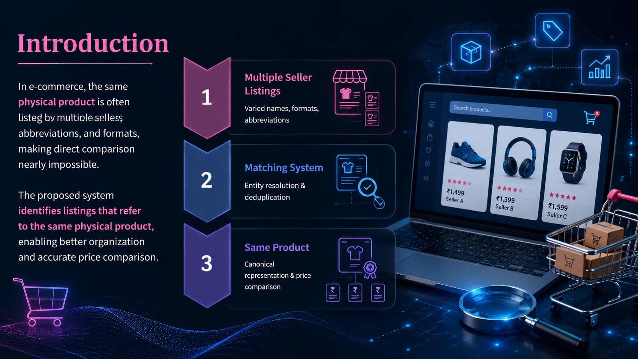




Introduction
Multiple online sellers list the same physical product using different names, abbreviations, and formats — making direct comparison nearly impossible.
The proposed system identifies listings that refer to the same physical product, enabling better organization and price comparison.
Multiple Seller Listings
Varied names, formats, abbreviations
Matching System
Entity resolution & deduplication
Same Product
Canonical representation & price comparison

Slide 3
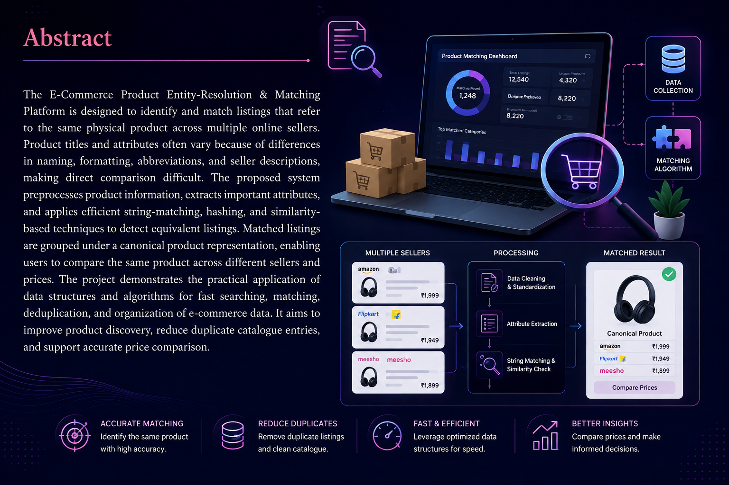
Abstract
The E-Commerce Product Entity-Resolution & Matching Platform is designed to identify and match listings that refer to the same physical product across multiple online sellers. Product titles and attributes often vary because of differences in naming, formatting, abbreviations, and seller descriptions, making direct comparison difficult. The proposed system preprocesses product information, extracts important attributes, and applies efficient string-matching, hashing, and similarity-based techniques to detect equivalent listings. Matched listings are grouped under a canonical product representation, enabling users to compare the same product across different sellers and prices. The project demonstrates the practical application of data structures and algorithms for fast searching, matching, deduplication, and organization of e-commerce data. It aims to improve product discovery, reduce duplicate catalogue entries, and support accurate price comparison.

Slide 4
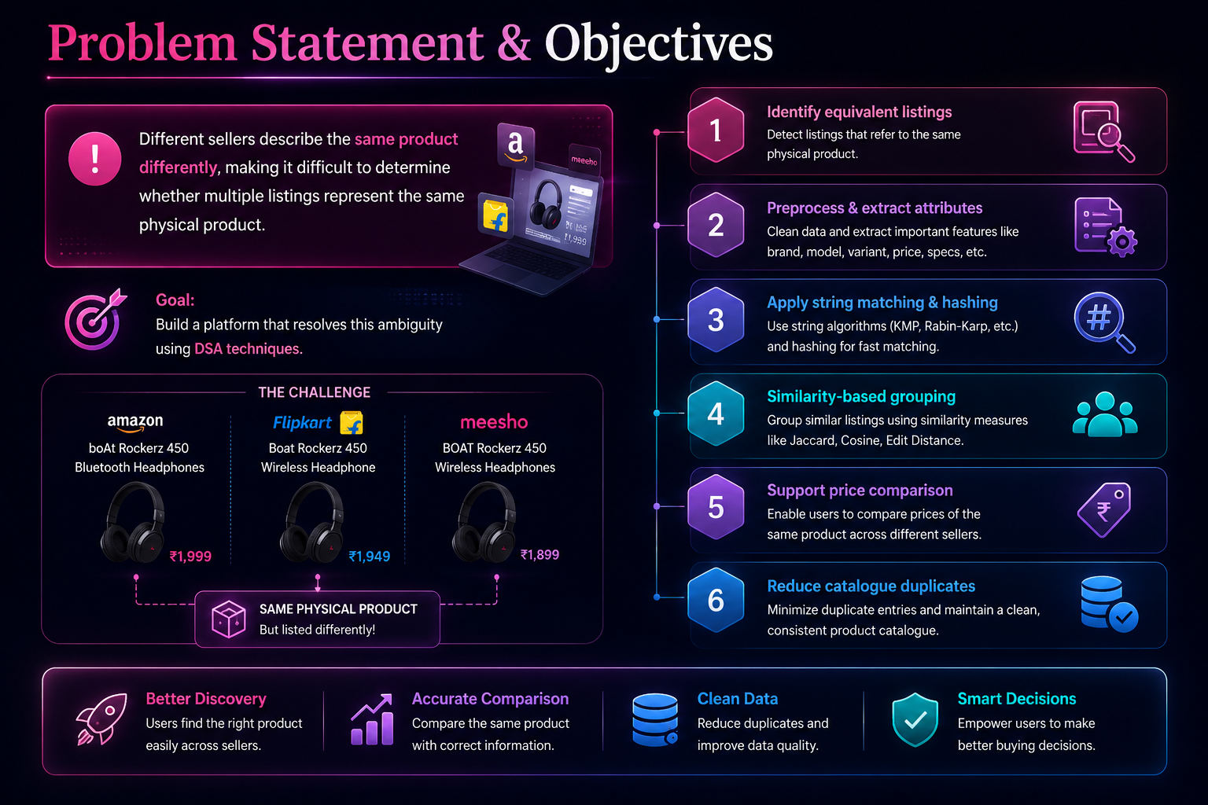

Problem Statement & Objectives
1
Identify equivalent listings
Different sellers describe the same product differently, making it difficult to determine whether multiple listings represent the same physical product.
2
Preprocess & extract attributes
Goal: Build a platform that resolves this ambiguity using DSA techniques.
3
Apply string matching & hashing
4
Similarity-based grouping
5
Support price comparison
6
Reduce catalogue duplicates

Slide 5
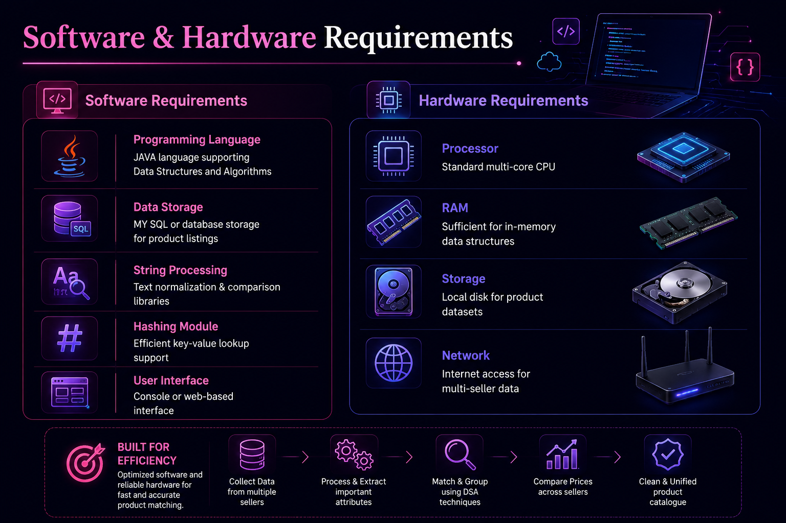
Software & Hardware Requirements
Software Requirements
Hardware Requirements
Component
Description
Component
Specification
Programming Language
JAVA language
supporting DSA
Processor
Standard multi-core CPU
RAM
Sufficient for in-memory data structures
Data Storage
MY SQL or database storage for listings
Storage
Local disk for product datasets
String Processing
Text normalization & comparison libraries
Network
Internet access for multi-seller data
Hashing Module
Efficient key-value lookup support
User Interface
Console or web-based interface

Slide 6
Literature Survey
Research Areas
Research Area
Existing Approach
Limitation
Relevance
Entity Resolution
Entity Resolution
Record linkage
Variation in records
Identifies same product
Records referring to the same real-world entity
String Matching
String Matching
Text comparison
Naming differences
Compares product titles
Textual comparison of product names
Hashing
Fast lookup
Collision handling
Efficient matching
Hashing
Similarity
Similarity scoring
Threshold selection
Detects equivalent listings
Fast lookup across large collections
E-Commerce Matching
Product matching
Large catalogue size
Product deduplication
Similarity Measures
Scoring how closely listings correspond
E-Commerce Matching
Cross-seller deduplication

Slide 7
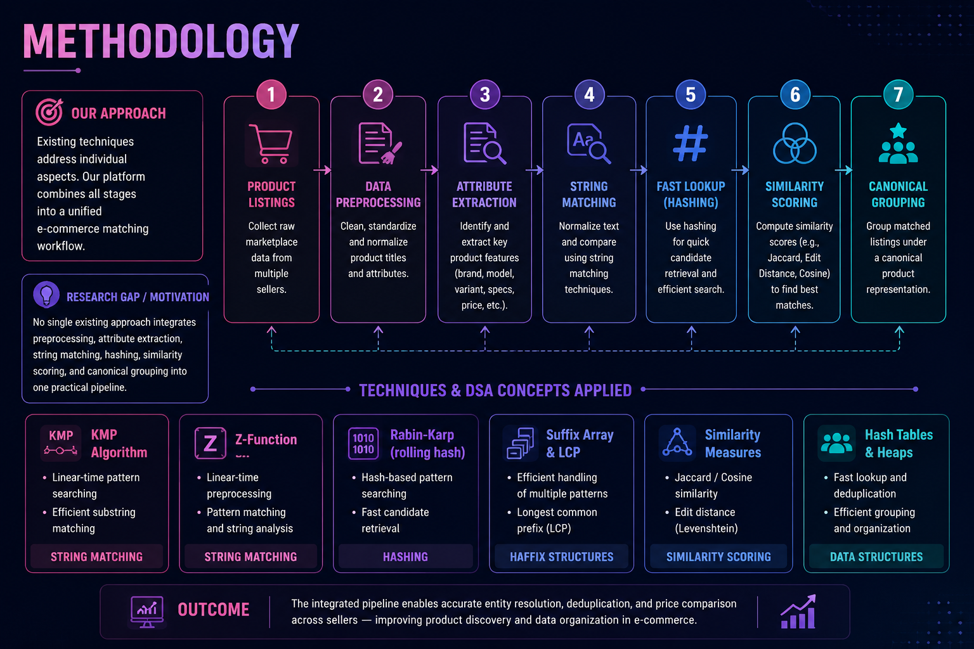


Methodology
Existing techniques address individual aspects. This platform combines all stages into a unified e-commerce matching workflow.
Product Listings
Attribute Extraction
Fast Lookup
Hashing for quick candidate retrieval
Collect raw marketplace data
Identify key product features
Research Gap / Motivation
No single existing approach integrates preprocessing, attribute extraction, string matching, hashing, similarity scoring, and canonical grouping into one practical pipeline.
Data Preprocessing
String Matching
Clean and normalize attributes
Normalize and compare text

Slide 8
DSA Concepts Used
String Matching
Hashing
Compares product titles & textual attributes
Efficient lookup & matching across records
Searching
Similarity Techniques
Finds relevant records in large collections
Measures how closely listings correspond
Deduplication
Data Organization
Groups equivalent listings, reduces repetition
Arranges listings under canonical products

Slide 9


Expected Output & Benefits
ILLUSTRATIVE EXAMPLE
Platform Benefits
Seller A
"Samsung Galaxy S24 128GB Black"
Identifies Equivalents
Seller B
Resolves listings to the same product
"Samsung S24 – 128 GB – Black"
Seller C
Price Comparison
"Galaxy S24 128GB Black"
Enables accurate cross-seller comparison
Canonical Product: Samsung Galaxy S24 – 128GB – Black → Compare Seller Prices
Reduces Duplication
Cleaner, organized product catalogue
Better Discovery
Improves product search & matching

