Slide 1
Auto HSD Analyser
Automated, engineer-grade HSD triage for Intel server platforms
Read · Decode · Correlate · Report · Learn
Presented by: ______________ Date: ____________

Slide 2
The Problem
HSD triage is slow, manual and inconsistent
Every HSD means reading the whole comment thread, opening SOL / PythonSV / POST logs, and decoding raw error codes by hand.
Decisive evidence is buried — register values, repro steps, experiment matrices, the converged root cause.
Verbose serial logs are full of incidental noise (WHEA / MCA / PCIe) that hides the real failure.
Past-ticket knowledge lives in people's heads, not in a searchable, reusable form.
Net: hours per ticket, uneven quality, and re-investigation of already-solved issues.

Slide 3
What It Does
One HSD ID in → a structured root-cause triage out
READ — pulls the full ticket over Kerberos SSO: title, description, entire comment thread, attachments.
DECODE — scans SOL / PythonSV / POST logs; decodes MCE/MCA (MCACOD · MSCOD), EWL, RC-Fatal, MCHECK, POST; pulls Axon SVTools signatures.
CORRELATE — reconstructs the investigation, converges on the root cause, separates the real failure from log noise.
REPORT — clean Markdown + HTML triage: debug summary, timeline, findings, root cause, next actions.
LEARN — writes every ticket into a self-learning Knowledge Base; recall improves over time.

Slide 4
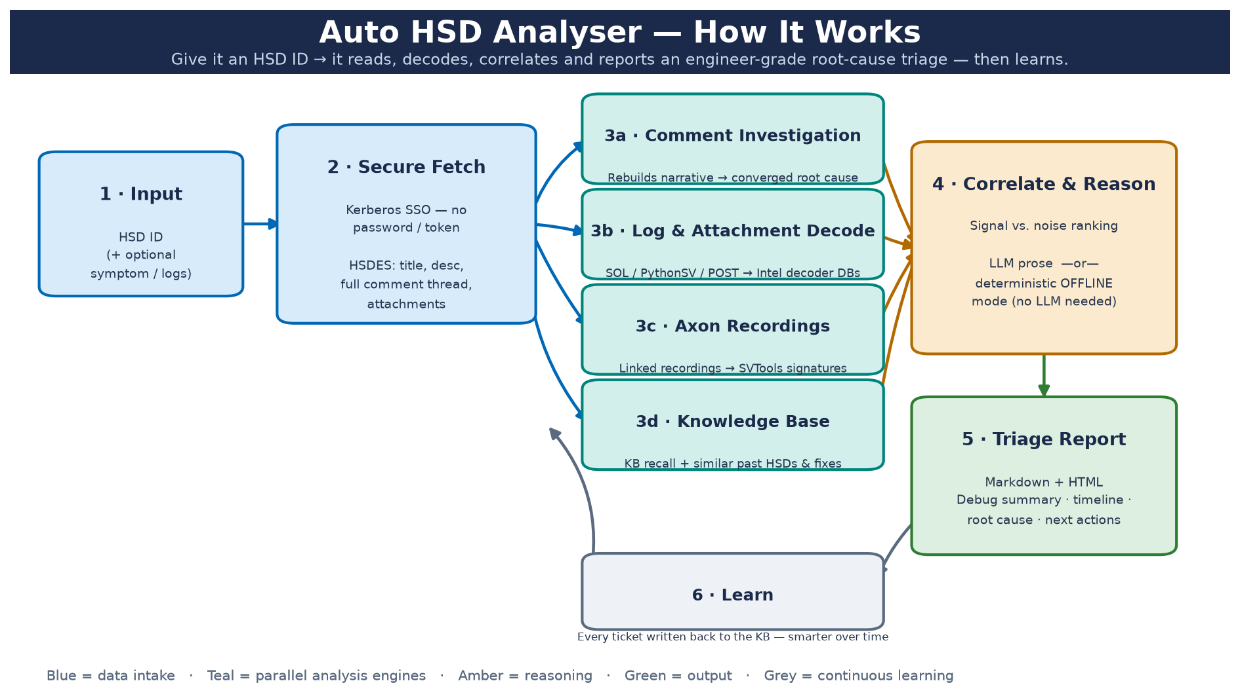
How It Works
End-to-end data flow

Slide 5
How It Finds the Root Cause
Two paths — it always returns an answer
A · When engineers have investigated
• Reconstructs the comment thread in order.
• Reports the team's converged root cause, verbatim.
• Cites who said it + how proven (hypothesis vs confirmed).
• Surfaces the decisive register / experiment evidence.
B · When there are no comments
• Analyses the attached logs end-to-end.
• Decodes MCE / MCA codes → bank, IP, error class.
• Folds in Axon SVTools failure signatures.
• Proposes an evidence-based hypothesis + data to confirm.

Slide 6
Key Capabilities
Reads like a human debug engineer
Comment-thread analyzer — rebuilds who observed / tried / concluded what, converges on the cause + disposition.
Deep log decode — MCE/MCA (MCACOD · MSCOD → bank / IP / class), EWL, RC-Fatal, MCHECK, POST checkpoints, boot/stage progress.
Axon integration — pulls linked recordings and their SVTools failure signatures as precise corroborating evidence.
Signal-vs-noise ranking — flags incidental WHEA / MCA / PCIe telemetry so the real failure leads.
Deterministic OFFLINE mode — full report with zero LLM dependency; optional LLM adds prose.
Self-learning KB — recalls similar past HSDs with their root cause and fix.

Slide 7
Anatomy of a Report
What your manager will see
Debug Summary — RESULT, boot/stage progress, metrics, hypothesis, conclusion, next actions.
Investigation Summary — compact timeline, key evidence, converged root cause, disposition.
Findings — failure signatures (noise flagged), decoded MCA / BIOS / POST, confidence score.
Root Cause + Validation — verdict, provenance, and what's needed to confirm it.
Next Actions — targeted checks + PythonSV / rdmsr commands to close it out.
Appendix — full narrative, decoded log evidence, KB matches, similar HSDs.

Slide 8
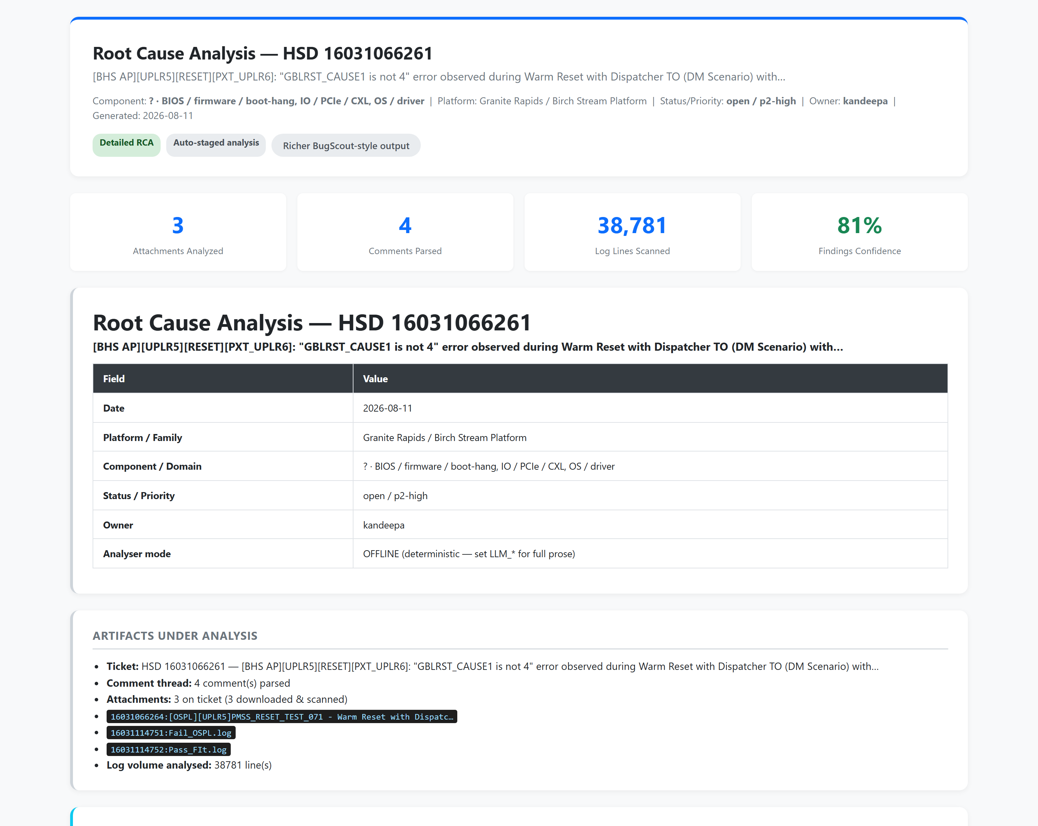
Live Demo
Sample: HSD 16031066261 — Warm Reset / GBLRST_CAUSE1
Root cause: S3M version mismatch (Base/Fit-loaded UP vs OSPL UP).
Evidence: GBLRST_CAUSE1 = 0x4 (pass) vs 0x0 (fail) + 6-row experiment matrix.
Noise flag: WHEA / MCA / PCIe marked incidental.
Disposition: root-caused; handed to S3M team; ticket open.

Slide 9
Benefits & Impact
≈ 2 min per ticket vs 2–4 hrs manual (illustrative estimate — tune to your data)
Faster — minutes vs hours per ticket; reading, decoding and correlation are automated.
Consistent — engineer-grade output every time, independent of who runs it.
Complete — decisive register / MCA / experiment evidence surfaced automatically, nothing missed.
Always answers — cites the team's cause, or proposes one from logs + MCE/MCA + Axon.
Secure — Kerberos SSO, runs locally on any Intel-domain Windows machine.
Compounding — the Knowledge Base makes every future triage faster and smarter.

Slide 10
Data Sources & Provenance
Every fact in the report is traceable — nothing leaves the Intel network
Root cause & investigation — the HSDES ticket itself: description + full comment thread, read live over Kerberos SSO and cited per author.
Attached logs — SOL / PythonSV / POST logs from the HSDES attachments API, plus linked Axon recordings (SVTools failure signatures).
Silicon MCE / MCA decode — bundled Intel decoder databases in app/decoders/, derived from Intel MCA / RAS customer documentation:
MCA 712 codes · MCHECK 496 · EWL 124 · RC-Fatal 50 · IPSD 28 · POST checkpoints (MCACOD / MSCOD → bank, IP, error class, action).
Similar past issues & fixes — HSDES search + a local self-learning Knowledge Base (kb/).
All processing is local; the report labels each cause with its source and how proven it is.

Slide 11
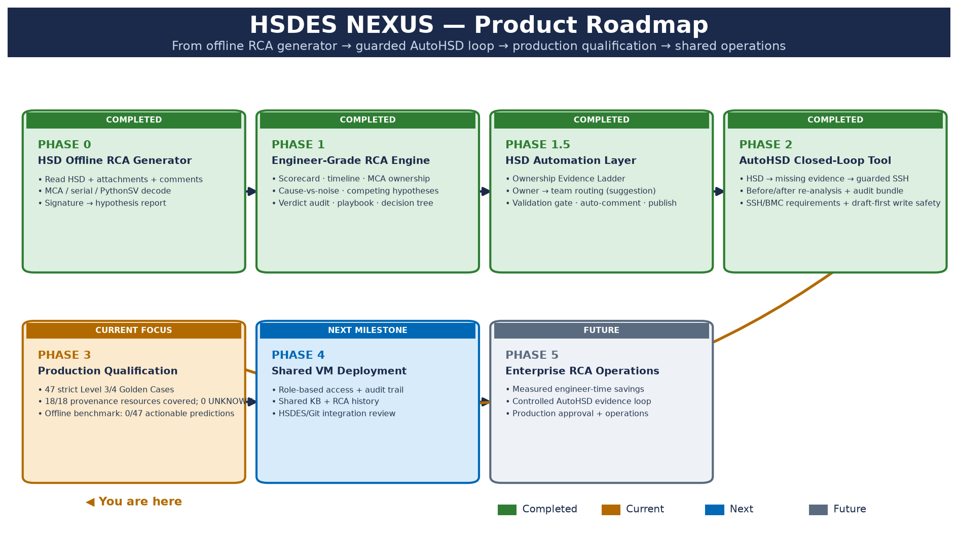
Product Roadmap
Phase 0 → Phase 5 · current state and release gates

Slide 12
What's New — Operational Loop & Qualification
Current release baseline and remaining production gates
HSD write-back — posts an executive RCA summary straight into the ticket comment thread (root cause · owner · confidence · evidence · next action); full report saved as HTML/MD. Dry-run + preview first.
Validation Gate — blocks auto-posting weak conclusions: WORKING HYPOTHESIS, confidence < 70%, unproven owner, OR an unresolved contradiction → draft-only (explicit --force override).
Ownership Evidence Ladder — Level 1 direct (first-error / TOR owner) → Level 4 weak (KB similarity), so confidence is explained, not a black box.
Owner → Team routing (suggestion only) — CHA→Uncore, UPI→Fabric, PCIe→PV.Domain.IO, IMC→RAS/Memory, DCU→Core; never auto-reassigns.
AutoHSD closed loop — retrieve HSD → collect missing evidence with guarded SSH/BMC requirements → re-analyze → compare before/after → gate → draft/post result; 10 focused integration tests pass.
Release baseline — 75 tests pass, provenance covers 18/18 resources with 0 UNKNOWN, and 47 strict Golden Cases are loaded.
Qualification blocker — the bounded offline benchmark completes but produces 0/47 actionable predictions; live RCA measurement remains separate from fixture-only validation.

Slide 13
Phase 2 — AutoHSD Closed-Loop Tool
Implemented and fixture-tested; SSH collection remains opt-in
Flow
• New HSD created → parse title → classify failure type.
• Kernel Panic · PCIe/CXL · TOR Timeout · Memory Poison · Hardware Error.
• Node reachability check (SSH) — up or down.
• Node up → collect profile logs → run NEXUS RCA → validation gate.
• Gate PASS → draft HSD update; POST remains opt-in via HSDES_WRITE_ENABLED.
Safety & efficiency
• Node down → post 'Node unreachable, analysis not possible' (no empty report).
• Evidence profiles collect only artifacts relevant to the failure type.
• Secrets (SSH) read from environment only — never logged or committed.
• Weak / contradicted RCA never auto-posts — stays a draft.

Slide 14
Anticipated Questions (1 of 2)
Prepared answers for the demo
Q: Does any Intel data leave the network / go to an external AI?
A: No. It runs locally on your Intel-domain machine and talks only to HSDES. LLM reasoning is optional and off by default — the demo runs in deterministic OFFLINE mode.
Q: How secure is authentication?
A: Kerberos SSO — it authenticates as you, with no password and no stored token. Any teammate on the Intel domain can run it as themselves.
Q: Can we trust the root cause it reports?
A: Yes — it doesn't guess. It repeats the root cause the engineers actually wrote in the ticket, cites who said it, and labels how proven it is (e.g. 'unvalidated hypothesis' vs 'confirmed'). If no cause is stated, it says so instead of inventing one.
Q: Does it modify or close the HSD ticket?
A: It posts an executive RCA summary as a ticket comment (opt-in) — it never closes or overwrites fields. A validation gate blocks weak/contradicted conclusions, which stay drafts until reviewed.

Slide 15
Anticipated Questions (2 of 2)
Prepared answers for the demo
Q: How does it separate the real failure from log noise?
A: When the comment thread has converged on a cause, broad signatures (WHEA / MCA / PCIe) are explicitly flagged as incidental background telemetry, so the real failure leads.
Q: What if the comments are thin or missing?
A: It falls back to decoded log evidence, boot/stage progress, MCA/BIOS/POST decode, and Knowledge-Base recall of similar past HSDs — you still get a structured triage.
Q: How long does a ticket take, and what does it cost?
A: Seconds to a couple of minutes per ticket versus hours by hand. It uses only open-source Python libraries and runs on your existing machine — no new licensing.
Q: Which platforms and domains are covered?
A: Server platforms today (GNR / SRF / CWF) across RAS/MCA, UPI, memory, PCIe/CXL, power, BIOS/IFWI/BMC, OS/driver; DMR / COR are ready to add.
Q: How does the 'learning' work?
A: Every analysed ticket is written into a local self-learning Knowledge Base, so recall of similar issues and their fixes improves over time.

Slide 16
Thank you
Questions & discussion

