Slide 1
NEXUS
Evidence-graded HSDES triage for Xeon validation
A practical bridge from ticket noise to defensible engineering action
Intel Confidential | 2026-09-11

Slide 2
The Debugging Problem
Why a ticket ID is not yet an explanation
INPUT
RISK
COST
NEED
HSDES
Noise
Rework
Evidence
Narrative, comments, attachments, partial logs
Many signals are symptoms, victims, or snapshots
Known signatures are re-investigated across teams
A traceable route from machine facts to action
The hard problem is not producing prose; it is deciding what the evidence actually proves.
A human comment can be valuable context without being machine proof.
A reporting bank, first-error source, and originating owner are not automatically the same thing.
Intel Confidential | 2

Slide 3
The NEXUS Answer
A disciplined evidence path
Read
>
Decode
>
Separate
>
Grade
>
Gate
>
Act
Read the ticket and attached evidence.
Decode MCA, boot, serial, PythonSV, and first-error signals.
Separate machine evidence from human claims and historical recall.
Grade ownership, confidence, contradictions, and missing evidence.
Block weak or ambiguous conclusions from autonomous posting.
Return a report, draft, or explicitly bounded next action.
Intel Confidential | 3

Slide 4
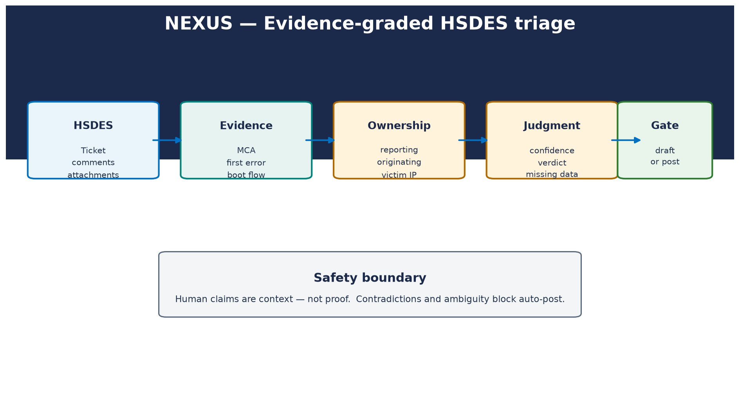
Architecture
Where evidence changes shape
Intel Confidential | 4

Slide 5
Safety Is the Product
The system is designed to know when not to overclaim
COMMENT ISOLATION
MCA FATALITY
POSTING
No
Never
Blocked
Comment-only root cause cannot become CONFIRMED
UC + PCC is never mislabeled corrected
Conflict, ambiguity, and weak evidence stay drafts
Safety invariants are explicit, named, and regression-tested.
HSDES_WRITE_ENABLED defaults false.
force=true cannot bypass write-disable.
Intel Confidential | 5

Slide 6
AutoHSD: From Ticket to Evidence
Closed-loop collection with a narrow safety boundary
HSD
>
Evidence audit
>
Reachability
>
Read-only SSH/BMC
>
Re-analyze
>
Gate
>
Draft/Post
Collection is conditional. Existing attachments win; unreachable nodes produce insufficient evidence rather than fabricated logs.
Intel Confidential | 6

Slide 7
What Ships Today
A focused engineering tool, not a promise of autonomous closure
RCA
AUTOHSD
KNOWLEDGE
WRITE-BACK
Structured
Guarded
Traceable
Draft-first
Evidence, ownership, verdict, missing data
SSH/BMC collection and before/after analysis
KB, provenance, historical reference
Post only after configuration and gate
The tool can say: insufficient evidence, contradiction, or working hypothesis.
That behavior is a feature for validation teams: uncertainty is visible and actionable.
Intel Confidential | 7

Slide 8
Current Evidence Snapshot
Numbers from the current workspace, not a marketing baseline
REGRESSION
PROVENANCE
GOLDEN
AUTOHSD
82/82
18/18
47
10/10
Current full test suite
Inventory coverage; 0 unknown
Strict Level 3/4 qualified cases
Focused integration checks
Production qualification remains open: benchmark sanity has actionable predictions, but this is not yet a completed accuracy qualification.
Intel Confidential | 8

Slide 9
A Concrete Safety Case
16031734105: reporting owner versus first-error source
Naive path
NEXUS path
Outcome
Select the reporting CCF bank and state a confident CCF root cause.
Preserve PUNIT first-error evidence, CCF reporting evidence, and decoder ambiguity.
WORKING HYPOTHESIS; contradiction detector; auto-post blocked.
The value is not a louder answer. It is a more defensible boundary around the answer.
Intel Confidential | 9

Slide 10
Knowledge That Stays Honest
Mining accelerates review; validation creates trust
HISTORICAL GRAPH
RELATIONSHIPS
CANDIDATES
88
421
88
Nodes
Edges
Consensus rows for review
Candidate mining is not Golden truth.
Bugeco, sighting confirmation, reproduction, and engineer review determine validation tier.
The corpus remains a controlled evidence set, not a random similarity dump.
Intel Confidential | 10

Slide 11
What the Engineer Sees
A report that is useful before it is certain
Executive summary
Evidence chain
Next action
What happened, what is known, what is missing.
MCA, first error, boot stage, ownership, contradictions.
The smallest useful collection or validation step.
Historical reproduction suggestions are explicitly reference-only and do not change confidence, verdict, or posting.
Intel Confidential | 11

Slide 12
What Is Not Claimed
Boundaries matter
Not a replacement for silicon, firmware, or validation engineering judgment.
Not a guarantee that every ticket has enough evidence for an RCA.
Not an autonomous writer by default.
Not a substitute for the centralized Elastic log pipeline; direct collection is limited to configured SSH/BMC paths.
Not production-qualified until the evidence-backed benchmark is completed.
Intel Confidential | 12

Slide 13
Next Moves
The shortest path to a defensible pilot
Complete evidence-backed benchmark validation with representative workloads and raw logs.
Shadow-mode AutoHSD on a small volunteer cohort.
Measure time-to-first-useful-action, not just report generation time.
Expand domain review for borderline ownership and decoder cases.
Only then decide whether shared deployment and broader operations are warranted.
Intel Confidential | 13

Slide 14
The Ask
A focused collaboration request
Validation leaders
Debug experts
Pilot sponsors
Nominate representative HSDs and review borderline cases.
Confirm evidence ownership and resolution tiers.
Support a shadow-mode, draft-only evaluation.
The next decision should be based on observed engineering value and evidence quality.
Intel Confidential | 14

Slide 15
Appendix
NEXUS in one sentence
NEXUS connects HSD symptoms to evidence, evidence to ownership, and ownership to a guarded engineering action — while making uncertainty impossible to hide.
Presentation generated locally from the current repository state.
Intel Confidential | 15

