Slide 1
NEXUS: AI-Assisted Root-Cause Analysis for Xeon Server Validation
From HSD to actionable RCA — automatically
Intel Confidential | 2026-09-11

Slide 2
The Challenge
Scale creates a consistency problem
SCOPE
EFFORT
SIGNALS
NEED
8,800+
2–4 hrs
Many
Repeatable
HSDs across validation cycles
Typical initial-triage estimate
Machine facts, comments, snapshots
A consistent evidence-to-action path
Known signatures are repeatedly re-investigated across teams.
The most valuable debug context often lives in comments, logs, and individual experience.
Validation needs speed without trading away evidence discipline.
Intel Confidential | 2

Slide 3
What NEXUS Does
One path from a ticket to an evidence-graded action
HSD
>
Read ticket & logs
>
Decode hardware evidence
>
Separate fact from opinion
>
Graded RCA verdict
>
Update ticket
NEXUS reads the HSD, decodes machine evidence, isolates human claims, grades confidence and missing data, then returns a structured RCA and guarded ticket update.
Intel Confidential | 3

Slide 4
Built-In Safety Intelligence
Safety is a product capability, not a postscript
Evidence discipline
Conflict awareness
Guarded action
Never confuses an engineer’s guess with proven evidence.
Automatically flags conflicting ownership signals instead of guessing.
Refuses to auto-post weak or ambiguous conclusions.
82 automated safety and correctness checks continuously verify these behaviors.
Intel Confidential | 4

Slide 5
AutoHSD: Closed-Loop Analysis
NEXUS knows what is missing and goes to get it safely
HSD
>
Missing evidence detected
>
Safely collect additional data
>
Re-analyze
>
Confirm or escalate
Existing attachments are used directly.
When needed, read-only SSH/BMC collection gathers targeted evidence.
Before/after analysis makes the effect of new evidence visible.
Intel Confidential | 5

Slide 6
Knowledge at Scale
NEXUS learns from Intel’s validated engineering history
HISTORICAL HSDs
RELATIONSHIPS
REFERENCE CASES
88
421
47
Mined and cross-referenced
RCA relationships mapped
Validated cases across 5 platform families
Platform families represented: DMR, GNR, ICX, SPR, SRF
Intel Confidential | 6

Slide 7
Real Example
A confirmed DMR fix path
Reported symptom
Owning IP
Resolution
Frequent L1 instruction-fetch MCEs during branch-tree workload testing.
Core / FE / BPU — validated RTL Bugeco reference.
Fixed in PNC C0; evidence tier: Level 4 fix validated.
HSD 15019342741 | Bugeco 13013348392
Intel Confidential | 7

Slide 8
Architecture at a Glance
A layered pipeline for evidence, ownership, and action
Evidence extraction
>
Ownership engine
>
Decoder analysis
>
Confidence engine
>
Validation gate
>
Report / HSD update
Each layer preserves provenance and contributes only the evidence it is designed to handle.
Intel Confidential | 8

Slide 9
Current Capability Summary
Implemented capability, evidenced in the current build
SAFETY
PROVENANCE
CORPUS
AUTOHSD
82 checks
18 resources
47 cases
Guarded
Automated RCA safety and correctness coverage
Full source-decoder inventory verified
Historically validated references across 5 families
Closed-loop evidence collection implemented and tested
Intel Confidential | 9

Slide 10
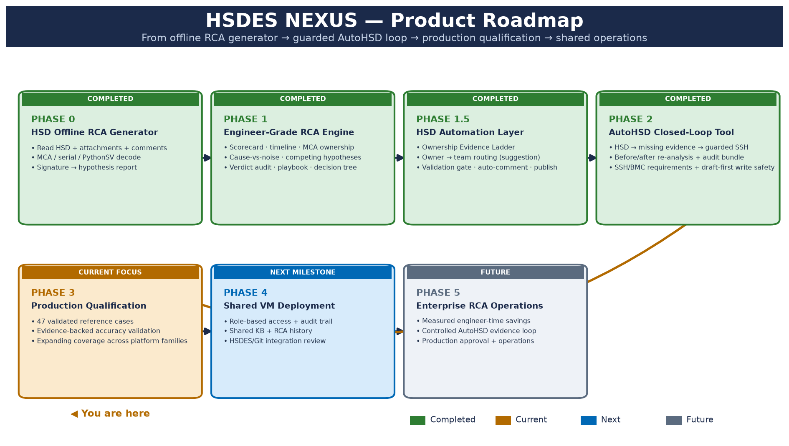
Roadmap
Forward motion: expanding value from a strong foundation
Intel Confidential | 10

Slide 11
Why This Matters
A consistent debug method compounds over time
Faster initial triage from a shared evidence vocabulary.
More consistent ownership reasoning across teams and platform families.
Institutional knowledge remains searchable, traceable, and reviewable.
Engineers spend more time validating the next decision and less time reconstructing the last one.
Intel Confidential | 11

Slide 12
What’s Needed to Scale
A focused path to broader engineering value
Pilot volunteers
Domain review
Deployment sponsors
Run shadow-mode evaluations on representative HSDs.
Review borderline ownership and evidence tiers.
Support the next controlled operating environment.
Intel Confidential | 12

Slide 13
Thank You / Questions
NEXUS turns HSD history and machine evidence into a guarded engineering action
Questions and discussion
The next step is a measured, shadow-mode validation with the teams closest to the evidence.
Intel Confidential | 13

