Slide 1


TERADYNE​
Excess Inventory Process Optimization​
Team 441

Slide 2
Agenda
  Project Background and Business Scope
  Project Timelines
  Current & Suggested Process
  Business Process
  Visualizations
  Analysis
  Results and Findings
  Root Cause Analysis
  Our Recommendations
  What We Learnt….
  Q&A

Slide 3


Project Background and Business Scope​
Background
Scope
Teradyne's SBM group upgrading excess inventory approval portal
Reliance on metrics and subjective judgments may introduce bias.
Historical demand volatility causing unwanted inventory
Impact on targets and finances
Algorithm modification
Mitigate financial risk
Informed decision-making
Excess inventory reduction
Iterative process improvement

Slide 4
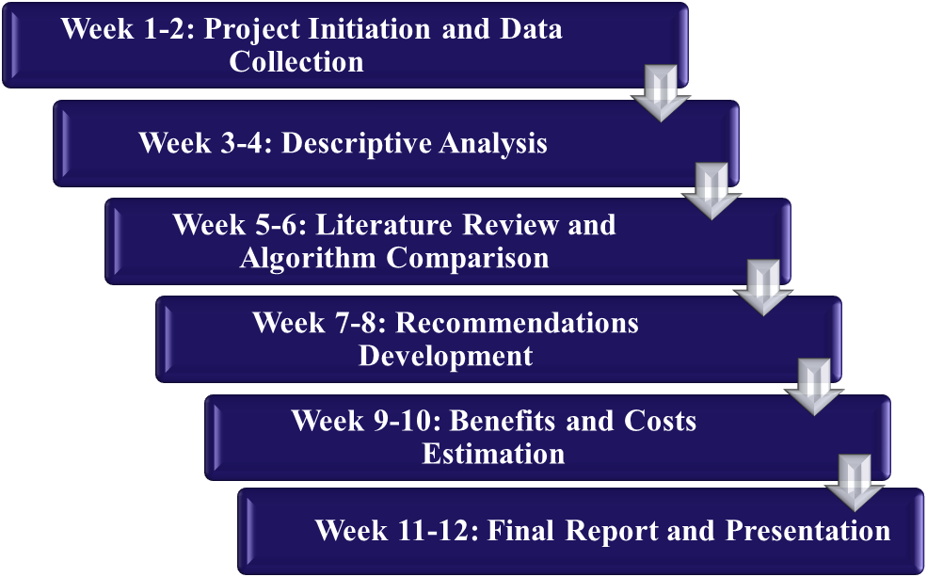

Project Timeline​

Slide 5

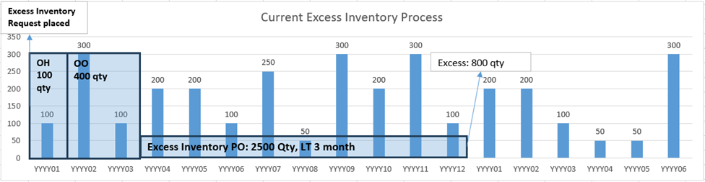
Current Process​
Process
Issues
The excess costs are calculated for a period of 52 weeks post which the costs are sent through levels of approval based on the amount.
The process defines ‘excess’ as after 12 month timeline, does not consider ‘excess’ with respect to timeline connected with lead time of the part, which affects the semi annually inventory targets.

Slide 6
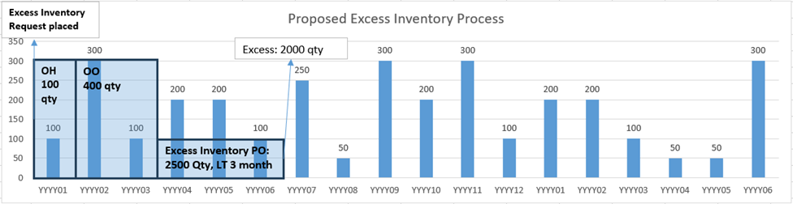
Suggested Process​
Process
Improvement
Defines ‘excess’ inventory as per timeline (T) which follows 2 times the lead time while considering demand in timeline (T) and excess after new timeline → improve the decision-making process from the approver’s perspective
Segmentation of Timeline (T) days into three categories:
<=182 (6 month), 182< T(2*LT) < 365, >=365 (12 month)
Removes any possible bias that can be caused because of not considering the timeline with respect to lead time.
Additionally, adding a buffer zone for potential fluctuating demand. (so, Timeline = 2*LT)

Slide 7
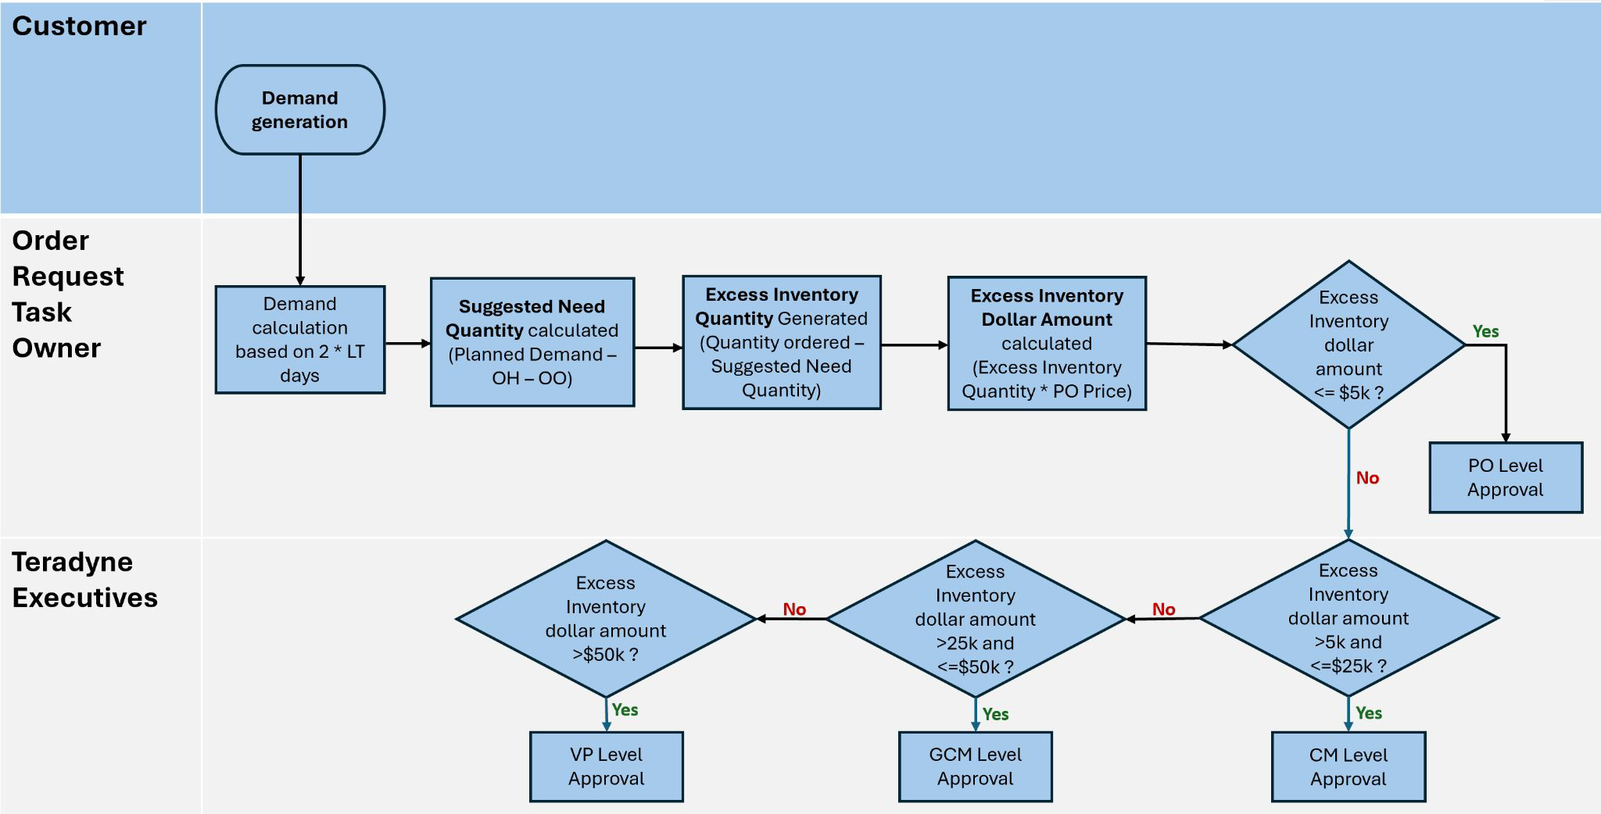
Business Process
Site
TER Part Number
Due Date
Planned Demand
Notes:
same process that we follow in the current business process

Slide 8
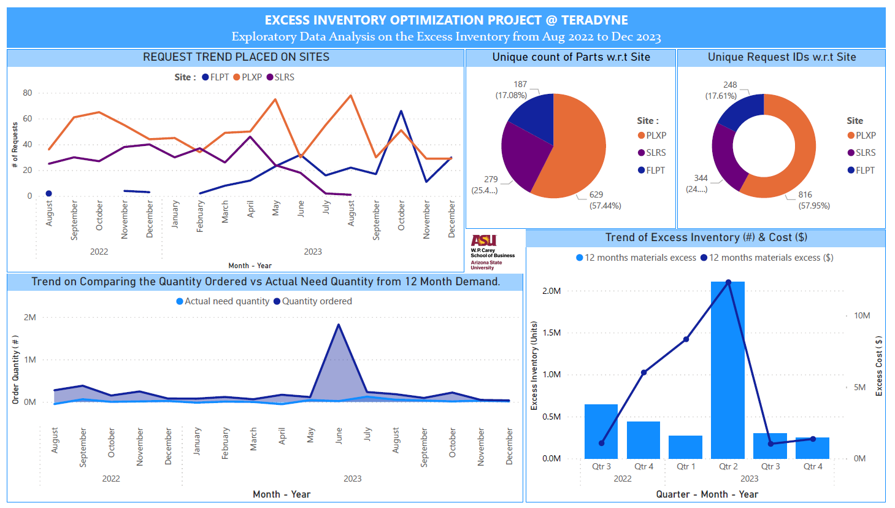
Exploratory Data Analysis
File A :
Excess Inventory Purchase
# of Requests : 1408
# of Sites : 3
# of Part Number : 1064
From Aug’22 to Dec’23
Notes:
Initial preprocessing - Pick required columns for analysis, Standardize the Column names, Changes in particular columns ‘Due Date’, Going through the calculation to data formats.

Slide 9
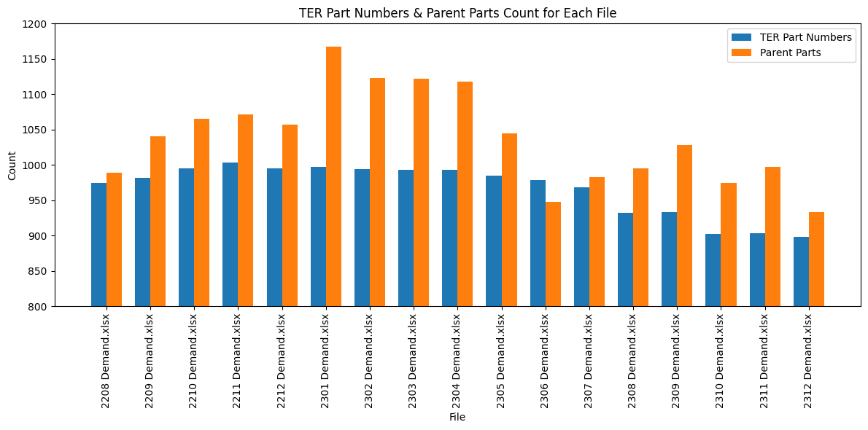
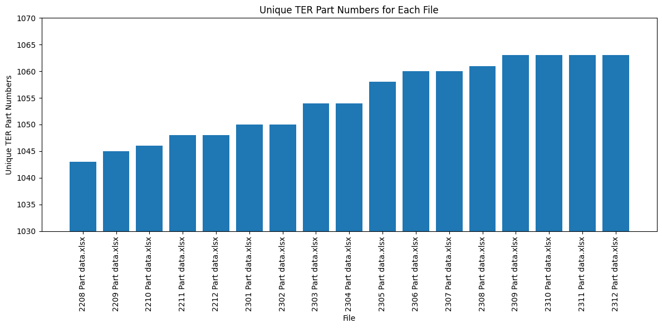
Exploratory Data Analysis
Files B :
Demand (17 Files)
Selected Columns : Site, TER Part Number, Due Date, Planned Demand, Parent Site, Parent Part.
Files C :
Part Data (17 Files)
Selected Columns : Site, TER Part Number, cum lt wks
Notes:
Initial preprocessing - Pick required columns for analysis, Standardize the Column names, Changes in particular columns ‘Due Date’, Going through the calculation to data formats.

Slide 10
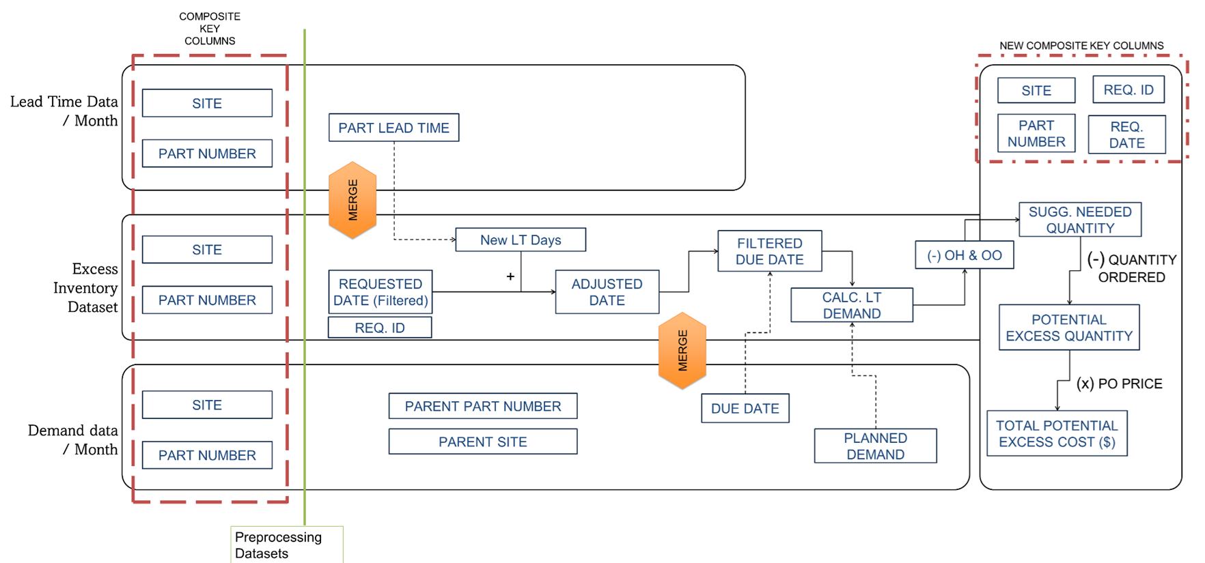
Analysis Steps
2
1
Segment New LT Days as <182, 182-365 and >365 days
Adjusted Date :
Requested Date + Cum Lt weeks * 2 * 7
4
Aggregated Planned Demand - OH - OO
Site
TER Part Number
Due Date
Planned Demand
5
Sugg. Needed Quantity - Quantity Ordered
6
Potential Excess Quantity * PO Price
3
Aggregate the Planned Demand upto the Adjusted date
on Due date.

Slide 11
Python Code

Slide 12
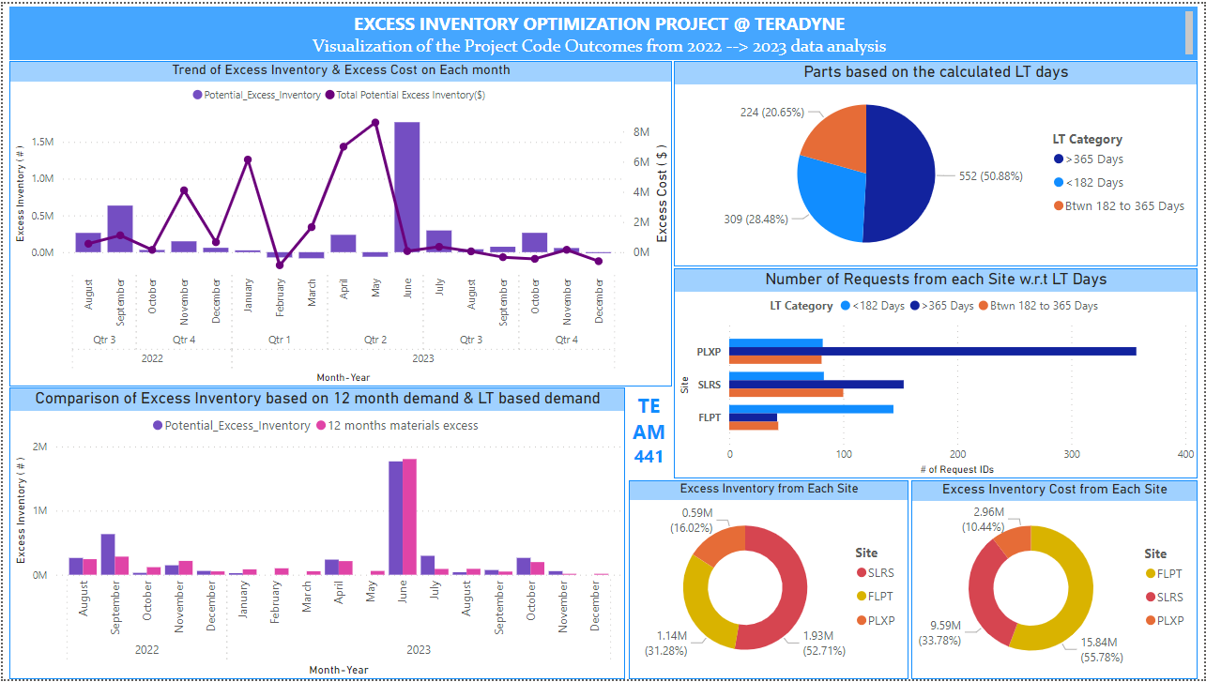
Findings

Slide 13
Results and Findings
$ 12 M
$21 M
75 %
Current Process
Suggested Process

Slide 14
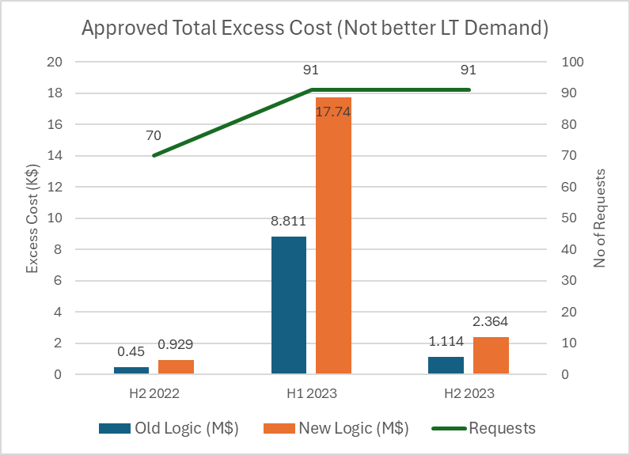
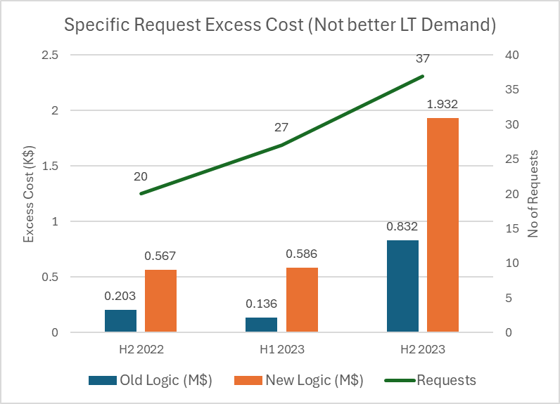
Results and Findings
43.6 %
6.7 %
54.5 %
% of Excess ($) Inventory affected
Excess Cost approved for particular requests within 365 days

Slide 15
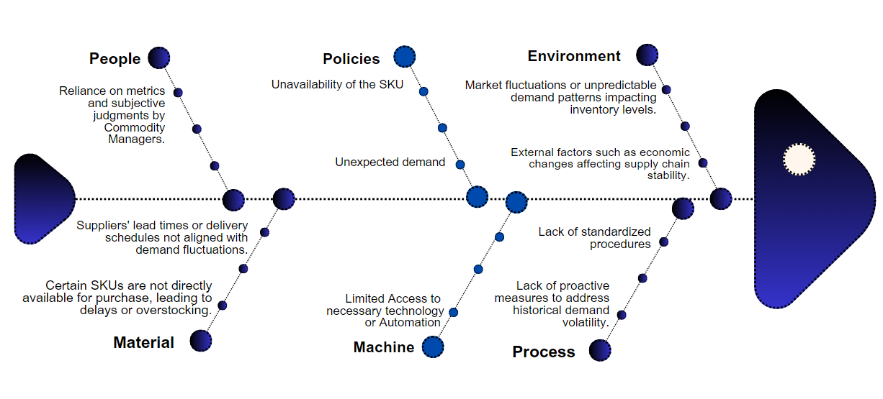
Root Cause Analysis

Slide 16
Recommendations
01
Evaluate supplier performance using lead times, on-time delivery, and quality metrics.
Supplier Performance Metrics
02
Analyze the accuracy of demand forecasts compared to actual demand data by including more necessary data like MoQ.
Demand Forecasting Accuracy
03
Assessing stockout frequency helps Determine if inventory levels are adequate, with MOQ influencing order frequency, batch sizes, and the balance between stock sufficiency and excess.
Stockout Rate & MOQ Impact
04
Gather feedback on product availability and order fulfillment to assess the impact of excess inventory on customer satisfaction.
Customer Satisfaction Metrics

Slide 17
What We Learnt…
The various facets of Automated Testing Equipment industry.
The variables pivotal in understanding and forecasting demand
Importance of active and robust demand forecasting in supply chain.
Efficiency of a multi-layered approval process.

Slide 18

Q & A

Slide 19


Thank you for
the Opportunity !!!

