Slide 1

Cucumber – BDD
Behavior Driven Development gives us an opportunity to create test scripts from both the
developer’s and the customer’s prospective as well. They implement important acceptance test scenarios while
development is in-progress.
All Stakeholders brainstorm about which test scenarios should be passed in order to call
this software/application successful. This way they come up with a set of test scenarios.
All these test scripts are in simple English language,
Example
The user should be able to login with correct username and correct password.
The user should not be able to login with incorrect username and correct password.
The user should not be able to login with correct username and incorrect password.

Slide 2
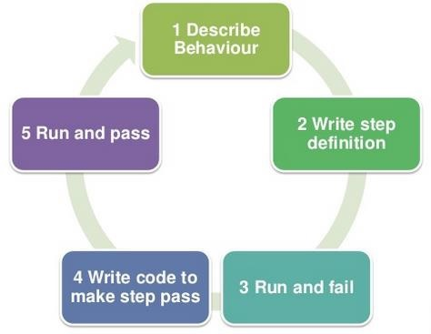
The language, in which this executable feature files is written, is known as Gherkin. Gherkin is a plain English text language, which helps the tool - Cucumber to interpret and execute the test scripts.

