Slide 1
AI-Powered File Reader
using Docling & Streamlit

Slide 2
Problem Statement
• Difficulty in handling unstructured documents (PDF, DOCX, TXT)
• Lack of easy-to-use tools for extracting meaningful text
• Manual document review is time-consuming and inefficient

Slide 3
Proposed Solution
• Streamlit-based user interface for file upload & browsing
• Docling library for document parsing & text extraction
• Save files to configurable destination folders
• Display content in Markdown & JSON

Slide 4
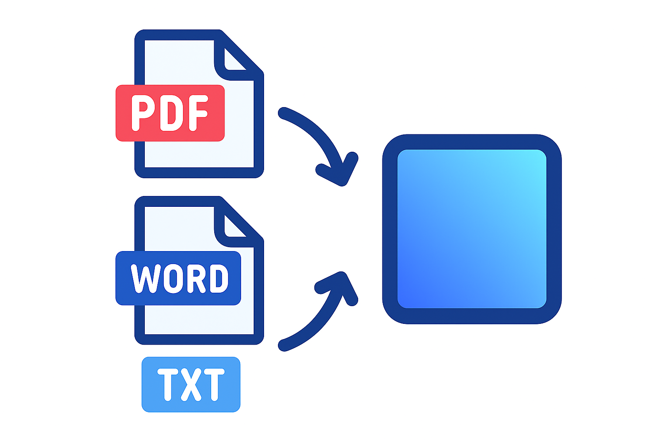
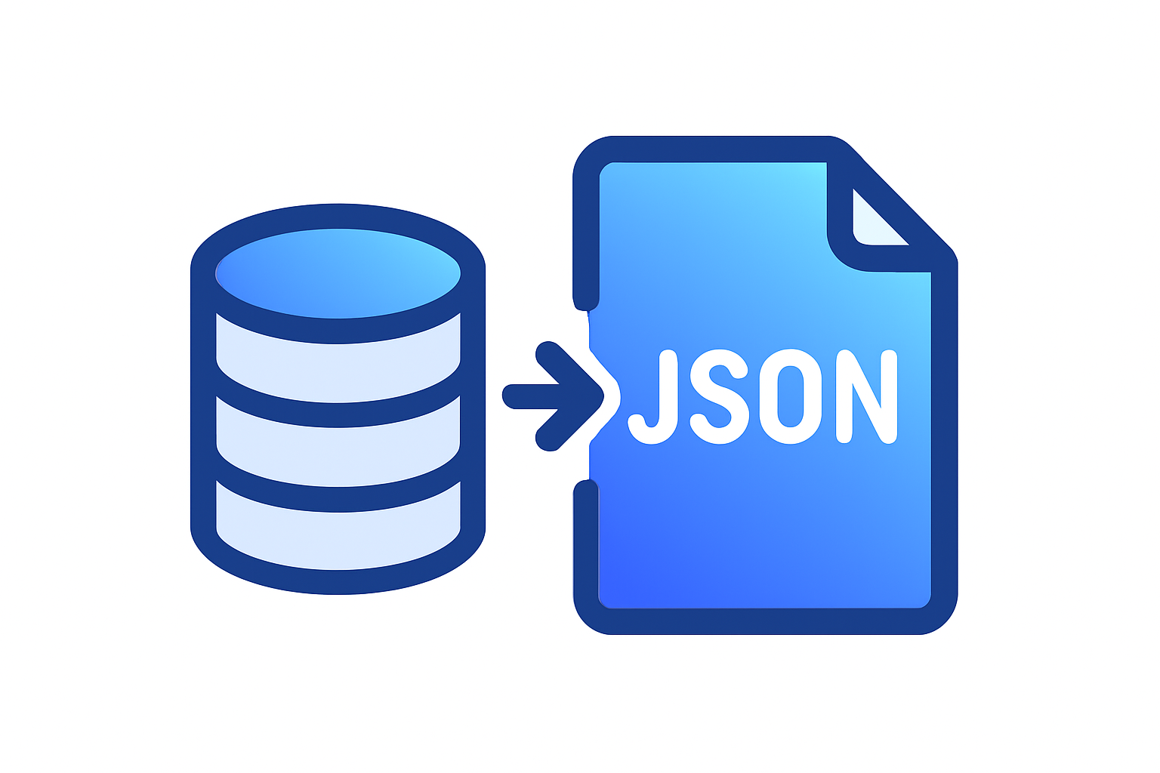


System Architecture

Slide 5
Workflow
1. Enter destination folder path
2. Upload file via Streamlit uploader
3. File saved to folder
4. Docling processes → Markdown/JSON
5. Display extracted content in browser
Start
Upload File
Docling Processing
Output

Slide 6
Technology Stack
• Frontend: Streamlit (Python-based UI)
• Backend: Python, Docling
• Storage: Local filesystem / GCP bucket (scalable)
• Optional: FastAPI for API layer (future scope)

Slide 7
Key Features
• Supports multiple document types (PDF, DOCX, TXT)
• User-defined storage path
• Real-time extraction & preview
• Export as Markdown & JSON

Slide 8
Future Enhancements
• Integrate with GCP Cloud Storage
• Add multi-user support
• Provide download option for extracted results
• Enable OCR for scanned PDFs

Slide 9
Conclusion & Q/A
✔ Simple, efficient document reader app
✔ Combines Streamlit + Docling
✔ Scalable with GCP integration

